Slide 1
Dr. Kemal naci ekşi anatolian high school
İSTANBUL/TURKEY

Slide 2
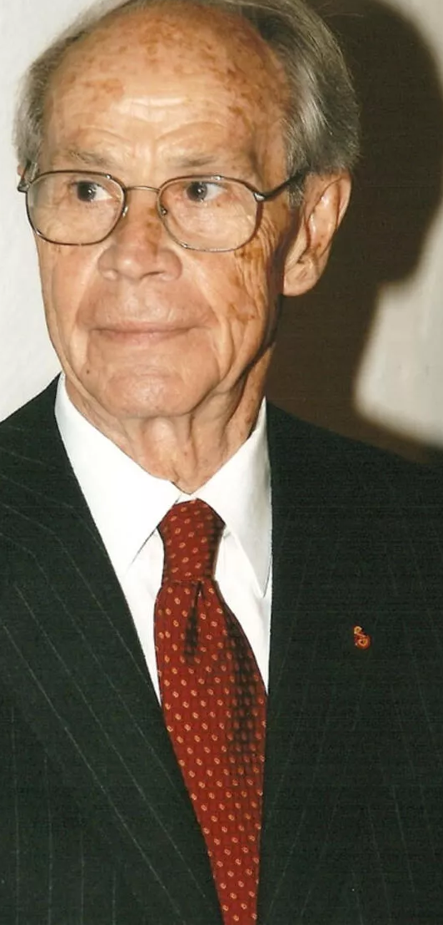
Firuz Kanatlı, the founder of Eti, was born in Eskişehir in 1932. His parents ran a flour mill. Firuz Kanatlı came to Istanbul to study high school after primary school. After studying business administration for his higher education, he returned to his family's factory and started working. Firuz Kanatlı, who didn't stay here long, left the factory to start his own business.

Slide 3
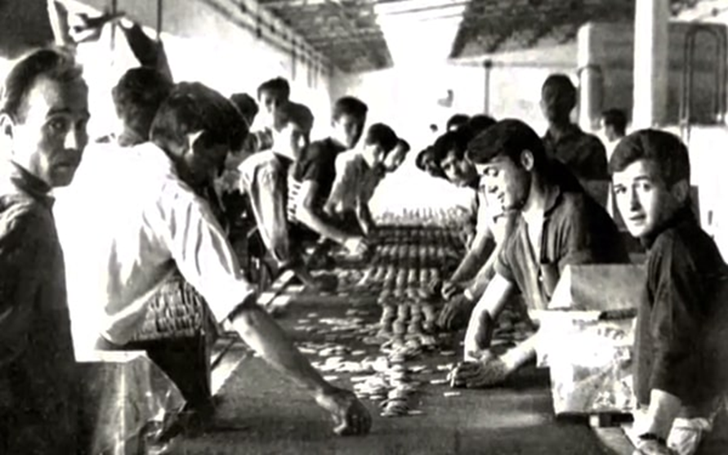
He did his military service as a canteen manager. After observing the soldiers' demand for biscuits, he decided to enter the biscuit business during this period. With the support he received from his father, he established his first production facility in Eskişehir. Choosing the Hittite name of one of the oldest civilizations of Anatolia as the brand name, Kanatlı also chose the Hittite sun as the logo.

Slide 4
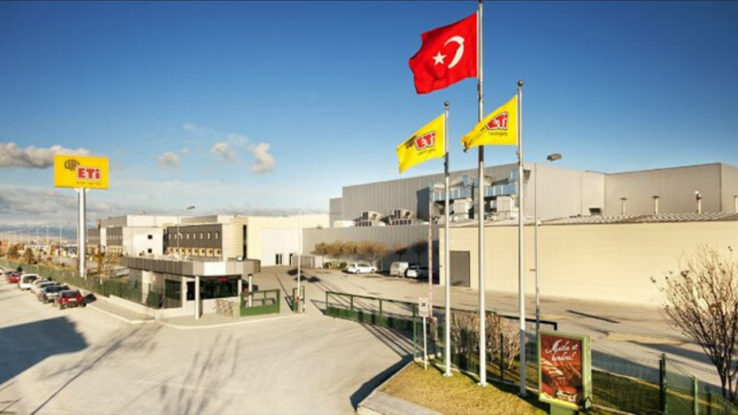
In 1962, the Eti biscuit factory was producing 3 tons per day with 20 employees. in 1963, a second plant was established to increase production capacity. in 1974, it carried out its first biscuit export to Cyprus.

Slide 5
In the 1970s, Ülker had consolidated and guaranteed its place in the market with advertising campaigns. Eti also developed its ads and published "I have a riddle, guys!" he composed the music for the commercial. "When it comes to biscuits, its name comes to mind every moment," the slogan appeared in their minds, and Eti's fame increased considerably during this period.

Slide 6
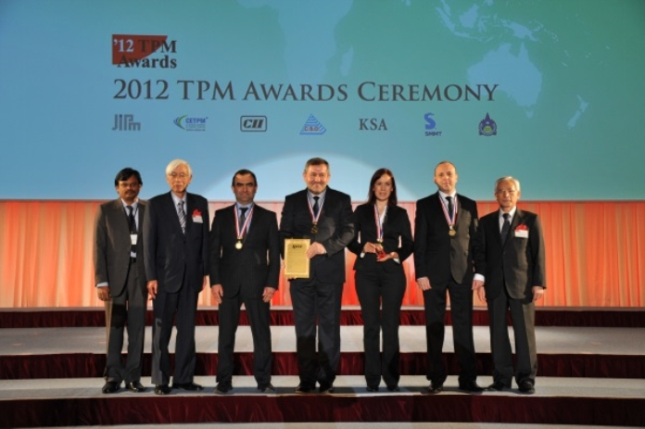
Eti, which continues to increase its product diversity to date, has achieved many national and international successes.

