Slide 1
MY SOUFFLE’S RECIPE

Slide 2
materials: 1 egg 1 teaspoon of sugar 1 teacup of oil 1 teaspoon of milk 2 soup spoons of cocoa 8 tablespoons of flour 1 teaspoon baking powder 1 pack of vanilla 1 square of chocolate

Slide 4
1-) mix eggs and sugar well

Slide 5
2-) add liquid ingredients and mix

Slide 6
3-) add solid ingredients (except vanillin and baking powder)

Slide 7
4-) add the baking soda and vanilla and don't mix too much

Slide 8
5-) Put the resulting liquid mixture in the half of the bowl.

Slide 9
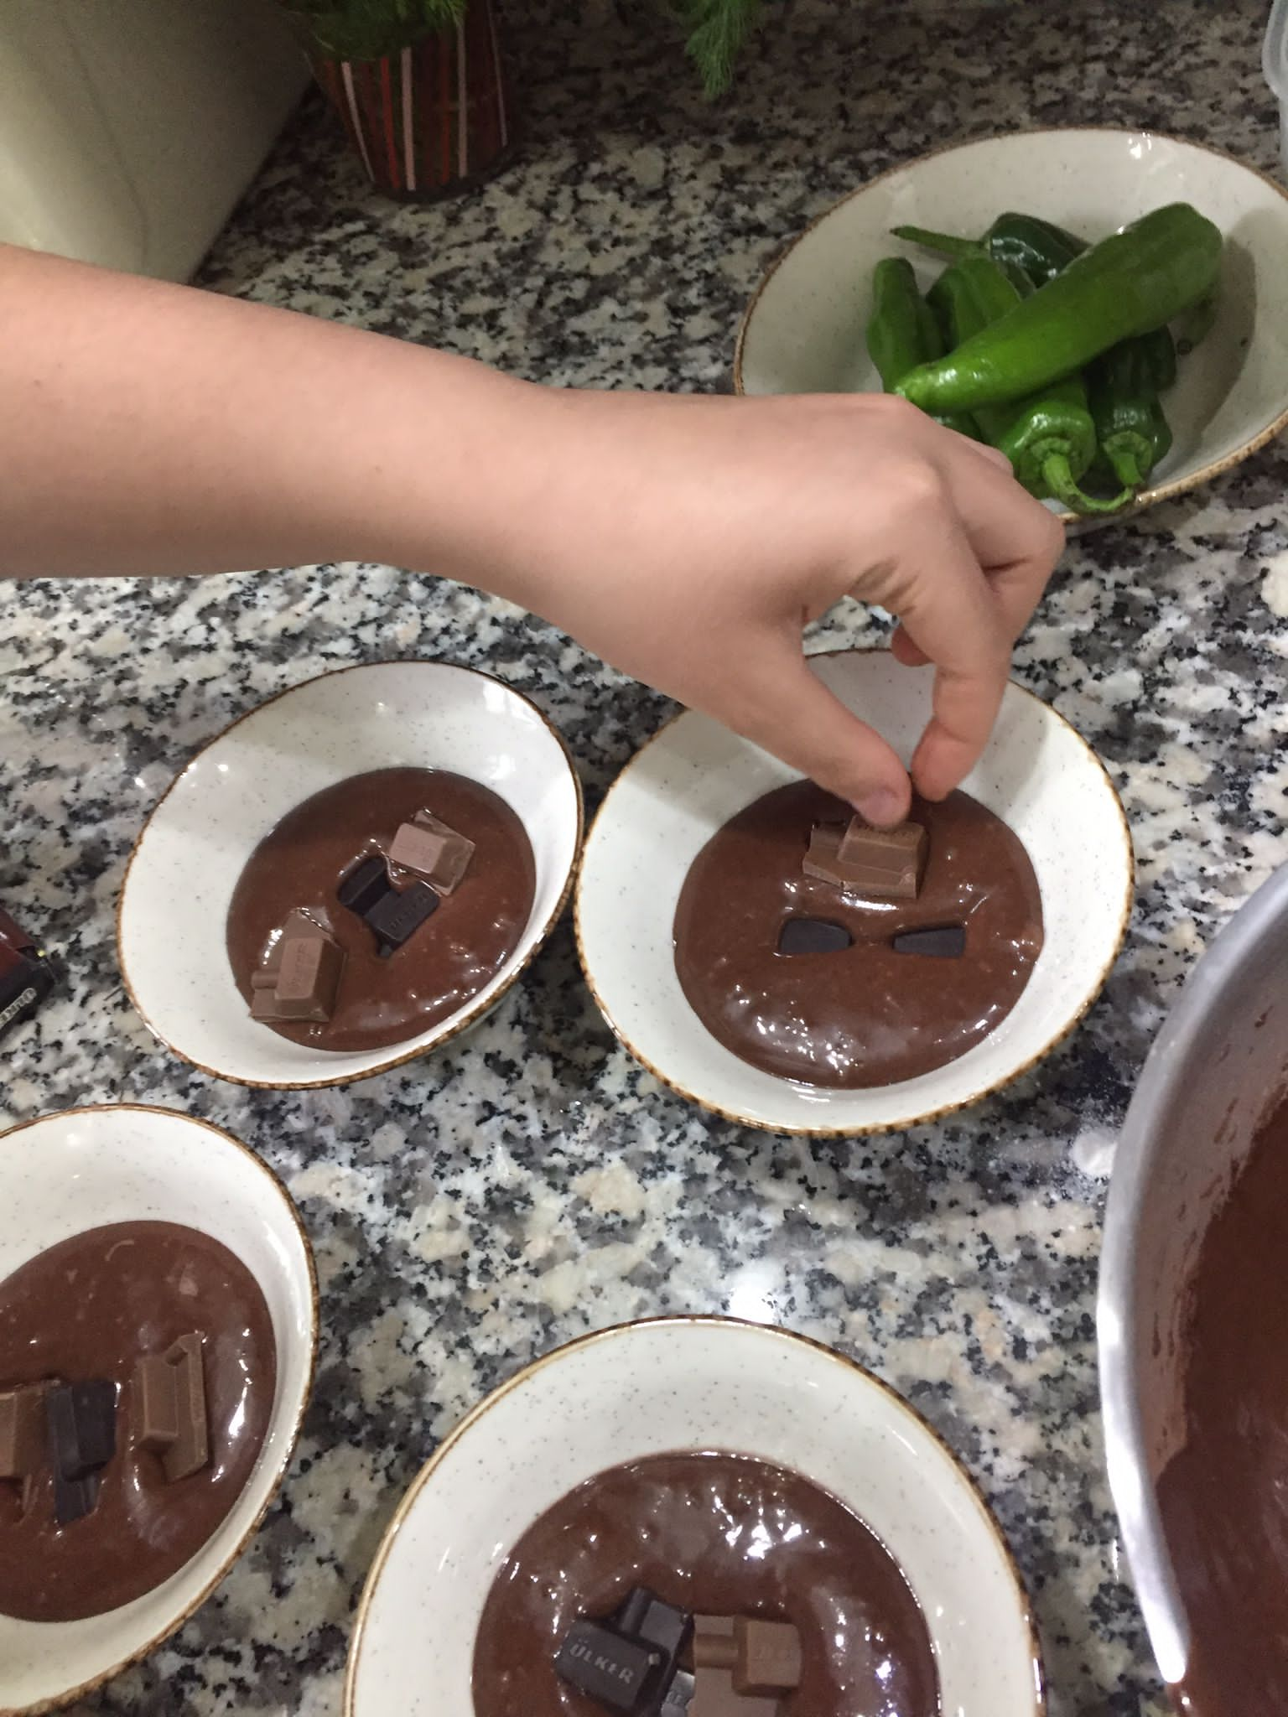
6-) put a few pieces of square chocolate on top

Slide 10
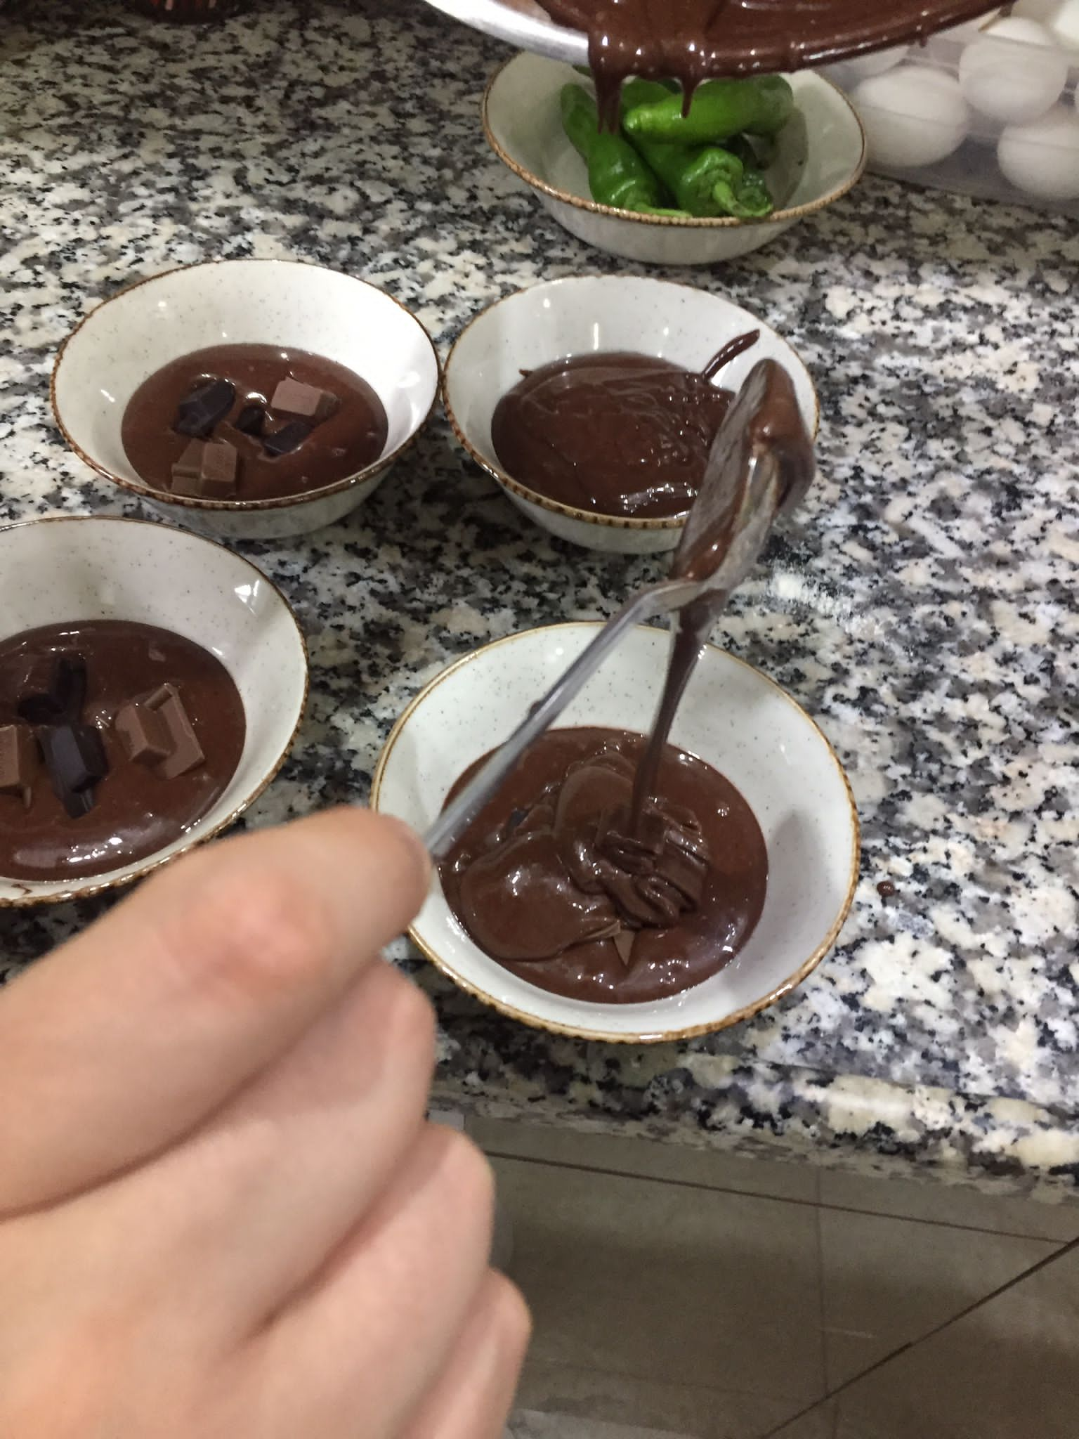
7-) cover it with the liquid mixture

Slide 11
8-) Put the bowls in the boiling water in the pot. Cook for 3 minutes with the lid open for 10 minutes with the lid closed and ENJOY (I recommend you to consume it hot)

