Slide 1
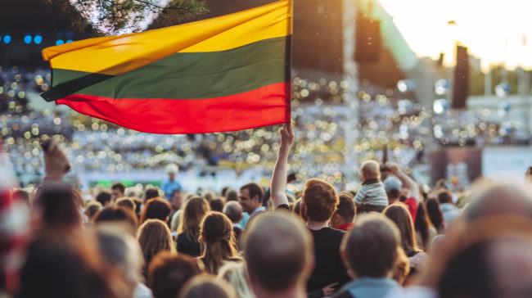
ABOUT LITHUANIA, OUR CITY AND GYMNASIUM
Made by students of Alytaus Adolfo Ramanausko – Vanago gymnasium

Slide 2
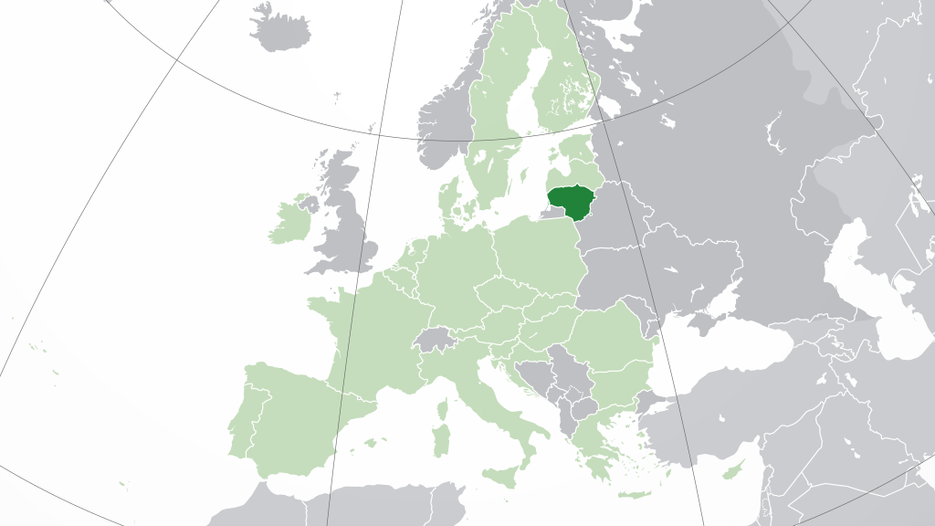
LITHUANIA
Lithuania is a country in the Baltic region of Europe. It is one of three Baltic states and lies on the eastern shore of the Baltic Sea. Its capital and largest city is Vilnius. Our national language is Lithuanian – one of the most complex languages in the world;
Population – 2,8 million.

Slide 3
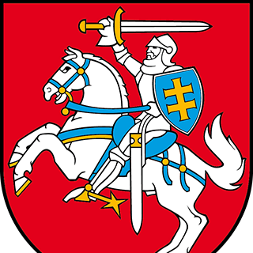
OUR FLAG AND COAT OF ARMS

Slide 4
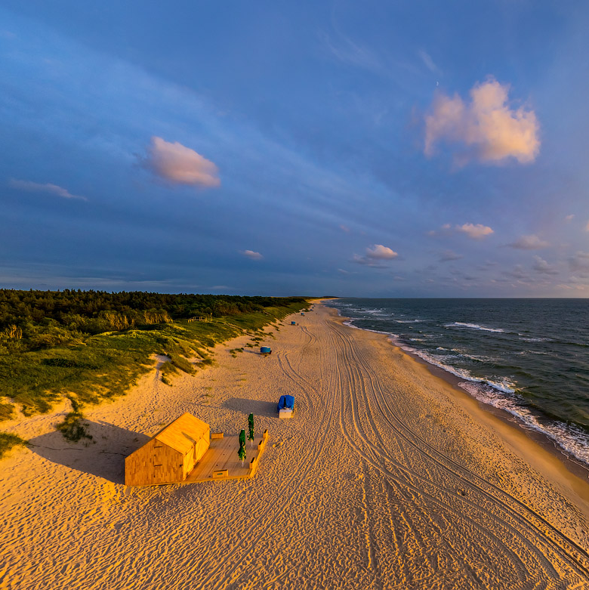
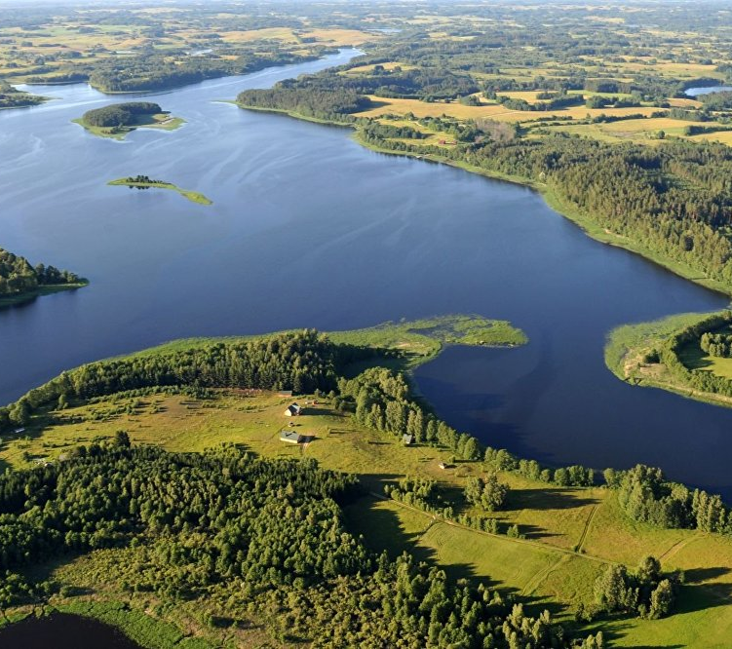
LANDSCAPE
Baltic Sea - the only sea our land has contact with.
Drūkšių lake – our largest lake.

Slide 5
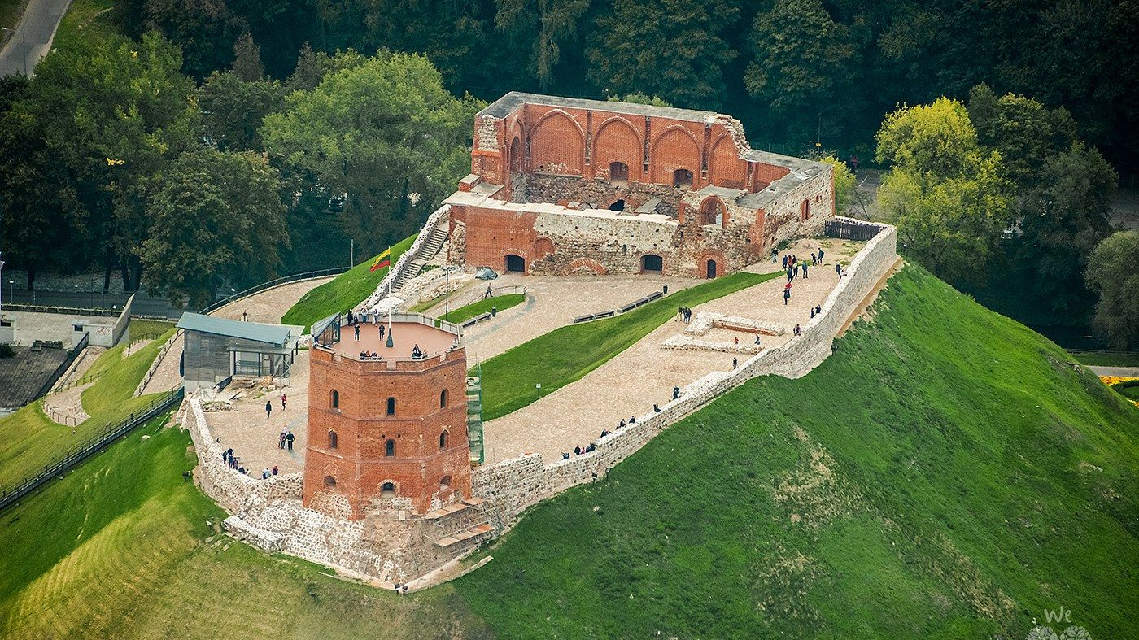
HISTORICAL PLACES
According the legend, Vilnius, our capital, was started with a castle being built on a hill on which our Grand Duke Gediminas saw a howling iron wolf in his dream that was later interpreted as the occurrence of a strong and unconquerable capital city. Thus a castle was built on the hill.

Slide 6
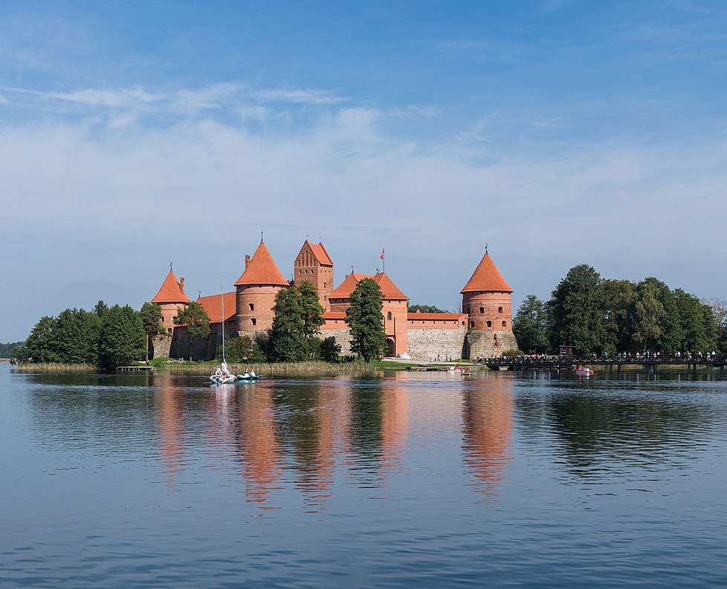
HISTORICAL PLACES
Trakai Island Castle

Slide 7
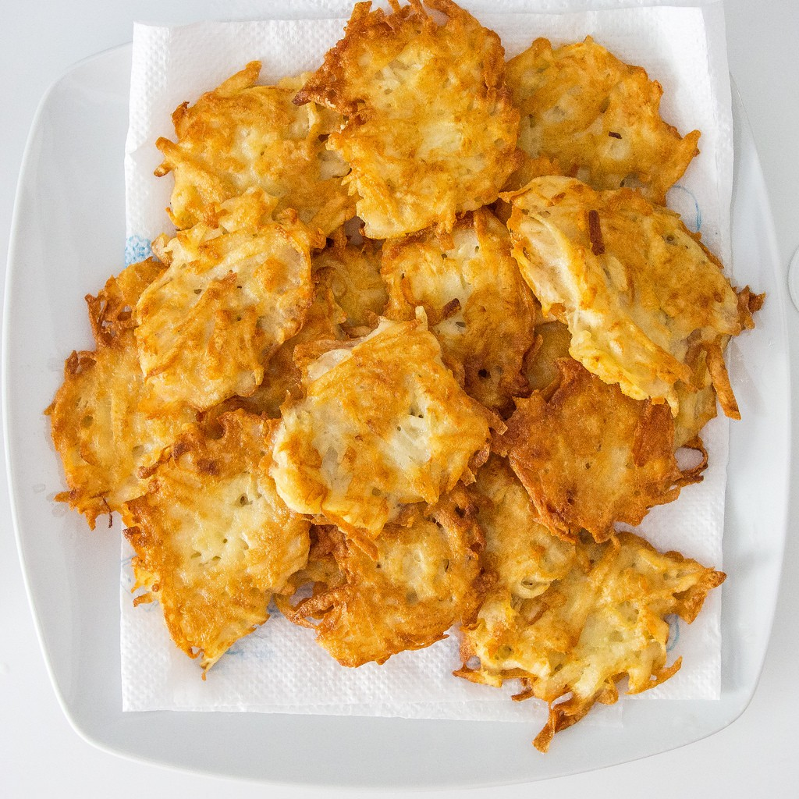
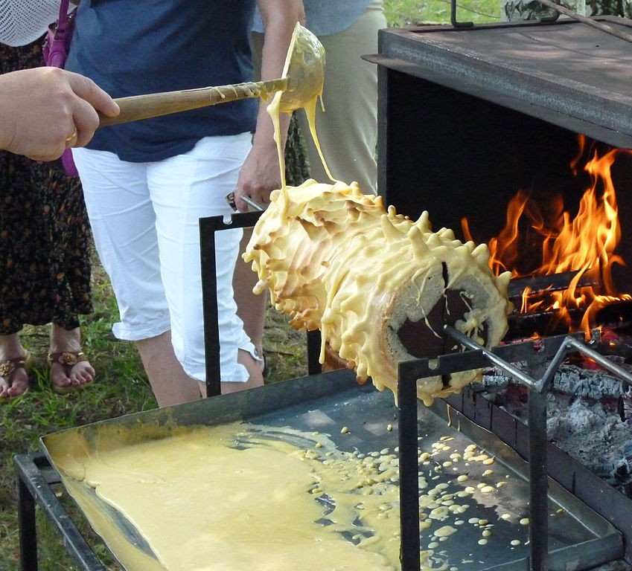
TRADITIONAL FOOD
Potato pancakes (on the top)
“Šakotis“ (currently cooking in the photo) is a variant of the German culinary product baumkuchen.

Slide 8
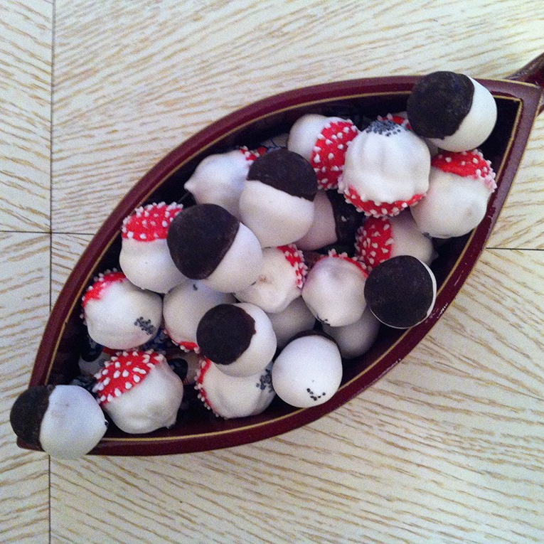
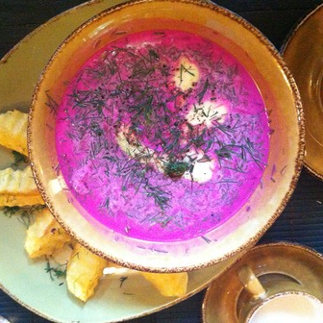
TRADITIONAL FOOD
Chilled Borsch (Šaltibarščiai)
Mushroom cookies (Grybukai)

Slide 9
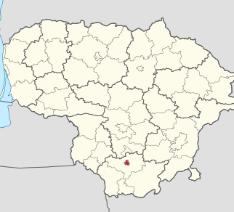
THE CITY WE LIVE IN - ALYTUS
Alytus is the historical centre of the Dzūkija region. The city lies on the banks of the Nemunas River (largest river in Lithuania);
It is the 6th largest city in Lithuania;
Red mark on the map is Alytus;
Population – approximately 50,000.

Slide 10
ALYTUS CITY EMBLEM

Slide 11
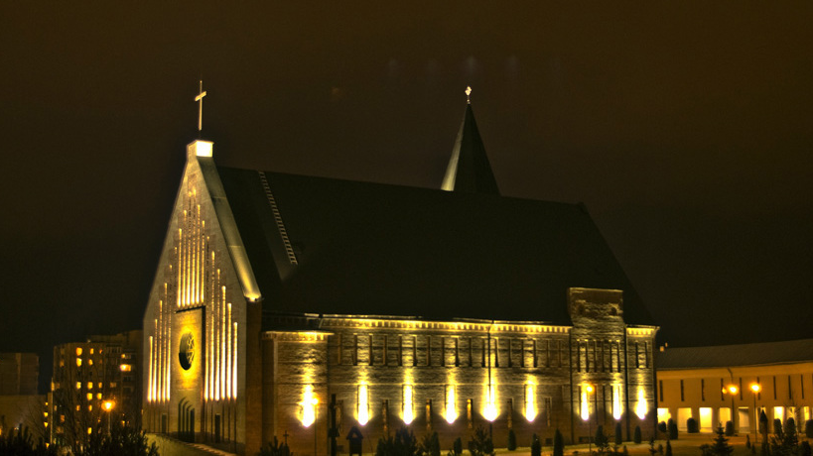
PLACES TO VISIT IN ALYTUS
Alytus Švč. M. Marijos (St. V. Mary‘s) Christian Assistance Parish – one of the most beautiful churches in Alytus.

Slide 12
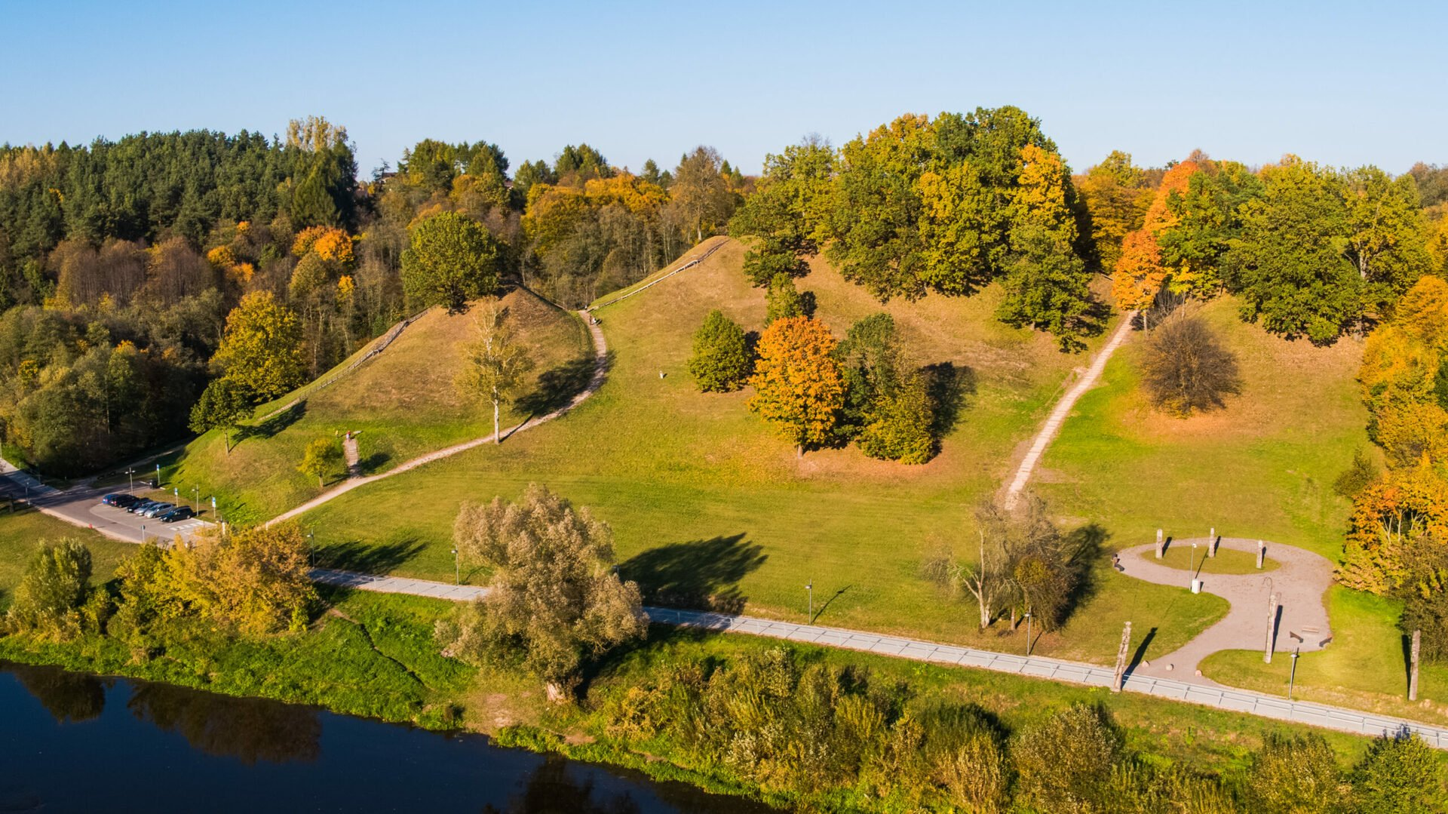
PLACES TO VISIT IN ALYTUS
Alytus Fort Hill. The view of Nemunas (biggest river in Lithuania) is amazing from up on the hill.

Slide 13
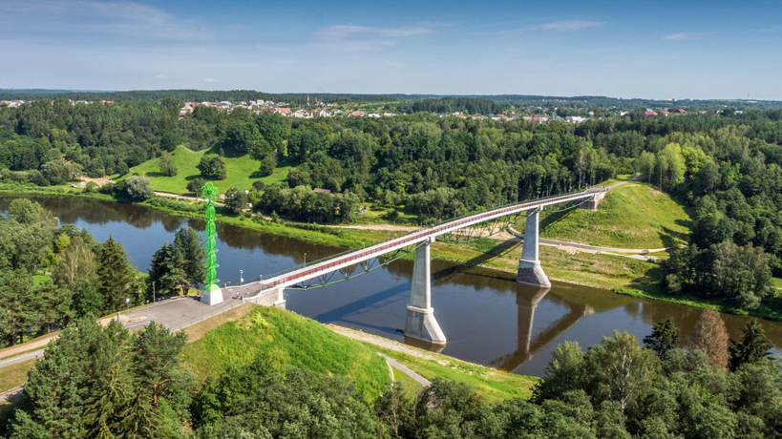
PLACES TO VISIT IN ALYTUS
Baltosios rožės bridge
(The bridge of the White Rose)
The pedestrian and bicycle bridge in Alytus across the Nemunas, connecting the first part of Alytus and the Old Town with the Alytus fort hill. It is the highest pedestrian and bicycle bridge in Lithuania, 38.10 m high from the average water level.

Slide 14
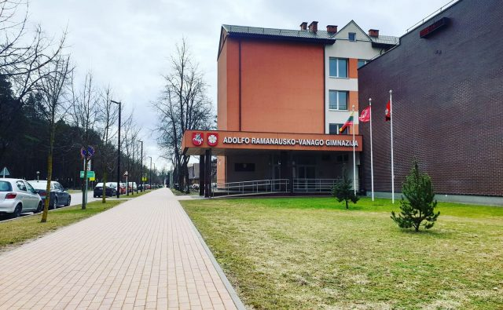
OUR SCHOOL
Alytus Adolfas Ramanauskas-Vanagas Gymnasium
The school was established in 1919. 1941 in the old school building. Named after Adolfas Ramanauskas-Vanagas.

Slide 15
Adolfas Ramanauskas-Vanagas
He was a teacher who also previously served the army, but with the outbreak of the second Soviet occupation in 1945, April 25 he became a partisan, who quickly enough, took a part in managing the other partisans in the rebellion.

Slide 16
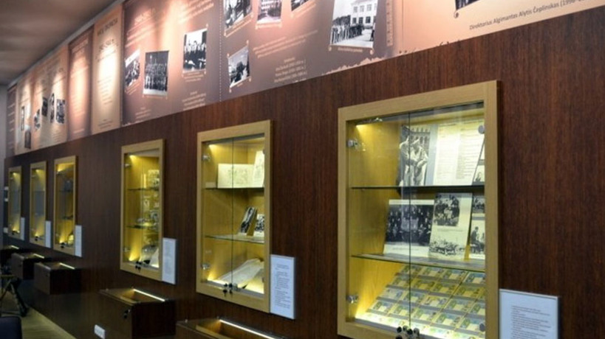
SCHOOL MUSEUM
The Museum was established in 1969. It is one of the oldest school museums. The museum collects, preserves and promotes the exhibits of the Adolfas Ramanauskas-Vanagas Gymnasium, the Teachers' Seminary, the French squadron "Normandy-Nemunas", and the historical material of the Dzūkija region. Part of the museum premises was dedicated to Adolfas Ramanauskas-Vanagas.

Slide 17
ABOUT LITHUANIA, OUR CITY AND GYMNASIUM
Made by students of Alytaus Adolfo Ramanausko – Vanago gymnasium

