Slide 1
PRESENT YOUR SCHOOL, TOWN AND COUNTRY
Created by: Asya Ceran

Slide 2
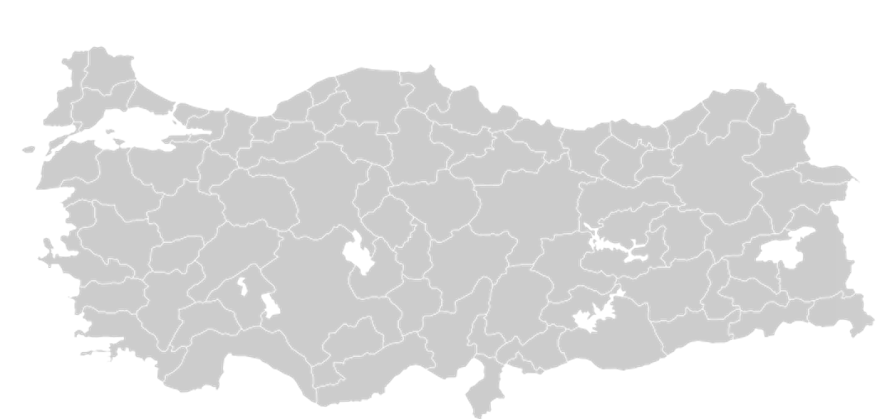
The Republic of Turkey located at 36-42 north latitudes and 26-45 east meridians which makes it in midrail.
Also four seasons can be seen in a year.
It surrounded on three sides by the sea and It has a bridge that connects two continents called Europe and Asia.
Turkey hosts lots of cultures and nations. In history, Turkey hosted different nations in different centuries, that’s why other nations come and live in here. Their historical artifacts being protected in it.

Slide 3
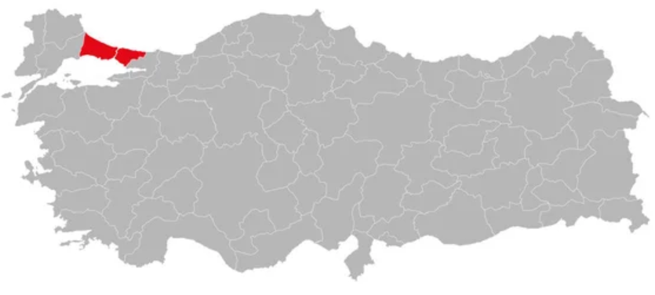
The town I live in is Istanbul. It has ots of stories about itself. Such as the seven hills history. Rumour has it that Rome Emperor Constantine built the city on seven hills, based on the idea of Istanbul has the Sun, the Moon and five planets. Besides, Byzantine Empire and the Ottoman Empire built their magnificent builds on these seven hills like the Rome.
The Seven Hills
Sarayburnu
Suleymaniye (Beyazit)
Cemberlitas
Fatih
Yavuz Selim
Edirnekapi
Kocamustafapasa

Slide 4
I study in Dr. Kemal Naci Eksi Anatolia Highschool. It is a project school.
It has different oppurtunities that suits to all students. For example, every year our school arranges an erasmus and It encourages It’s students for it.
I have to mention that, if you want to get in the school you must get a palpable score from the highschool exam (LGS).
I got in here with 8 percentile which equals to 422,2222 points.
The teachers are really good at teaching, I can say that without any doubts. Also the students have different interests and successfull at their lessons.

Slide 5
THANK YOU

