Slide 1
MY COUNTRY, TOWN AND SCHOOL
MADE BY ESMANUR YAŞAR
NACİ EKŞİ ANOLATİON HİGH SCHOOL

Slide 2
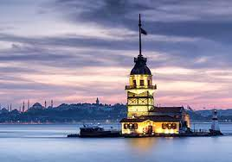
MY COUNTRY
TURKEY
my country is very important city for this world. it is historical , traditional and tourist.ıf countine example, there are many tower like Maiden's tower, Galata tower. they are very beatiful and people take a lot of photos in front of the it. there are many mosques like Sultan ahmet mosque,Hagia Sophia mosque and hundres of other historical places can be given as examples.Traditionally , There is a wide variety of dishes, folk dances and musics. our foods are very delicious. some of our main dishes; kebab ,iskender lahmacun and our deserts; sütlaç ,künefe. you can eat them for dinner. IN addittion to these, our folk dances and traditional song type türkü can be given as an example.So my country is very touristıc . Thousands of tourısts come every year.
Turkısh people are very helpful,funny and they are attached to their country.

Slide 3
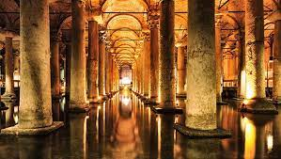
MY TOWN
İSTANBUL
Istanbul is my city, my home, where I live and the former capital of Turkey. but i dont like this city because it is very crowded . the population is close to 16 million From all around the world every year tourist come in this city. there are very important places in Istanbul for example Grand bazarr , you can buy gifts for your be loved ones.ın taksim, you can take a lot of nice pictures.with the tram in the back you can have a good background because its is very beautiful. and the last one is my favorite place in the istanbul. is Basilica Cistern. when you come in you can see a fascinating view. this is our history.

Slide 4
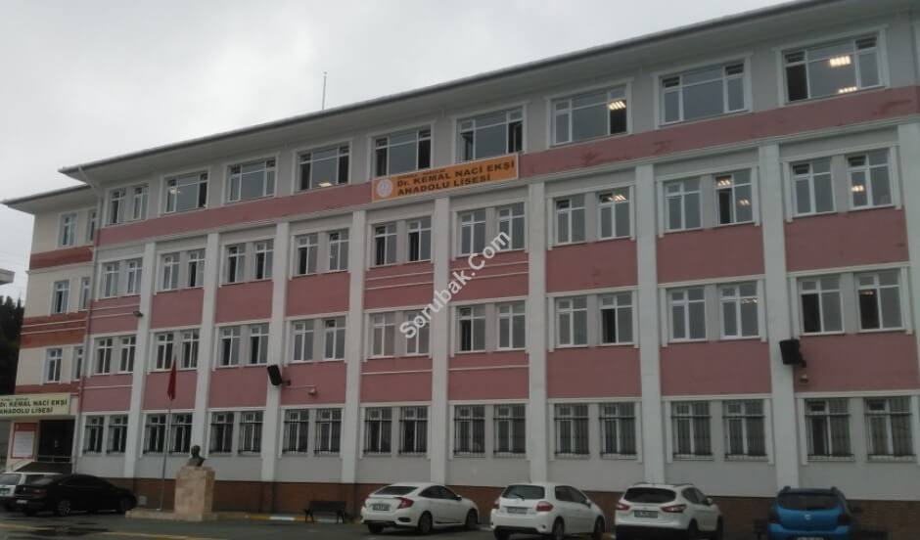
MY SCHOOL
Dr.kemal naci ekşi anolation high school
I study at Naci ekşi Anolation high school . I am in the to second grade in this school. This school was founded in 1989. So this school is a multi-disciplinary and well-educated school.our teachers are very good,fun and helpful to us. so we students always want to do our best and we always study our lessons.we and our teachers always do activites in the field of music and sports etc. ın this way , we both have fun and learn new things.

