Slide 1
Dr. Naci Ekşi High School
Meriç Özenç

Slide 2
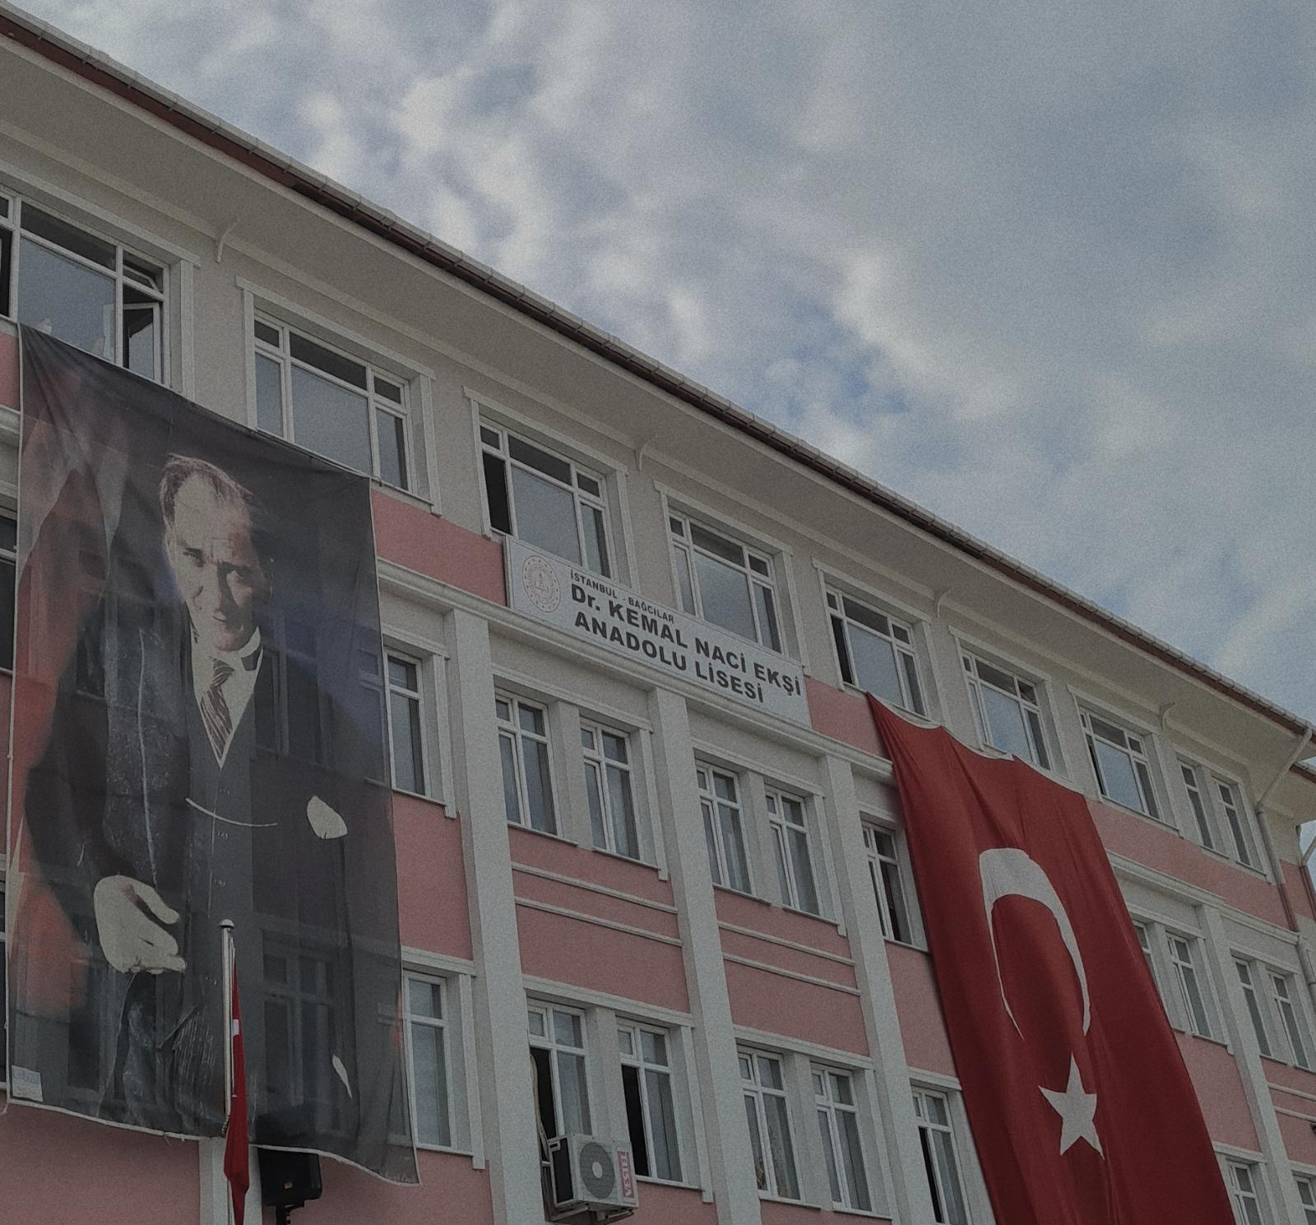
My School
My school's name is Dr. Naci Ekşi High School. My school is a qualified school where students who are successful in the high school entrance exam held in Turkey are taken. I have a social school in all directions. Students can participate in a lot of events and get help from teachers for events. At school, everyone knows and loves each other.

Slide 3
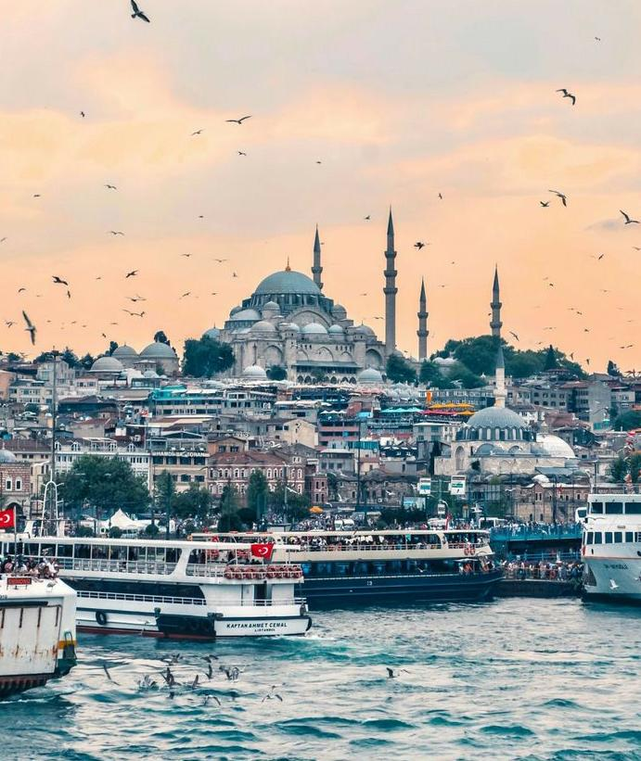
My Town
Istanbul is a city in the Marmara Region of Turkey and one of the 81 provinces of the Republic of Turkey. It is the most populated and the most migratory province of the country in terms of population. It is one of the leading cities in economic, historical and socio-cultural terms. The city is the 34th in the world in terms of economic size. The population is 15.46 million. Its people are friendly and warm-blooded.

Slide 4
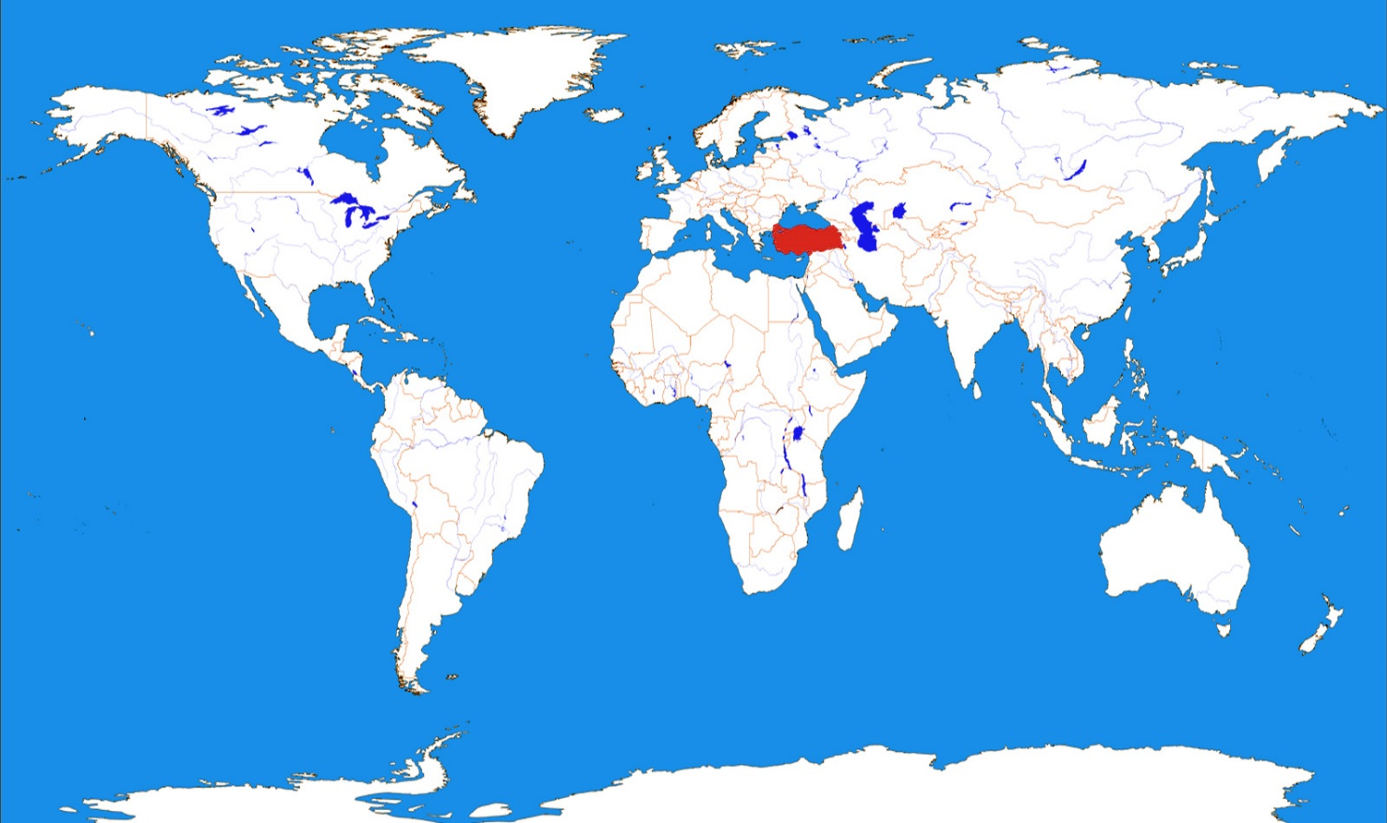
The Republic of Turkey is a country with most of its territory located in Anatolia and a small part in Thrace, the southeastern extension of the Balkan Peninsula. The capital city is Ankara. The founder of my country is Mustafa Kemal Ataturk. The population is 84.34 million. The Turkish people are very dependent on their country. People like to help. The tourist destination is quite a lot.

Slide 5
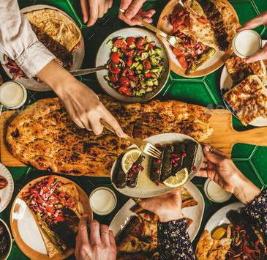
Traditional Turkish Cuisine
There are 19 thousand kinds of dishes in Turkish cuisine. Some of the most favorite dishes are: baklava, shish kebab, lahmacun, alexander, olive oil wrap, meatballs, künefe. Because these are traditional dishes, the Turkish people love them, but some tourists don't like them very much. Most dishes necessarily have meat in them.

