Slide 1
Christmas Cards made by students
Tukuma novada speciālās izglītības iestāde
December, 2021

Slide 2
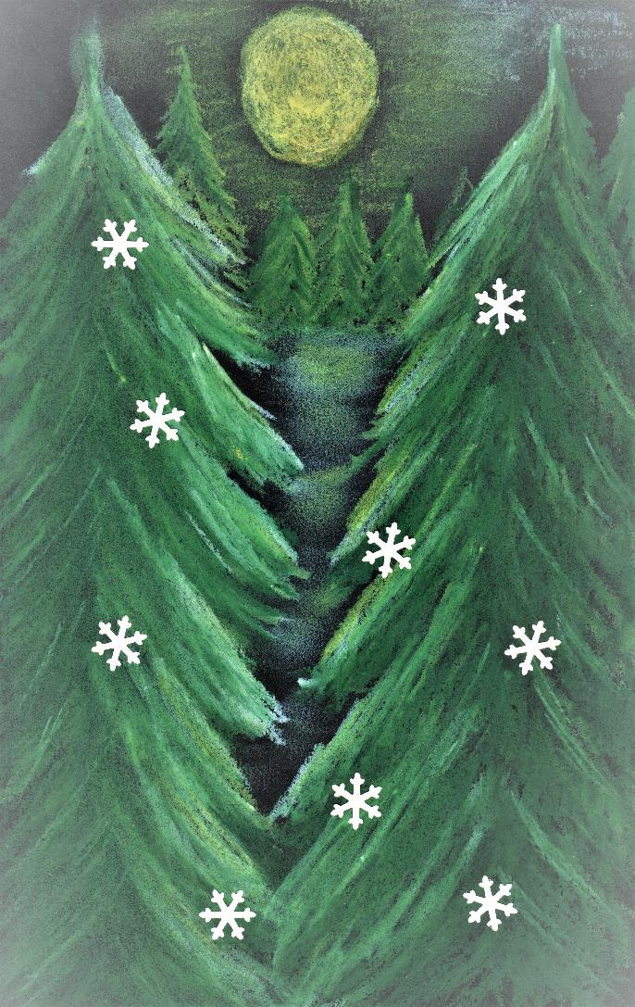
Vineta Zvirgziņa
Year 8 student

Slide 3
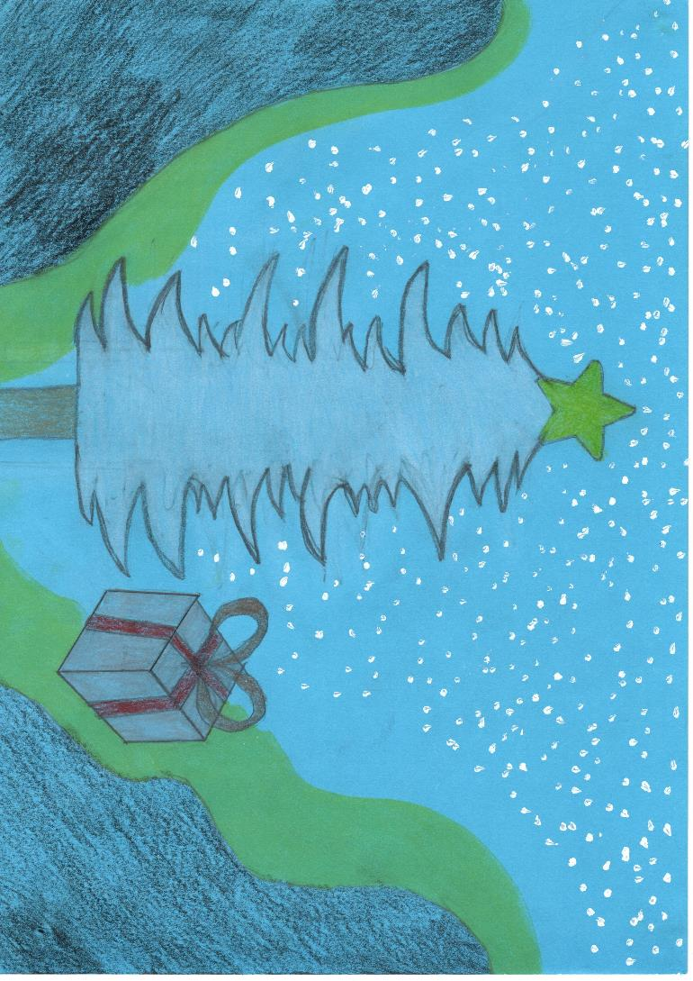
Tomass Kozulis
Year 8 student

Slide 4

Sņežana Jefimova
Year 9 student

Slide 5
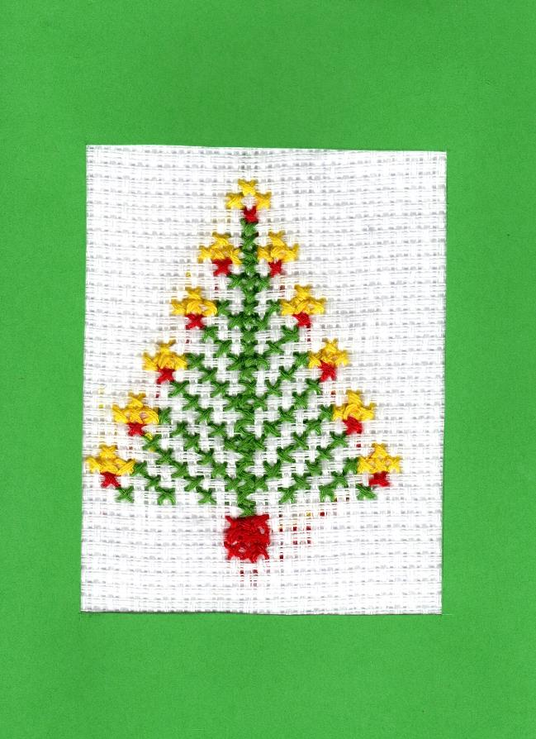
Simona Siliņa
Year 8 student

Slide 6

Santa Dakša
Year 8 student

Slide 7

Rusalīne Aleksandere
Year 7 student

Slide 8
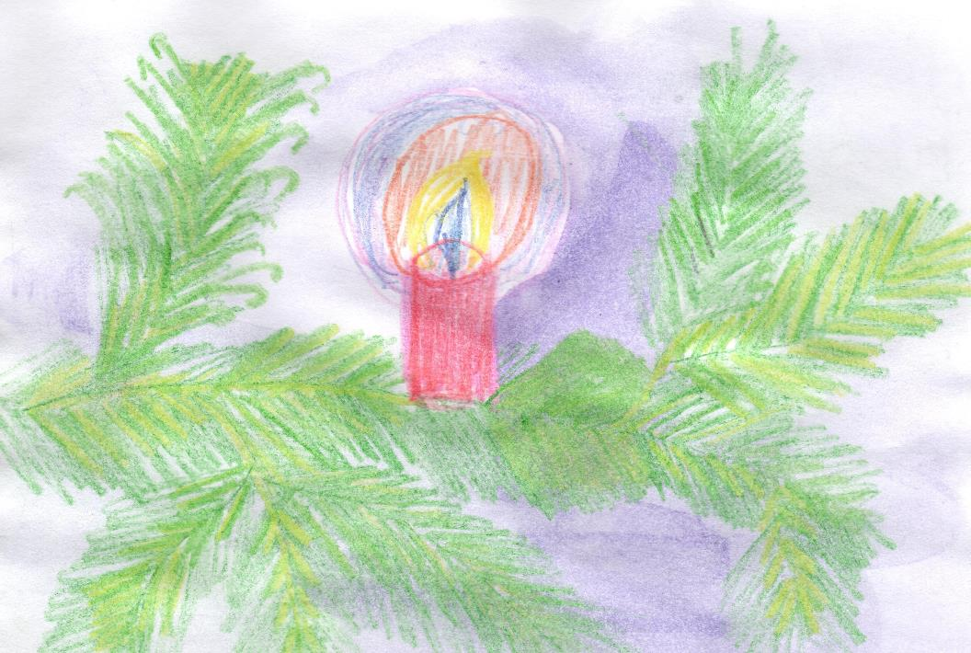
Raitis Klāvs
Year 7 student

Slide 9
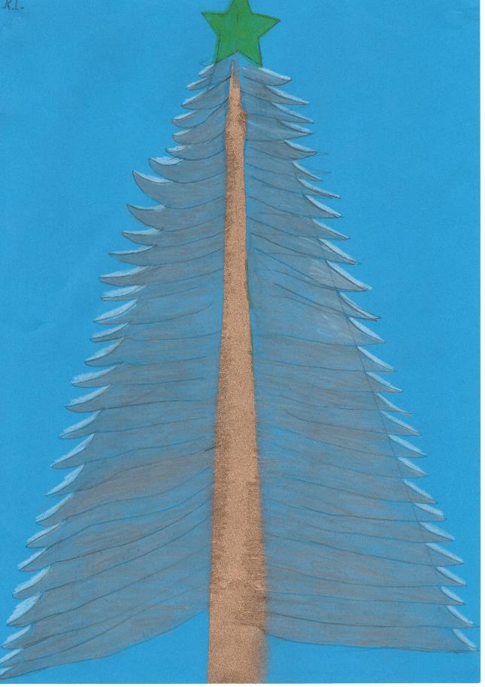
Reinis Legzdiņs
Year 8 student

Slide 10
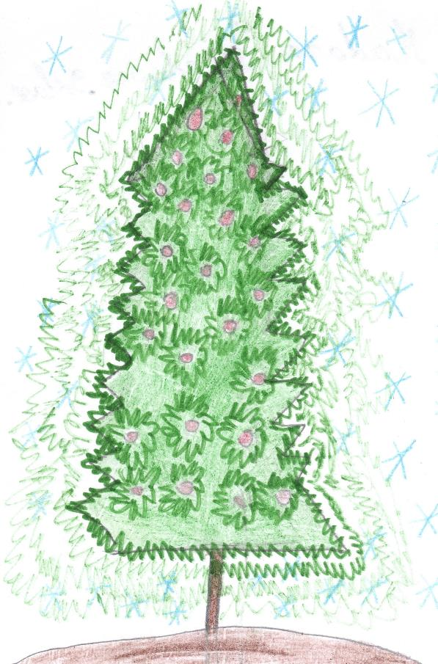
Madara Jēkabsone
Year 9 student

Slide 11
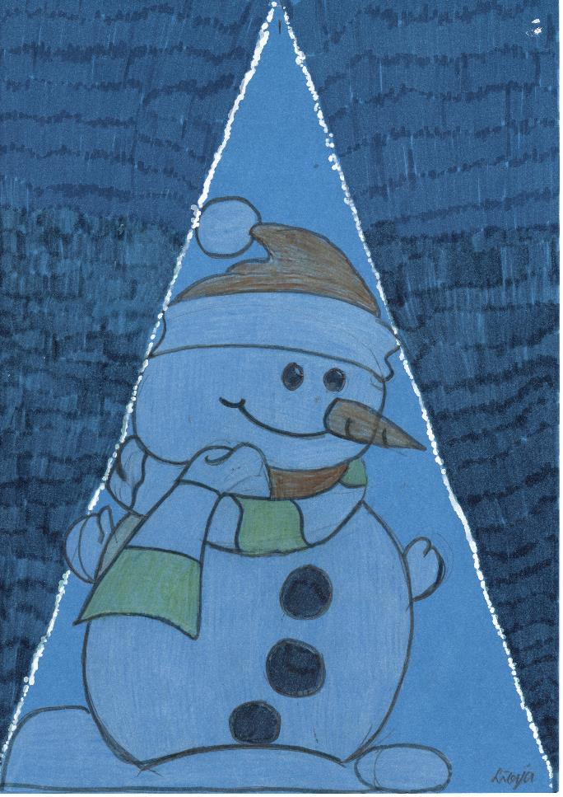
Līvija Leparte
Year 8 student

Slide 12

Līga Zorina
Year 8 student

Slide 13

Lāsma Strode
Year 7 student

Slide 14

Kristīne Vozkova
Year 7 student

Slide 15
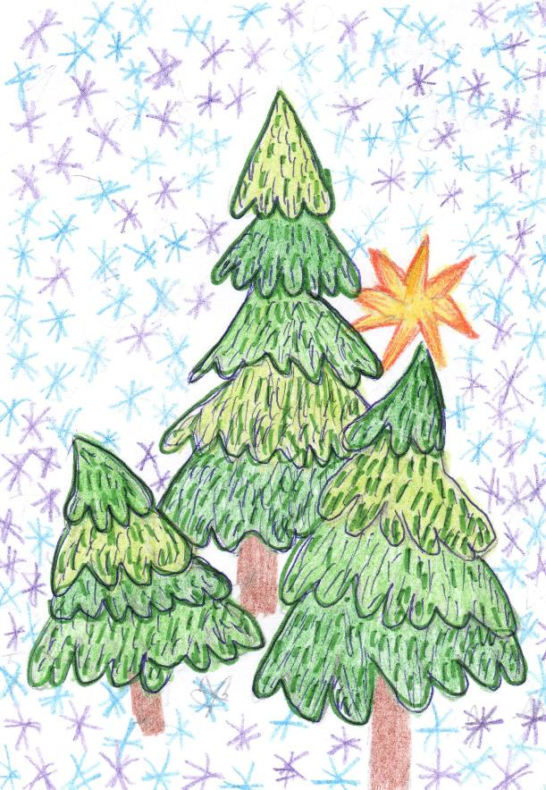
Liāna Kļava
Year 8 student

Slide 16
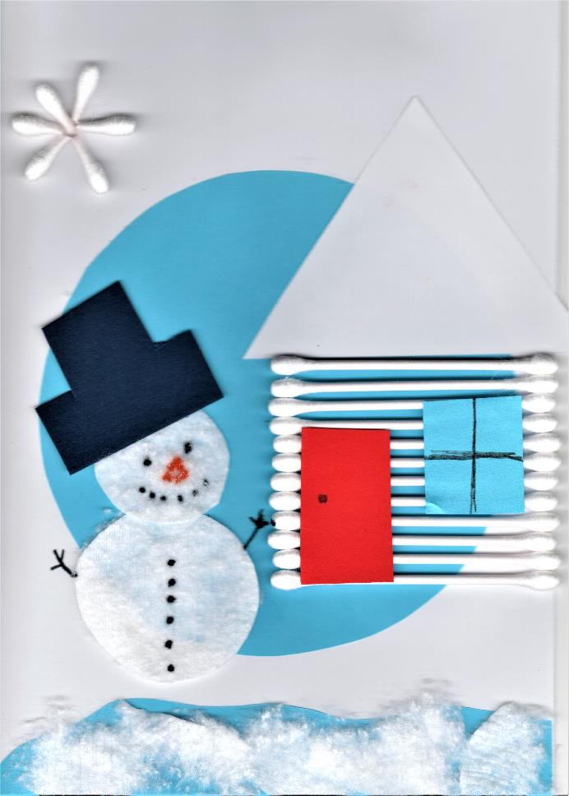
Leo Freimanis
Year 4 student

Slide 17
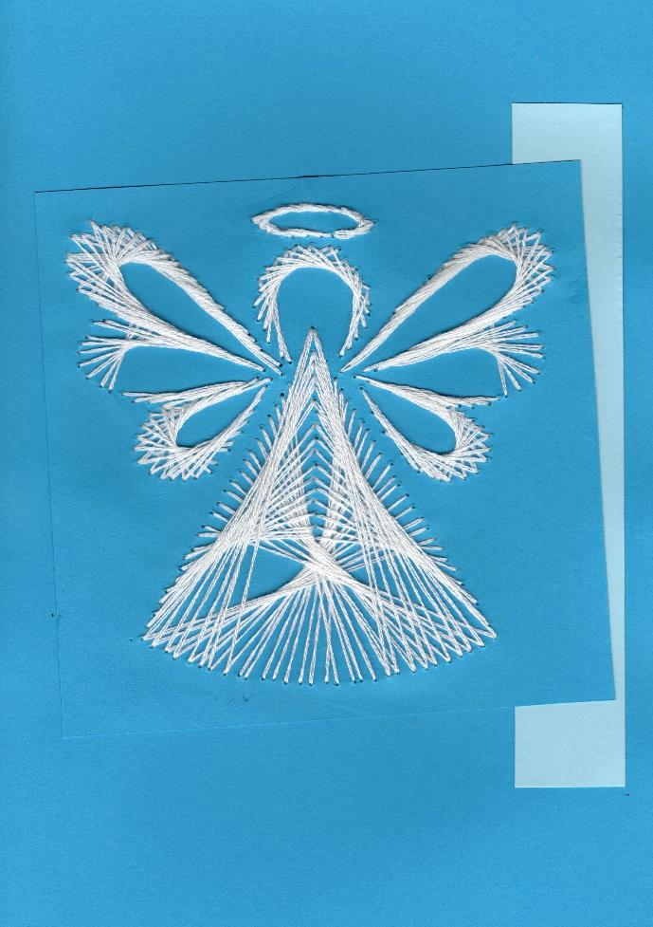
Laima Siliņa
Year 8 student

Slide 18
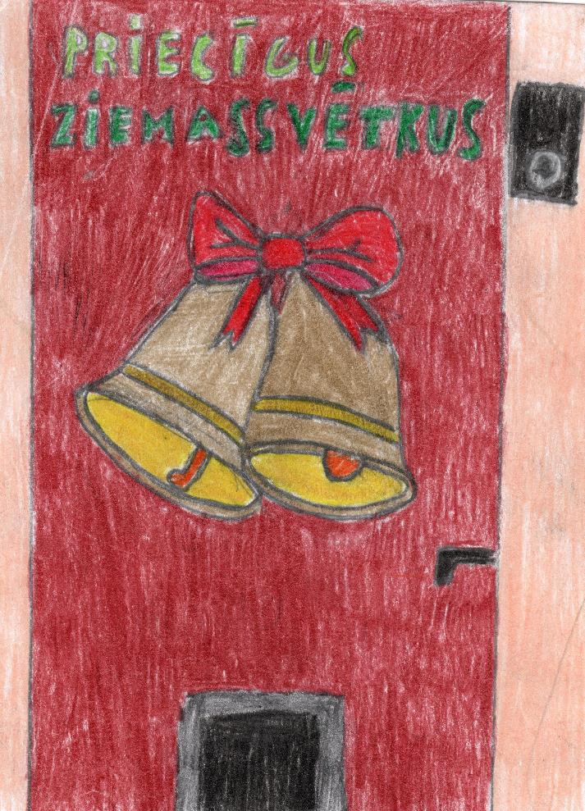
Kristers Lamberts
Year 8 student

Slide 19

Kristiāna Lormane
Year 7 student

Slide 20
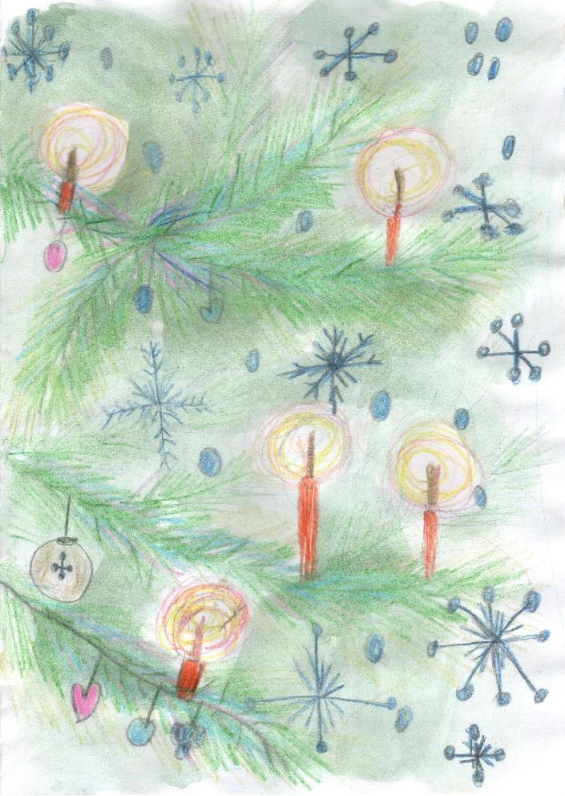
Kaļina Aleksandere
Year 5 student

Slide 21
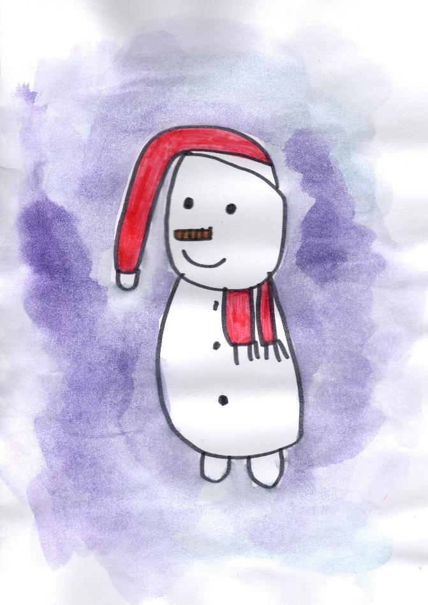
Kate Slobožaņina
Year 5 student

Slide 22

Karīna Stefanovska
Year 8 student

Slide 23

Karīna Legzdiņa
Year 9 student

Slide 24

Jānis Pūliņš
Year 6 student

Slide 25
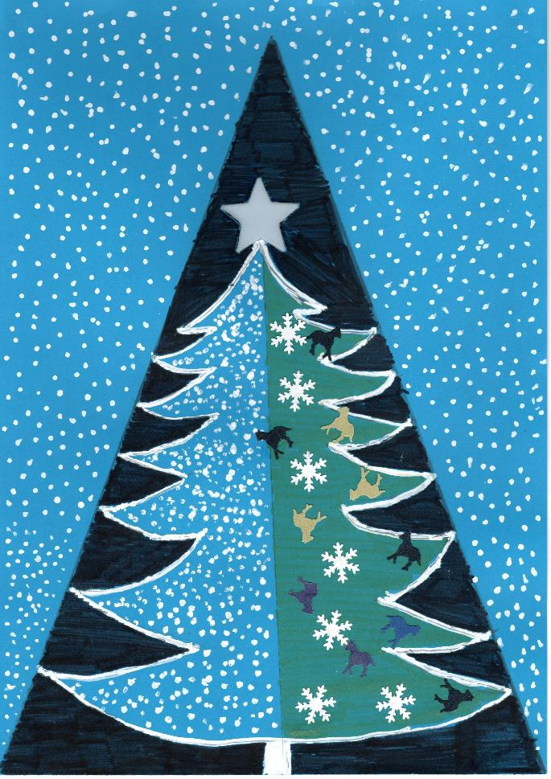
Juris Štālmanis
Year 8 student

Slide 26
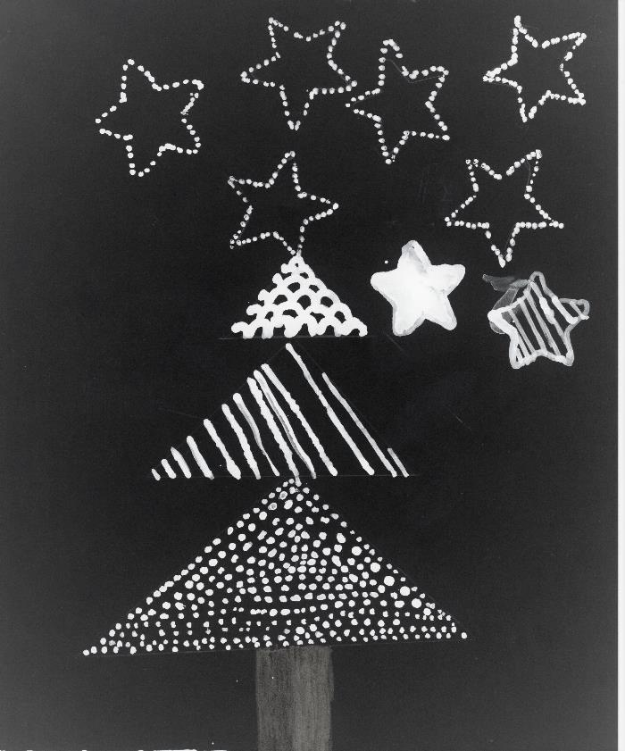
Artūrs Millers
Year 8 student

Slide 27
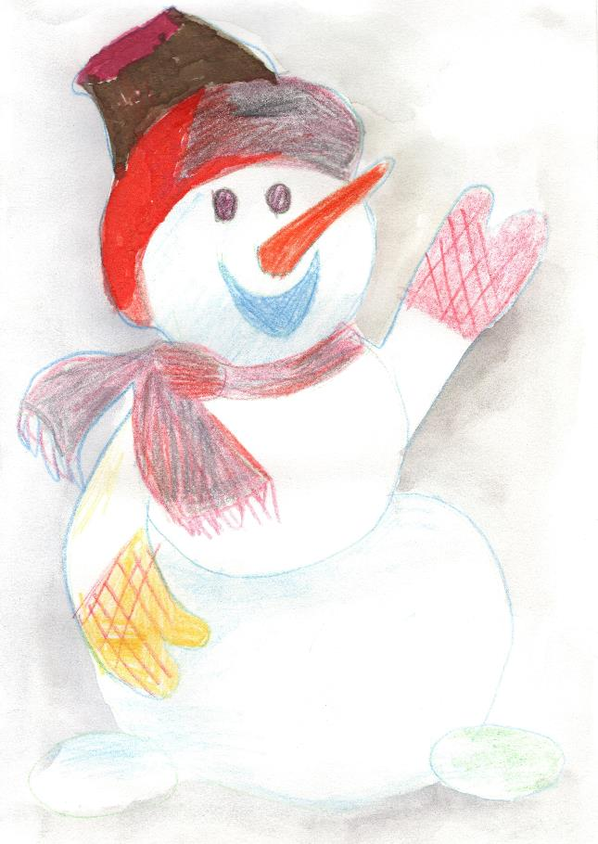
Artis Pone
Year 5 student

Slide 28

Angelika Joniņa
Year 6 student

Slide 29
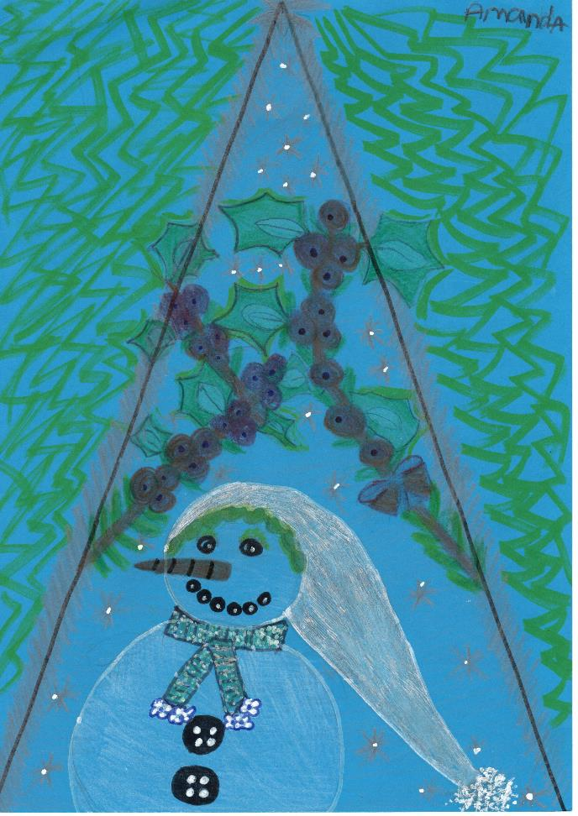
Amanda Ziediņa
Year 8 student

Slide 30
Wishing you a Christmas that's merry and bright!
We hope you have a safe and relaxing holiday season.

Slide 31
Wishing you a Christmas that's merry and bright!
We hope you have a safe and relaxing holiday season.

