Slide 1
7th Primary School of Giannitsa Greece
Class 5th

Slide 2
Greece is in the Balkan peninsula and borders Albania ,Fyrom , Bulgaria and Turkey . The Aegean Sea is in the South.

Slide 3
Giannitsa ,our town, is in the north part of Greece .

Slide 4
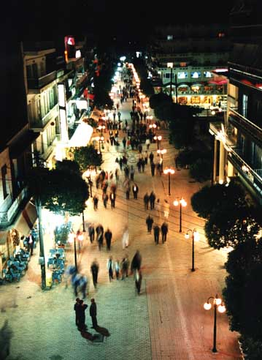
The weather in Giannitsa is hot in the summer and cold and rainy in the winter . It rarely snows during winter.

Slide 5
Giannitsa is very close to Pella, which is the birthplace of Alexander the Great.

Slide 7
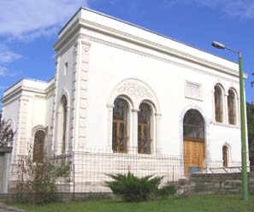
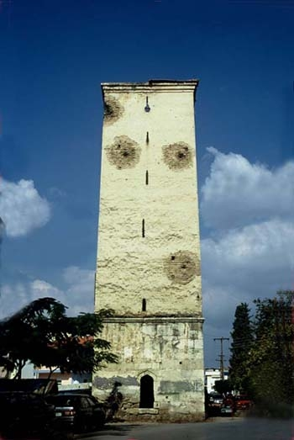
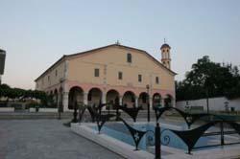
There are many attractions in our town.

Slide 8
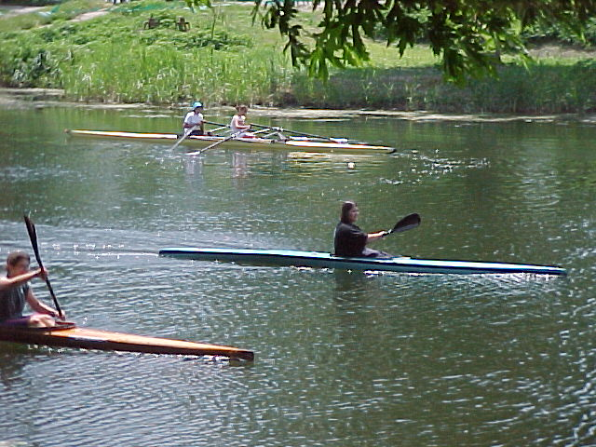
Loudias river flows near Giannitsa

Slide 9
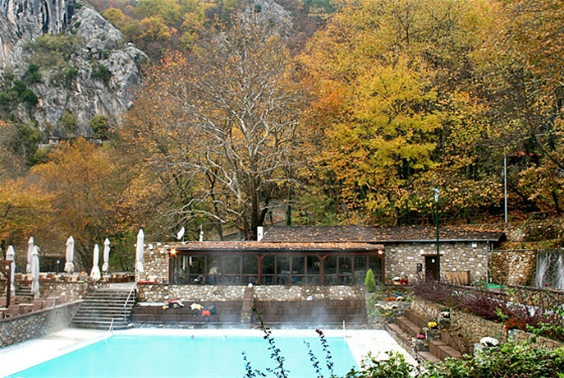
The nature around our town is very beautiful.

Slide 10
This is our school. There are more than 200 pupils and 25 teachers.

Slide 11
There is a large playground in front of the building ,where we relax during breaks and have fun in our celebrations.

Slide 12
We are very happy to work with Other European Schools

