Slide 1
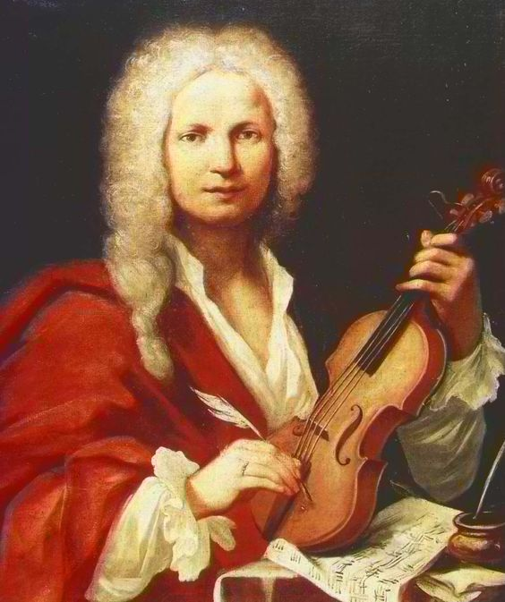
Vivaldi’s works, operas and concerts

Slide 2
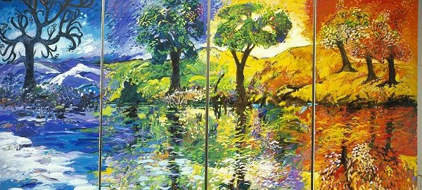
The four seasons
"The four seasons" is known as the most popular Vivaldi's composition. There are four concerts, each inspired by a season of the year. This work was published in 1725

Slide 3
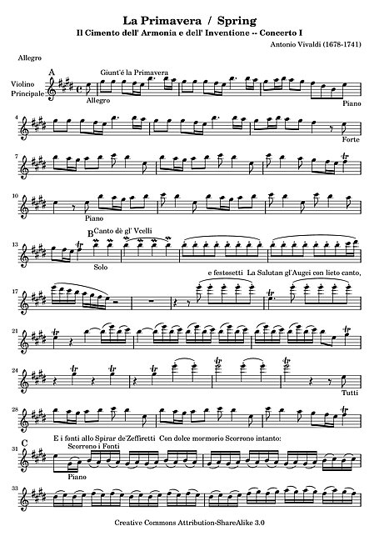
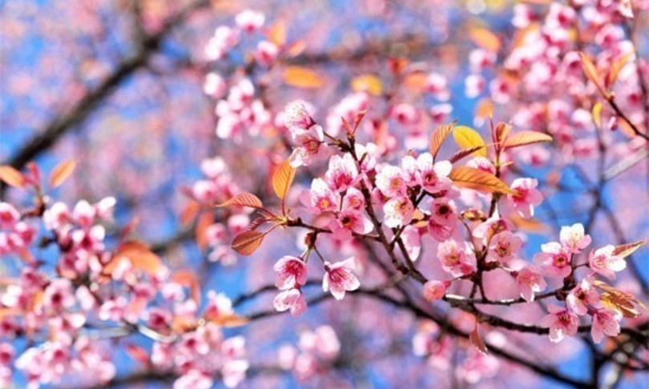
First concert: Spring
It is a sonnet, or a short poem. It is usually divided into three parts and is played by solo string instruments. the music describes the trend of the spring episodes: the birdsong, the storm and the final dance.
https://www.youtube.com/watch?v=l-dYNttdgl0

Slide 4
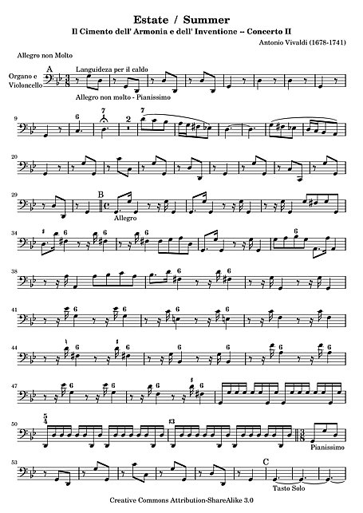
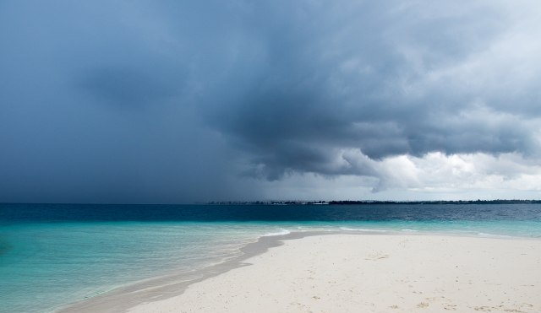
Second concert: summer
Summer too, like the others, is based on a sonnet: Summer is the only concert in the cycle that effectively reflects the explosive charge of the season; moreover, it can be considered as a whole, without distinction between the various movements.
https://www.youtube.com/watch?v=Nx5c_JZIM6M

Slide 5
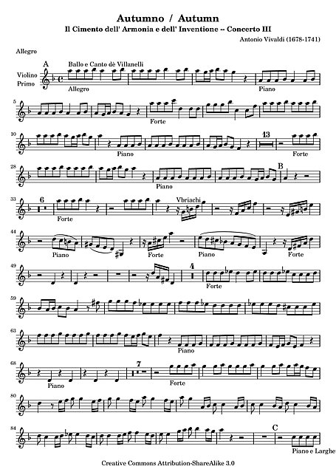
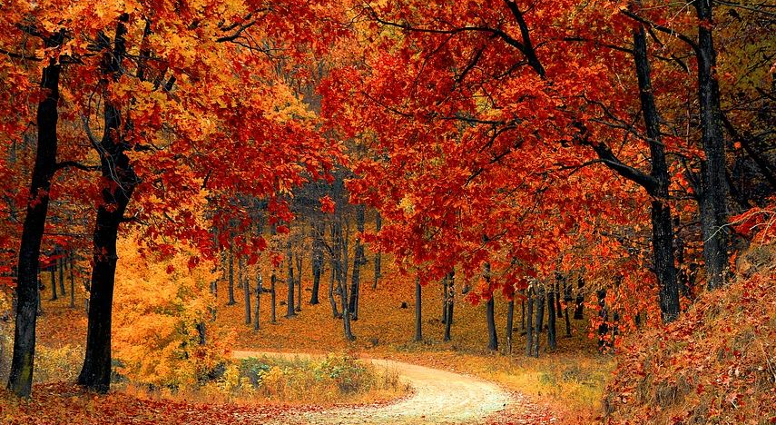
Third concert: autumn
This concert too, like the others, is divided into three movements and takes inspiration for its theme from a sonnet. In Autumn Vivaldi describes the figure of Bacchus, god of wine and intoxication. The first movement, in fact, opens with an overview of a vineyard, where some farmers are harvesting. The climate is festive.
https://www.youtube.com/watch?v=H7hGiZ579cs

Slide 6
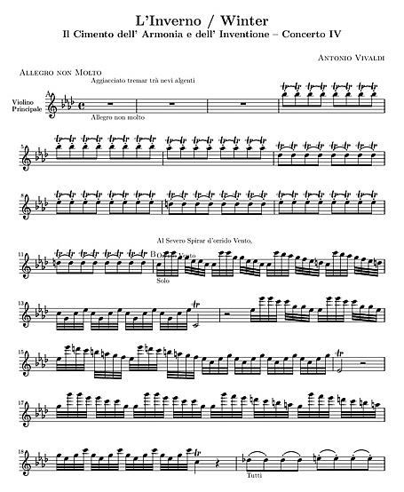
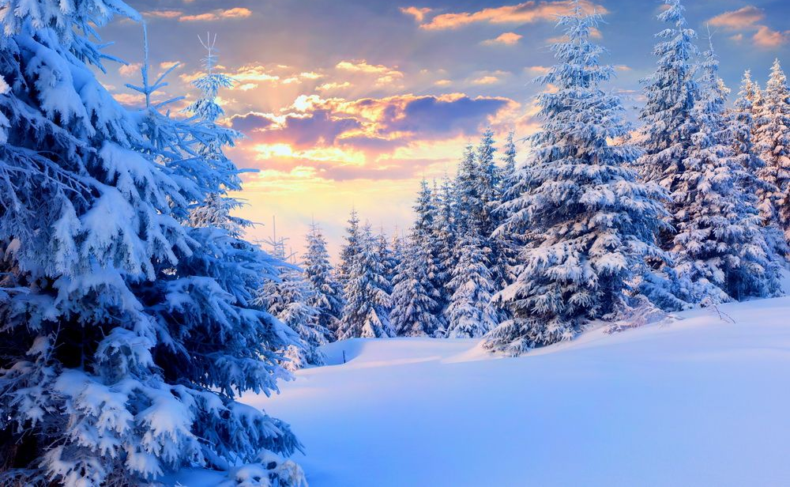
fourth concert: Winter
Winter begins with a cold shiver and the whipping of the winds. People hurry towards the houses, chattering their teeth and stamping their feet to ward off the pressing cold
https://www.youtube.com/watch?v=TZCfydWF48c

Slide 7
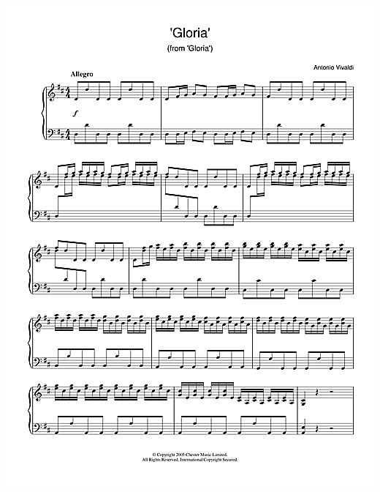
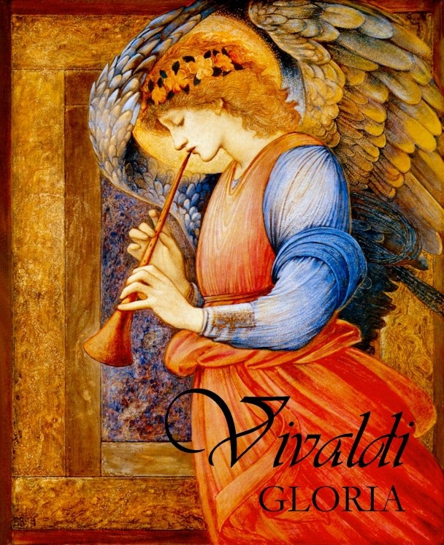
Gloria
As with other choral pieces, the composer, Vivaldi, wrote many introductions which had to be performed before the Gloria itself. There are four introductions to these Glorias
https://youtu.be/RMHguvZPcqQ

Slide 8
Lavoro svolto da: chiara giulia noemi stella lucia

