Slide 1
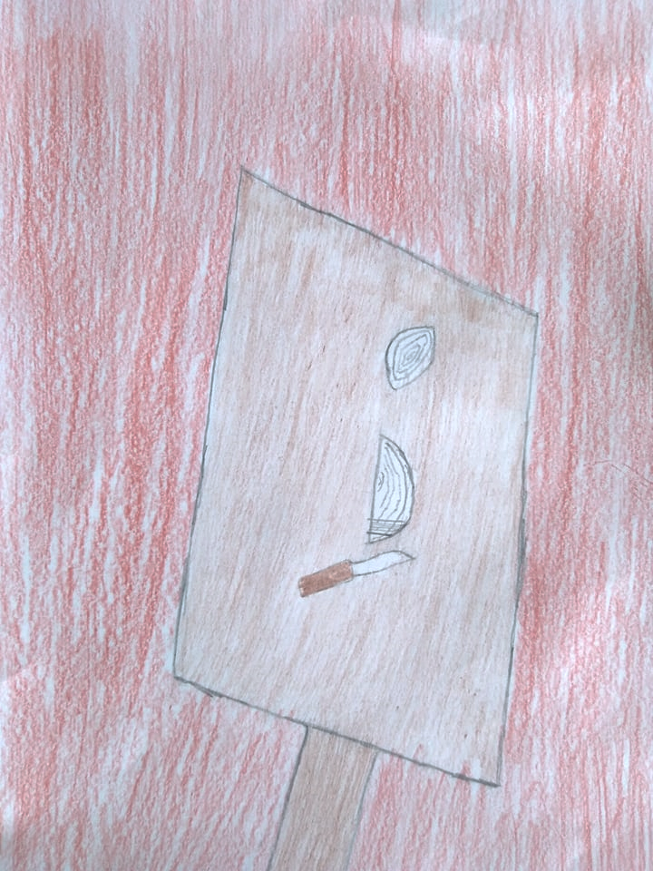
“Young cooks”

Slide 2
Georgia is blessed with wonderful fresh vegetables, ideal for making delicious, refreshing salads.

Slide 3
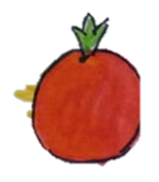
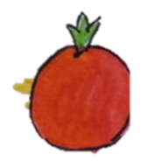
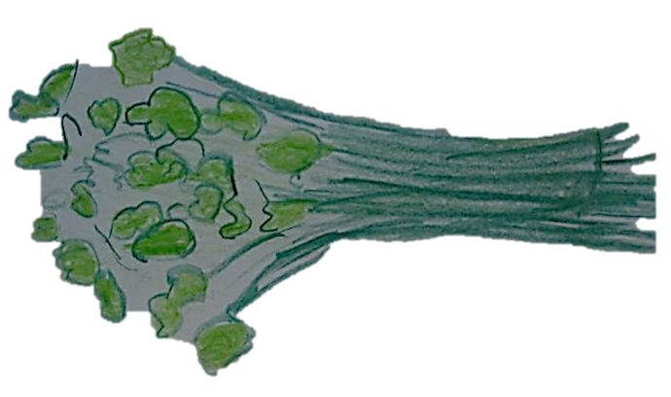
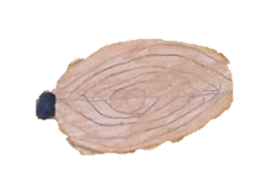
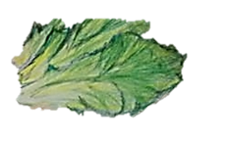
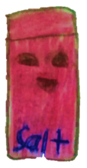
Ingredients
tomatoes
fresh parsley
red onion
cucumbers
lettuce leaves
Oil and Salt

Slide 4
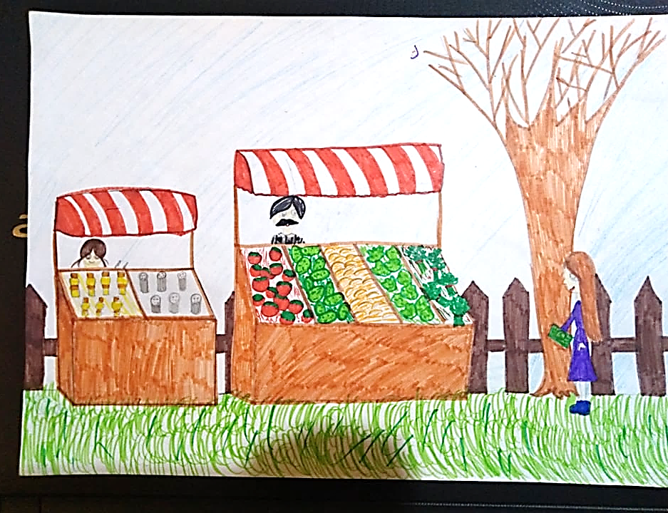
Let's buy vegetables in the market!

Slide 5
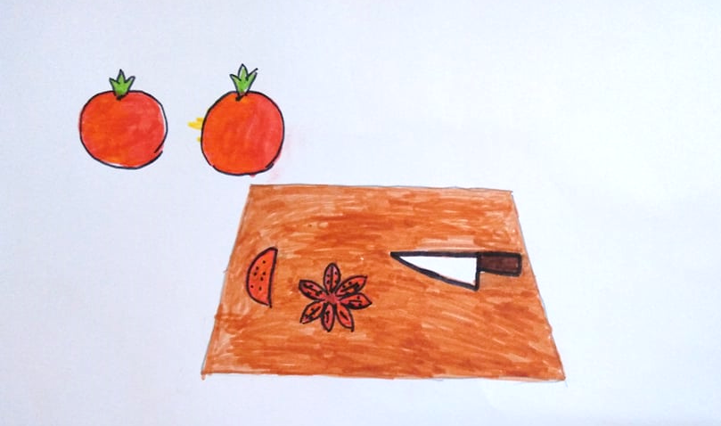
Chop vegetables as shown in the photograph below

Slide 6
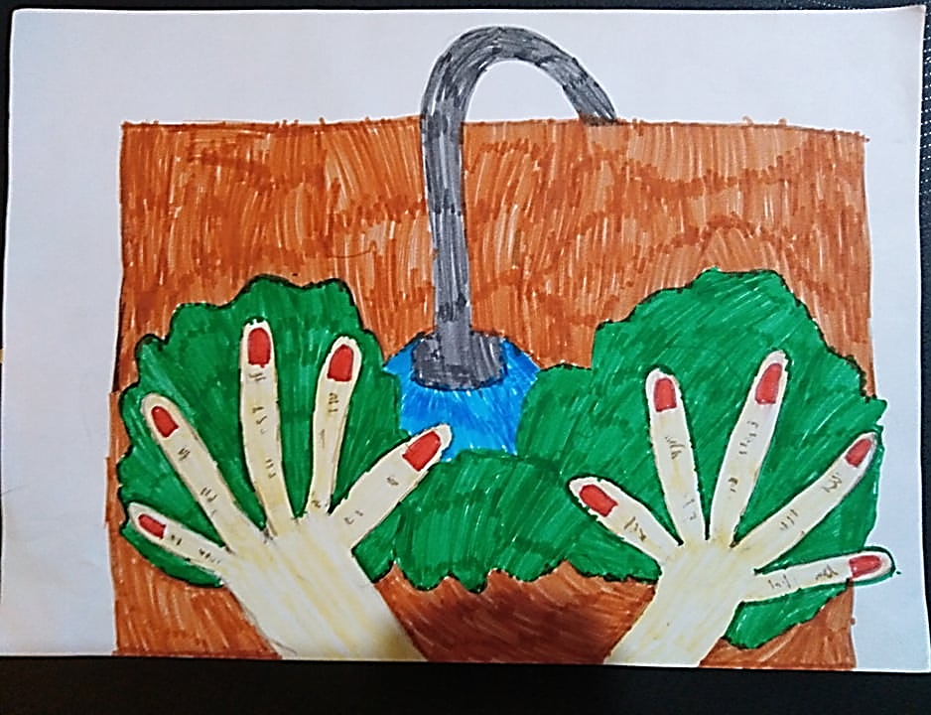
Wash salad
sheets

Slide 7
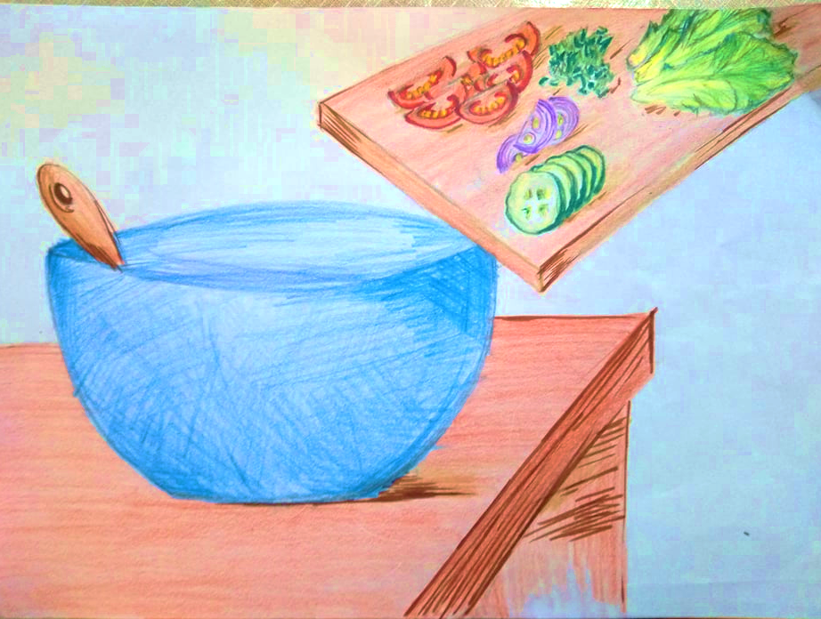
Place prepared ingredients in a salad bowl.

Slide 8
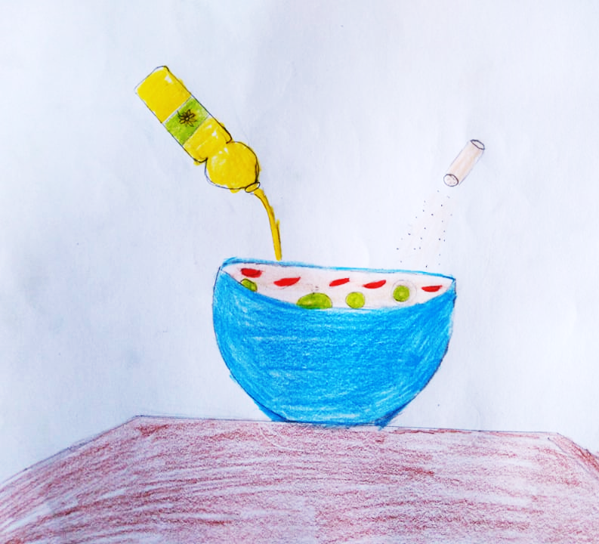
Add a sprinkling of salt and oil, according to taste.

