Slide 1
Project “Mirror, mirror on the wall?!”
Assessment results

Slide 2
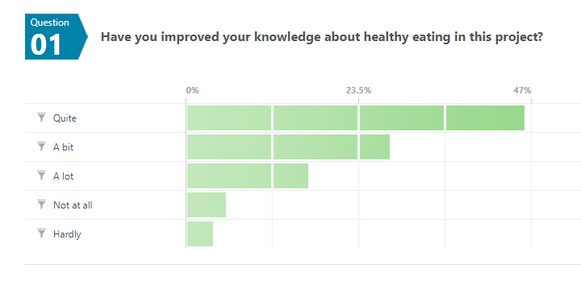
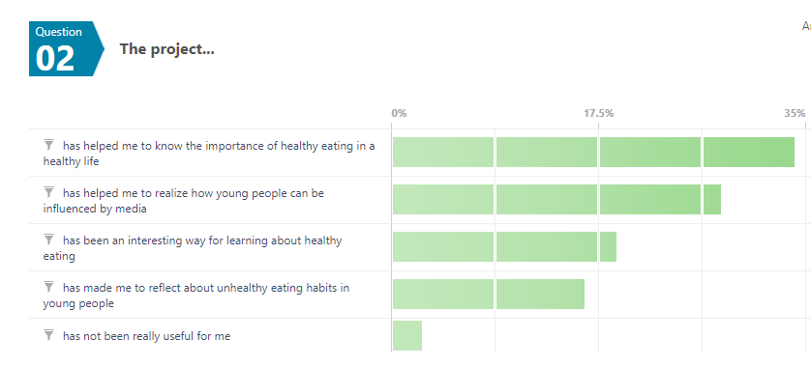
More than 75% have improved their knowledge about healthy eating
They are more conscious about lifestyle and how media can influence young people

Slide 3
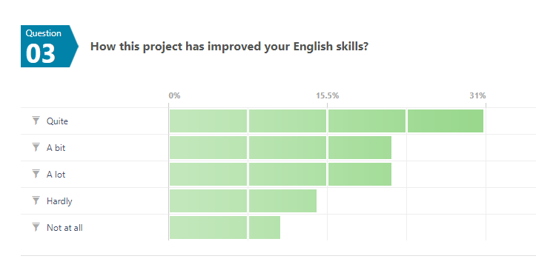
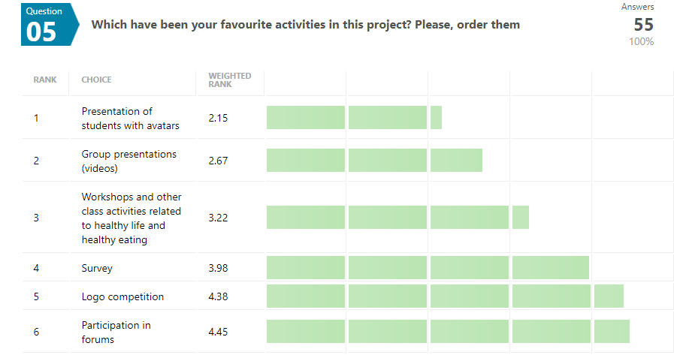
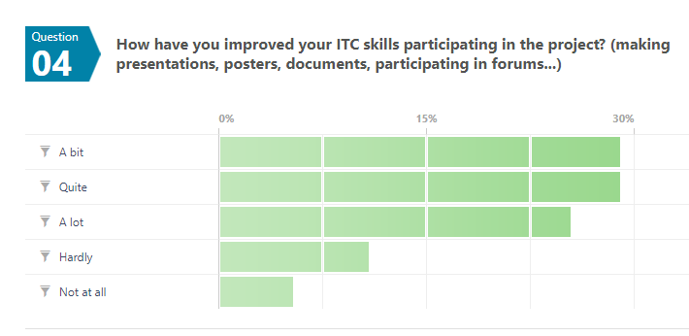
Their favourite activities have been to participate in forums, logo competition, and do the survey.
Most of te students have improved their English and ICT skills

Slide 4
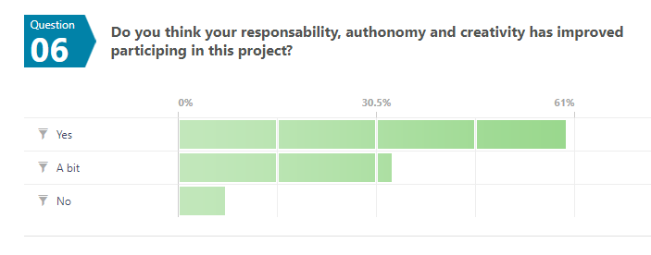
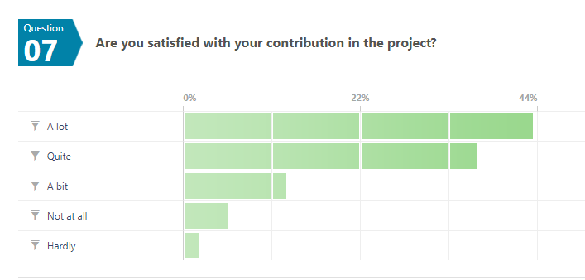
Students think that their authonomy and responsability has improved
The vast majority of participants are satisfied with their contribution to the project

Slide 5
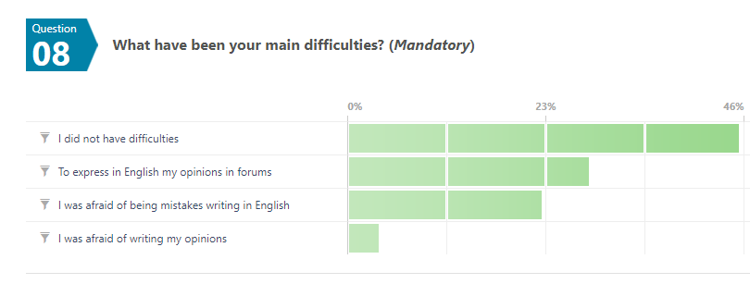
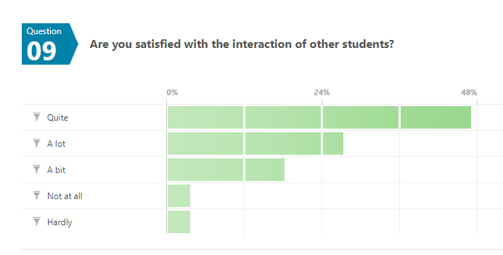
Some students had difficulties related to language or expressing ideas
The participants are mostly satisfied with the interaction among them

Slide 6
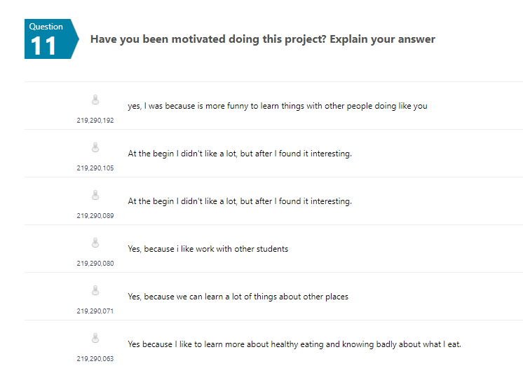
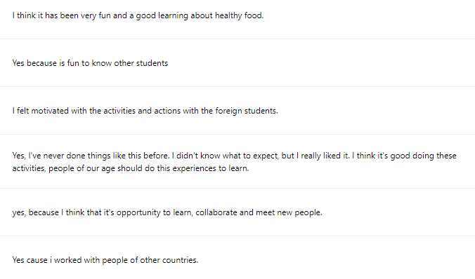
Most students have been really motivated during the project

Slide 7
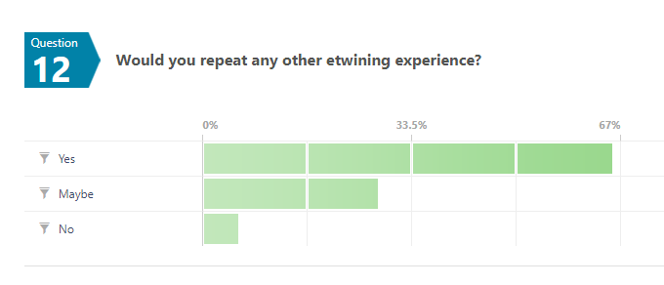
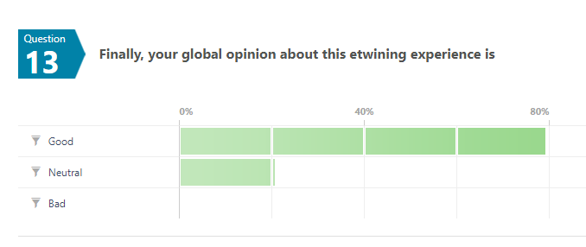
Most of the participants would be repeat this etwining experience, and it has been considered as a GOOD EXPERIENCE

Slide 8
Thanks for your participation!

