Slide 1
ARE YOU OPTIMISTIC ABOUT THE FUTURE OF THE EU?

Slide 2
The situation of the EU has improved in the last years and most of the countries have an optimistic perspective of the economic situation in Europe, however, there are a few countries who do not share this point of view.

Slide 3
Despite this optimism, we think that there are still many things that can be improved, and we would like to share with you some of our thoughts:
Firstly, we think people do not know enough about the European Union and how it works. Therefore, there is a lack of knowledge about it. In response to this situation, in our opinion each country should provide their inhabitants with conferences, courses and through the media with information about the EU and its tasks. Moreover, the most efficient way of getting people involved in all of this, is through education, by addressing it in subjects such us social sciences or economy.

Slide 4
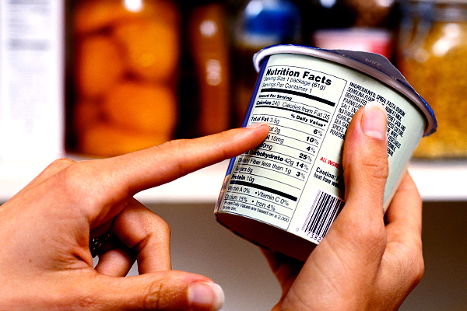
The EU has began a series of measures that are not of common knowledge:
For example, the EU has a great influence and importance in our consumer’s rights:
- It has established a maximum price per minute for mobile calls abroad.
- It has reduced advertising spaces to twelve minutes per hour.
- It has set the informative labelling of the food.
- It has limited the amount of chemical substances in the toys.

Slide 5
Programs related to student mobility, like Erasmus, Leonardo da Vinci or programs that contribute and promote worker’s mobility like “Eures”, have their origin in the European Parliament.
The CAP (Common Agricultural Policies) is one of the most important European policies that manage and grant subventions for farmers and ranches, which are decisives for some economies like the Spanish one.

Slide 6
The growth of populism
The growth of populist political parties in some European countries is attempting against the democratic and inclusive values of the society.
These parties are threating the rights of some collectives such as:
LGTBI+: In Rumania there has been a referendum to forbid the homosexual marriages in their constitution. Furthermore there has been a growth of violence against this collective.
Gypsies: The Italian Government have attempted to do a census of gypsies in order to expel them.
Immigrants: The Hungarian Government has established a law to punish anyone who helps the immigrants.

Slide 7
A new economic war
The USA has began the path of the economic protectionism, closing their borders and defending their products against the ones from abroad.
The USA has announced the imposition of commercial taxes to the importation of steel and aluminium from the European Union.

Slide 8
Taking into consideration the past of Europe, full of wars and conflicts, it is important to maintain and promote the European Union values, like unity, freedom, diversity, equality… In order to avoid future confrontations which do not benefit our society.
We trust the European project but we think there are still a lot of things that we must improve if we want it to move forward.
All of us should get involved with this, especially the young generations, because we are the future.

Slide 9
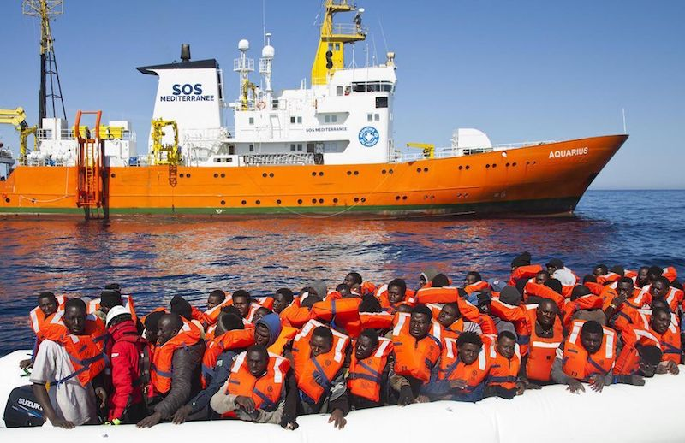
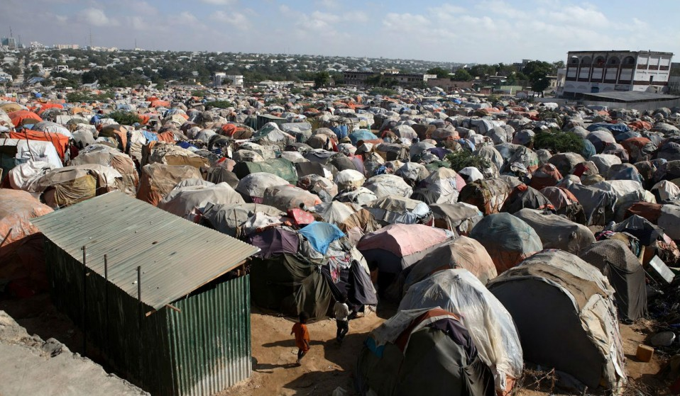
Immigration
According to the UNO, more than 2000 people have died in the Mediterranean in 2018. This is a very important problem that nowadays affects mostly southern European countries; we can say it is an humanitarian drama.

Slide 10
These people come to Europe looking for proper life conditions, and this should not concern just the southern countries; we think all European states should care about it and try to help, following the fundamental values of the EU, such us the respect of human dignity and human rights.
In conclusion, the EU should become aware of this terrible problem and get into agreements to try to solve it in the most solidary way, fulfilling the acquired commitments.

Slide 11
THE SPANISH DELEGATION
Thank you for your attention.

