Slide 1
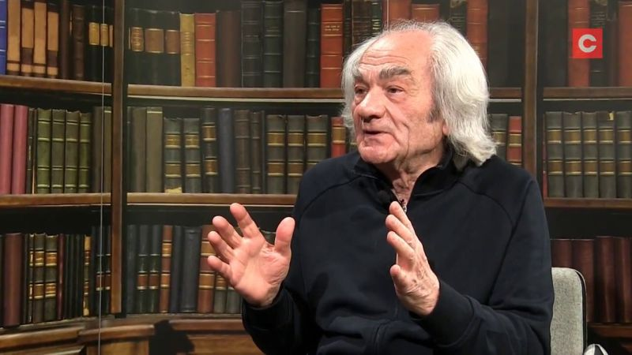
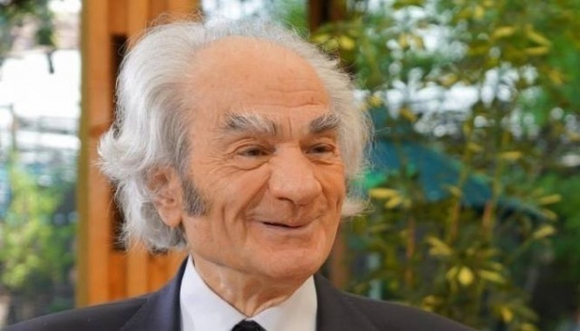
Leon Dănăilă
neurosurgeon, senator and author.
The candidate from Romania.

Slide 2
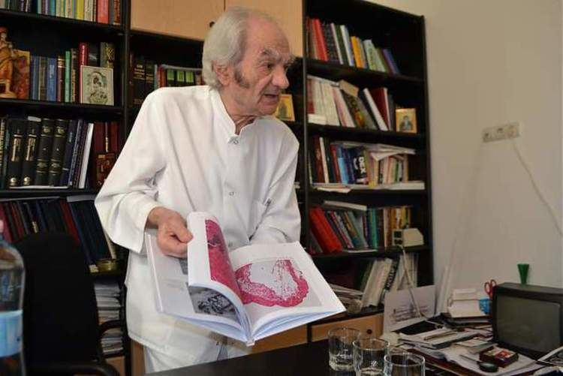
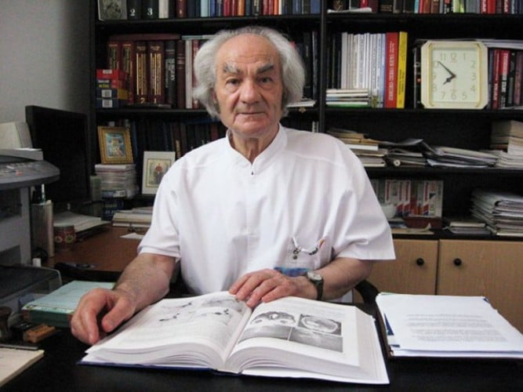
Leon Dănăilă was born on 1 July 1933, in Darbani, in Botosani county, Romania. He is a graduate of the Faculty of General Medicine of Iasi as well as the Faculty of Psychology and Philosophy of Bucharest.
Biography

Slide 3
HIS CAREER AS A NEUROSURGEON
Dănăilă was able to perform the most complex of neurosurgical operations.
He succeeded in reducing operation mortality from operations to percentages comparable with those reported by the world's most reputable neurosurgical clinics.
The surgical mortality rate in Bucharest fell from 50% to 2-6% for acoustic nerve neuroma.
The surgical mortality rate in Bucharest fell from 49% to 3% for intracerebral aneurysm cases.
Up to the present, he had performed more than 40,200 surgical interventions.

Slide 4
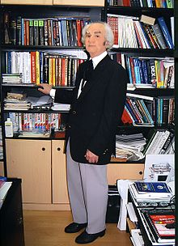
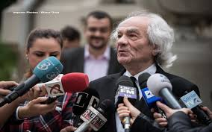
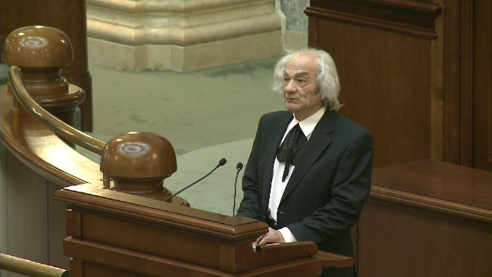
He was elected a titular member of the Romania Academy in 2004. At the 2016 Parliamentary Elections, he won a seat in the Romanian Senate for Bucharest .
HIS CAREER AS A SENATOR

Slide 5
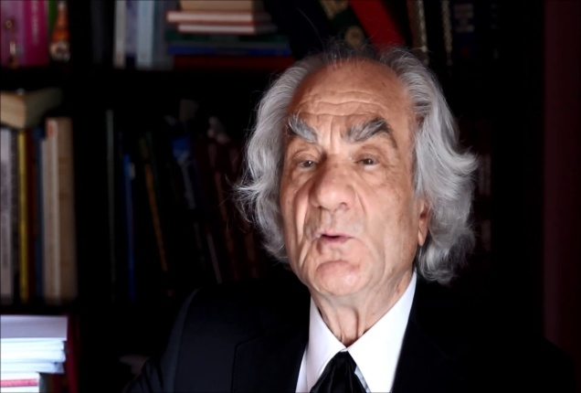
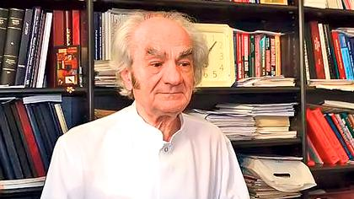
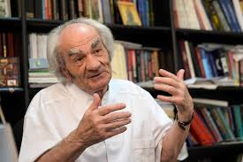
HIS CAREER AS AN AUTHOR
Out of the total of 54 published books, he had been the sole author of 7 books, the primary author of 28 books, joint author,but not primary one,of 19 books, and contributing author in 3 books.
Out of the 54 published books, textbooks and atlases, 24 had been drawn up in English.
His works are quoted by renowned scholars and researchers throughout the world.

Slide 6
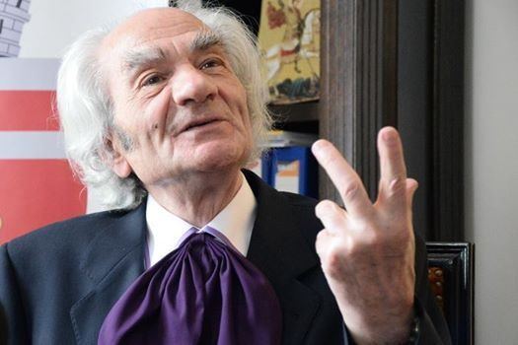
Dr. Leon Danaila, 85 years old, currently offers free consultations and still operates free of charge for its patients. He donated his own money to the hospitals to upgrade their conditions for the pacients and to buy medical machines.
He should win the Malala Prize because he is considered the best neurosurgeon in Europe and he made a lot of charitable activities and donations. He is an example for every doctor and even for every person.

Slide 7
Thank you for your attention!
Leo Giurca, Romania.

