Slide 1
Isidoro macías
Padre Patera
Our spanish candidate

Slide 2
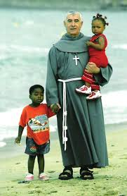
Biography
We suggest Padre Patera to the Malala prize in regret to all his hard work during all his life to help the needed, especially in Algeciras in favor of sub-Saharans immigrants which cross the Strait of Gibraltar.
He was born in 1945, and since he was a child he had to help his family economically. This would make him feel that there could be others who also would need help.
He became a clergymen, and started to travel to other countries in order to carry out humanitarian work.

Slide 3
Commitment for Human Rights
He fights for the truely accomplishment of human rights.
His work is foccus on:
Right of a dignified life, freedom and security.
Right to protection against discrimination.
Right of asylum
Right of wellfare: alimentation, residence, medical asistance, clothing and other basic facilities
Right to social insurance.

Slide 4
Awards
UVA Price (1991)
Andalusí Honor Price (2001)
Merit Badge by Guardia Civil (2002)
Hero of the year by Time (2003)
Mundo Negro Price (2006)
Gold medal of Ciudad de Algeciras

Slide 5
Argumentation
He has transform his own house into a shelter. Also in Algeciras, he had run a house called "Virgen de la palma" where he hosts elderly homeless people.
He has given them also money, food, clothing and support.
The majority of his life he haven’t had the help of superior authorities and goverment.
His humanitarian work made posible the worthy life of lots of pregnant women and children from Africa.
Currently he leads an ONG called Cruz Blanca.

Slide 6
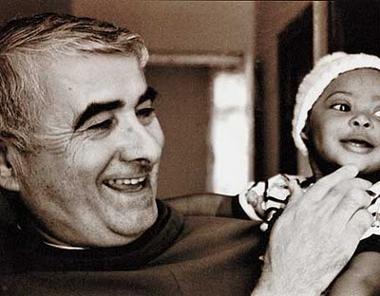
Thanks for your attention. “Padre Patera always understood that his fate was help the needed”

