Slide 1
Anna Dymna
Polish actress with a mission

Slide 2
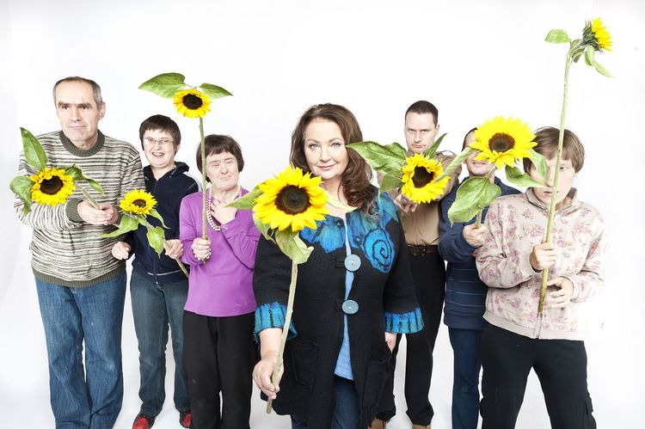
ANNA DYMNA
Polish TV, film & theatre actress
social activist
founder of the charity foundation „Against the odds„
The host of a cyclical program
Let’s meet broadcast by Polish TV
Anna devoted her life to serve the physically disabled and mentally handicapped.

Slide 3
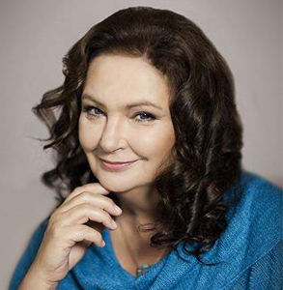
Biography
She was born in 1951, brought up and lives in Cracow, the cultural centre of Poland
In 1973 she graduated from the celebrated Theater School of Cracow
She started her acting career while still a student.
Since 1990 she has been a lecturer at her university.
Anna has played about 250 theatrical and film roles–has been one of the best Polish actresses.
Her life has been full of pain and struggle. She lost her husband at the age of 28, was seriously injuries in two car accidents.

Slide 4
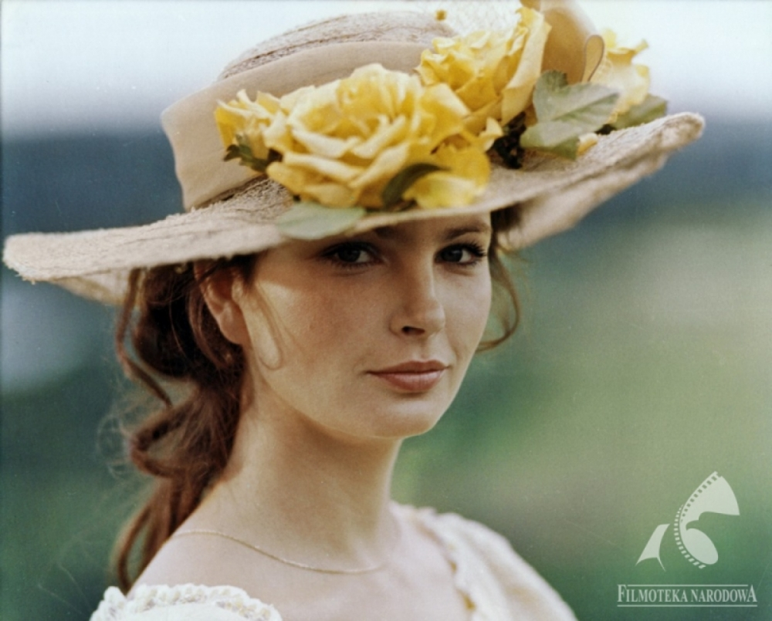
” Acting it is the most beautiful profession in the world because it deals with the deepest secrets of the heart and soul of man”.
” While working on roles, I try to understand the other person: his pain, complexes, motives for acting, thoughts and feelings”.
- says Anna Dymna.

Slide 5
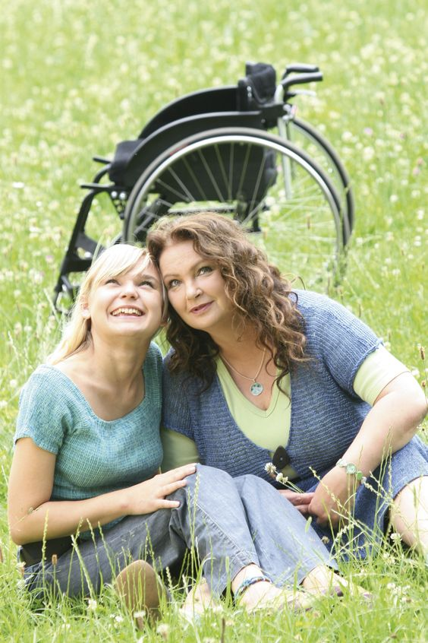
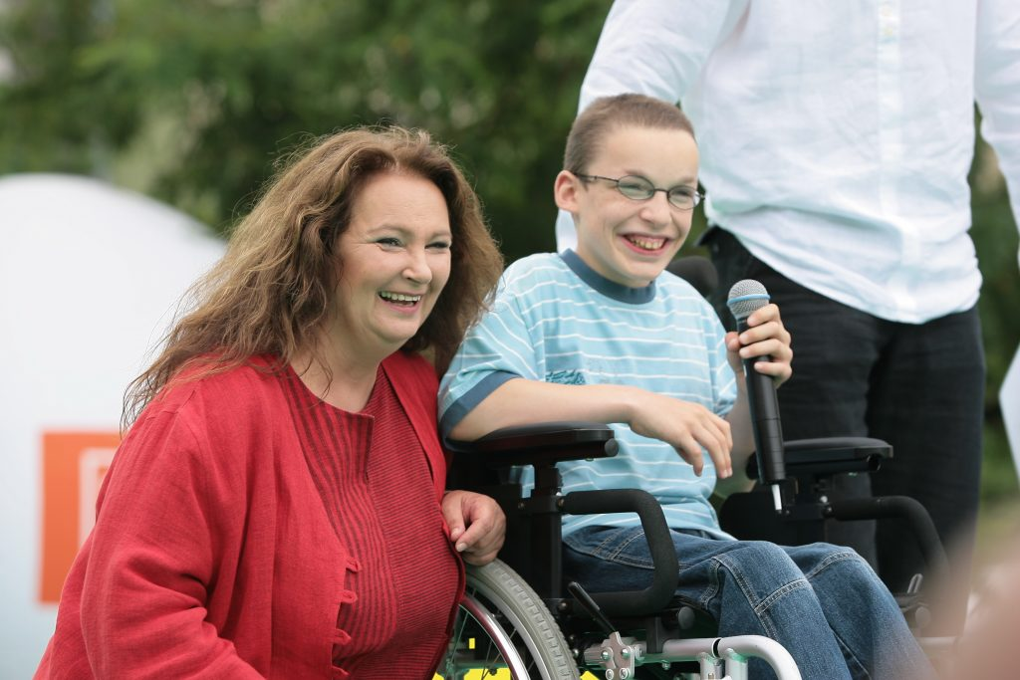
”Only thanks to this I dared to approach people who are dramatically experienced by fate. I am learning to understand their suffering, somehow tame them and help them live.”
- says Anna Dymna.

Slide 6
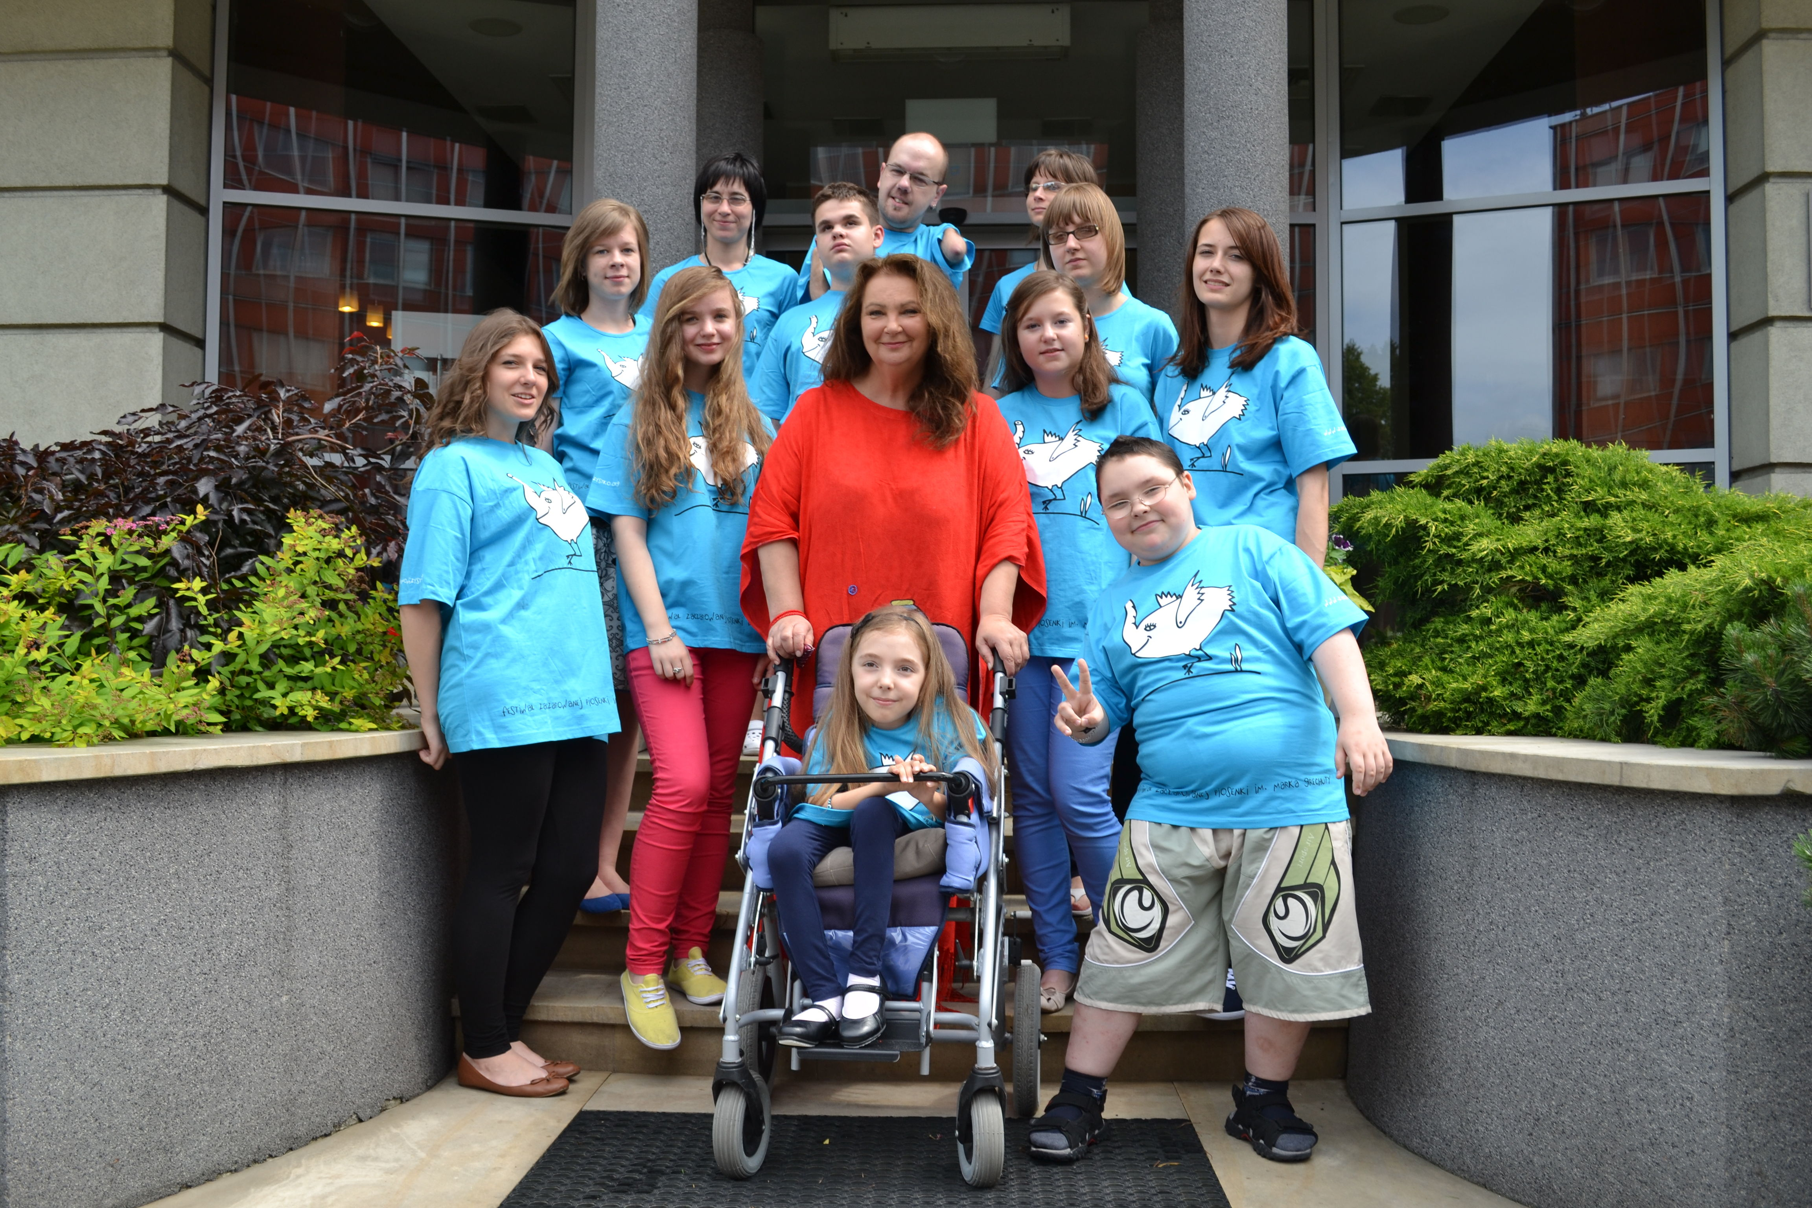
Charity Work
Anna Dymna has been involved in charity projects for many years.
In 1999 she started co-operation with the St. Brother Albert Foundation organizing charity performancesand therapies for the disabled.

Slide 7
Albertiana - Festival for the handicapped
In 2001 she originated the "Albertiana" -
National Festival of Theatre and Musical Works of Disabled Persons,
which continues every year.

Slide 8
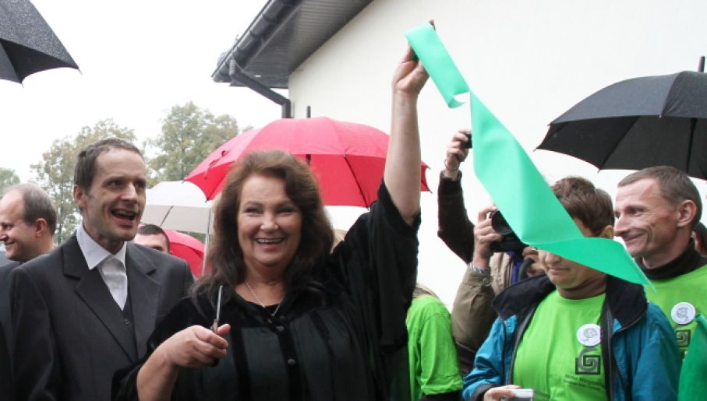
”Sun Valleys”
She raises money to build and open Therapeutic-rehabilitation center for people with intellectual disabilities „Sun Valleys”

Slide 9
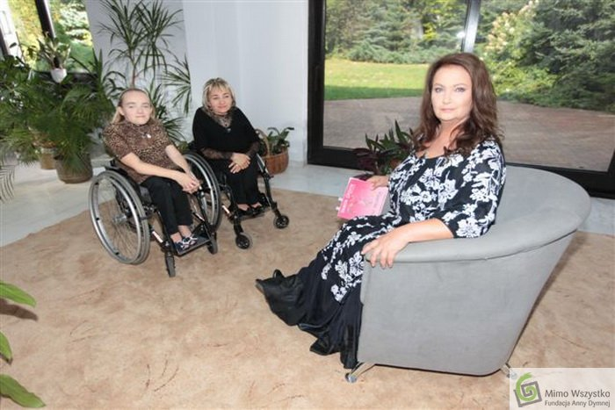
”Let’s meet”
The cyclical program "Anna Dymna – Let’s meet" is broadcast by the Polish Television Program No. 2 since 2003 (European Year of People with Disabilities).
It started at a time when seriously ill and disabled people were placed on the social margin in our country.
The change of that situation and the increase of social awareness should be owing to the form of conversations that Anna is leading to today on the TV channel 2

Slide 10
”Against the odds”
Finally, in 2003 Anna Dymna established her own charity foundation, called "Against the Odds" which aims at improvement in the living conditions of the poor and disabled people.
.

Slide 11
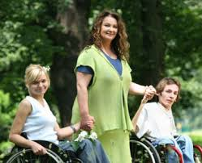
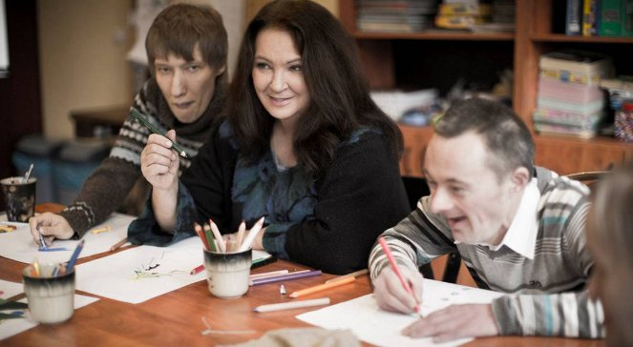
The aim is to be achieved by gradually diminishing mental barriers that exist between the disabled and the healthy citizens of society, as well as by equalising opportunities for them.

Slide 12
Anna was able to sacrifice stardom and dedicate her life for the benefit of the most disadvantaged and vulnerable people. She is just an ordinary woman but at the same time a modern hero who teaches us humanity and compassion.
Why vote for
Anna Dymna?

Slide 13
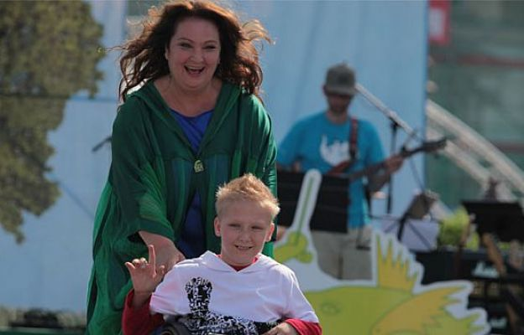
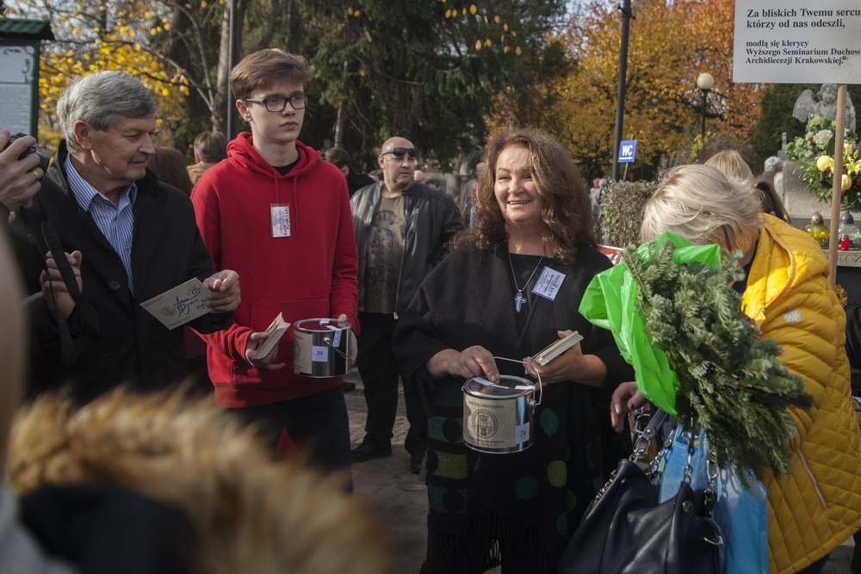
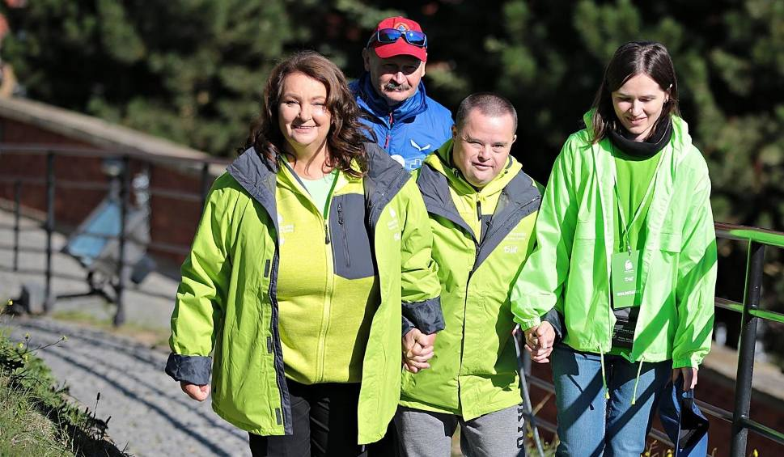
…because Man was created for action, not for deliberation ...!

Slide 14
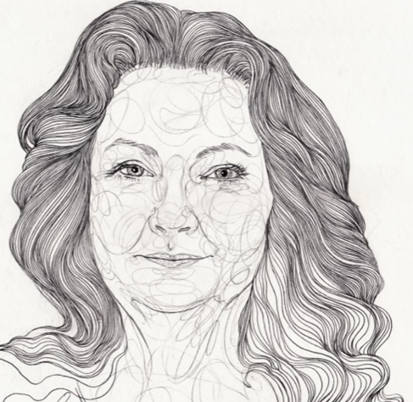
Anna Dymna OUR CANDIDATE FOR MalaLa Prize 2019
Presented by students:
Malwina Pawluk (PL)
Leo Giurca (Ro)
Natan Łuczak (PL)

