Slide 1
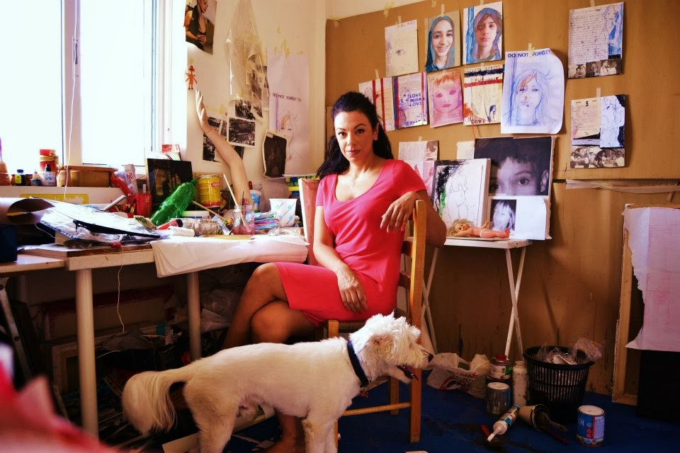
5th Lyceum of Thessaloniki, Greece
ELENI KARAGIANNI
March, 2019

Slide 2
HER STUDIES:
5th Lyceum of Thessaloniki, Greece
She studied freehand drawing (1990-1992) at the lab of the artist Nikos Stefos.
She graduated School of Fine Arts (1992-1997) having a degree at drawing, mixed techniques, engraving, history of art and pedagogy.
At 2008 she finished her postgraduate studies at the Humanitarian Studies School learning about the development of the child in the social environment and about cultural and social inequalities
March, 2019

Slide 3
LECTURES:
5th Lyceum of Thessaloniki, Greece
The latest years she participates as a lecturer in educational seminars and conferences proposing new ideas of visual arts in schools
e.g. The art as an implement of claiming human rights in the school community, education in refugees and art e.t.c.
March, 2019

Slide 4
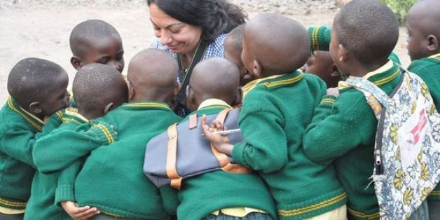
RESEARCH PROJECTS:
5th Lyceum of Thessaloniki, Greece
2014 – A mission in Rwanda – a European project: SENDMYFRIENDTOSCHOOL
This project was coordinated from Greece through Action Aid Hellas
2016 – Participation in “Facing the street – Digital story telling” which was coordinated by APIS Institute in Ljubljana, Slovenia
2016 – Took part in the work group of IncludU (educational program for pupils and teachers in principals of inclusion, which was coordinated by the University of Piraeus).
March, 2019

Slide 5
CULTURAL EVENTS – PROJECTS:
5th Lyceum of Thessaloniki, Greece
She organized art projects such as “Childhood art Project”, where 24 artists speak about their childhood in various cultural centers like “Mitera Foundation”, “Melina Mercouri”.
The last few years she organizes festivals of art and acceptance, at schools where she works as a teacher, which are open to the community.
March, 2019

Slide 6
ACTIVITIES:
5th Lyceum of Thessaloniki, Greece
Foundational member and chairman of the non-profitable organization: Network of Art and Action (People with Balloons).
This organization promotes the empowerment of vulnerable groups of people (refugees, sex workers, HIV positive people) via art and offers connection between the educational community and the modern social needs.
More here: http://balloonartpeople.blogspot.gr/p/blog-page_5.html
March, 2019

Slide 7
5th Lyceum of Thessaloniki, Greece
Students: Zoi-Aliki Filippopoulou
Chrysa Perti
Melina Rizoudi
Eva Spatala
Efi Veniamin
Teachers: Nikos Katsaras
Antonia Paraschiakou
March, 2019

