Slide 1
WELCOME TO TARGOVISTE
About Targoviste - presentation, information, photos and main attractions

Slide 2
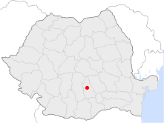
Location
The old fortress, Targoviste is located in central-southern part of Romania on a high terrace of 260m above the valley Ialomita, the boundary between the High Plains region and the Carpathian foothills of Targoviste, Dambovita River that includes the interfluve between the Ialomita river and to contact with "plain ramble, low and monotonous, being an extension of the hilly plains. Plain uniformity is taken from the Romanian Plain, Targoviste is located in the hilly its part of the Ialomita High piedmont plain, and Subcarpathian Hills neighborhood.

Slide 3
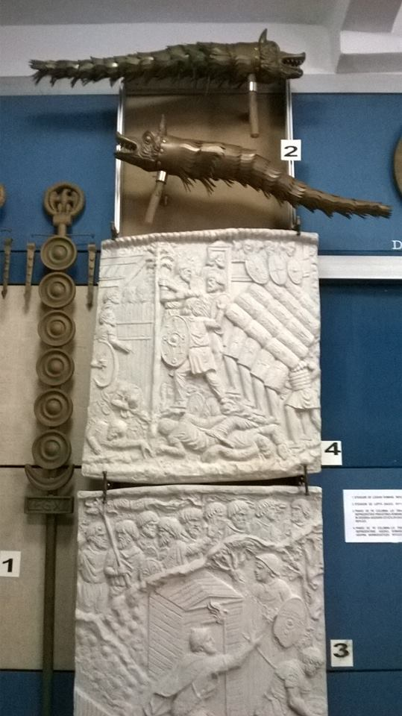
SOME HISTORICAL FACTS
The first mention of the city, 1396, is made by Johann Schiltberger Bavarian crusader who visited the city during the preparations for the battle of Nicopolis.

Slide 4
History
During the reign of Mircea the Old City became the main
royal residence of the Romanian Country. Also during this
ruler was restored Royal Court, whose ruins surround the
Chindia Tower today, the latest archaeological research has
advanced the idea that a court has been built here before
Mircea the Old. The first official act of 1406, the monastery
is written on paper Tismana of "Io. Mircea Basarab I, Prince
of the Romanian Country, Duke of Fagaras and Almas,
committing Severin, the despot and ruler of the earth's
Dobrotici Darstorului, to their knowledge, both those now
and the future "as its sign treaties of alliance .

Slide 5
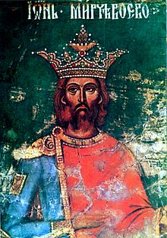
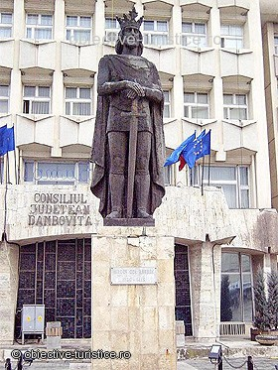
Mircea the Old

Slide 6
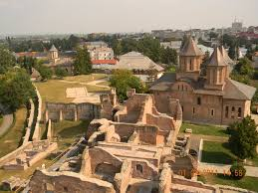
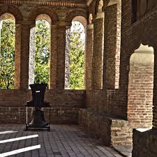
The Royal Court

Slide 7
The capital of Romania
In 1418 Targoviste is certified as a city and capital of the Romanian Country. During this period the city of Targoviste received a privileged status as the most important economic and cultural center of the Romanian Country actually favored by its location at the crossroads of important trade routes.
From 1424 to store the first regulation made by the ruler commercial Dan II, which establishes the local townsfolk customs privileges and rights that they enjoyed in the country. From 1451 dates the first collection of laws made by the grammar Dragomir, on orders from Prince Vladislav II. Vlad Tepes ascend the throne in 1456 with the support of his friends John Hunyadi and Stefan cel Mare and enrolled in history to win in 1462 against the Sultan Mehmet II, conqueror of Constantinople. During and Chindia Tower was built.

Slide 8
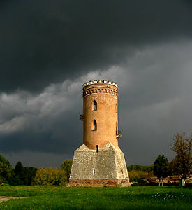
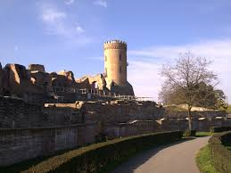
Chindia Tower

Slide 9
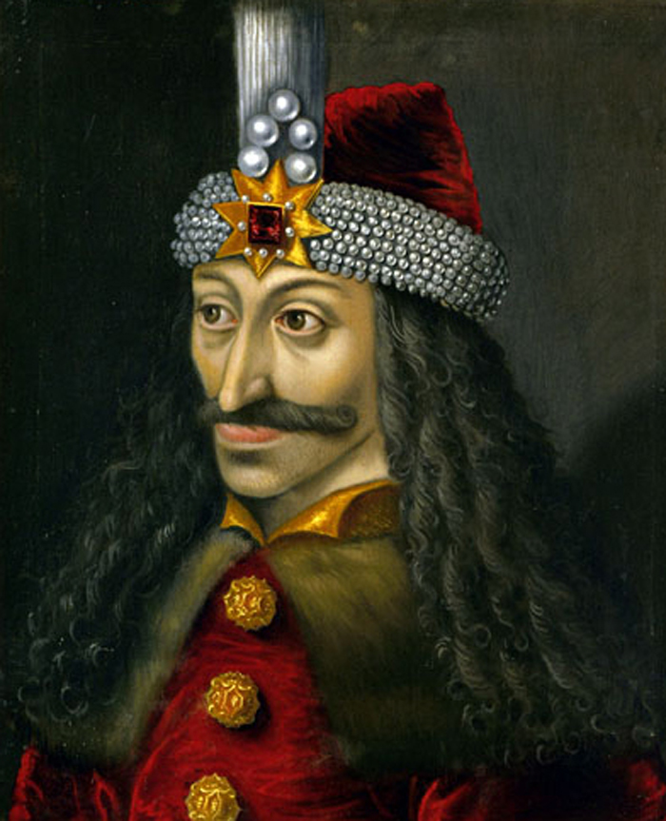
The Real Dracula: Vlad the Impaler
Few names have cast more terror into the human heart than Dracula. The legendary vampire, created by author Bram Stoker in his 1897 novel of the same name, has inspired countless horror movies, television shows and other bloodcurdling tales of vampires.
Though Dracula is a purely fictional creation, Stoker named his infamous character after a real person who happened to have a taste for blood: Vlad III, Prince of Wallachia or — as he is better known — Vlad the Impaler. The morbid nickname is a testament to the Wallachian prince's favorite way of dispensing with his enemies.

Slide 10
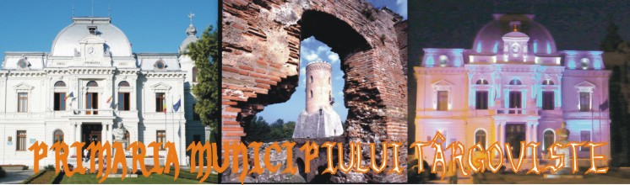
Other main attractions

Slide 11
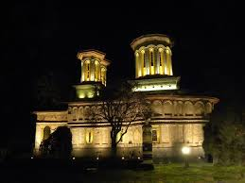
Târgu Church
On Str Alexandru Ioan Cuza is the beautiful, partially frescoed Târgu Church. Dating to 1654, it was painted during the 17th and 18th centuries, but destroyed during an earthquake in 1940. Extensive renovations followed in 1941 and in the 1970s, and were still ongoing at the time of research. The church is especially pretty when lit at night.

Slide 12
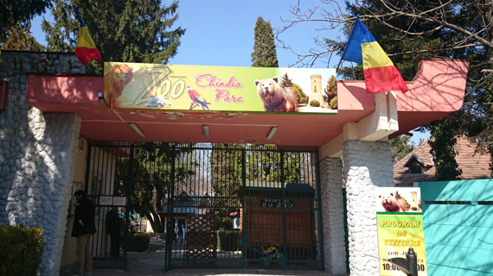
Zoo
Târgovişte's small zoo, in the park just north of the Princely Court, is surprisingly comprehensive, with some large cats, a hippo, lots of chimps and a variety of other animals. The zoo shows obvious signs of wear and tear, but the animals appear adequately cared for. Kids will love how close you can come to the animals.

Slide 13
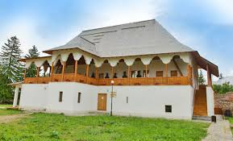
Museum of Printing & Old Romanian Books
Housed in a 17th-century palace built by Constantin Brâncoveanu for his daughter Safta, this museum is filled with original books from the beginning of Romania’s printing age and manuscripts by 17th- and 18th-century Romanian writers.

Slide 14
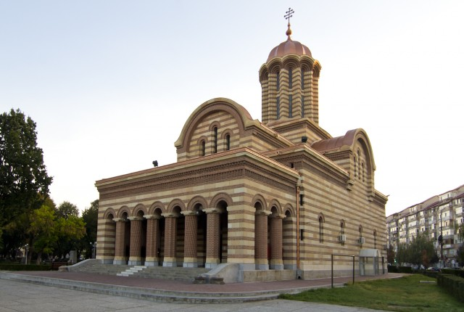
Targoviste Cathedral
Târgovişte's main church occupies a prominent position in the town's central Parcul Mitropoliei. The church is built of red brick in Byzantine style and dates from the early 20th century.

Slide 15
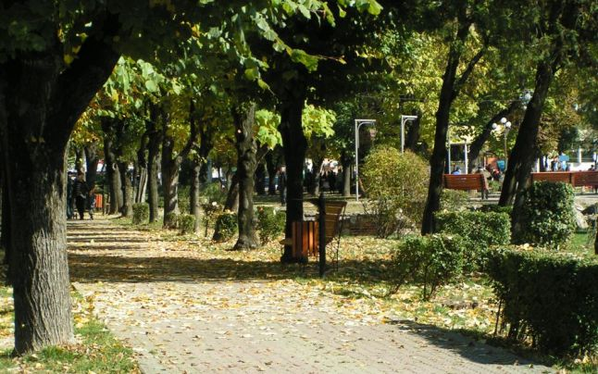
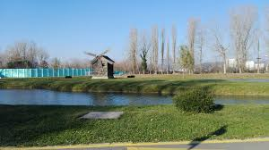
Chindia Park/ Mitropoliei Park

Slide 16
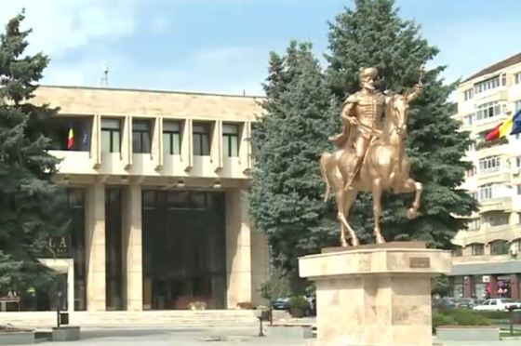
Statue of Mihai Viteazu
A large statue of 16th-century Wallachian Prince Mihai Viteazu marks the western end of the town's central park.

Slide 17
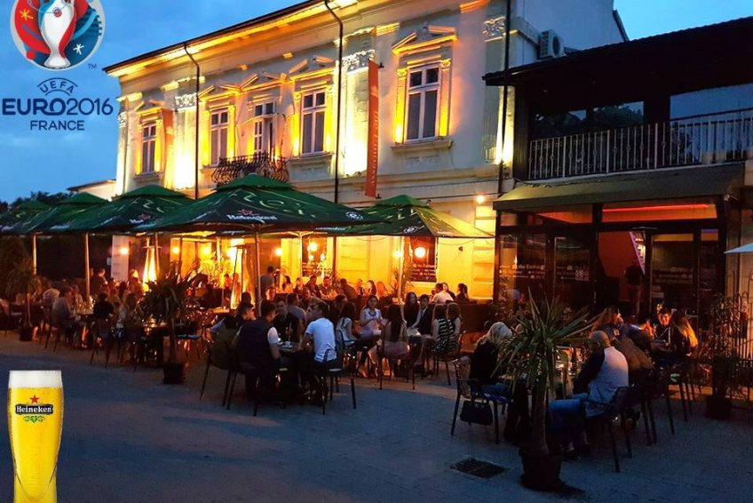
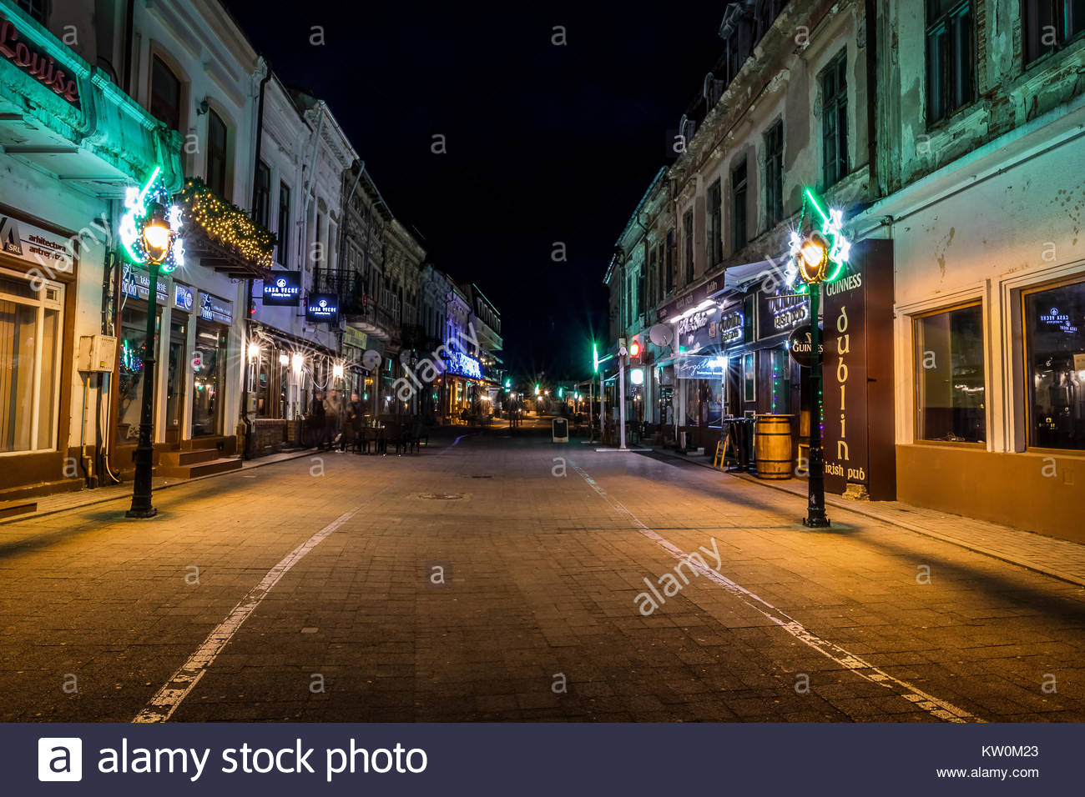
The Old Town

