Slide 1


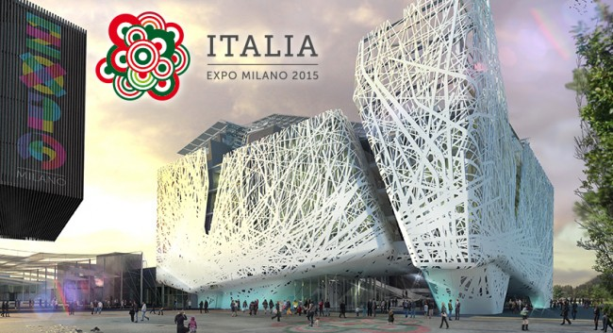
Expo Milano 2015
.

Slide 2
.
The Expo is a universal exposition. Food and energy for the life are the main themes.
The Expo opened on the 1st of May 2015 and it closed on the 31st October 2015.
The 2015 World Expo in Milan covers more than 2.9 square kilometers and contains more than 70 exposition pavilions.
More than 145 countries and 50 international organizations registered to participate in the 2015 Milan Expo.

Slide 3

There are some proposed sub-themes:
Science for Food Safety, Security and Quality.
Technology for Agriculture and Biodiversity.
Dietary Education.
Solidarity and Cooperation on Food.
Food in the World’s Cultures and Ethnic Groups.

Slide 4

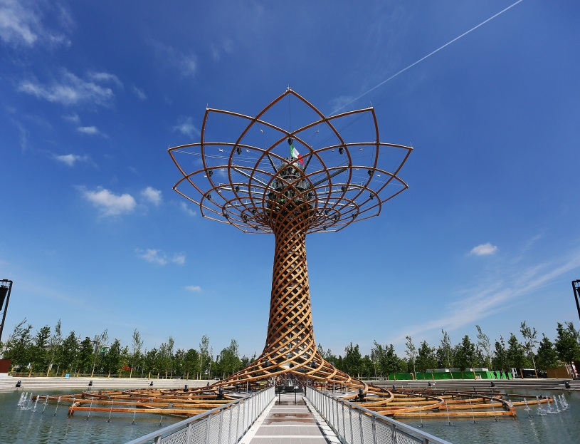
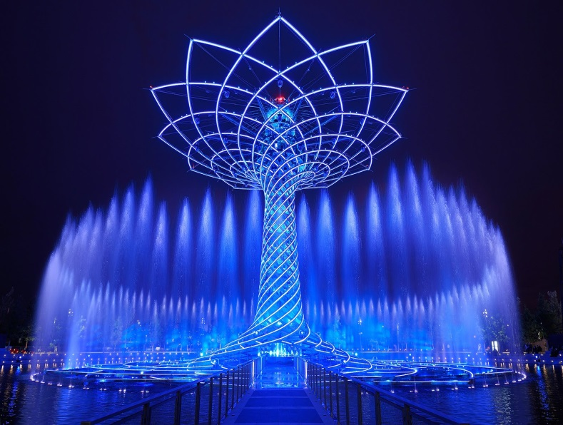

There is a tree of life. It offers a show for people. It is fantastic, fun and beautiul to watch and listen to!!!!

Slide 5

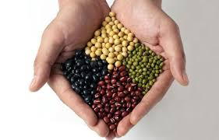

We think that the Expo is a occasion for meeting the culture of the world.

Slide 6





