Slide 1
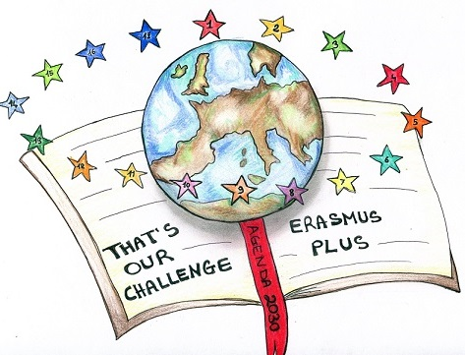
ERASMUS + PROJECT «AGENDA 2030: THAT’S OUR CHALLENGE» ECOAUDIT
ALAQUAS -SPAIN - 2/9 MARCH 2019

Slide 3
1.CONSUMPTION AND SOCIAL RESPONSABILITY
Four actions:
Seminar
Survey
Led Diplay
4. Preparation of Spicy Salt

Slide 4
1.CONSUMPTION AND SOCIAL RESPONSABILITY
Seminar
«LET’S START OUR
ECOAUDIT CAMPAIGN»

Slide 5
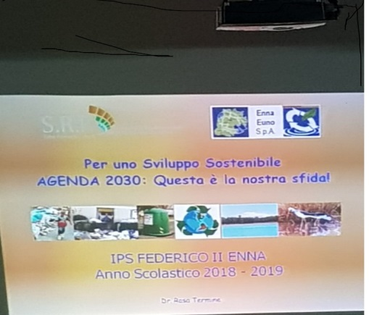
On Monday 17th December we started our activities for the Ecoaudit campaign with a seminar. The expert Rosa Termine focused our attention on the concept of Sustainable Development and on some goals of Agenda 2030, Goal 12 "Responsible Consumption and Production", Goal 11 " Sustainable Cities and Communities" and Goal 13 "Climate actions". The expert invited us to engage ourselves in recycling, reducing our consumption of water, electricity and gas and using sustainable means of transport.
This is a video realized on that occasion:
https://youtu.be/HM4na99R5qI

Slide 6
CONSUMPTION AND SOCIAL RESPONSABILITY
Survey on the six points of the Ecoaudit Campaign and the students’habits

Slide 7
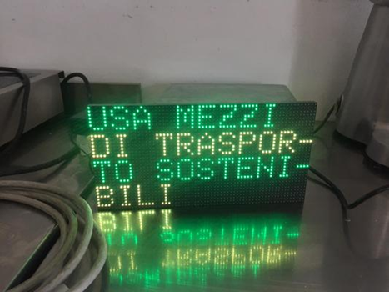
CONSUMPTION AND SOCIAL RESPONSABILITY
Dissemination and promotion of the Ecoaudit campaign by means of a LED DISPLAY

Slide 8
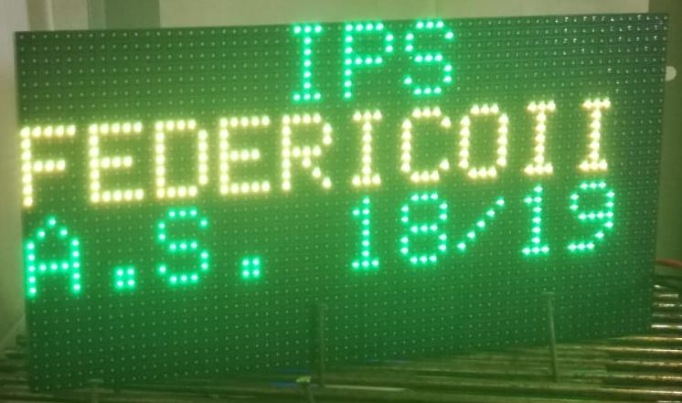
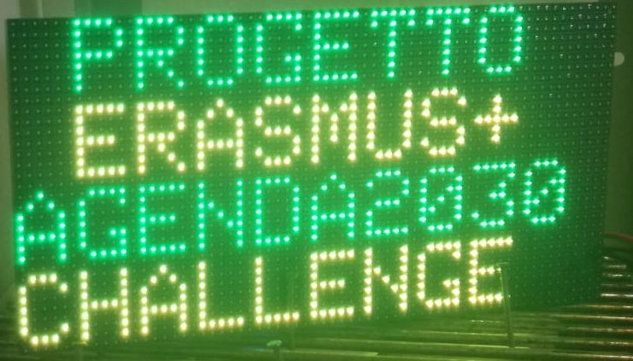
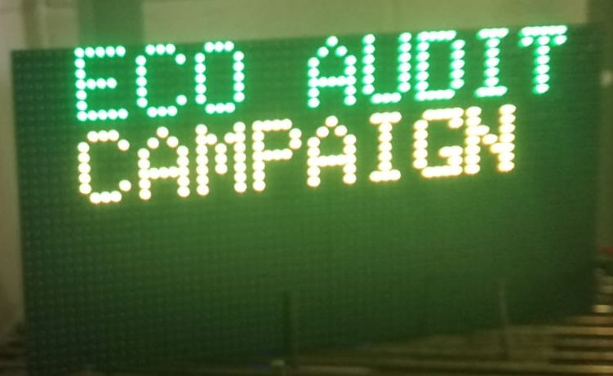
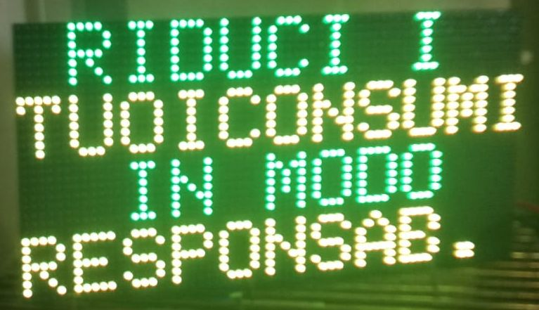
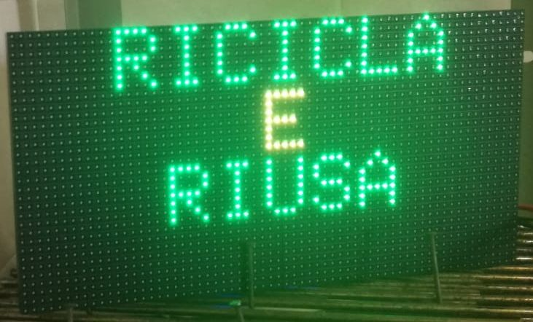
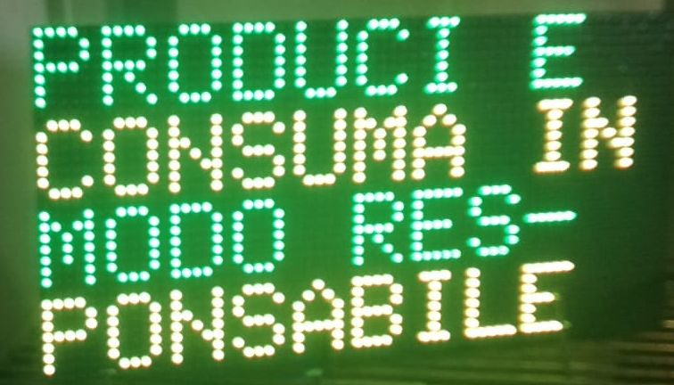
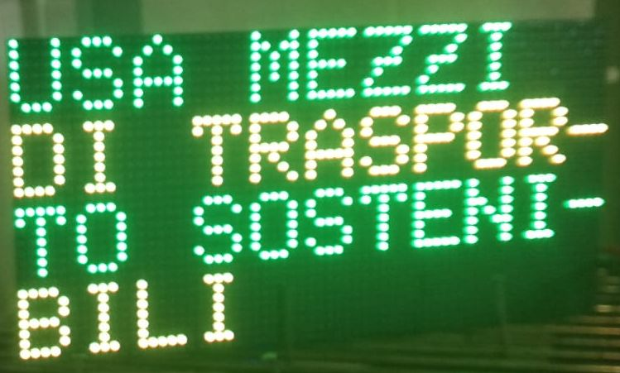
CONSUMPTION AND SOCIAL RESPONSABILITY

Slide 9
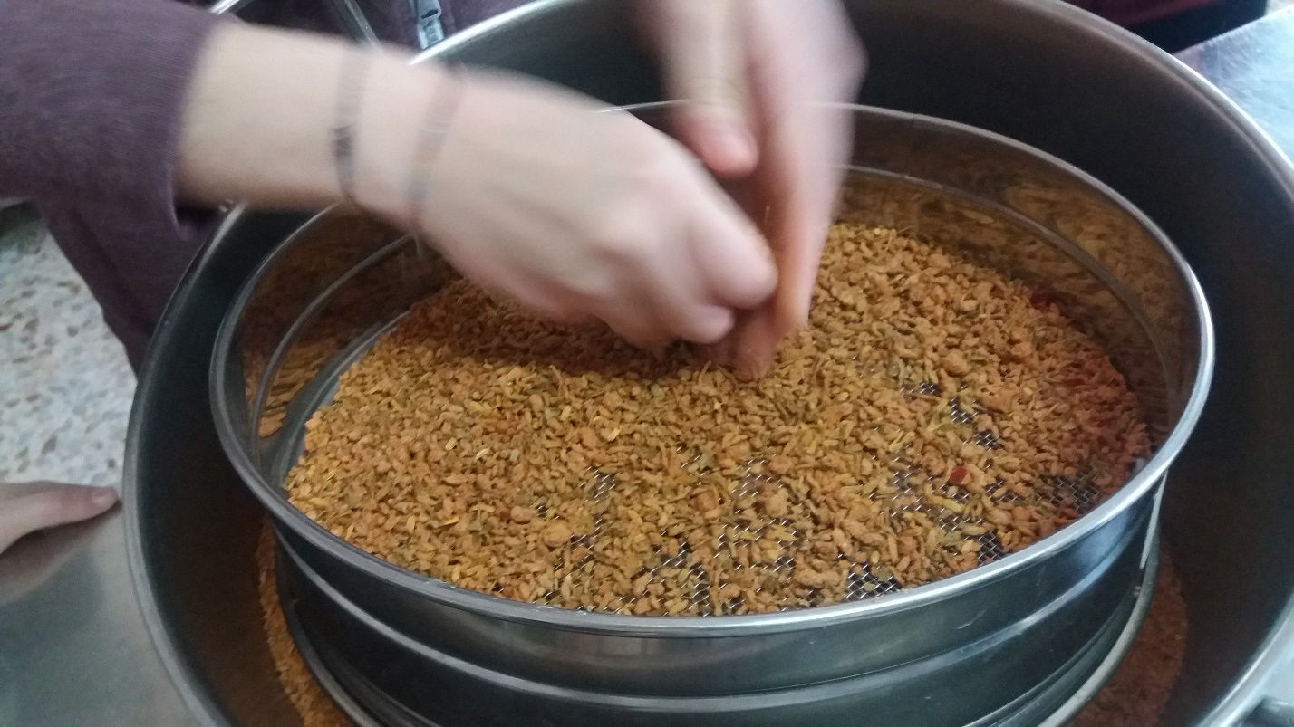
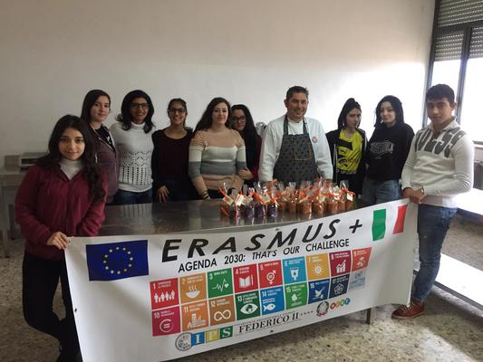
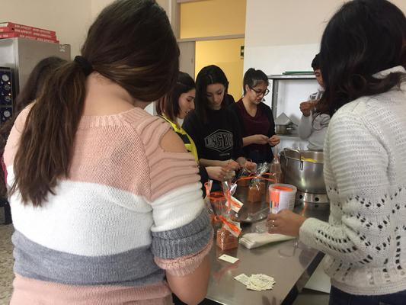
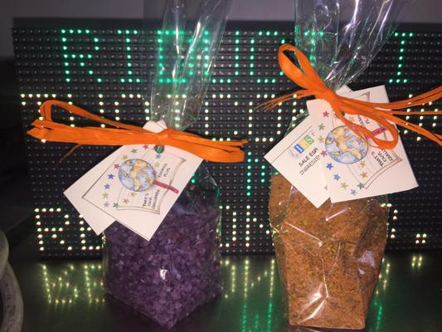
CONSUMPTION AND SOCIAL RESPONSABILITY
Preparation of Spicy salt

Slide 10
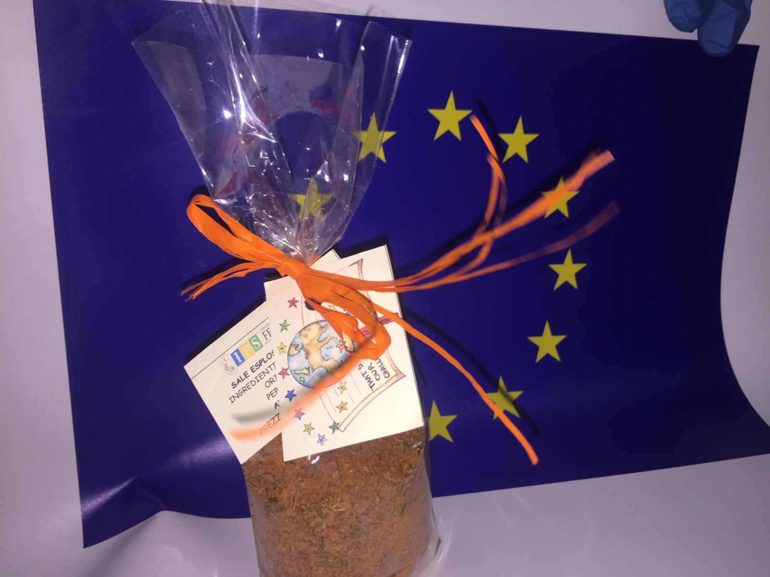
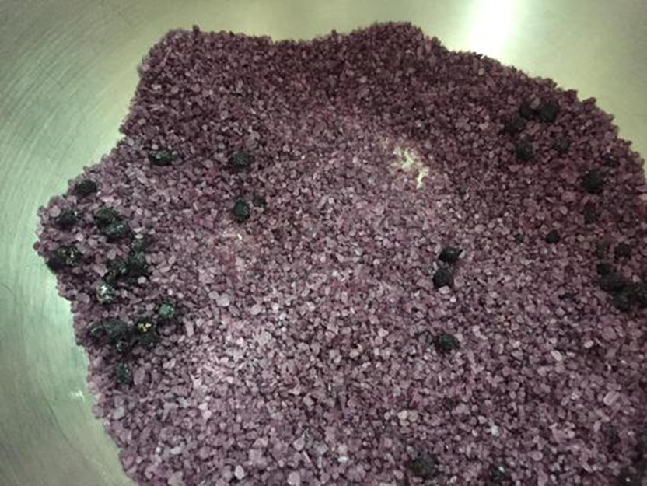
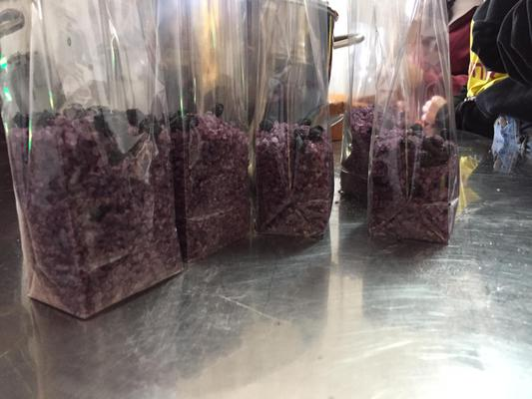
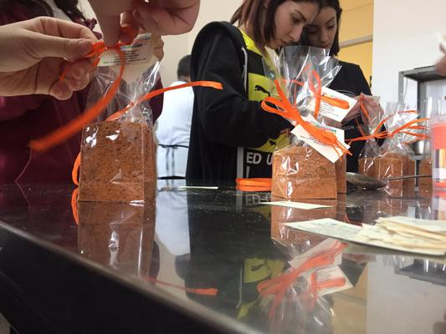
CONSUMPTION AND SOCIAL RESPONSABILITY
Preparation of the Spicy salt with organic herbs

Slide 11
2. ELECTRICITY
A MOTION SENSOR HAS BEEN PUT IN A SCHOOL BATHROOM
TO REDUCE THE CONSUMPTION OF ELECTRICITY

Slide 12
3. MOBILITY
We understood how to reduce our carbon footprint through CARSHARING
AND MORE SUSTAINABLE
MEANS OF TRANSPORT

Slide 13
4. NOISE
Our teachers asked us to reflect upon our use of headphones and to turn down the volume for our health

Slide 14
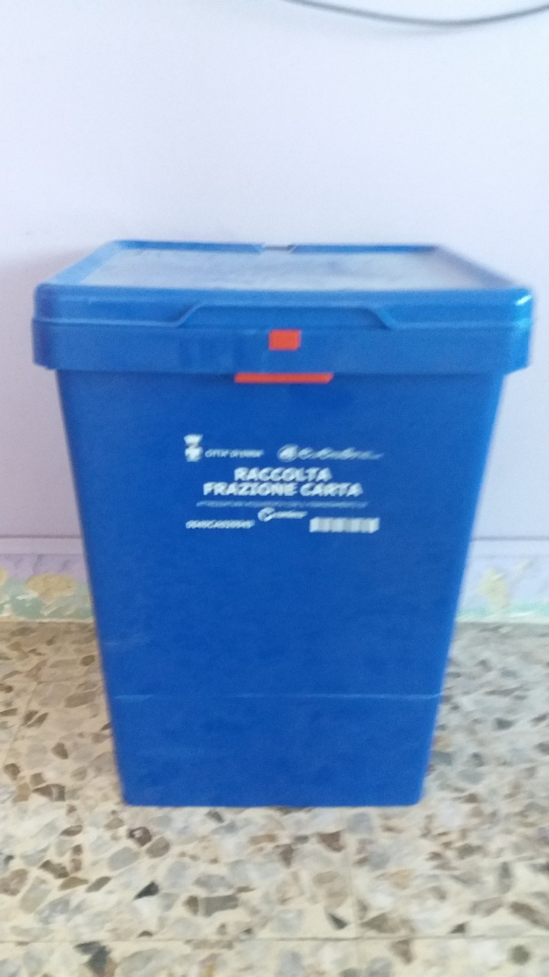
5. RECYCLING
Three actions:
PAPER BINS in each class and
ouside the school entrance
2. Action on «PACKAGING AND REUSE OF FOOD WASTE»
3. The day of superfluous and recycling

Slide 15
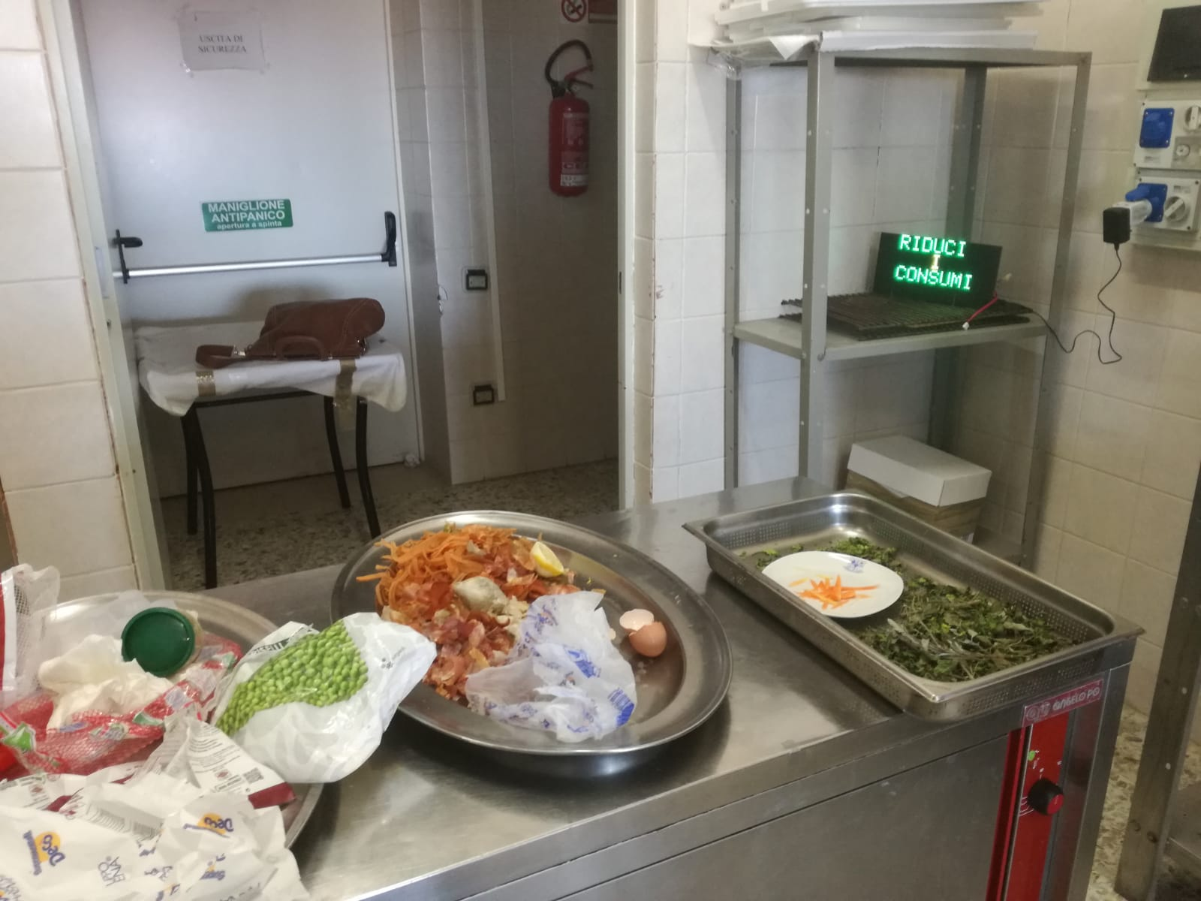
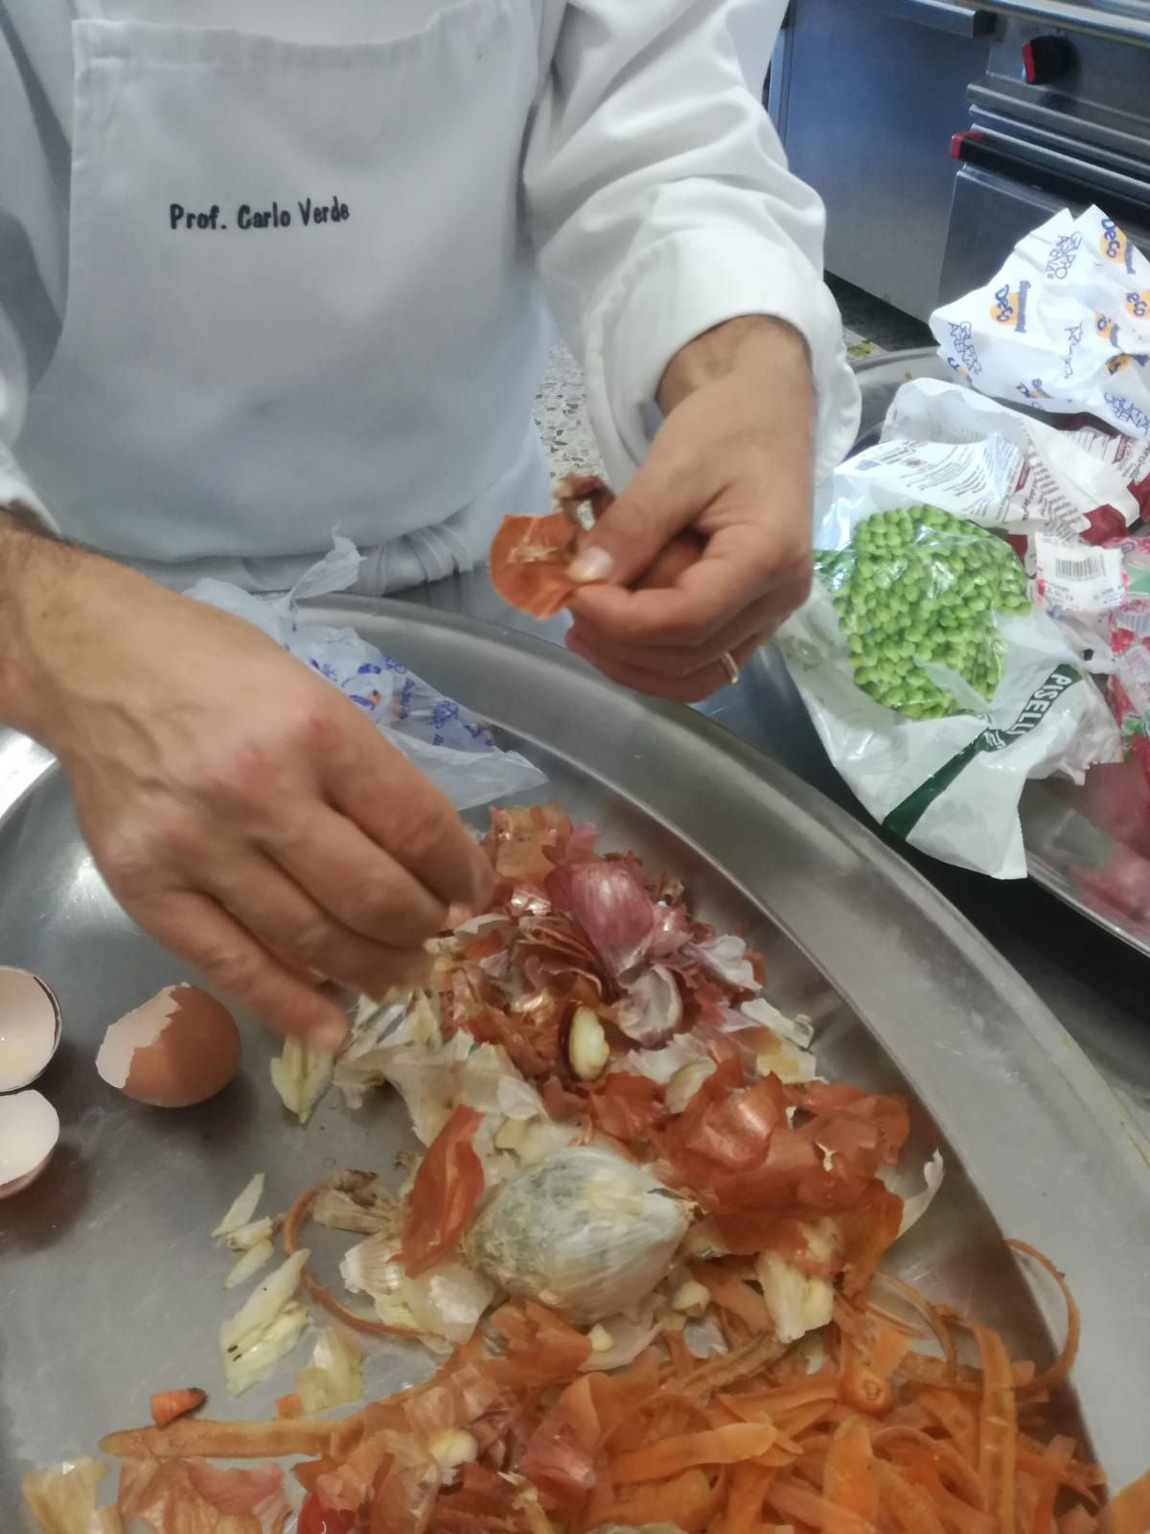
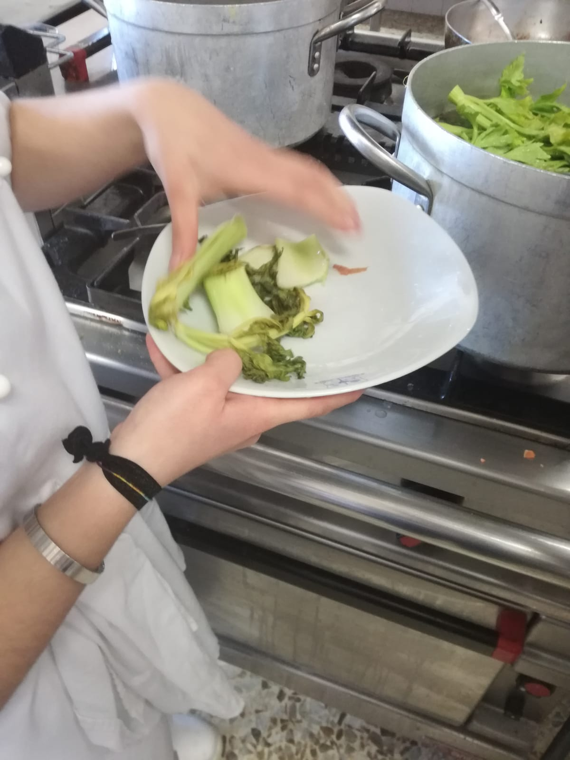
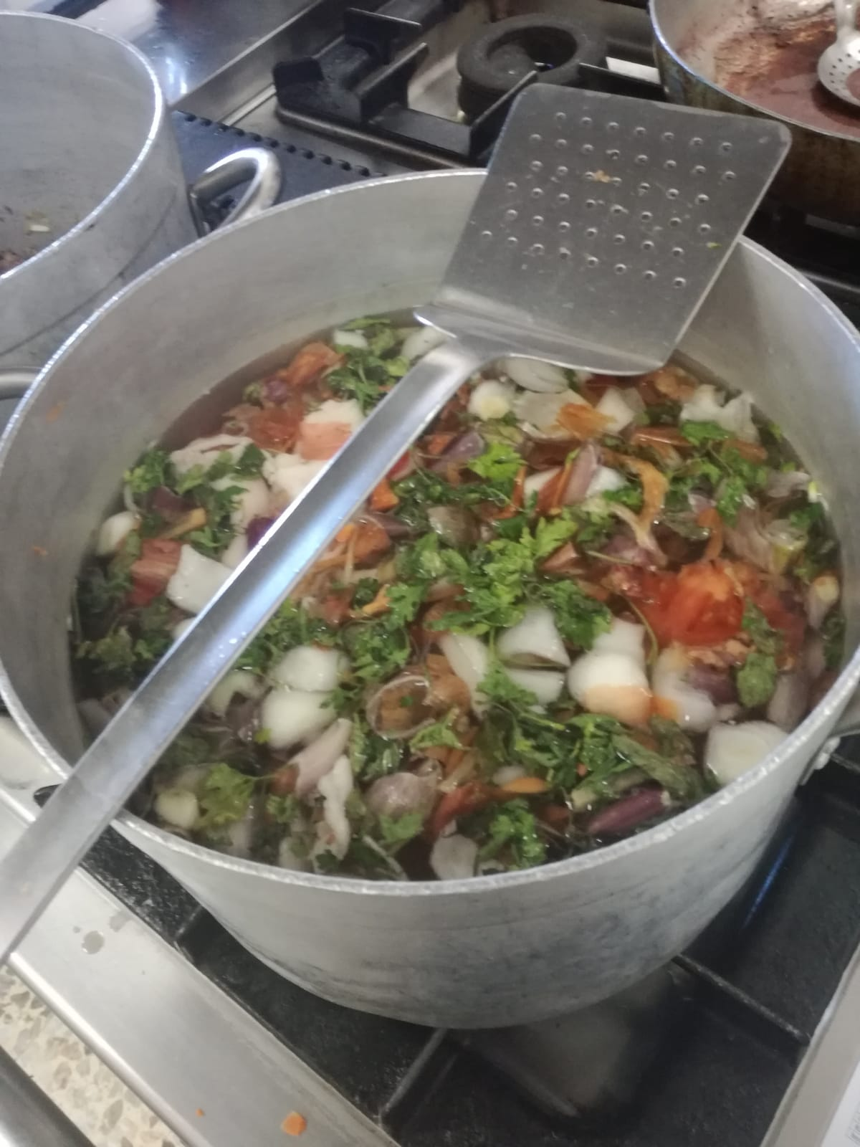
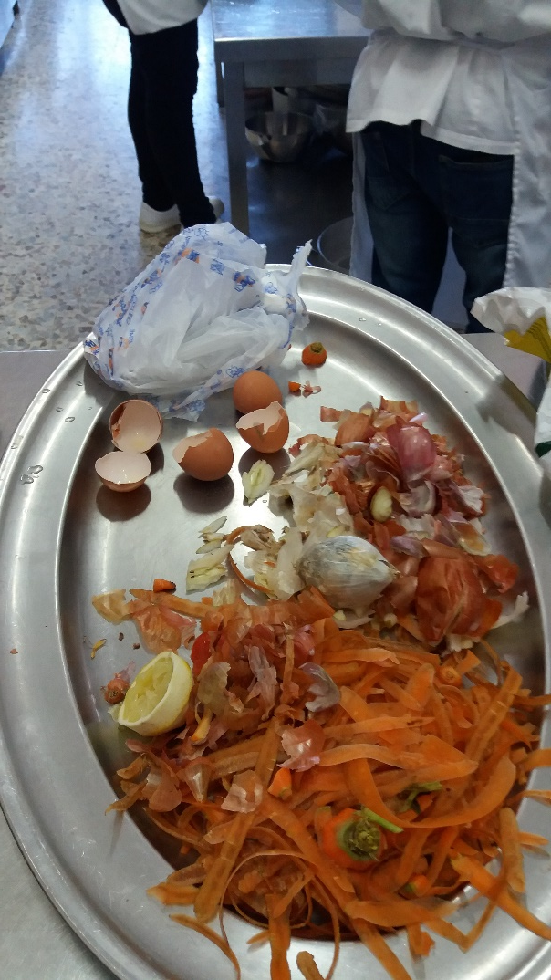
5. RECYCLING
We must pay attention to
packaging and learn to reuse food wastes

Slide 16
5. RECYCLING
3. The day of superfluous and recycling:
we collected a lot of objects we have at home which are TOTALLY USELESS AND SUPERFLUOUS and we tried to see if they could be useful for others.

Slide 17
6. WATER
Three actions:
Visit to the wastewater treatment plant
Seminar on the «Blue Gold»
Visit to the «Natural Special Reservation of Lake Pergusa»

Slide 18
6. WATER
VISIT TO THE WASTEWATER TREATMENT PLANT

Slide 19
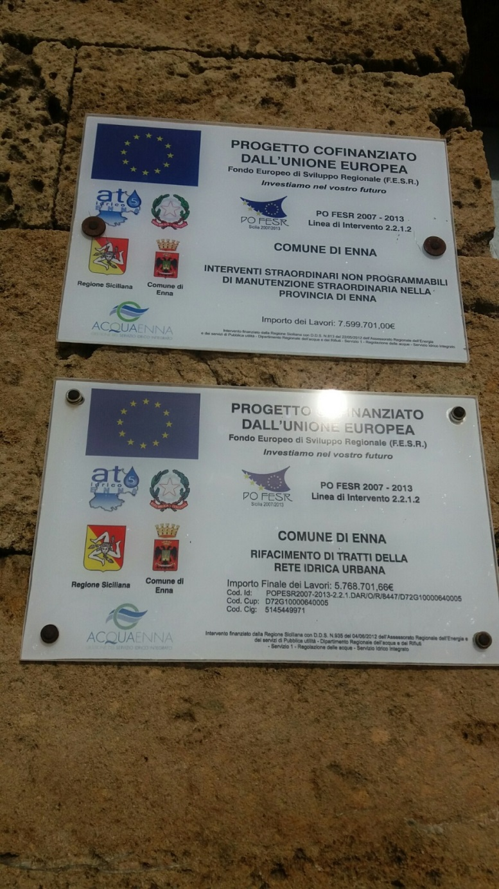
To better understand the cycle of water we went to visit the Wastewater Treatment Plant of the city of Enna

Slide 20
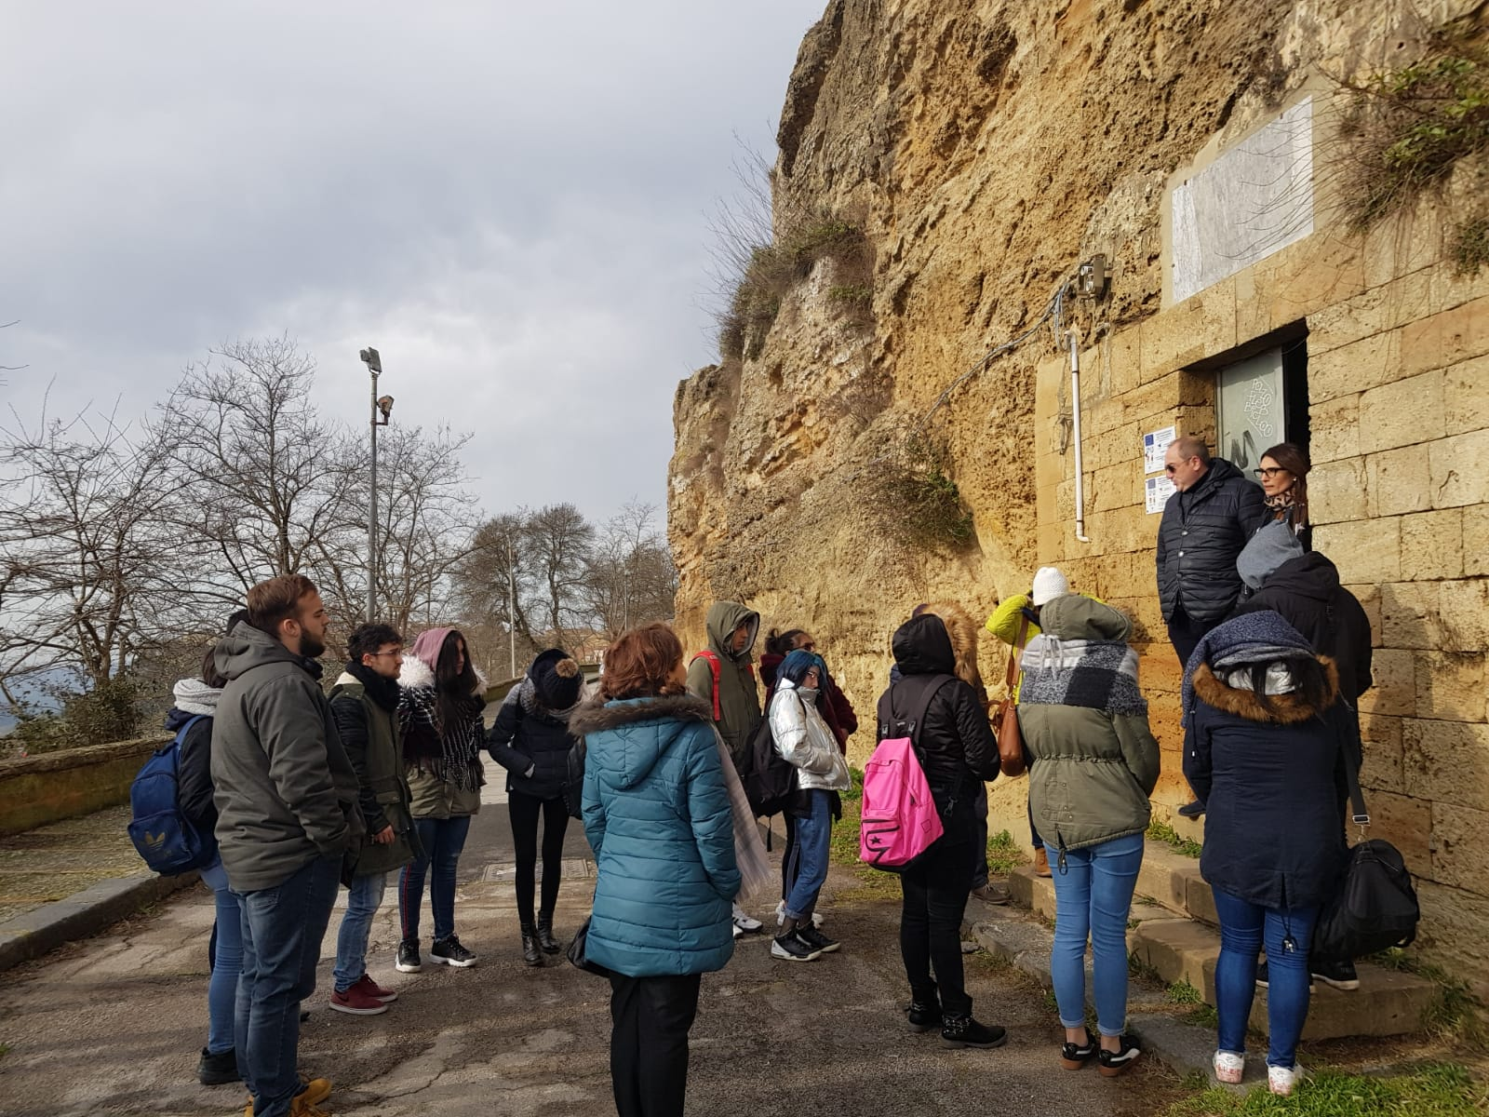
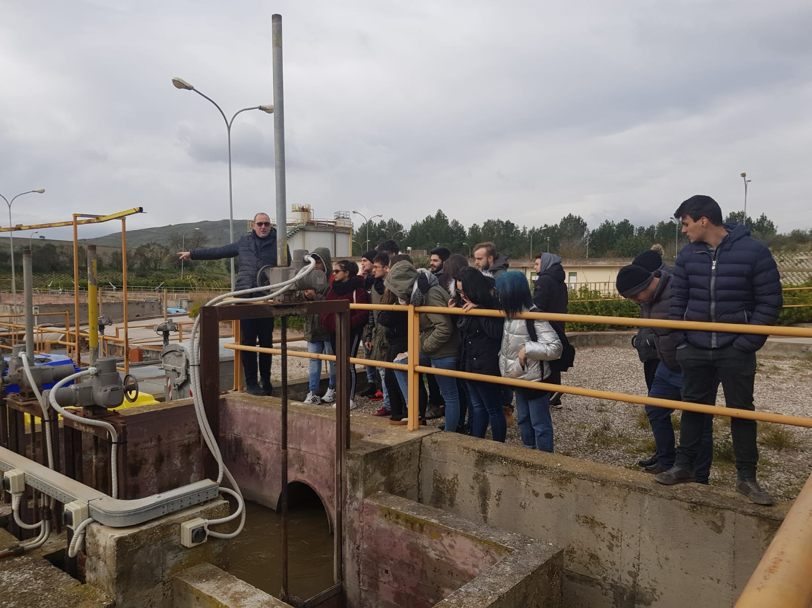
A curiosity: some big tanks were created under the Castle of Enna, being the highest part of the city, from where the water is distributed to the city still today

Slide 21
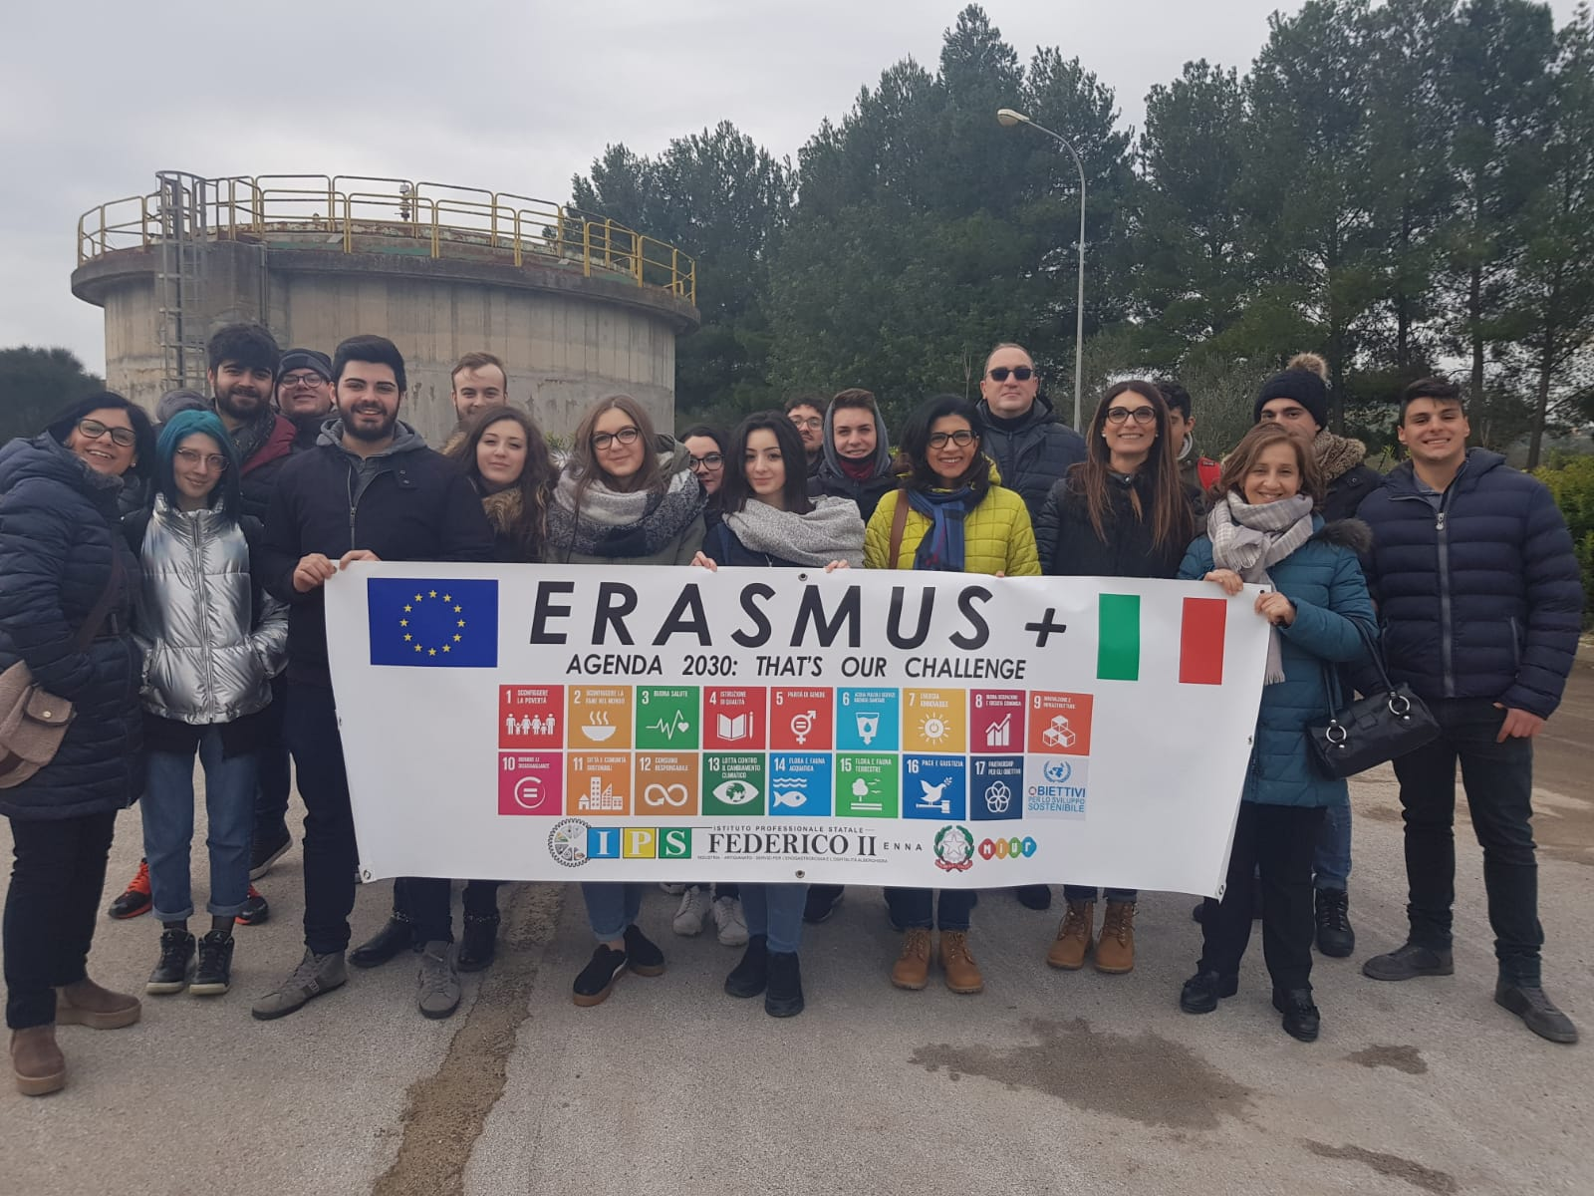
A lot of work has been done to renew the plant and new projects have been presented to complete and extend it in a short time

Slide 22
6. WATER
Visit to the «Special Nature Reserve of Lake Pergusa»

Slide 23
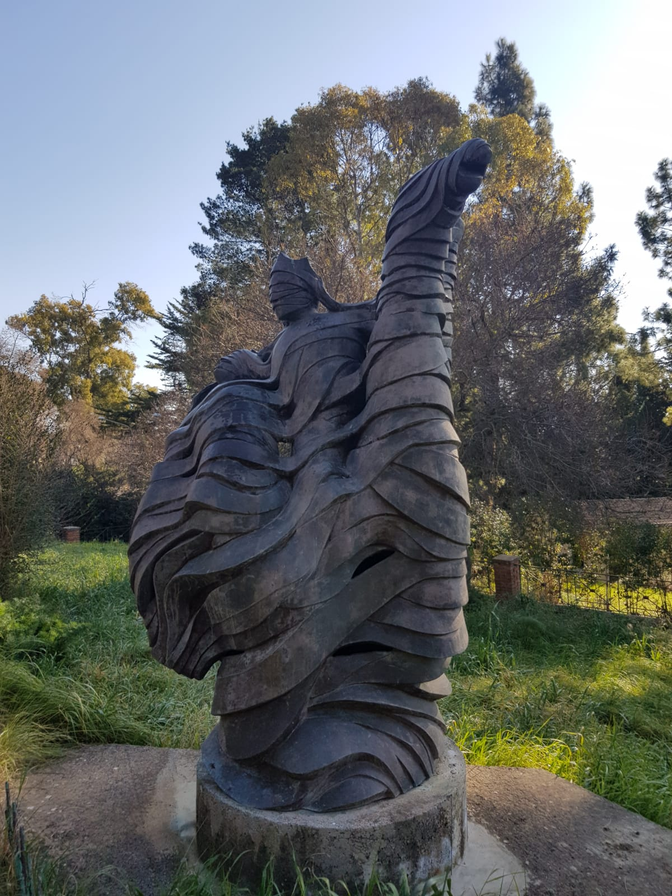
Lake Pergusa,
the myth of Proserpina’s rape and the cycle of seasons

Slide 24
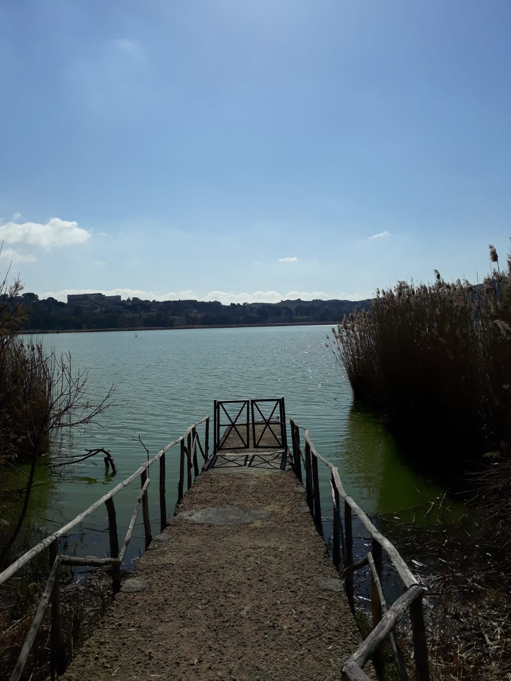
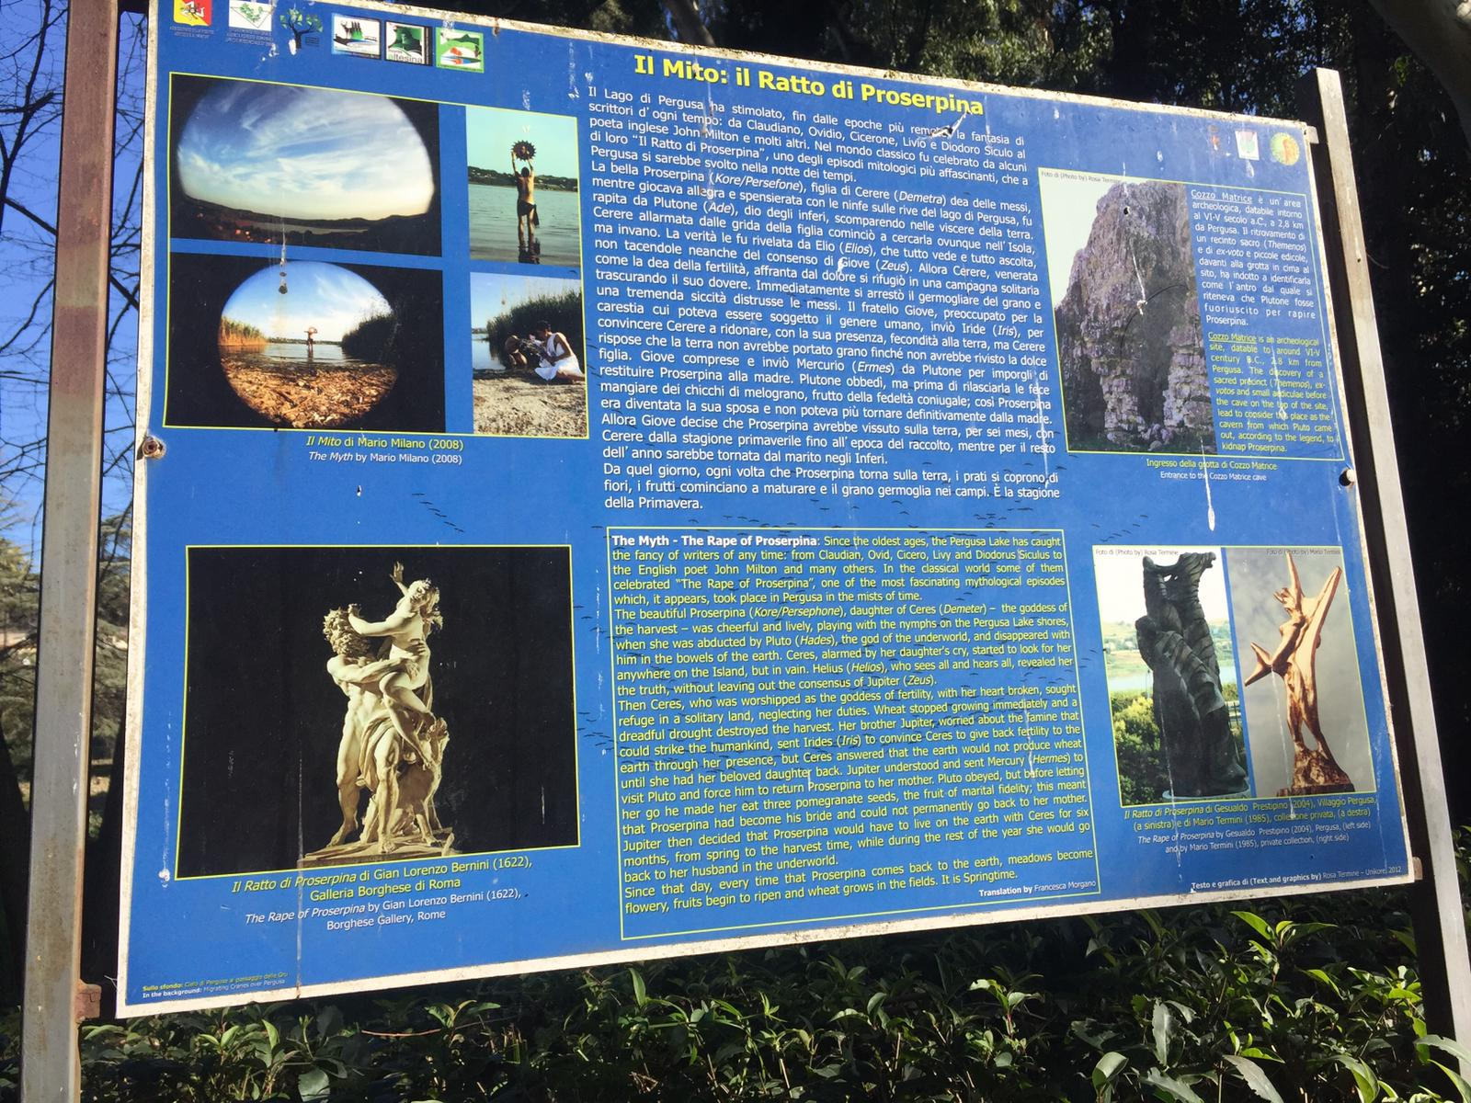
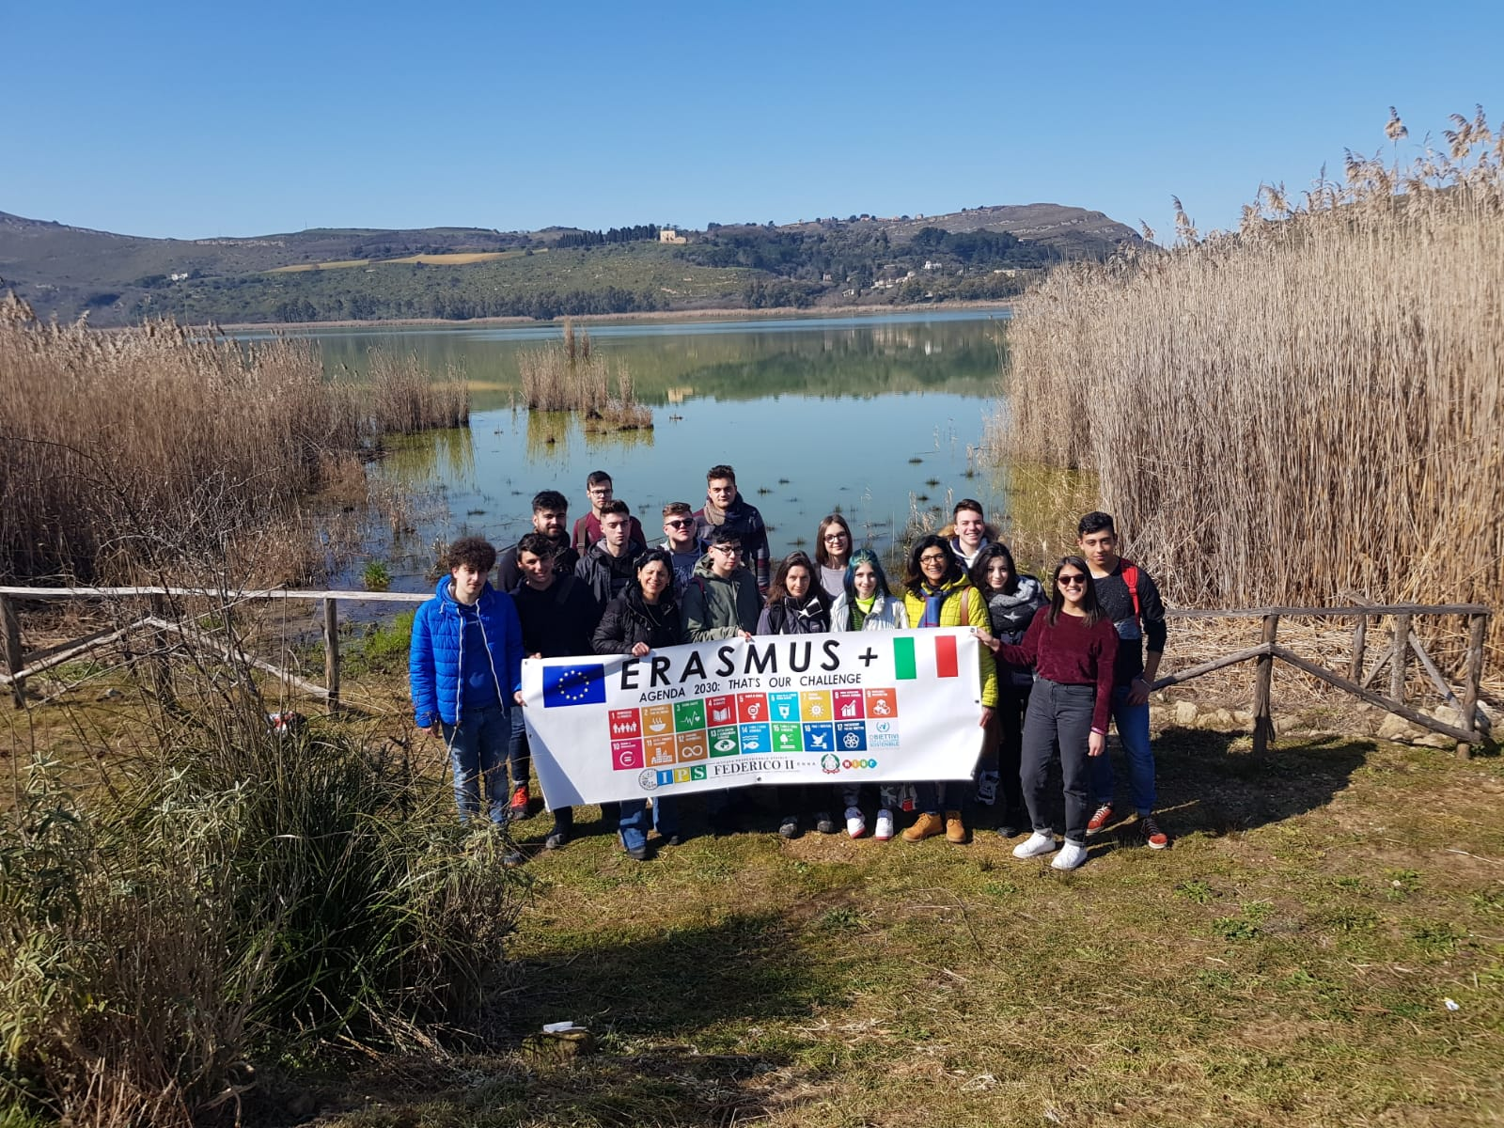
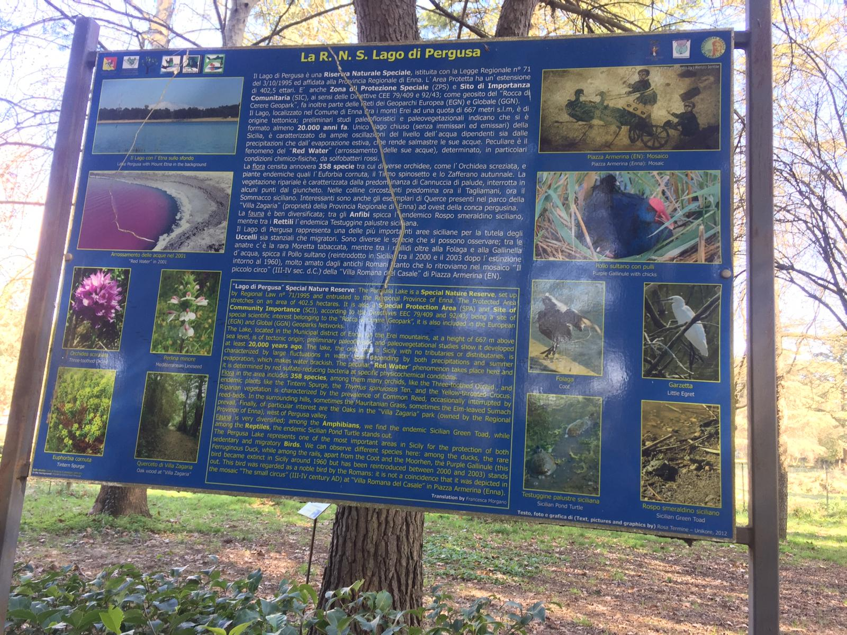
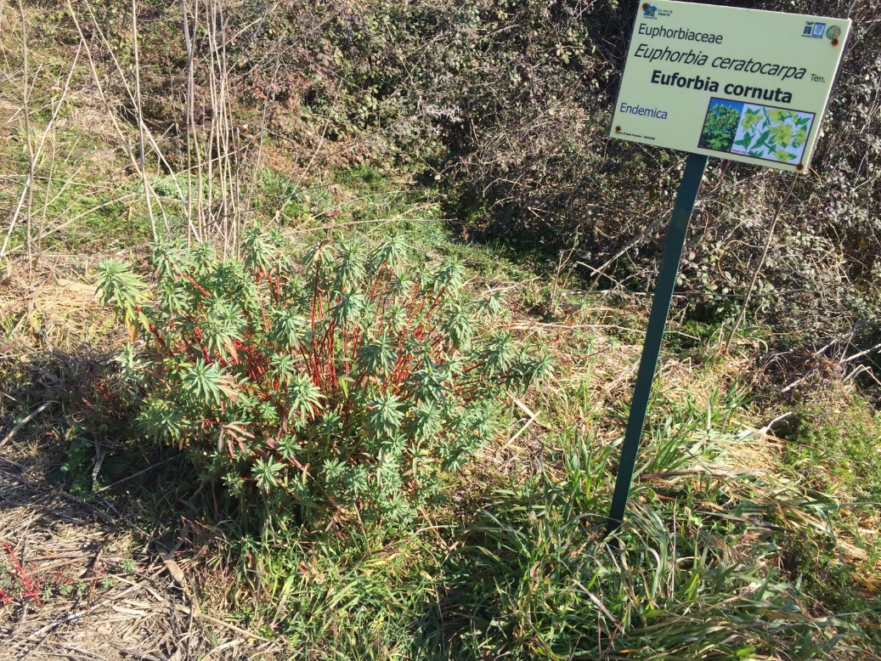
Lake Pergusa, we learnt about its flora and fauna, risks and
opportunities

Slide 25
ERASMUS STUDENTS
Limam Dhia
Incudine Gaia
Bevilacqua Daniela
La Malfa Luca
Failla Martina
Pergola Chiara
Giunta Elisa
ERASMUS STUDENTS
Ruszel Andrea
Fagarasan Claudia
Savoca Francesca
Nicotra Gabriele
Licata Adam
Schillaci Giorgio
Sanfilippo Sonia
TEACHERS
Concetta Maddalena
Giuseppa Dell'Aera
Francesco Paolo Tirrito
Lucia Pampallona
Rossella Trovato
Silvia Salerno
Di Venti Tiziana
Manuela Parlato
Armeli Gricio Martina
Serra Giada
Miano Elisea
Pagana Silvia Pia
CLASS
III B ENO
V B MAT
V A ENO
Baldini Francesca
Nobile Maria Concetta
Taibi Giovanna

