Slide 1
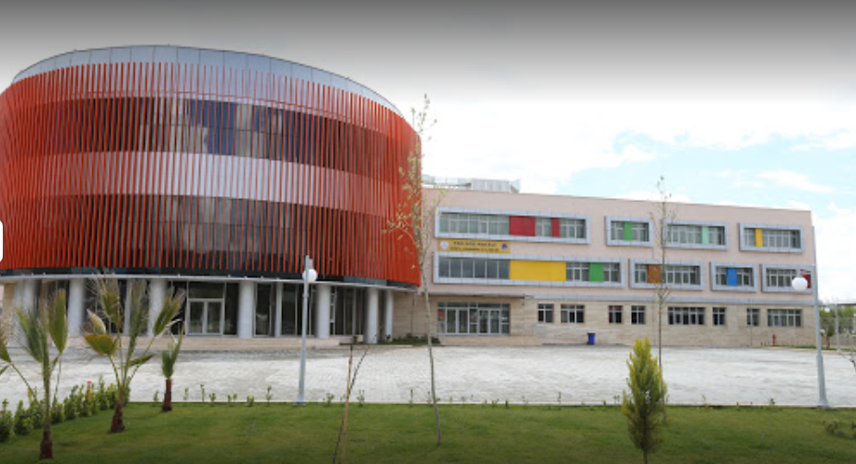
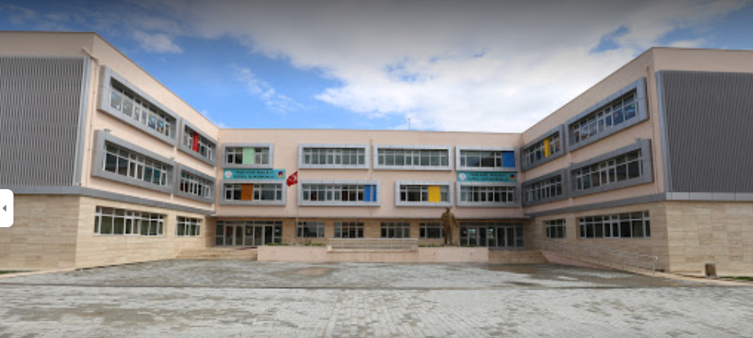
TED EGE COLLEGE

Slide 3
OUR UNITS
Media
Television
Family, Children, TV
Radio
Newspapers and Magazines
Internet

Slide 10
INTERVIEW

Slide 11
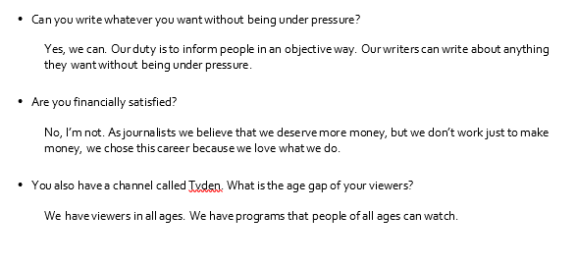
INTERVIEW

