Slide 1
TED EGE COLLEGE
National strategies against the media addiction among students

Slide 2
WHAT IS SOCIAL MEDIA ?

Slide 4
Possitive effects of social media

Slide 5
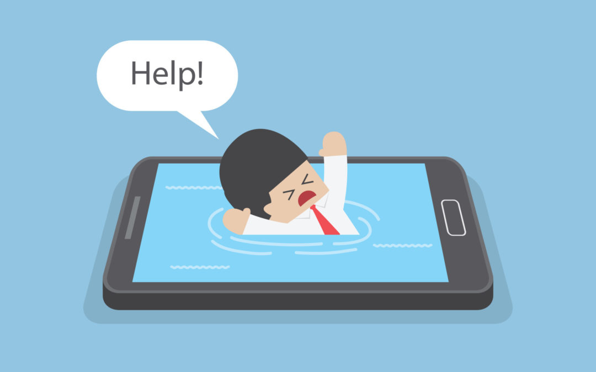
Negative effects of social media

Slide 6
Media addiction among students
Internet technology today shows a quick progress, and social networks increase their number of users on each day.
Especially young people show an intense interest in social media which is an extension of the Internet technology. Social media addiction is increasing both in Turkey and all around the world.
The scale has three factors including addiction, ethics and convergence, and it is a reliable and valid scale, as the reliability and validity of the scale had been tested. The study is conducted on 271 students between the ages of 13-19.

Slide 7
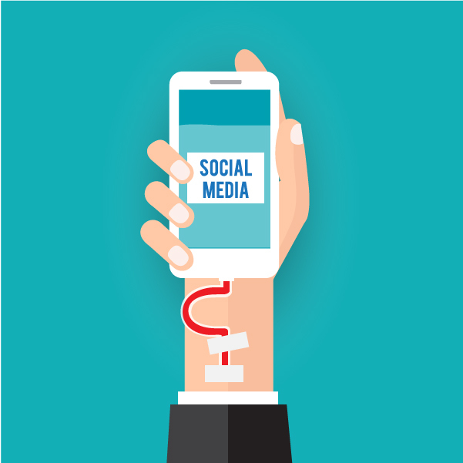
STRATEGIES ON MEDIA ADDICTION IN TURKEY
The works in Turkey for the treatment of social media and internet addiction in young people are coordinated by four different authorities. These are MEB (Ministry of National Education), RTUK (The Radio and Television Supreme Council), BTK (Information and Communication Technologies Authority) and Health Services.

Slide 8
WORKS ON MEDIA ADDICTION IN TURKEY
Schools in the west of the country offer the course, and it consists of eight units covering communication, media, television, radio, newspapers, magazines, and finally the Internet during the year.(MEB)
It informs children and individuals separately about all kinds of risks that may be encountered due to the increased internet use in recent days.(RTUK)
In Turkey, internet and social media addiction treatment is administered in Psychiatry, Child Psychiatry and Mental Health and Diseases departments of the hospitals. In addition, some private hospitals, psychologists and counseling centers provide treatment processes for internet and social medial addiction. (Health Services)

