Slide 1
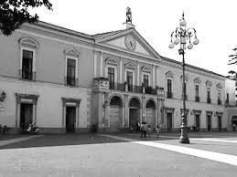
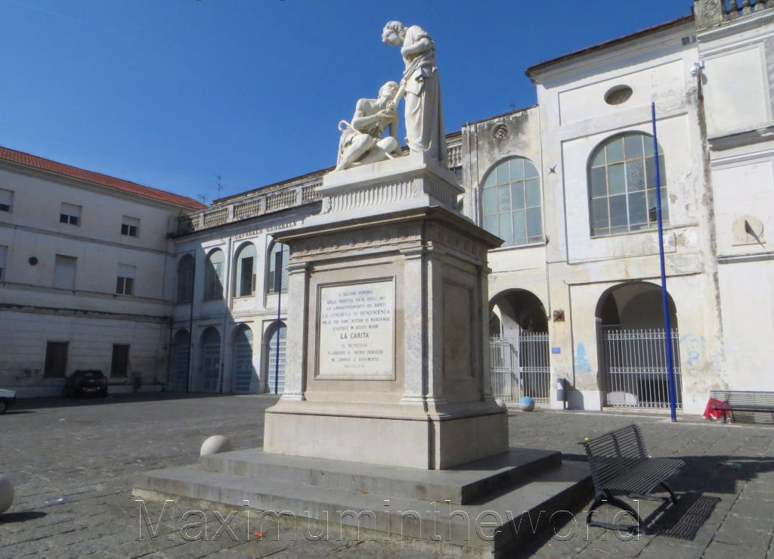
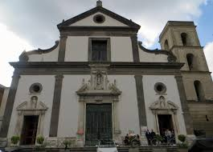
MARCIANISE
Monuments

Slide 2
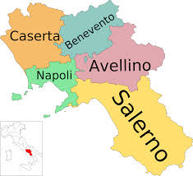
Marcianise, Campania, south Italy
Coat of arms of the town and Campania Map

Slide 3
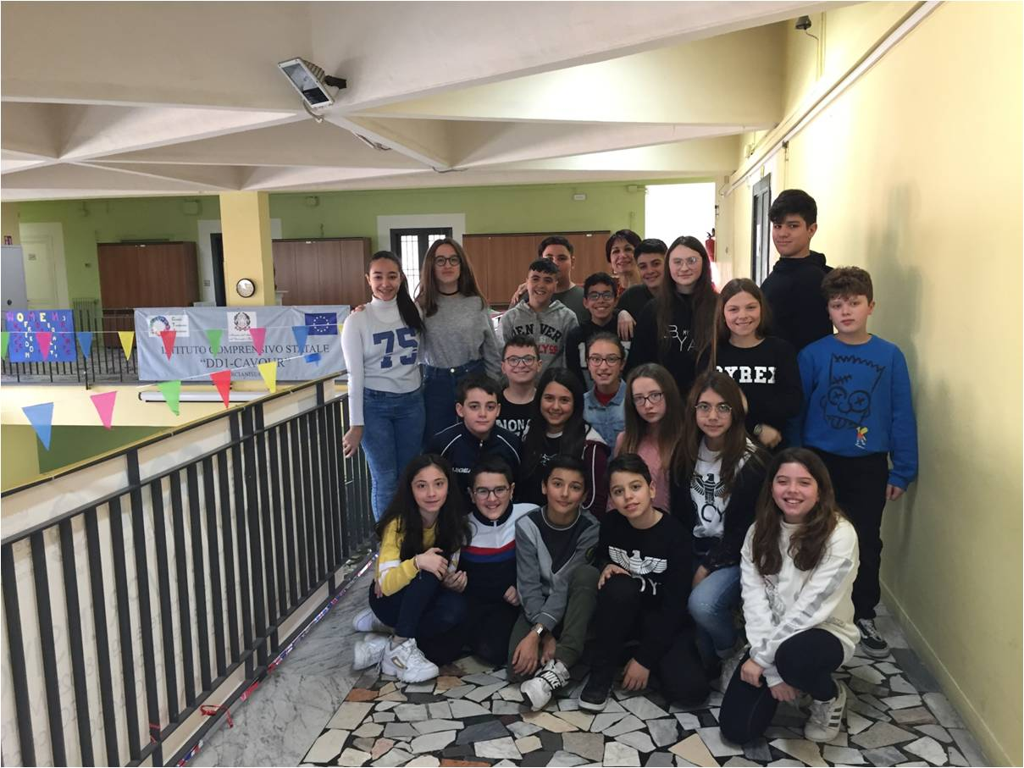
ICS «DD1-Cavour School» Marcianise 1B students

Slide 4
