Slide 1
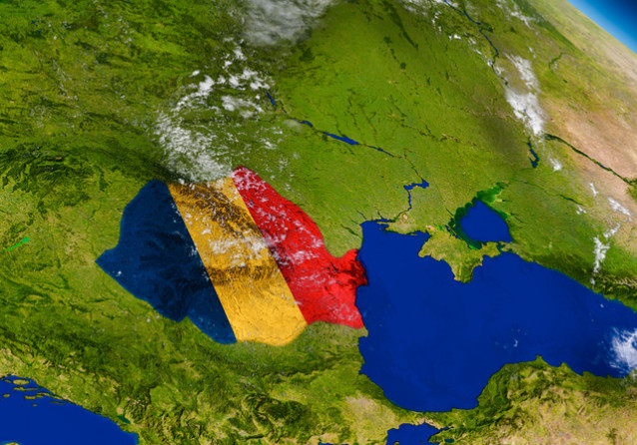
GAMES FOR ACTIVE LEARNING
2019-1-RO01-KA229-063665_1
2019 - 2021
MY COUNTRY, MY CITY, MY SCHOOL
“Elena Cuza” National College

Slide 2
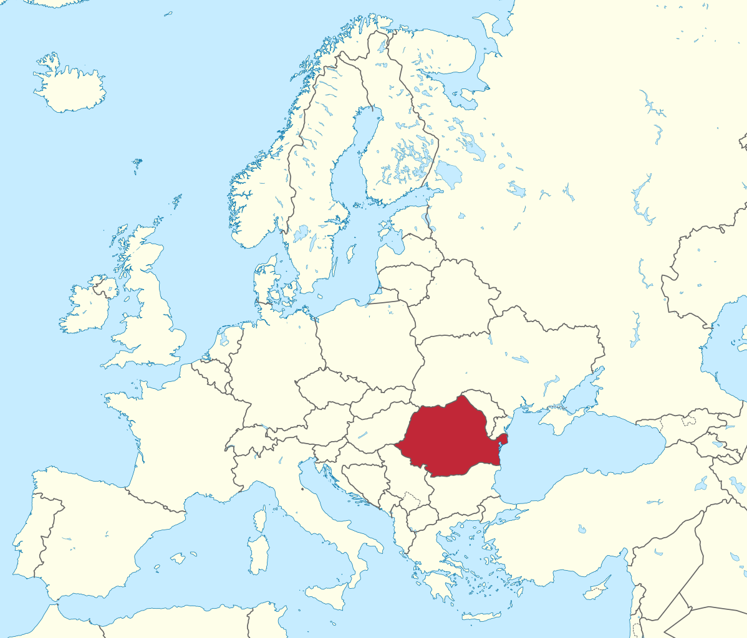
Romania is a country located at the crossroads of Central, Eastern, and Southeastern Europe.

Slide 3
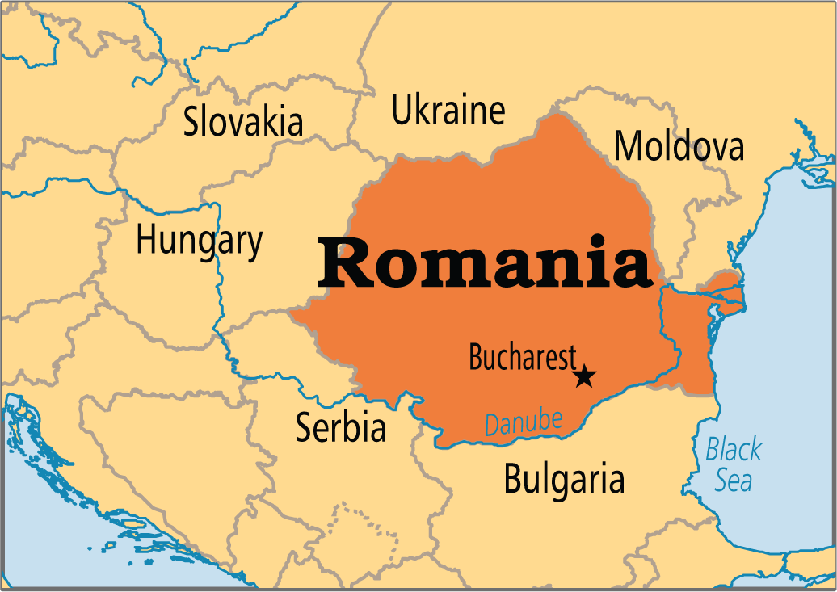
It borders the Black Sea to the southeast, Bulgaria to the south, Ukraine to the north, Hungary to the west, Serbia to the southwest, and Moldova to the east.

Slide 4
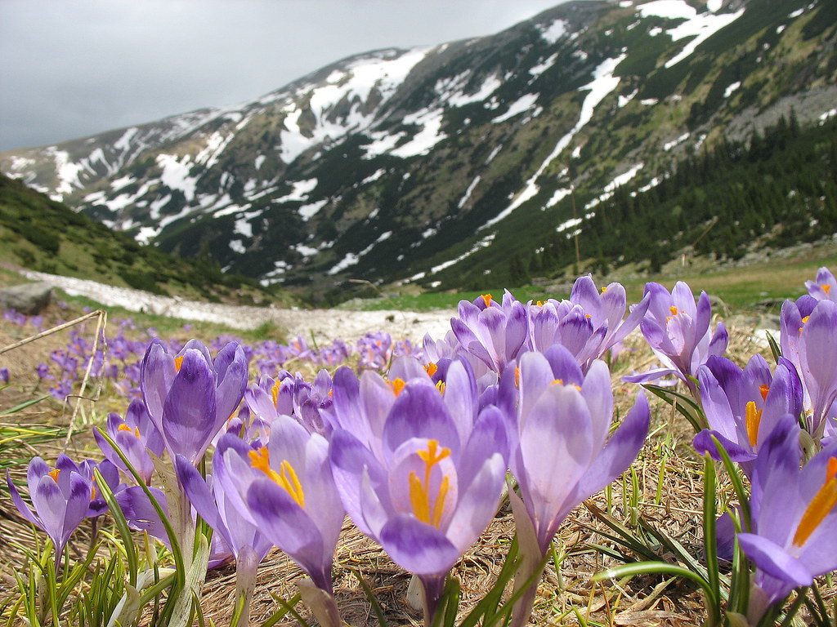
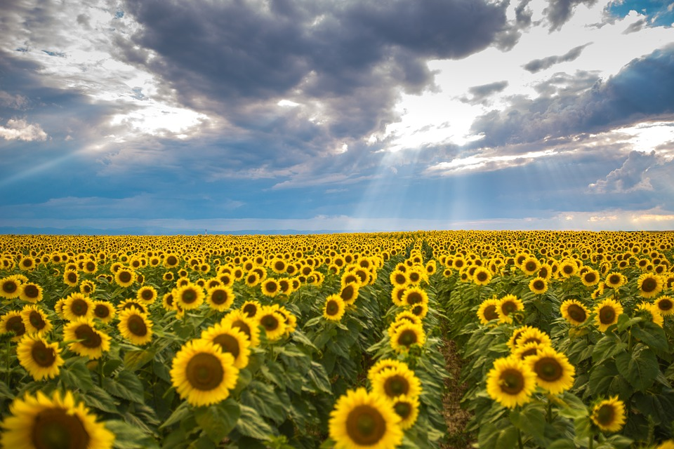
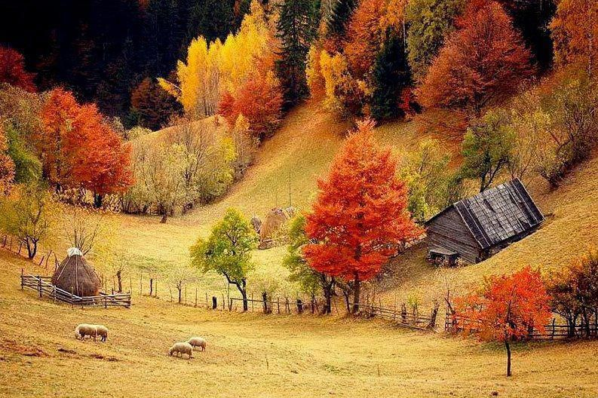
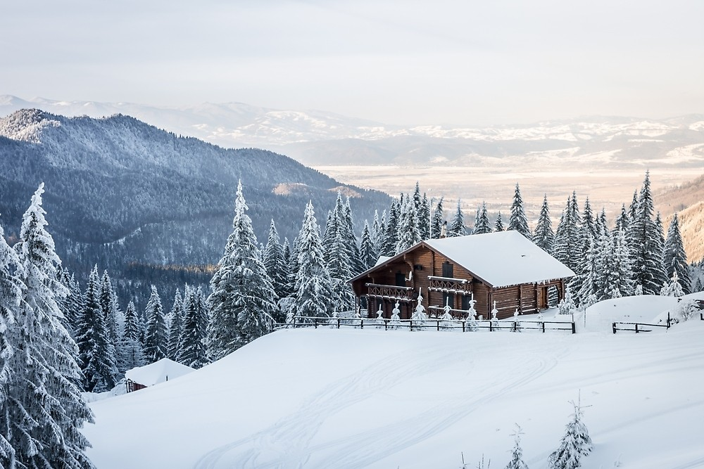
The climate of Romania is temperate-continental, with four distinct seasons.

Slide 5
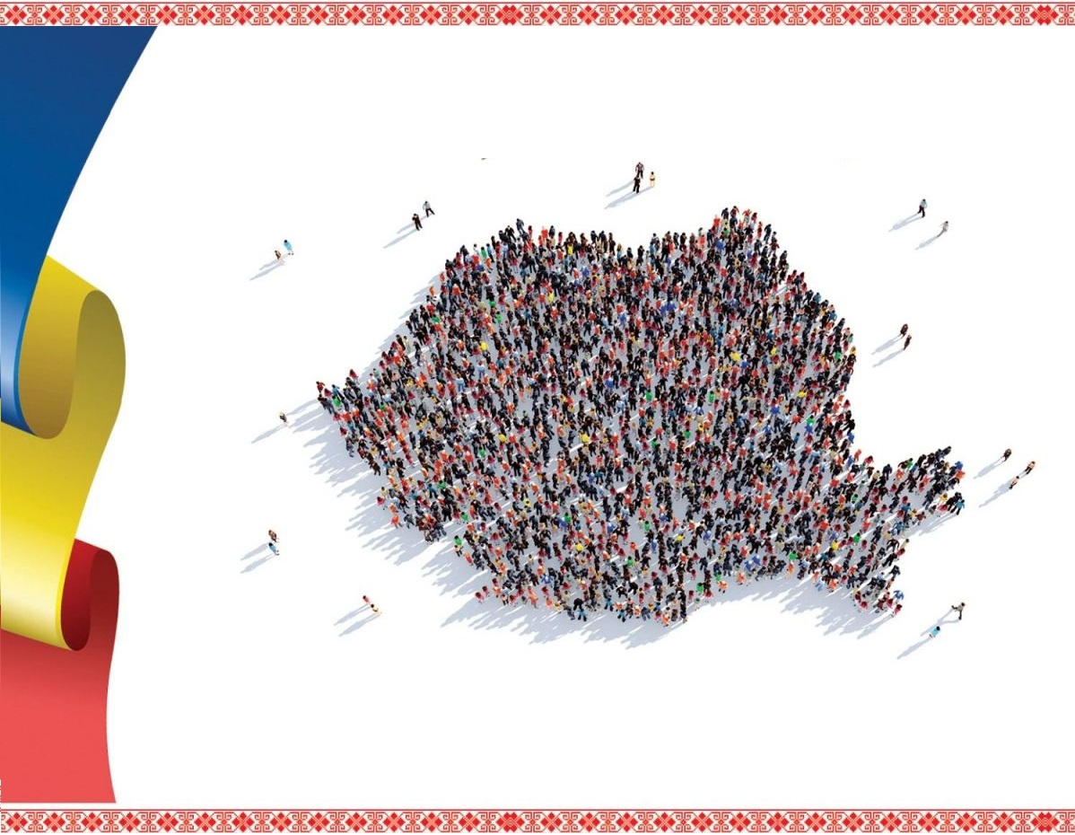
With a total area of 238,397 square kilometers , Romania is the 12th largest country and the 7th most populous member state of the European Union, having almost 20 million inhabitants.

Slide 6
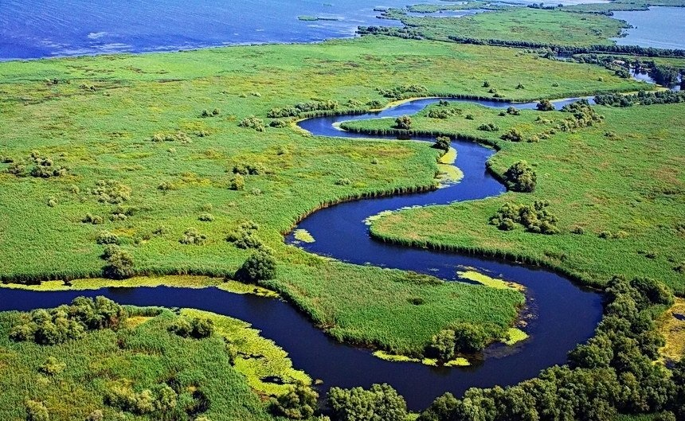
The River Danube, Europe's second-longest river, rises in Germany's Black Forest and flows into the Black Sea, forming the Danube Delta.

Slide 7
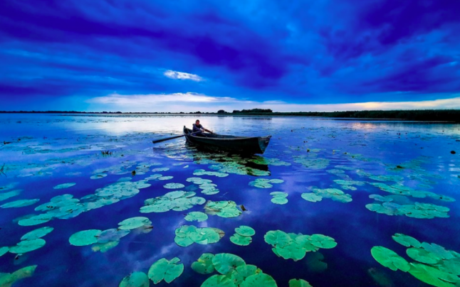
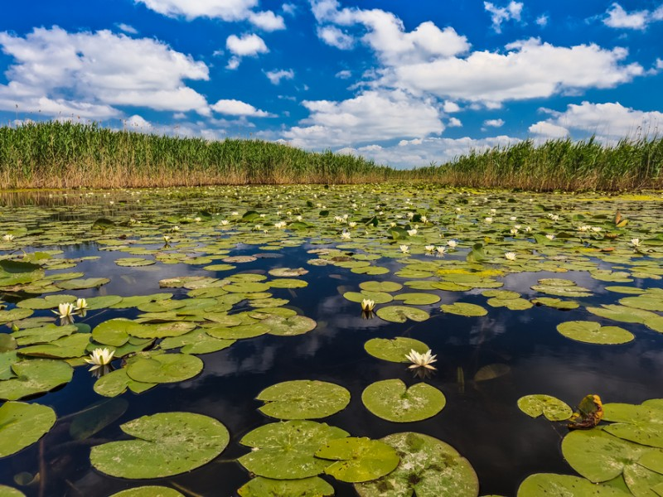
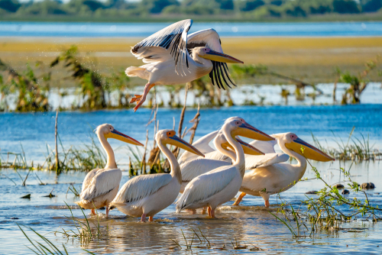
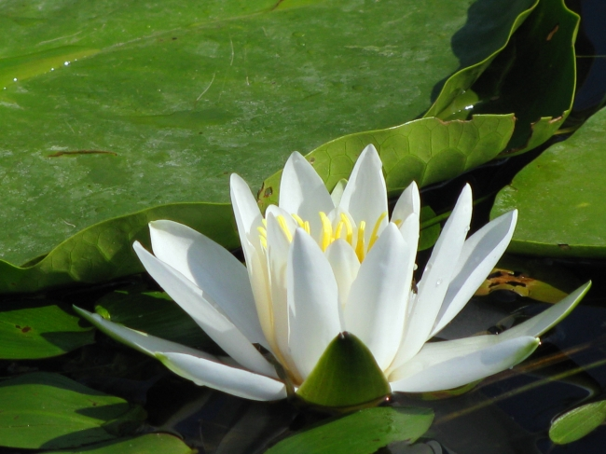
The Danube Delta is the second-largest and best-preserved delta in Europe, and also a biosphere reserve and a biodiversity World Heritage Site.

Slide 8
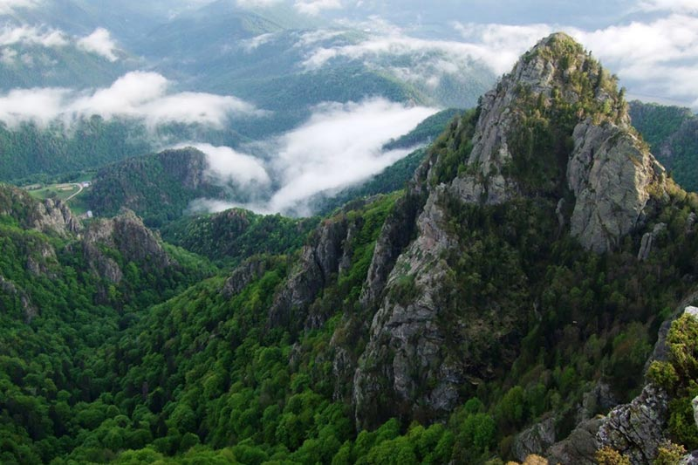
The Carpathian Mountains dominate the centre of Romania, with 14 mountain ranges reaching above 2 000 m, the highest of which is Moldoveanu Peak at 2 544 m .

Slide 9
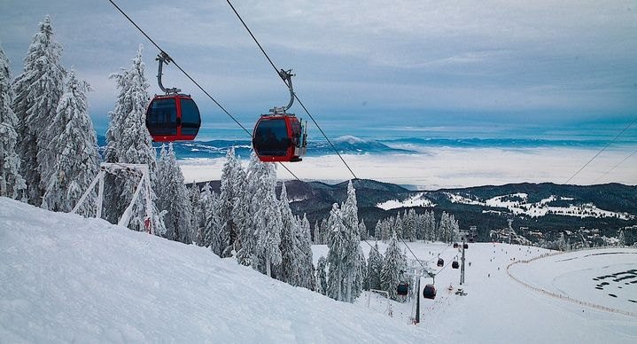
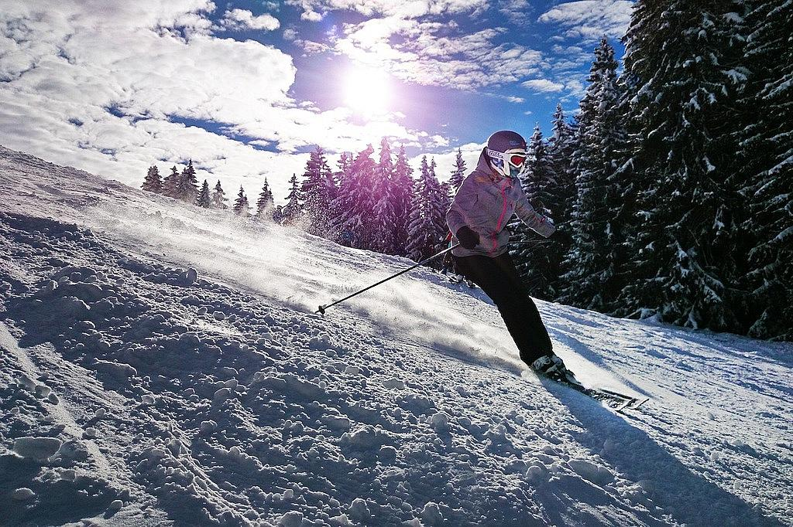
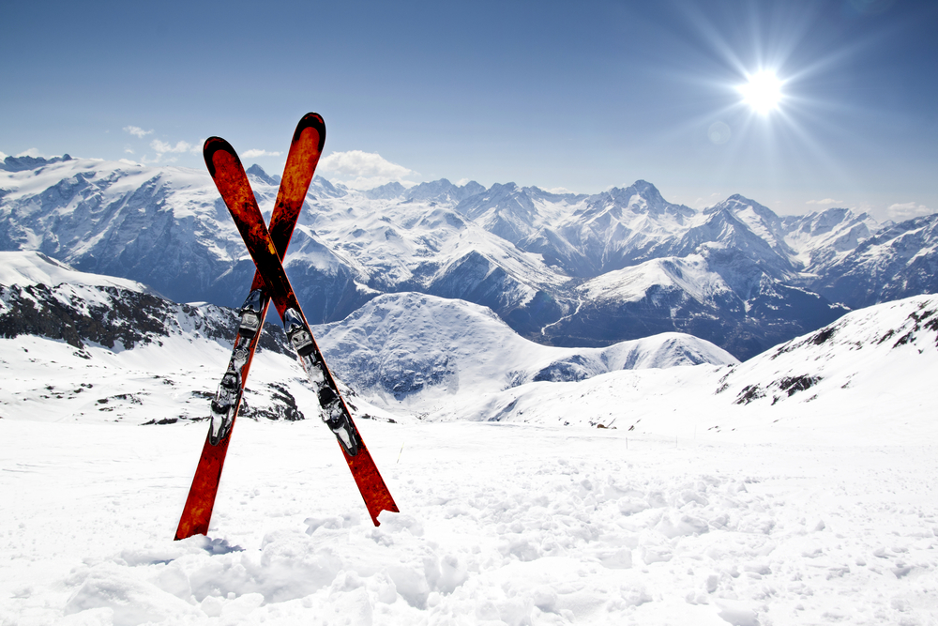
Most popular skiing resorts are along the Valea Prahovei and in Poiana Brasov.

Slide 10
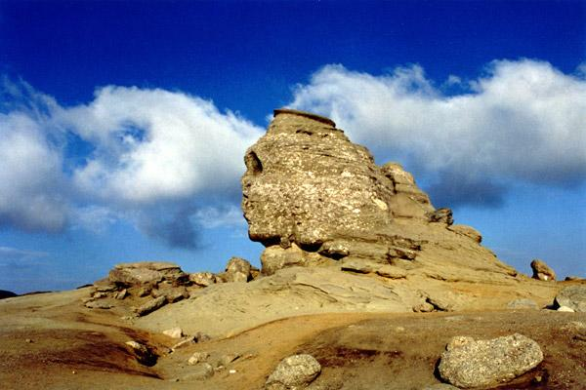
The Bucegi Plateau is mostly known for one of the most impressive natural monuments in Romania, the Sphinx.

Slide 11
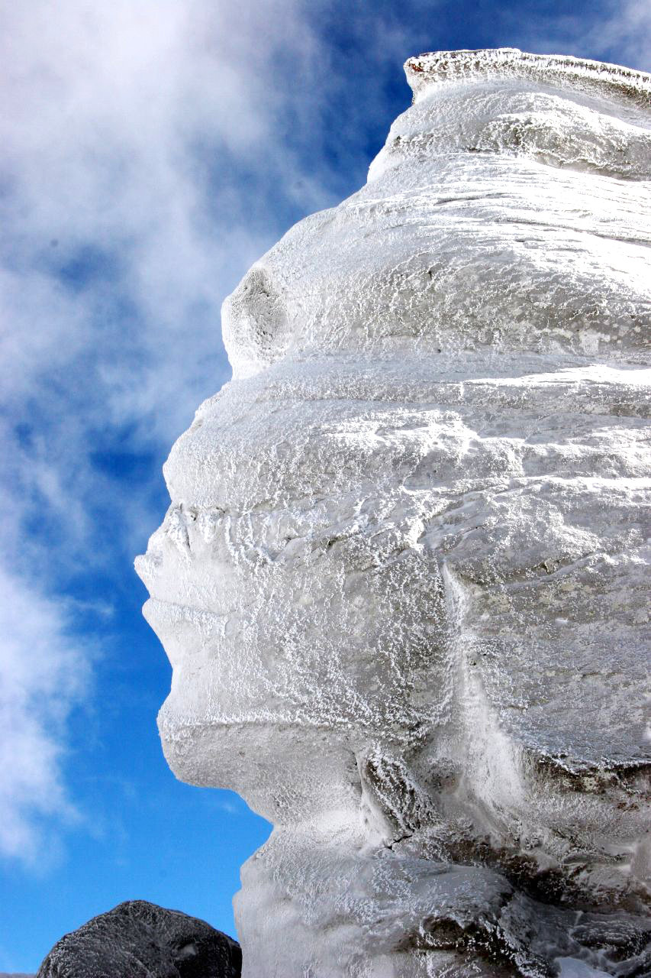
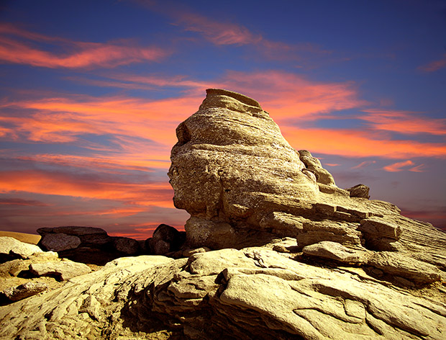
The name was chosen because of its shape that resembles the human face, the shape resulting from erosion produced by wind over a long period of time.
It measures 8 meters in height and 12 meters in width.

Slide 12
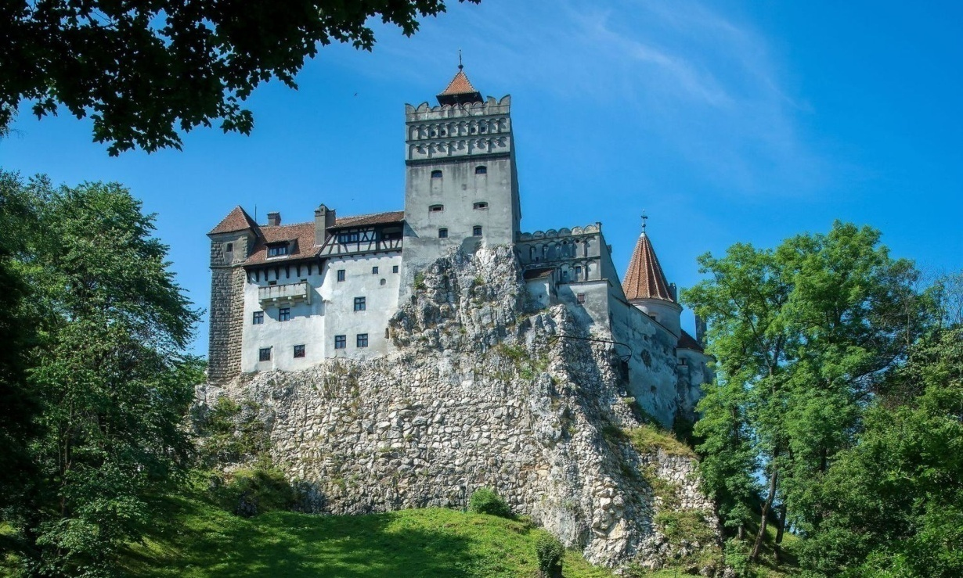
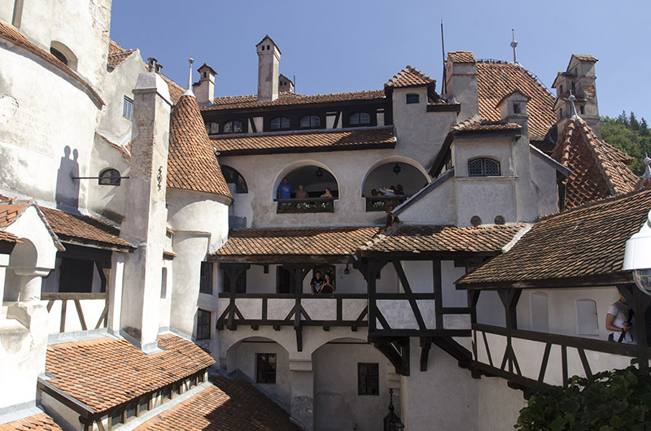
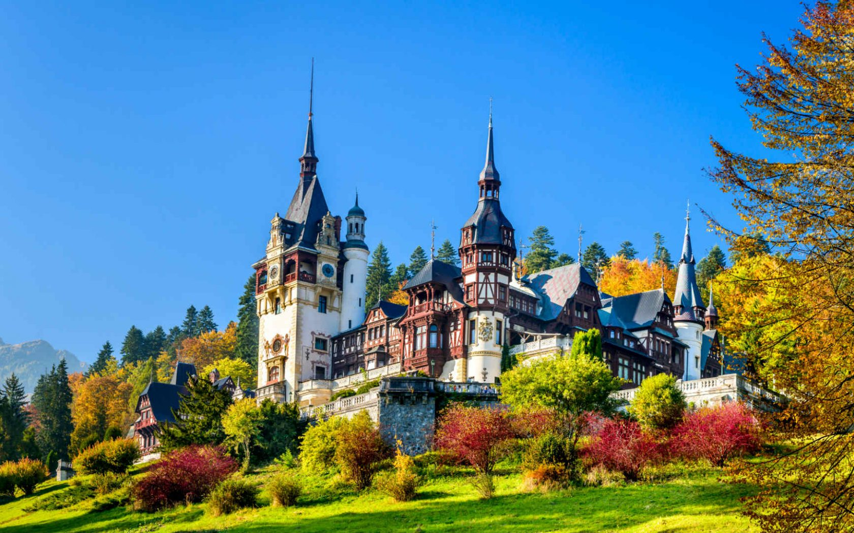
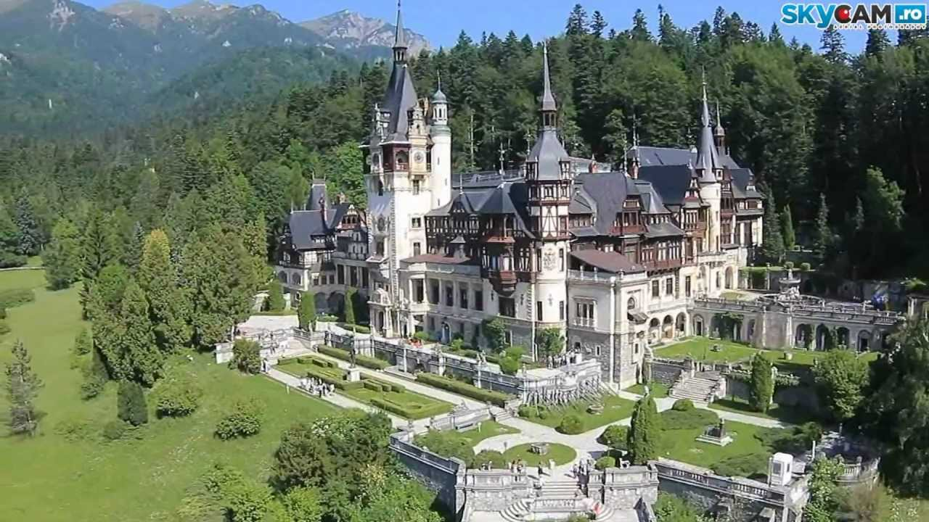
FAMOUS ATTRACTIONS IN ROMANIA
Bran Castle
Peles Castle

Slide 13
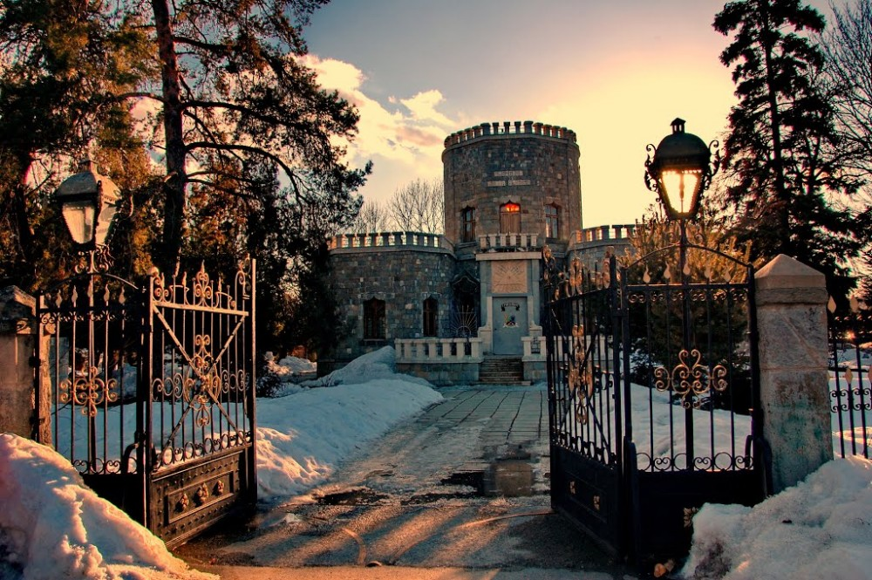
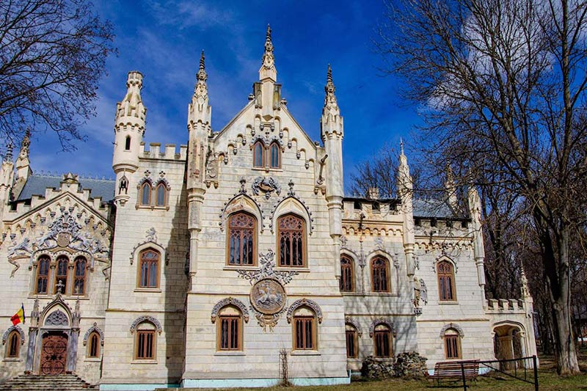
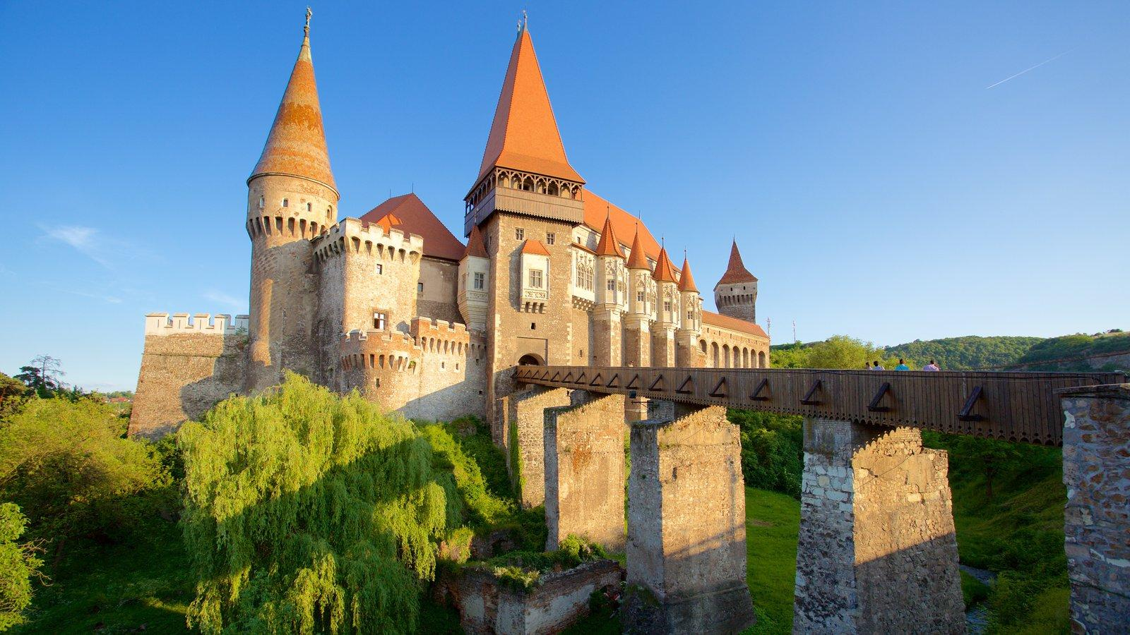
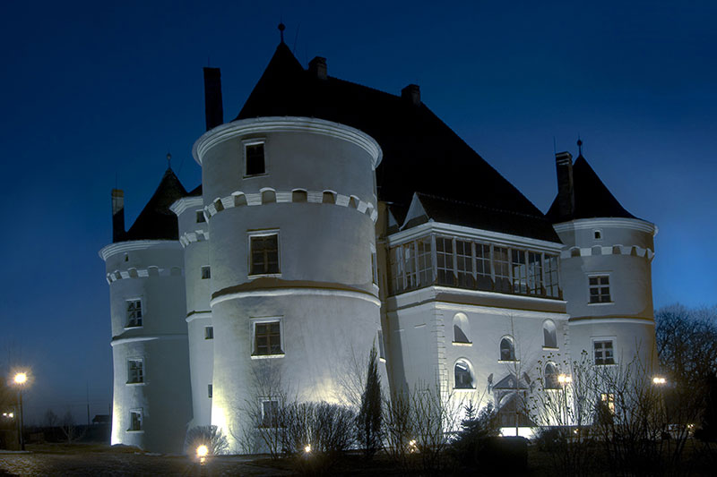
Iulia Hasdeu Castle
Sturdza Castle
Corvin Castle
Jidvei Castle

Slide 14
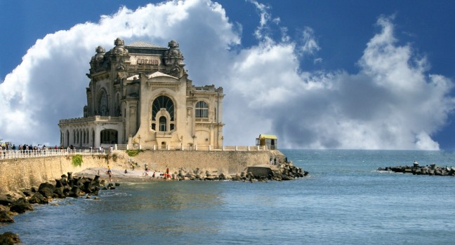
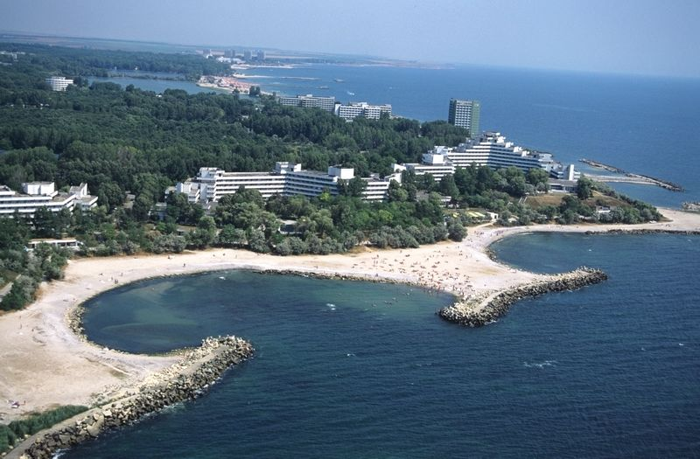
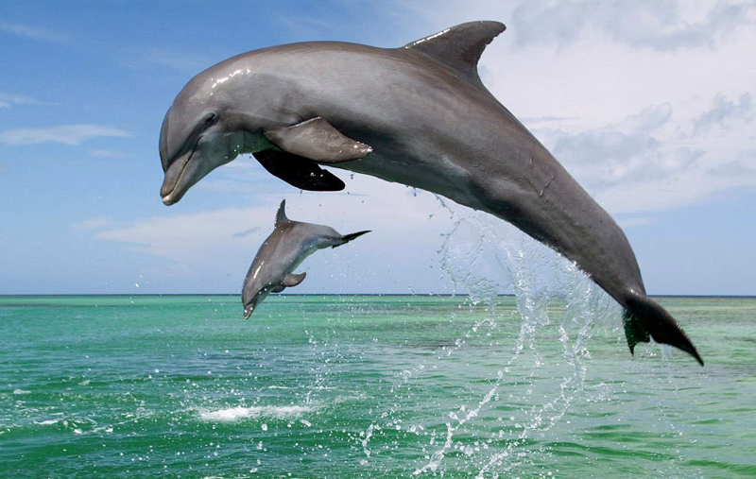
The Black Sea is one of the natural borders of Romania and the busiest and most popular summer destination for Romanians.

Slide 15
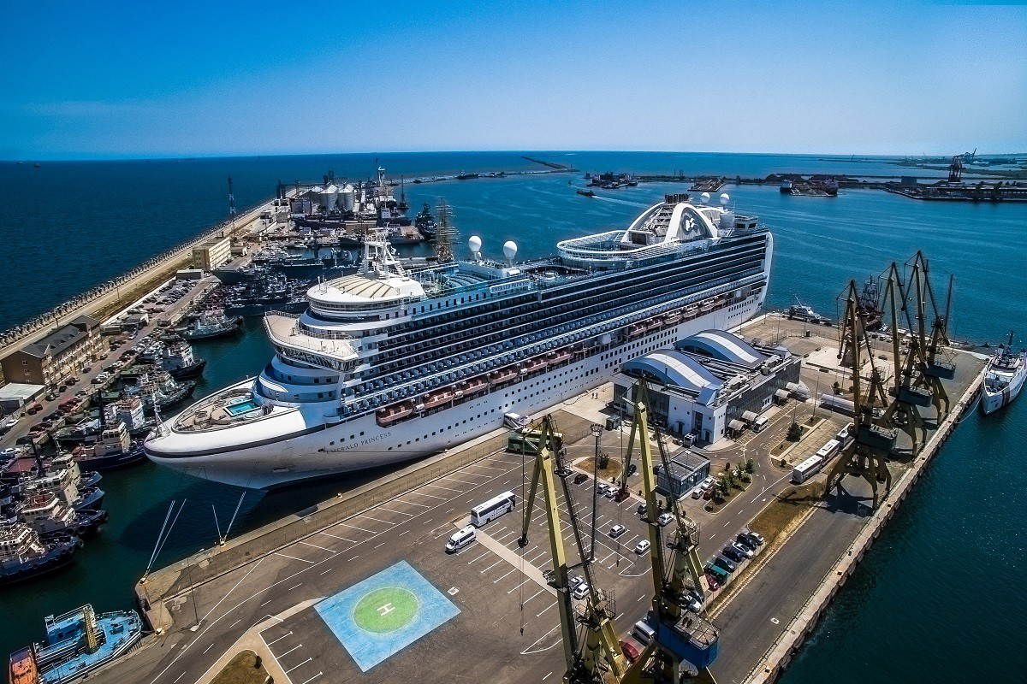
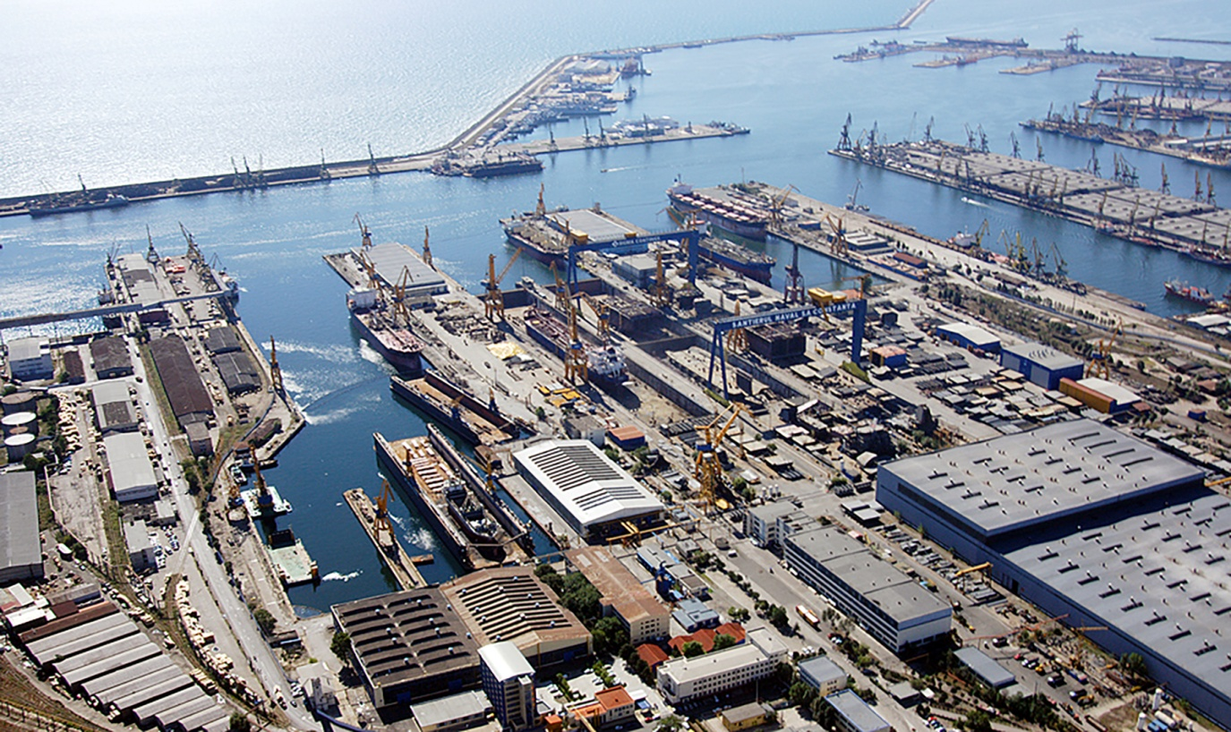
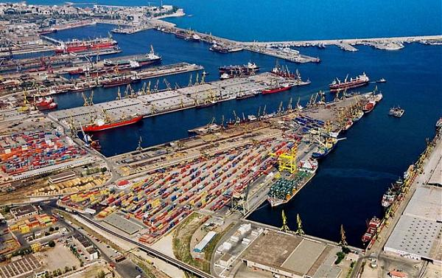
The Port of Constanța is located the western coast of the Black Sea.

Slide 16
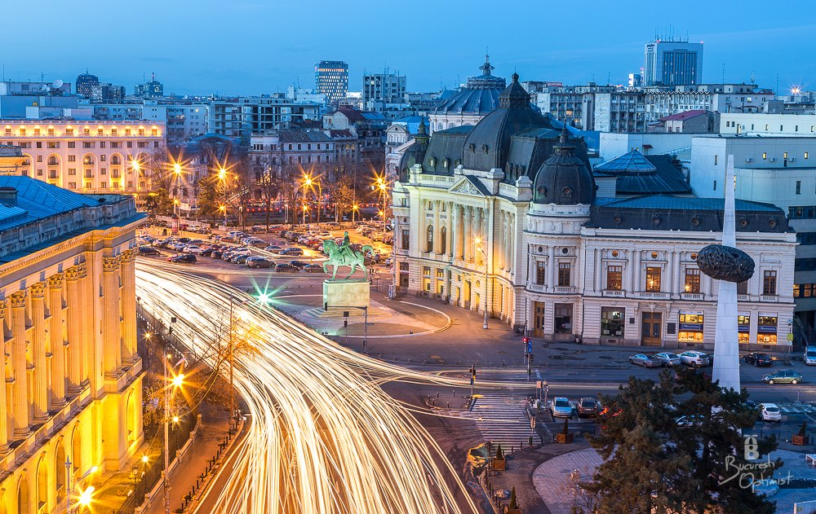
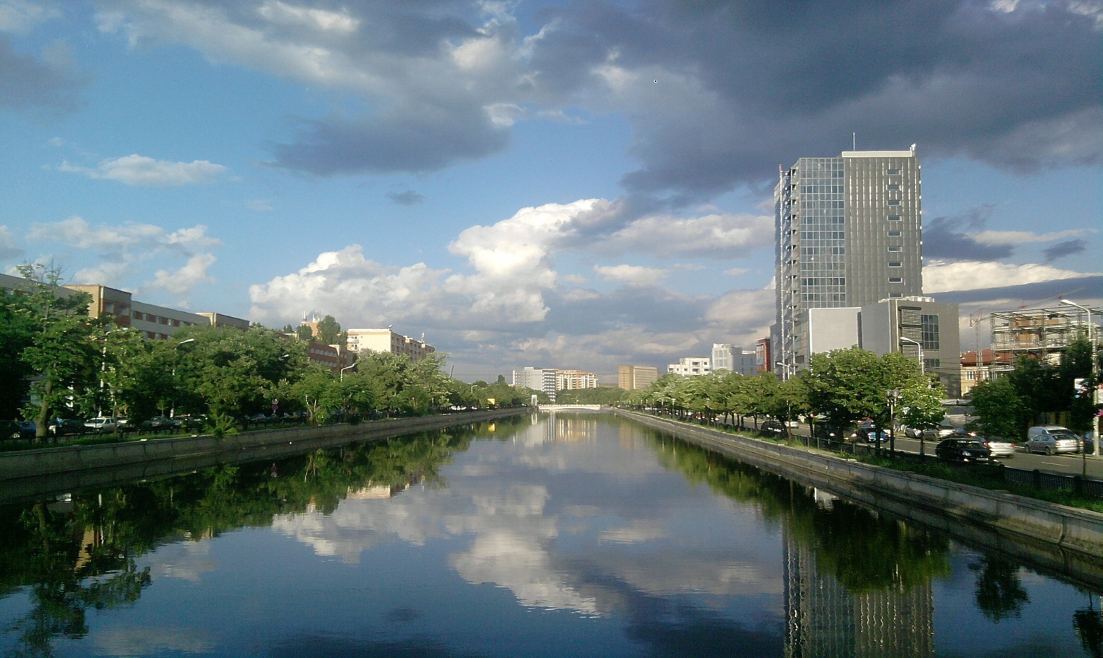
Bucharest is the capital and largest city of Romania, as well as its cultural, industrial, and financial centre.
It is located in the southeast of the country, on the banks of the Dâmbovița River.

Slide 17
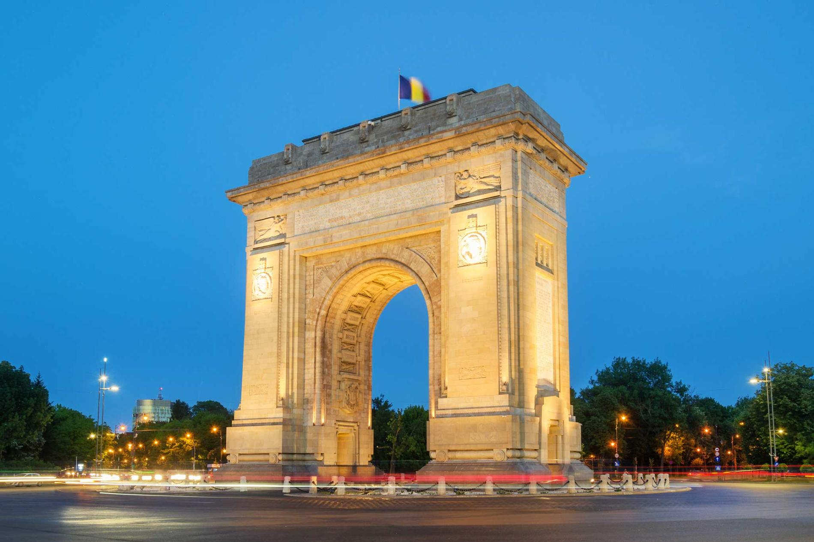
The Arc de Triomphe

Slide 18
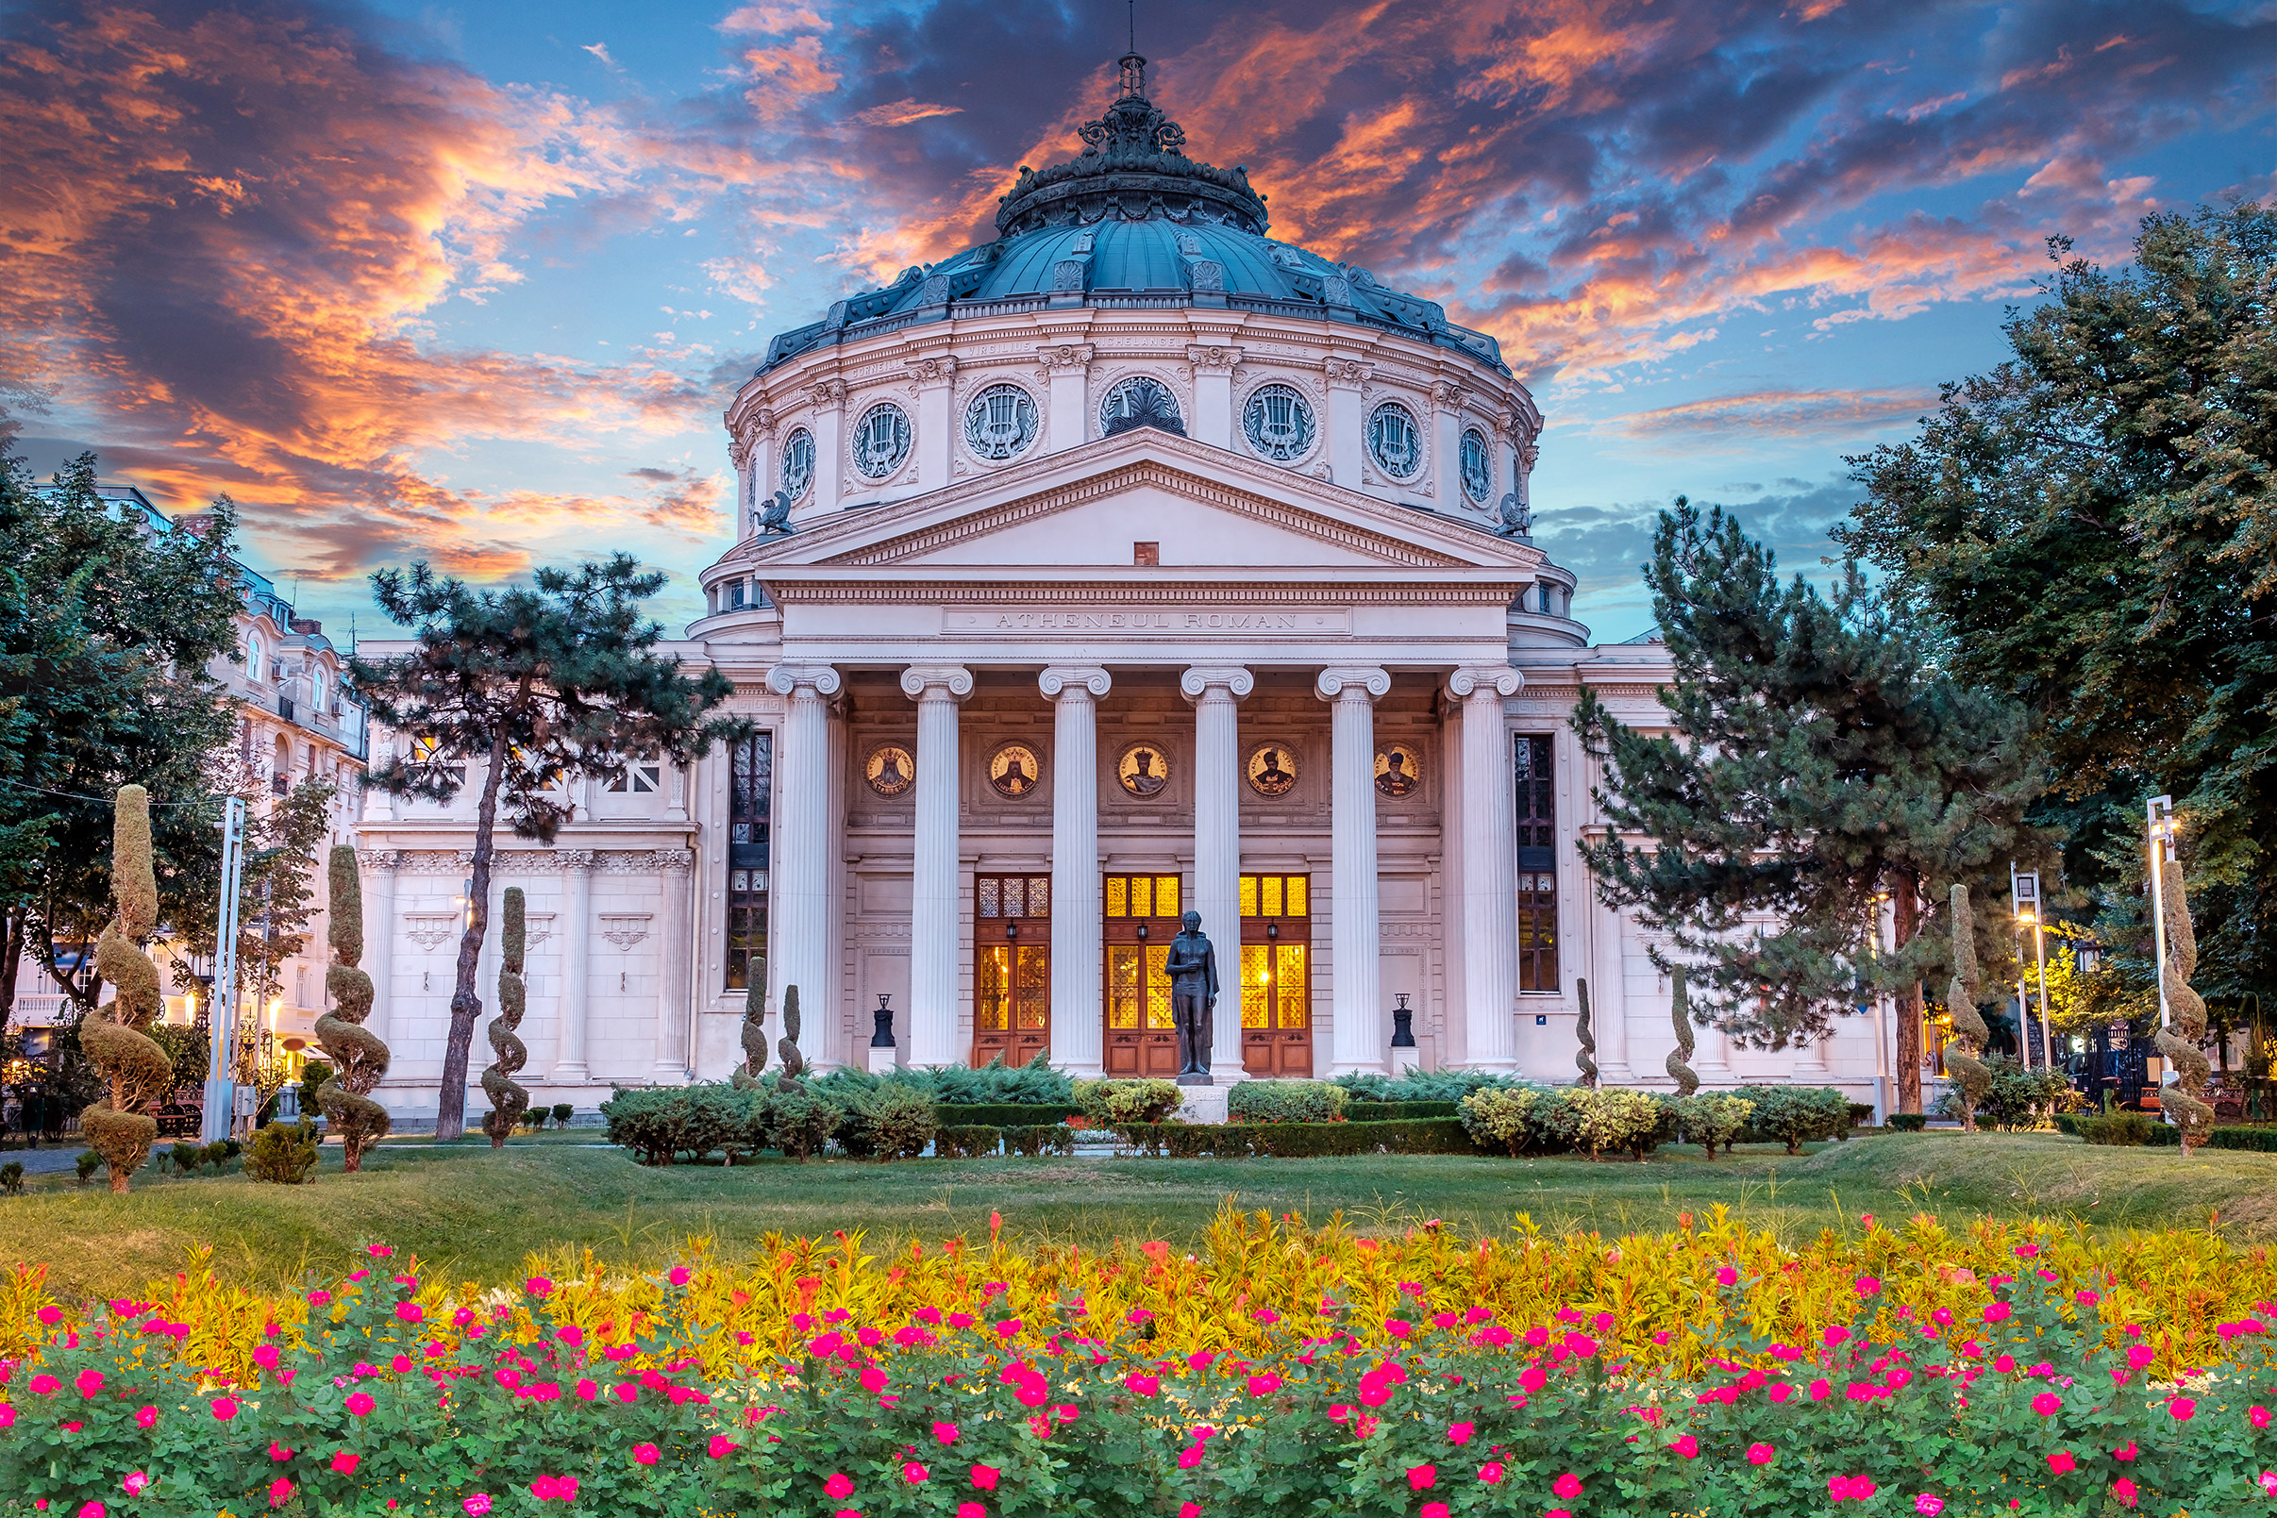
Romanian Athenaeum

Slide 19
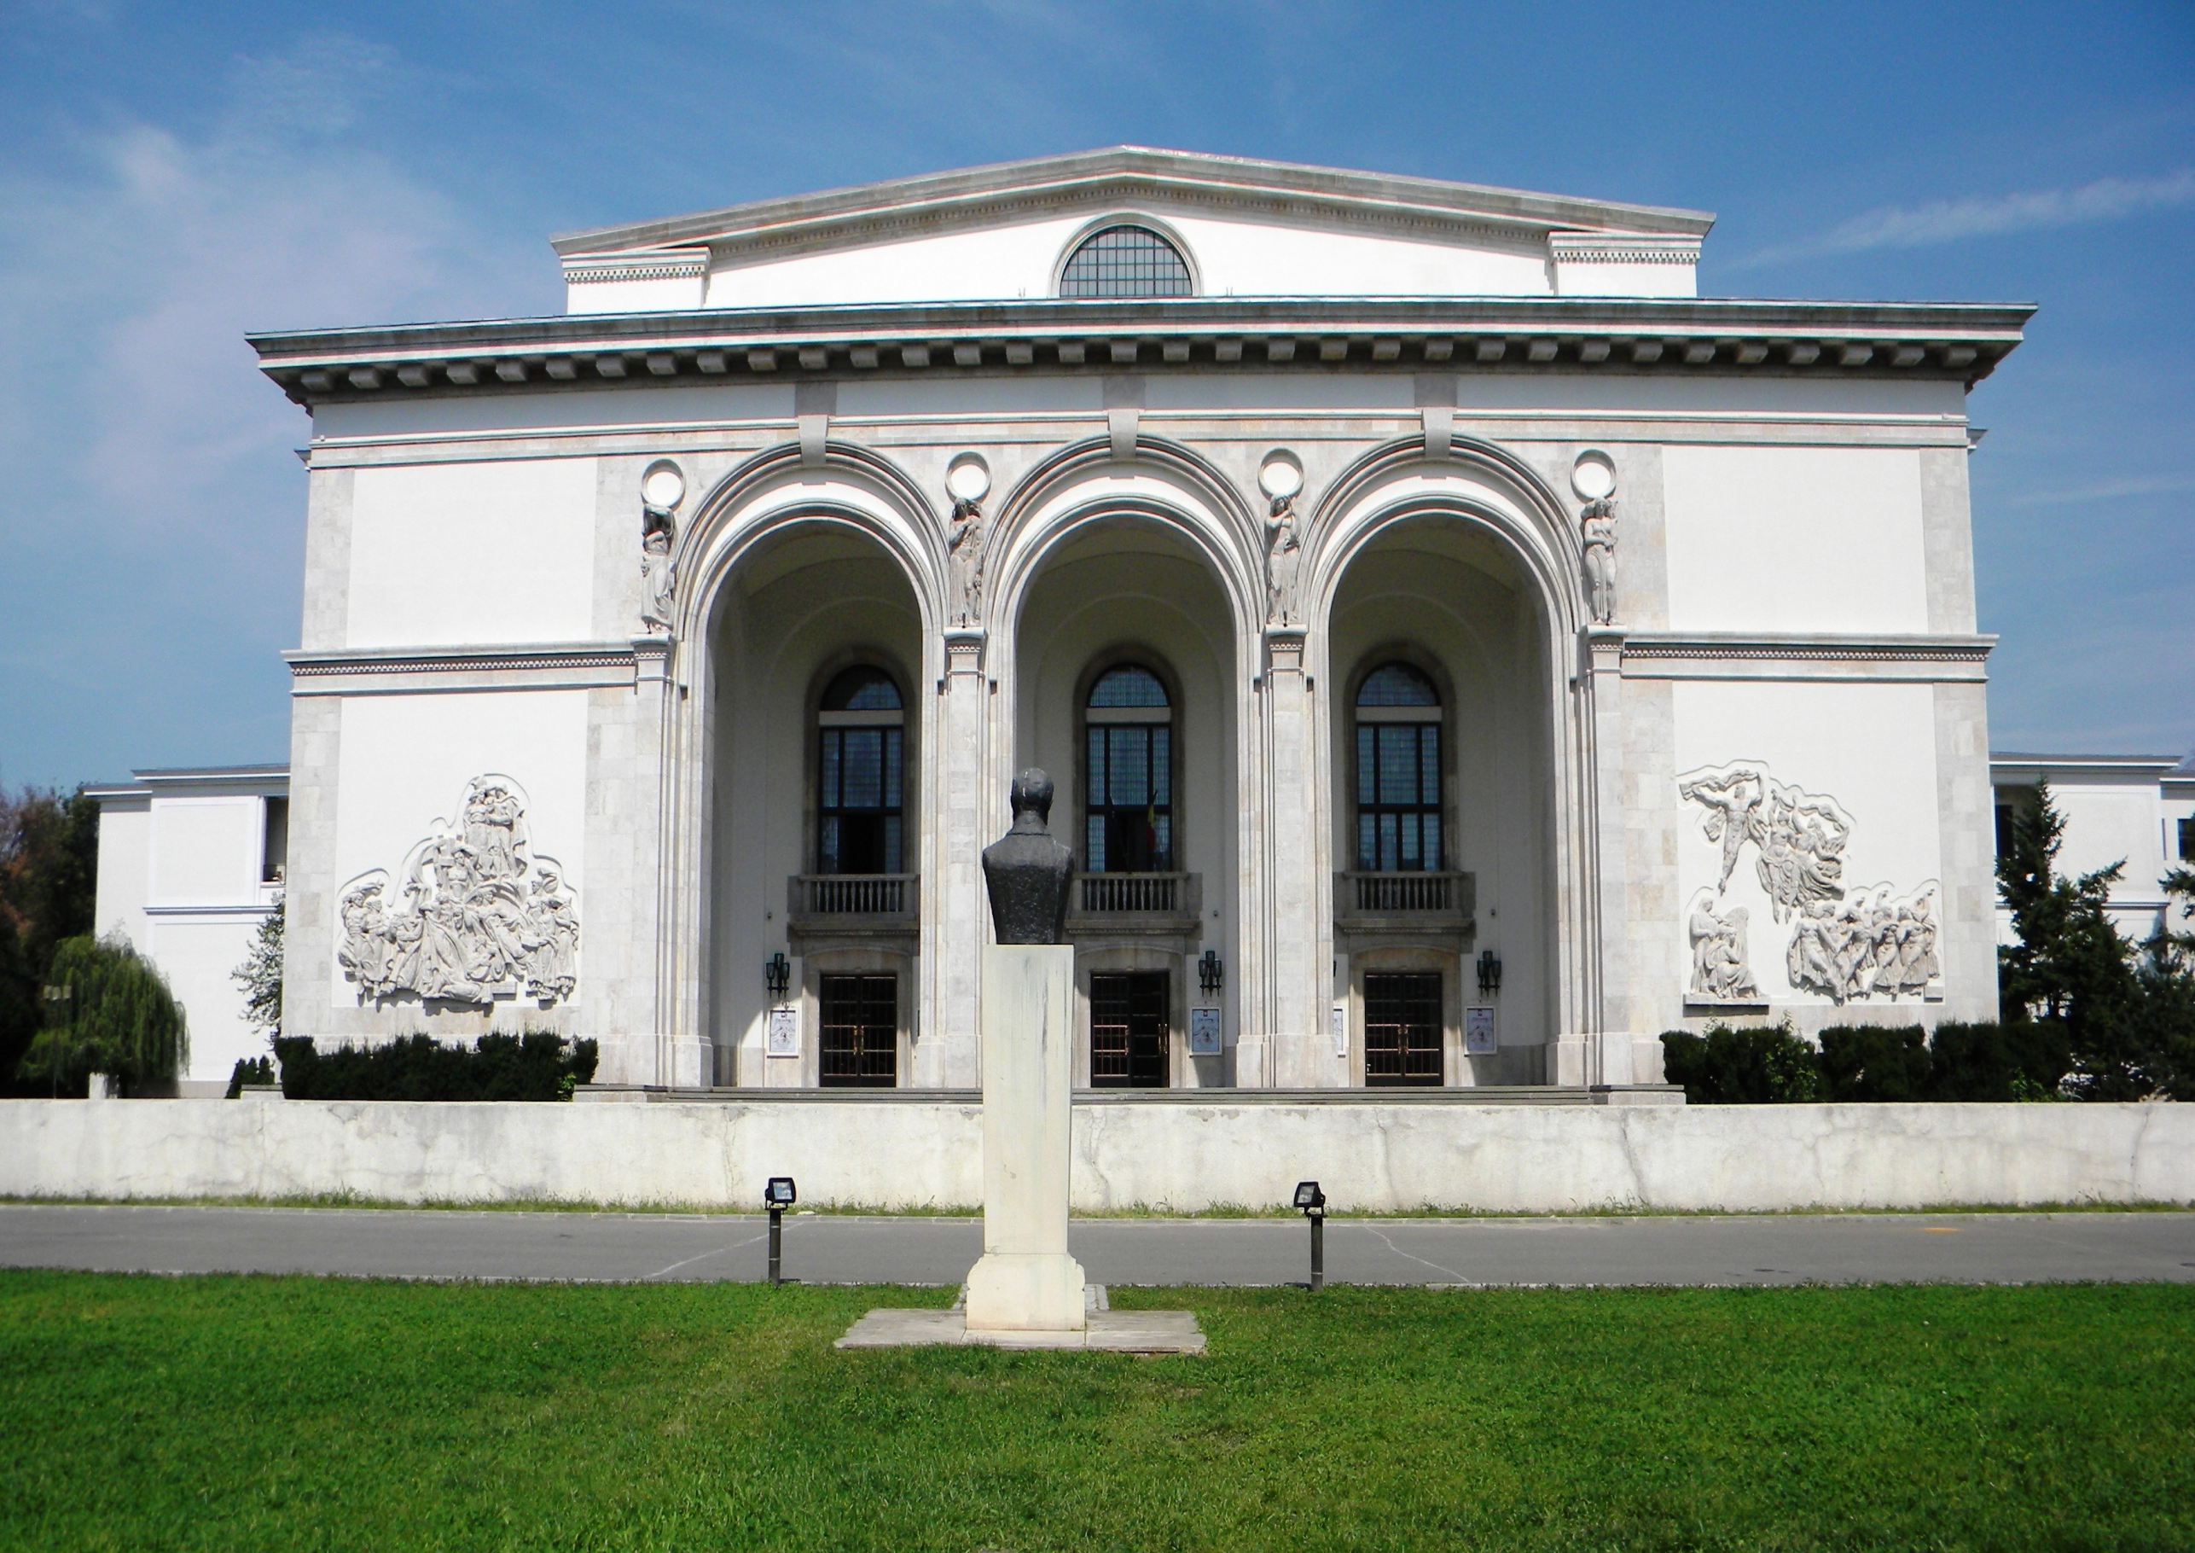
Romanian National Opera

Slide 20
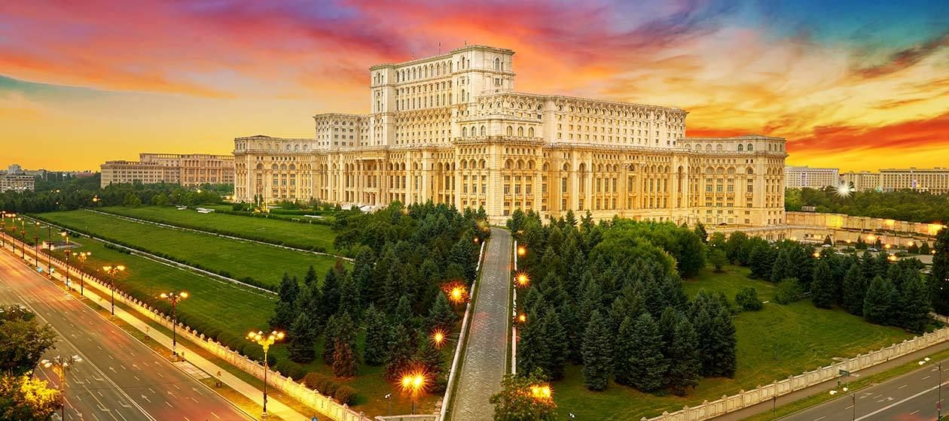
The Palace of Parliament

Slide 21
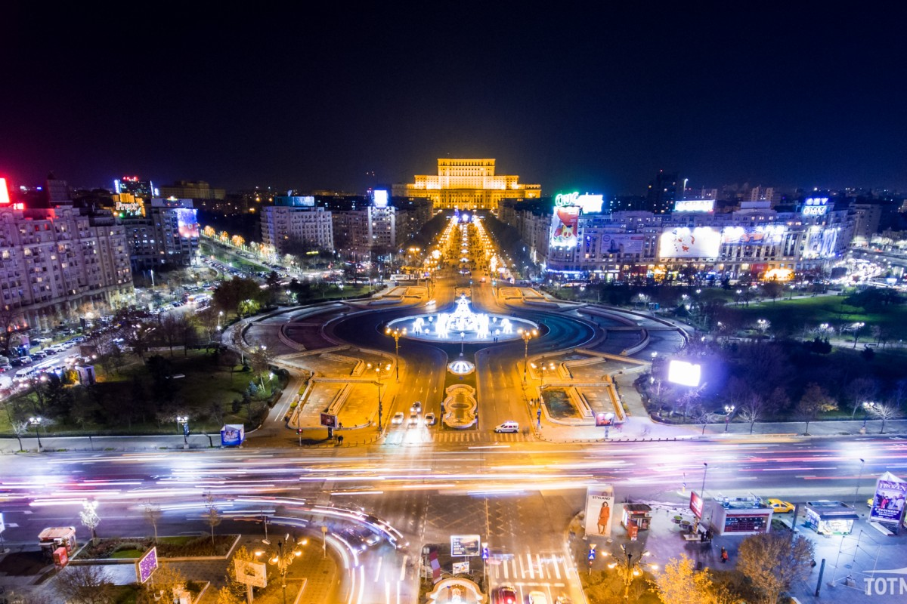
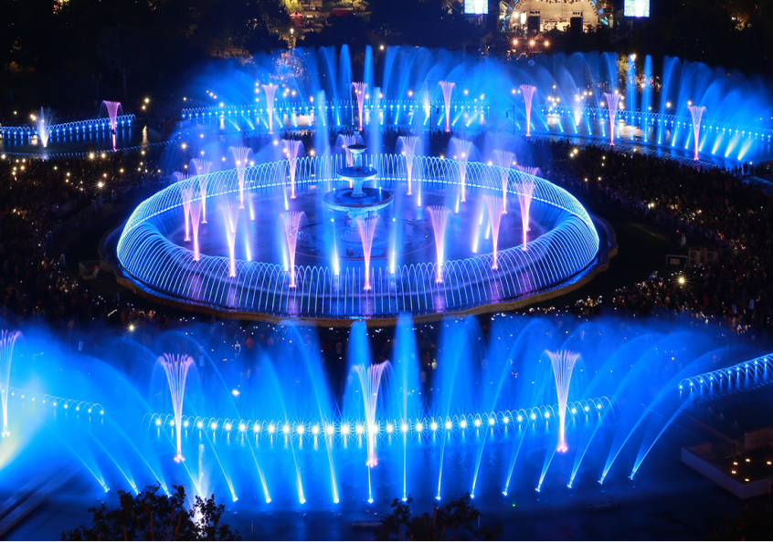
Unirii Square

Slide 22
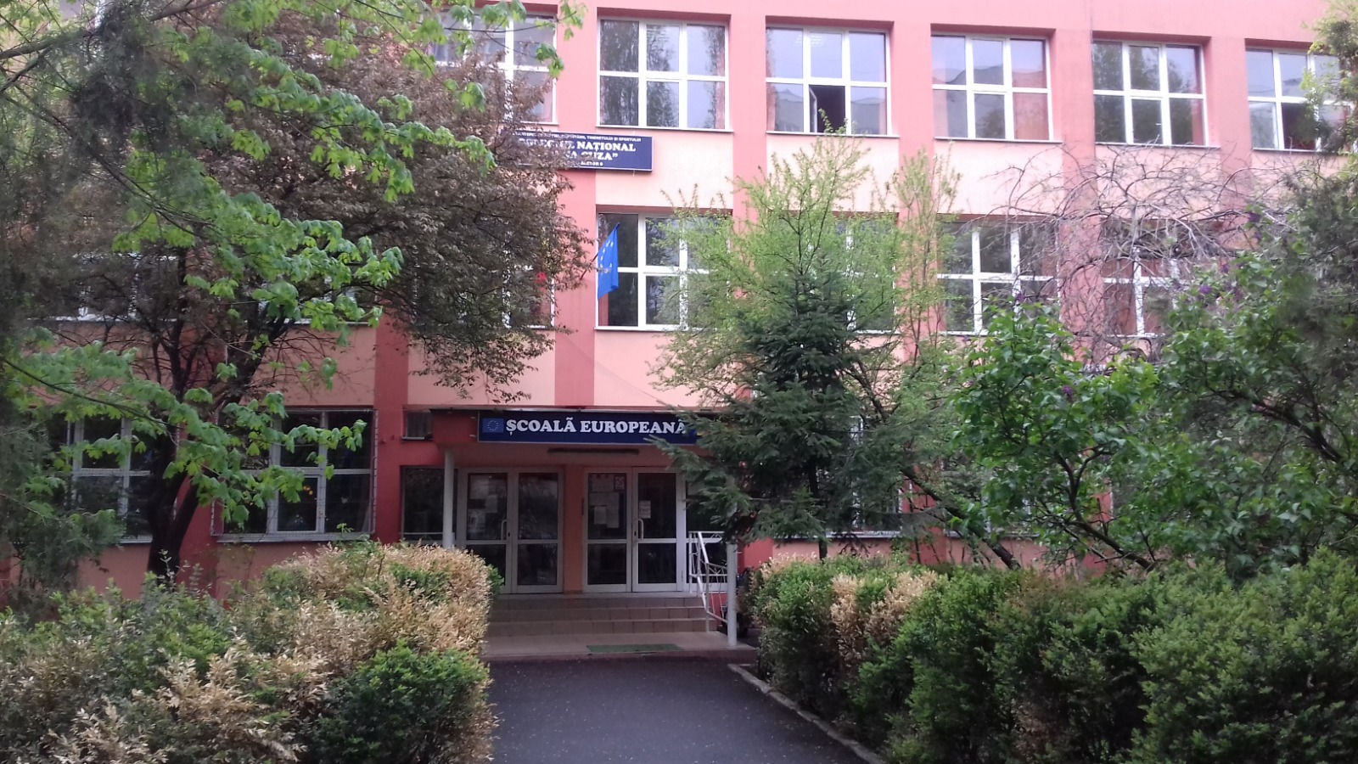
"Elena Cuza" National College opened in 1971.

Slide 23
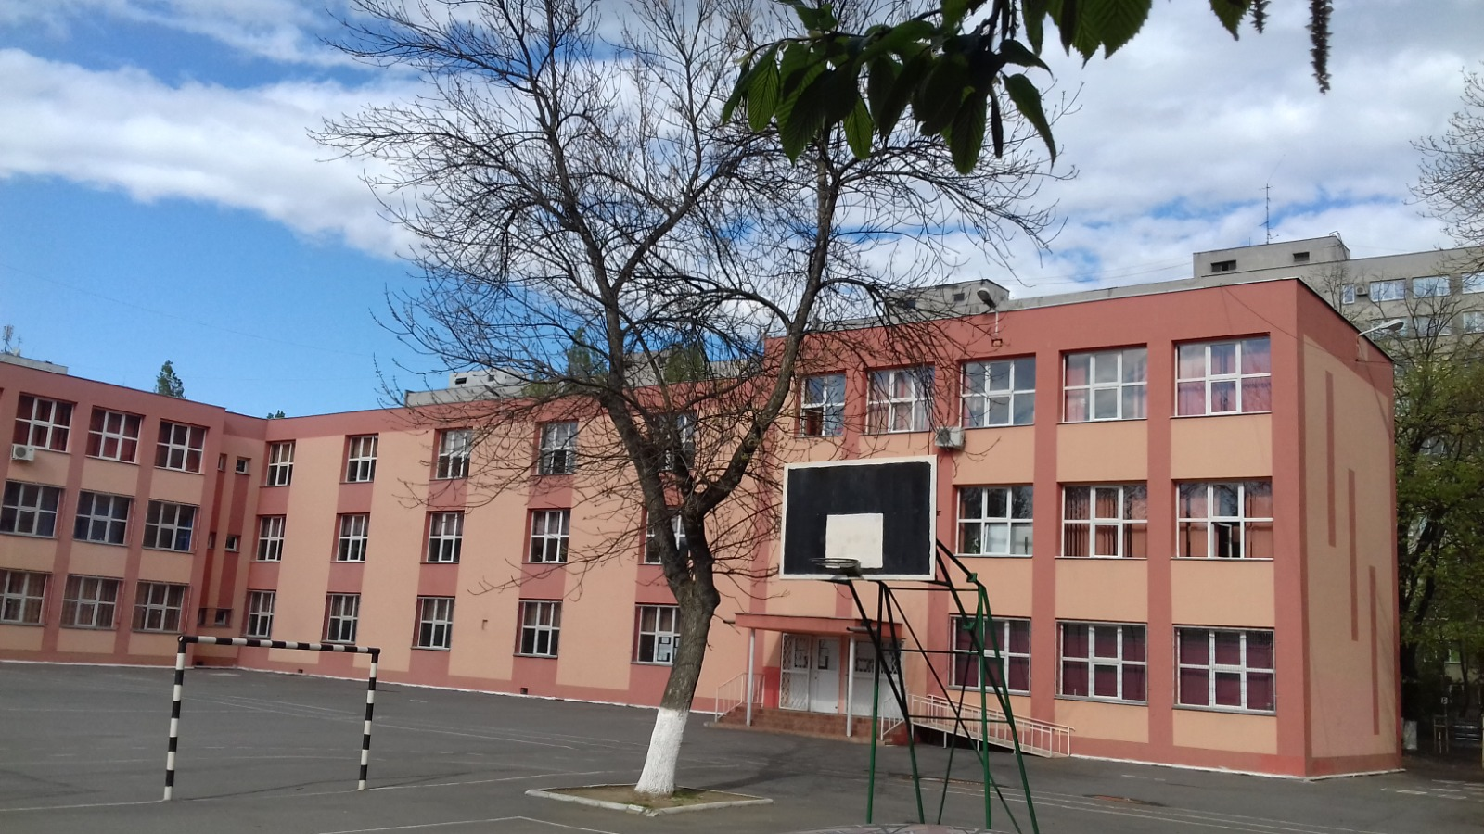

Slide 24
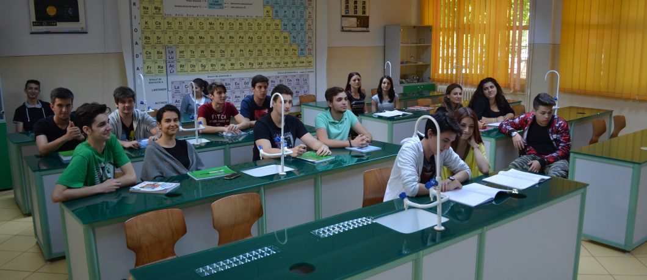
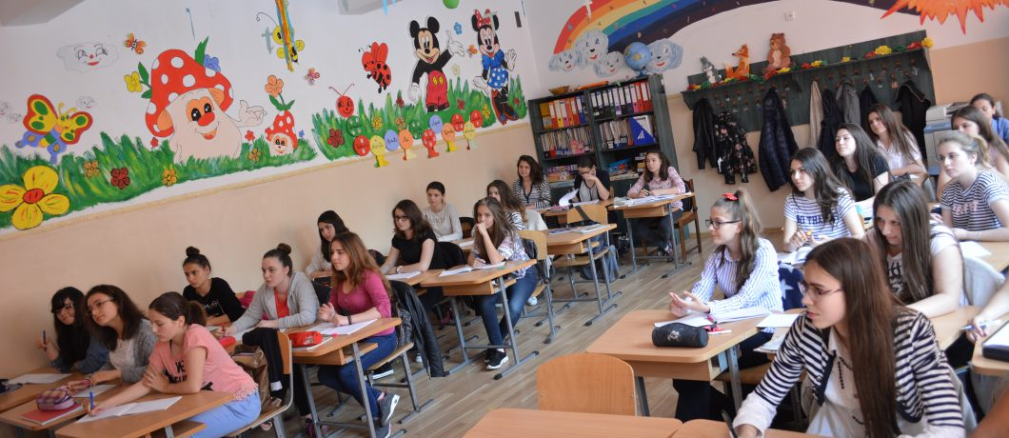
A number of 1200 pupils study in our school at different levels:
PRIMARY SCHOOL (6→11 years old)-preparatory class and primary school
MIDDLE SCHOOL (11→15 years old )-bilingual- intensive English classes,
HIGH SCHOOL (15→19 years old)- pedagogical profile; philology and bilingual English specialization; mathematics-computer specialization.

Slide 25
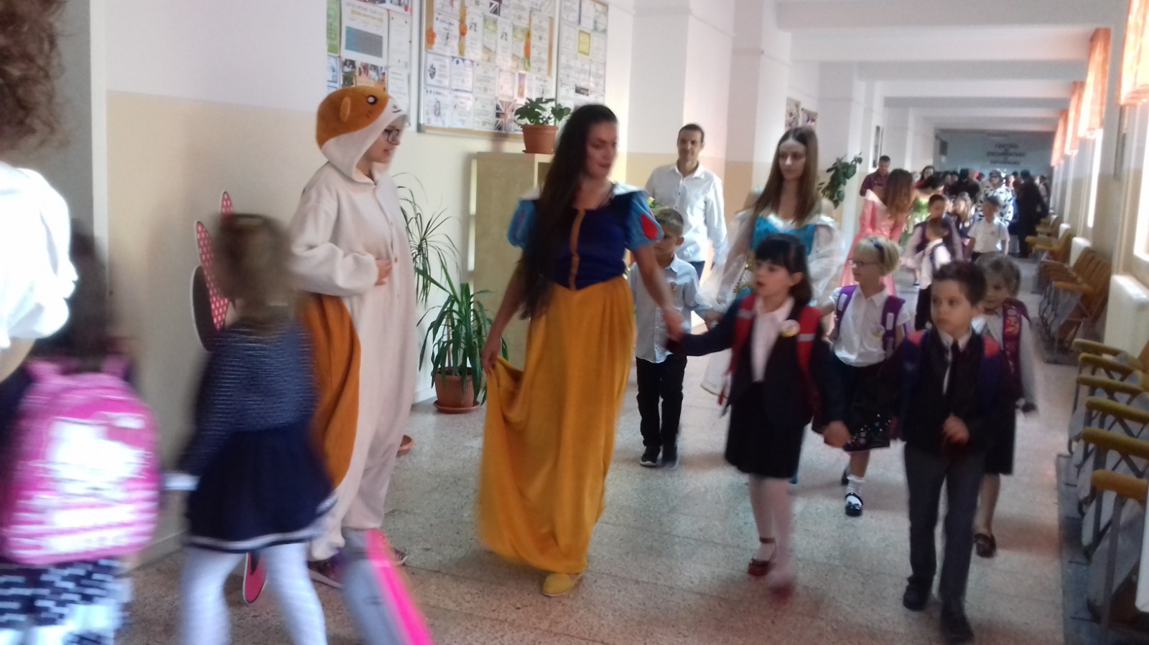
In Romania, children start preparatory class in school at 6 years old.

Slide 26
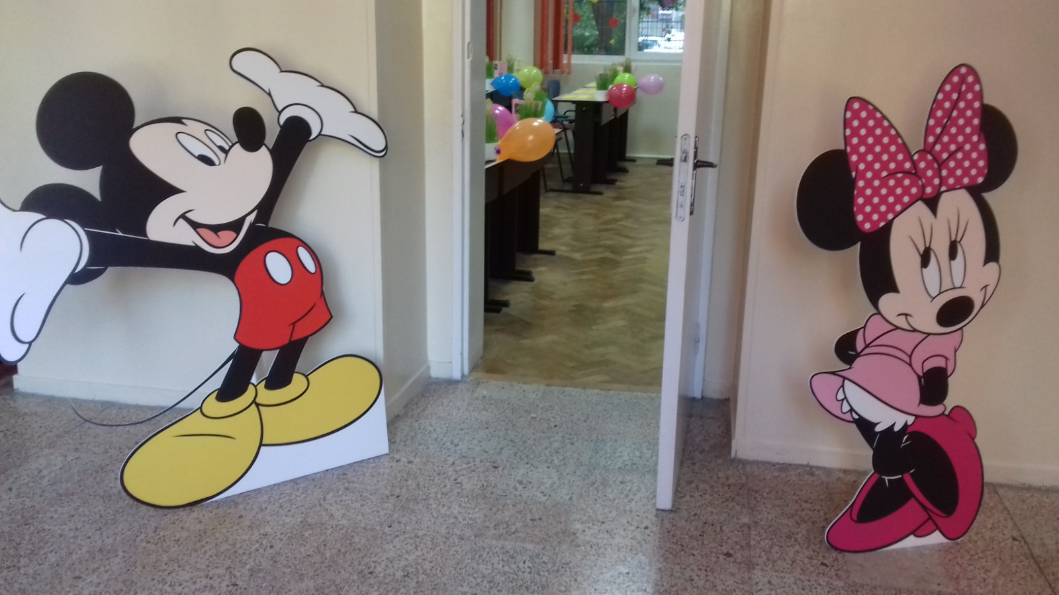
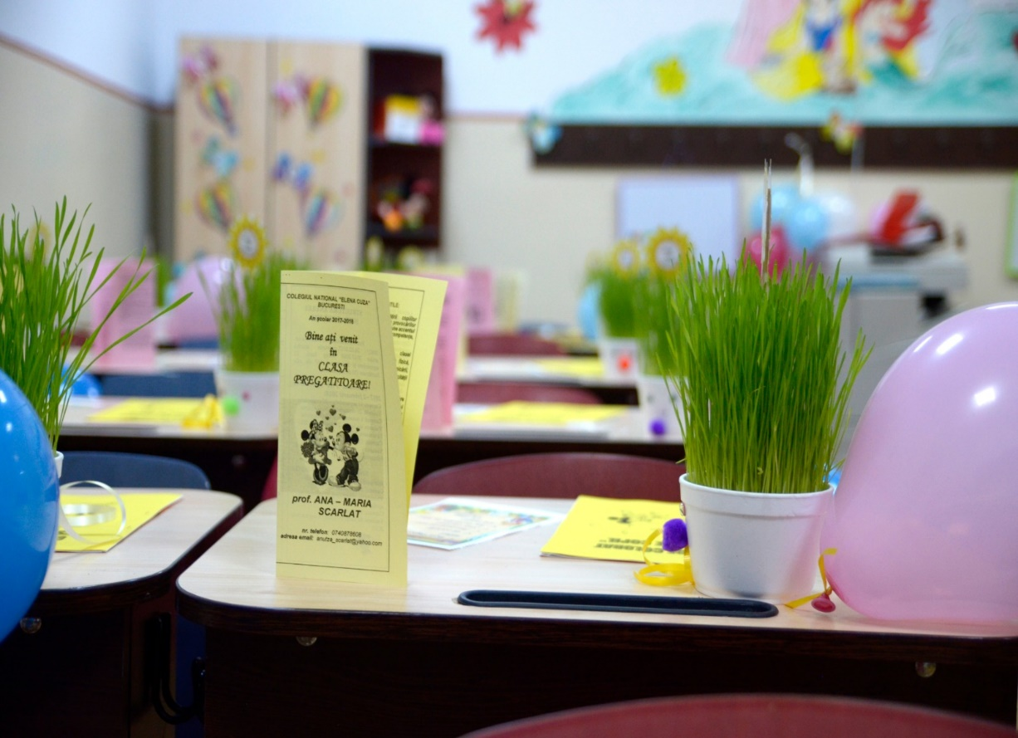
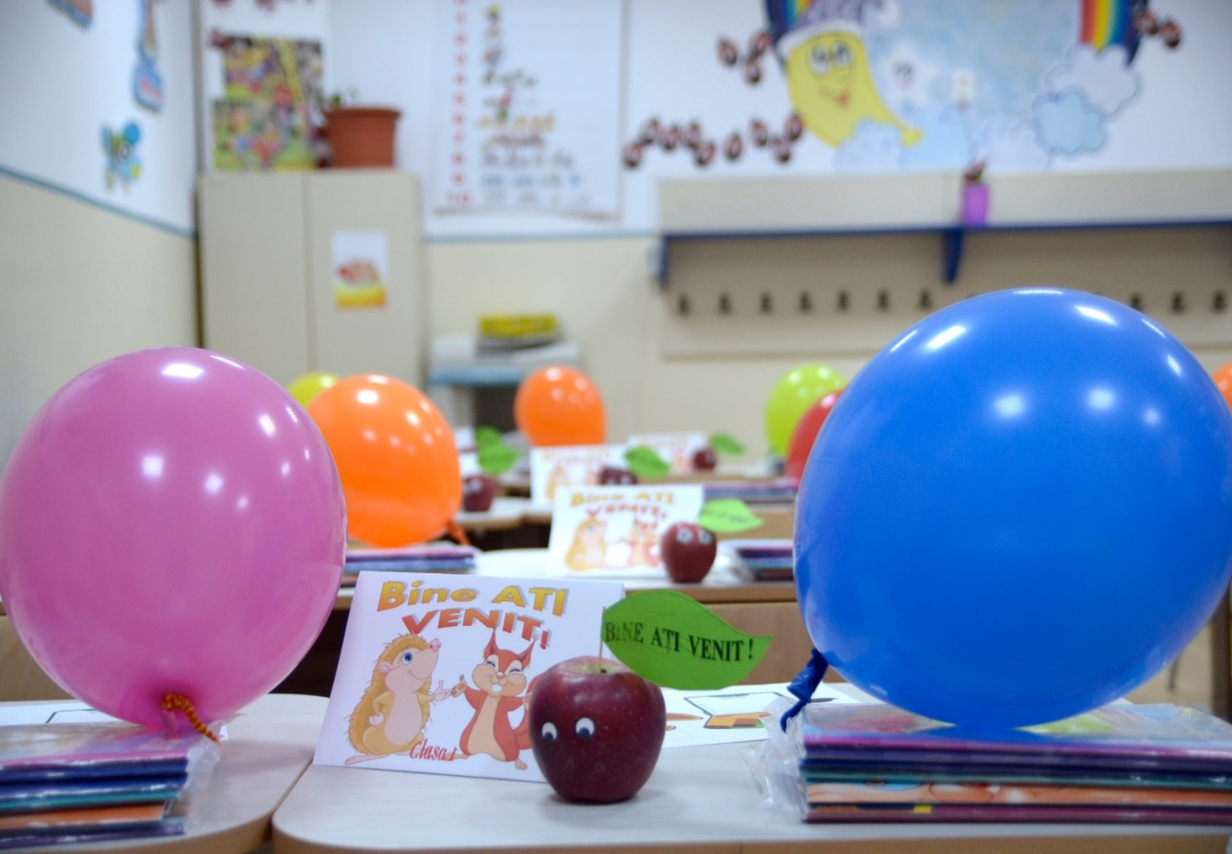

Slide 27
Primary school pupils have 4 or 5 classes a day.
Secondary school pupils have 6 or 7 classes a day.

