Slide 1
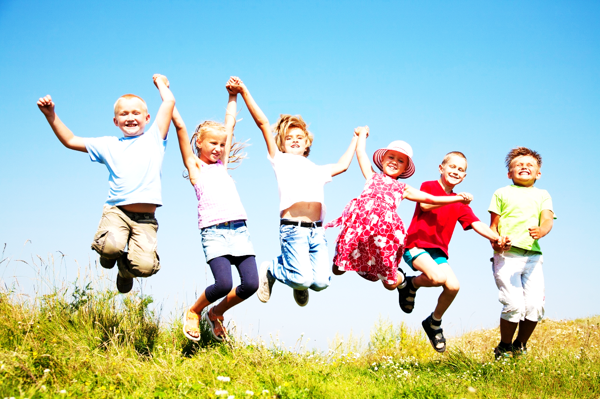
ROMANIAN TRADITIONAL GAMES
GAMES FOR ACTIVE LEARNING
2019-1-RO01-KA229-063665_1

Slide 2
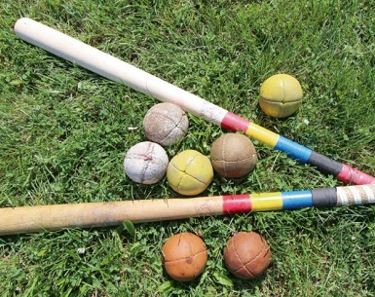
Oina
Among Romanian games, Oina, symbolizes the country's heritage more than any other. Dating back to at least the 14th century, no one is sure exactly when or how the ball sport began. Scholars even debate the origin of the name. Legend has it that Oina may mean 'game', according to the Cuman, a tribe of people from Turkey. However, the name more likely comes from the Romanian term for herding sheep as indicated by a number of other words used in the game with sheep references.
The team's captain is called a 'shepherd,' stepping up to bat is referred to as 'entering the sheep den,' and the players trying to catch a ball in the outfield are called pascari, which means guardians of the sheep. The pitch area is a rectangle of an approximate size of 70m x 32m with an 'in game', 'batting', and 'back zone.'

Slide 3
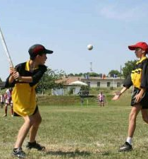
Teams
In Oina, there are two teams of eleven players on the field and up to five alternates to replace injured teammates. The defending team, those in the outfield attempting to catch the ball and stop the batting team, uses three midfielders, six side players, one back player, and one forward player.
Three of the side players line the path a batter will run to reach outfield bases and three side players will line the path a batter will run to return to the home base. The back player guards the furthest base while the forward player guards the home base. The attacking team waits their turn at bat but, unlike baseball, the pitcher is on the batter's team.

Slide 4
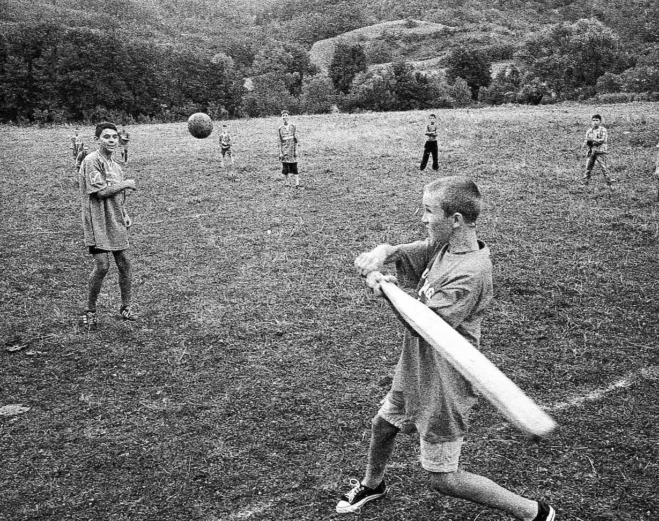
How to Play Oina
When a hitter strikes the ball, they attempt to run along one path to a base in the outfield, them back along another path to the home base. This means there are only two bases in the game, rather than the four used in baseball. If the ball is caught in the air or if a defending team player can touch the runner with the ball as they run between bases, the runner is out.
Each game takes approximately an hour with two, 30-minute halves with the teams switching places at half time. Scoring occurs when the attacking team's players reach a base, both in the outfield and when they return home. The defending team can also score, earning a point for every player they put out of the game before they get to the home base.

Slide 5
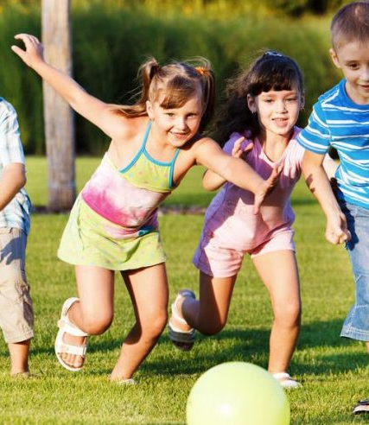
Romanian children play games just like children everywhere else in the world.
In fact, some of these games are very similar to the games played in other countries.

Slide 6
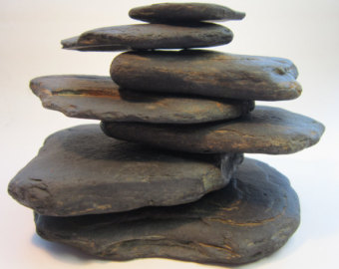
The Castle
The children divide into two teams: defenders and attackers.
One team will build a stack of stones as vertically as possible and guard it against the other children. Usually, a circle on the ground marks the line which the other team must stand behind when attacking.
The attacking team will take turns throwing a ball to knock down the 'castle.' If the stones fall, the attacking team then runs after the defending team, trying to take them with the ball.
The defending team, who scattered as soon as the castle fell in an attempt to escape the attackers, must keep trying to restack the stones while avoiding the attackers.
If the attackers tag everyone before the castle is rebuilt, they win. If the defenders rebuild before all their players are tagged, then they win.

Slide 7
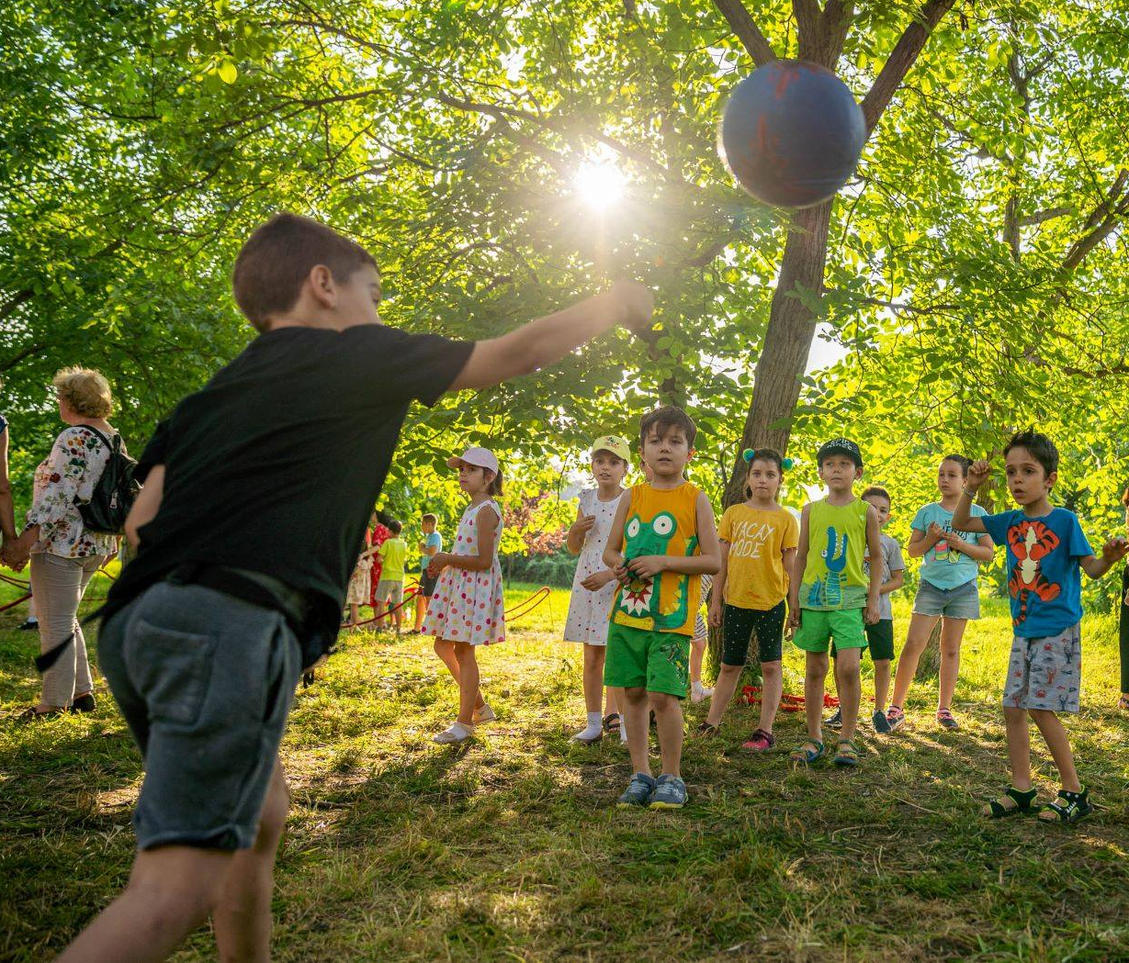
Ducks and Hunters
Two players need to be the hunters and the rest of the children are the ducks. The playground is marked . In each end of the playing space there is a hunter who is not allowed to enter the playing area. The ducks stand between the two hunters, in the centre of the playground.
The ‘hunters’ throw the ball from one to the other, trying to reach the ‘ducklings’ . The ball must fly from one ‘hunter’ to another quickly to catch as many ‘ducklings’ as possible.
The ‘duckling’ who catches the ball will has an extra life.
Duck players hit by the ball must go outside and the first disqualified will take the place of the hunters in the next game.
When there is only one ‘duck’ left in the middle, there will be as many throws as there are years, and if it is not ‘shot’ the ‘Ducks’ team wins. (eg if the duck is 9 years old, hunters have to remove it from the game from a maximum of 9 throws). If hunters fail, the game is restarted with the same hunters.

Slide 8
The little donkey
Three players are chosen, one will stand in the middle as MAGARUS ( little donkey) and the other two will have to throw the ball from one to the other, so that the one in the middle does not catch it.
In case he catches it, the one who passed the ball wrong, will take the place of MAGARUS(the little donkey).

Slide 9
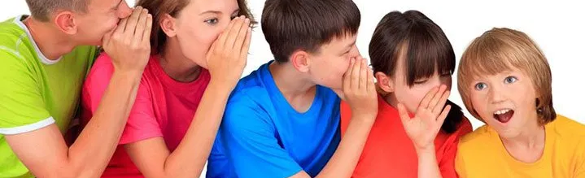
Wireless (Cordless ) Phone
Players sit next to each other . The game starts with the first player who whispers in the ear of the second player a word, chosen at random.
The second player must pass the same word on, whispering in the ear of the player next to him .
The word is whispered from one to another, until the last player who has to say out loud and clear what he understood. It is a game without winners, more fun, because it usually starts with one word and reaches to another.

Slide 10
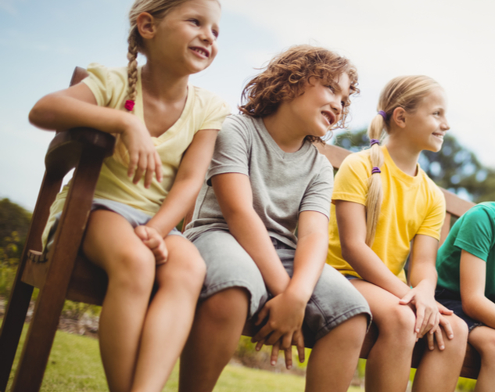
Flowers, girls and boys
It takes at least 4 children to play it.
Two children move away from the rest of the children and choose a number from 1 to 10. After their return the other players must guess number. The first to guess this number will choose a category: flowers, names of girls or boys, or any movie, artist or singer.
The two children who chose the number move away again, each choosing a representative from that category. The one who guessed this number will choose one of the two options, and will pair with the child who chose that option. The game resumes with the new pair.
This game has no winner.
The topics of the game can be adapted from flora and fauna to geography and literature.

Slide 11
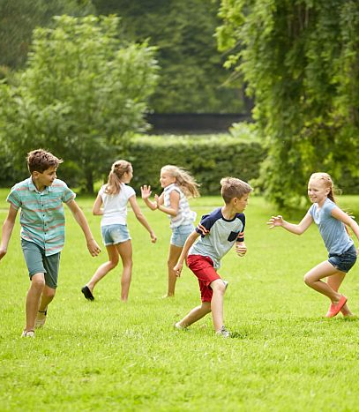
Leapsa
Leapsa is another variation of tag played by Romanian children. In one variation, called Perching Leapsa, the child who is 'leapsa,' or 'it,' tries to touch the other children. However, if a player is at risk of being tagged, they can perch on top of something like a chair or a box and be safe as long as they are not touching the floor.
Another variation, called Circle Leapsa, confines the play area to a circle. The 'leapsa' chases the other children to try to tag them, but if they crouch down before they are touched, they are safe in the same way they would be if they stood on a box in Perching Leapsa.

Slide 12
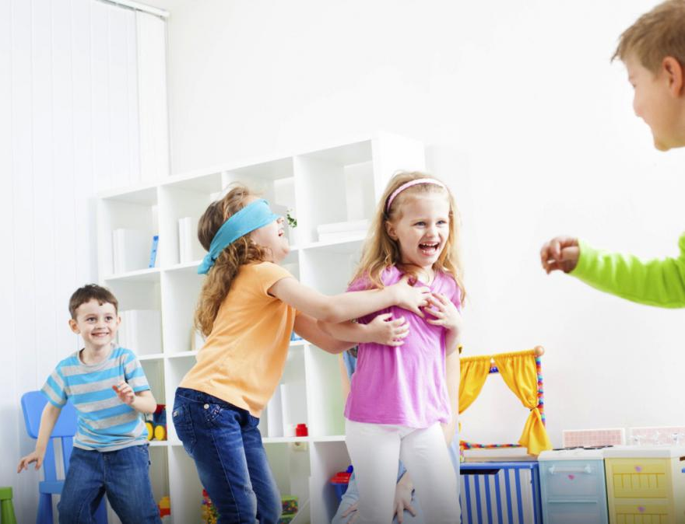
Old Blind Lady
Finally, a game similar to Leapsa called Baba Oarba involves tag with one child blindfolded.
The space in which the game will be played is delimited and children are not allowed to leave from the space . A blindfolded player is chosen (a scarf is tied on his eyes) , hence the name Baba Oarba (Old Blind Lady) . Tis player must catch the other players, who run away from him.
Once a player has been caught , Old Blind Lady tries to guess his name, touching him, smelling him .

Slide 13
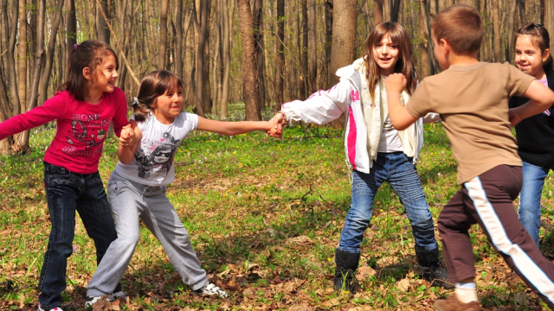
Country, country, we want soldiers!
It is a game that trains team spirit, strategy and speed. It is played with 2 teams, outside, in an uneven space, preferably with grass.
Children form two teams. The teams are placed at a distance, in 2 parallel rows. The members of each team hold hands.
One team shouts, "Country, country, we want soldiers!" The other team chooses a member to send, to break the chain / wall of the opposing team.
If he enters/ breaks the opponent's line, he has the right to choose a child and take him soldier to his team. If he fails to get through their hands, he will remain a prisoner in the opponent team.
The team that runs out of members loses.

Slide 14
Tangled mates
It is a game that challenges mobility, logical thinking and team spirit. It can be played both indoors and outdoors.
It is played in a team of at least 4 players. At the beginning, a child is chosen to handle the "mates". He is not allowed to watch the math tanglers are doing. They sit in a circle, holding hands and tangling, passing under each other's hands, in different directions.
At the signal, everyone stops and the one who was not allowed to watch returns and tries to bring the "mates" to their initial position, following the reverse path. Players are not allowed to take their hands off during the game.
The game ends when the hands have been handled. If not, the one who coordinates the handling is beaten and starts again.

