Slide 1
Spanish/Catalan legends and folk tales

Slide 2
Sir George
Itˋs about a dragon which ate the animals from the village and after all the animals were eaten, he wanted to eat the persons because he was hungry.
They did raffle and the turn goes to the princess.
Before the dragon ate the princess a knight came and killed the dragon in a brutal fight.
And then of the dragons blood grows a rose that the knight give to the princess.
Thatˋs the reason, why it’s traditionally celebrated in the streets of catalonia. Every 23 of april the boys give to the girls a rose, and the girls give to the boys a book.

Slide 5
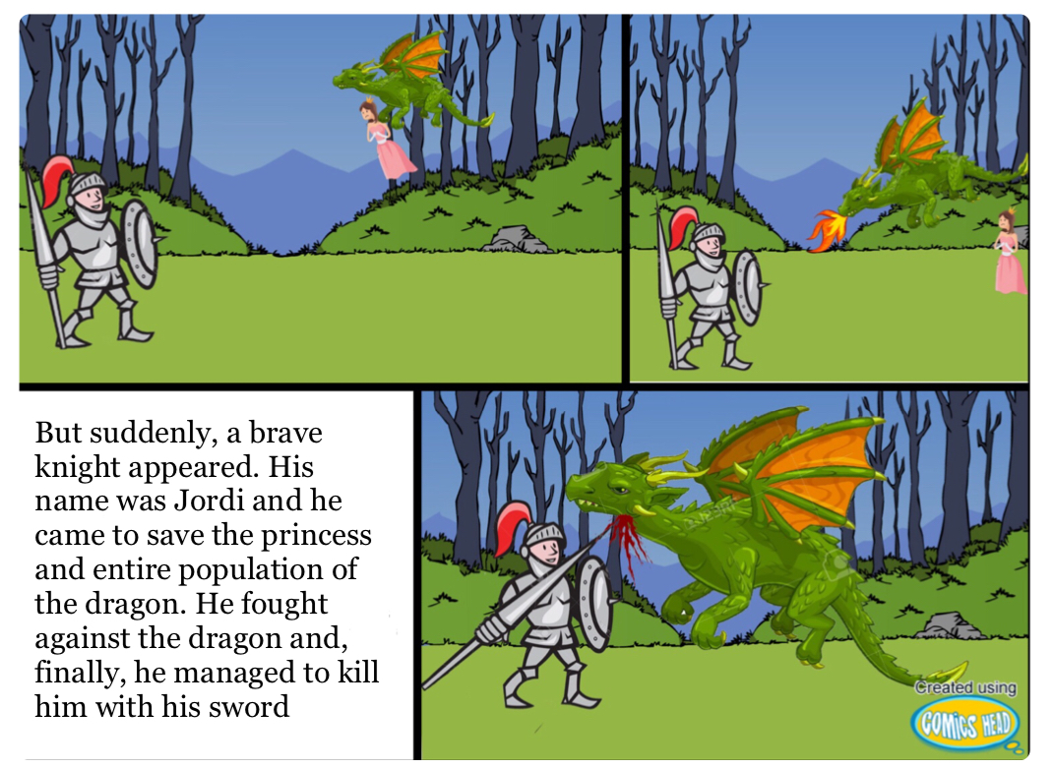

Slide 6
Differences
There are similarities between the spanish legend and the german, italian and hungarian legend.
Hungary: They gave the dragon both genders and not only women. They were chosen by chance.
Italy: The legend is the same
Germany: The legend is also the same

Slide 7
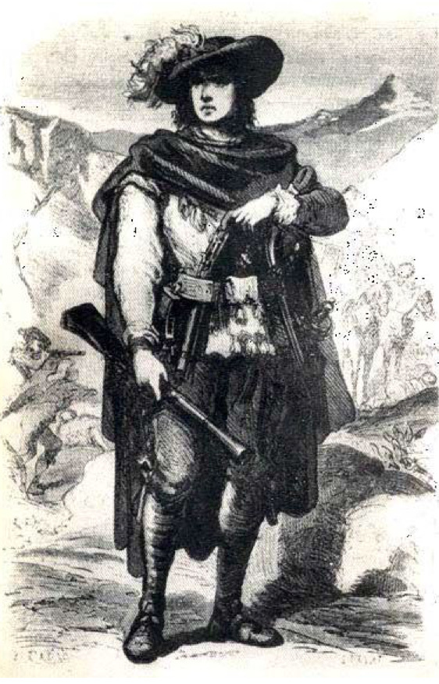
Serrallonga
He took values from the rich and gave it to the poor. But in the end he was killed.
It‘s almost similar to the story of „Robin Hood“
Serrallonga is a very important person for catalans, and we won‘t forget his actions.

Slide 8
Differences
Hungary: There isn’t any legend like this
Italy: It’s like the legend of Robin Hood
Germany: It’s like the legend of Robin Hood

Slide 9
The legend of the cow
It‘s about a grandfather and his apprentice who were walking around the forest. On their way, they saw a farm where a family lived. They had a cow.
The wise man stole the cow from the family and he decided to throw the cow down the cliff.
Months later, when they came back they saw that the family was richer than before because they found a way to survive without the cow.
Thus, they realized that they were able to find a way of living different from the cow.

Slide 10
Differences
Hungary: There isn’t any legend like that
Italy: There isn’t any legend like that
Germany: There isn’t any legend like that

Slide 11
How are the stories told?
The stories are told in the family
They‘re also told in a subjective manner

Slide 12
Topic of the stories
They almost have the same topic
They all play around the time of the Middle Age

Slide 13
Similarities between the legends
All legends are very important for the people living in Catalonia
They all have a moral
There are some similarities between the legends in Spain, Hungary, Italy and Germany

