Slide 1
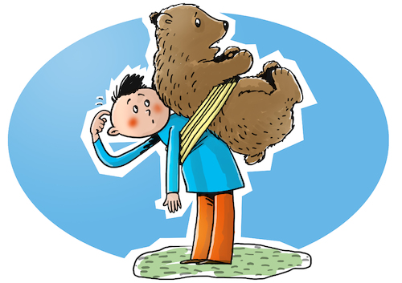

Slide 2
Animal Idioms

Slide 3
German Idioms
Hunde, die bellen, beißen nicht
Aus einer Mücke einen Elefanten machen
Ein Affentheater veranstalten.
Zwei Fliegen mit einer Klappe schlagen
Dogs that bark do not bite.
To make an elephant out of a mosquito.
To make a monkey theater
To hit two flies with one fly swatter

Slide 4
German Idioms
Da hast du aber Schwein gehabt.
Den Vogel abschießen.
Jemanden einen Bären aufbinden.
Jemandem einen Floh ins Ohr setzen.
You got a pig!
To shoot down the bird.
To untie someone a bear.
To put someone a flea in the ear.

Slide 5
Italian Idioms
Non dire gatto se non ce l‘hai nel sacco.
Quando il gatto non c‘é i topi ballon.
Mettere il carro davanti ai buoi.
Moglie e buoi dei paesi tuoi.
Do not say cat if you have not got it in the bag.
When the cat is not there, mice dance.
Put the wagon in front of the oxen.
Wife and oxen of your countries.

Slide 6
Italian Idioms
Lento come una lumaca
An old chicken makes a fantastic soup.
In the mounth of the wolf.
(being) slow like a snail
Gallina vecchia fa buon brodo.
In bocca al lupo.

Slide 7
Hungarian Idioms
Ravasz mint a róka.
Kutyából nem lesz szalonna.
Egy fecske nem hoz nyarat.
Lenyeli a békát.
Sly as a fox.
There will be no bacon from the dog.
One swallow doesn´t make a summer.
Swallow the frog.

Slide 8
Hungarian Idioms
Ajándék lónak ne nézd a fogát.
A béka feneke alatt van.
Köti az ebet a karóhoz.
Elefánt a porcelánboltban.
Don´t look at the tooth of a gift horse.
It is below the buttom of a frog.
He ties the dog to the post.
An elephant in the china shop.

Slide 9
Spanish Idioms
Ser un orge de gats
Tallar el bacalla
Anar peix
Haver-hi gat amagat
To be a cats organ
Cut the fish
Go like a fish
Hide cat

Slide 10
Spanish Idioms
Estar com gat i gos
Donar gat per llebre
Qui roba un ou, roba un bou
Be like cat and dog
Give cat for bunny
Who steal a egg, steal a cow

Slide 11
Idioms that are used in every Erasmus language
to be slow like a snail
sly as a fox
one swallow does not make a summer
To make an elephant out of a mosquito
To hit two flies with one fly swatter

