Slide 1
Italian legends and folk tales

Slide 2
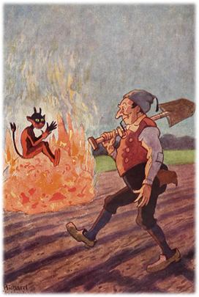
The devil and the peasant
The devil sits on a treasure on the peasants field. When the farmer goes to the devil, he is offered to get the treasure in exchange to give the devil half of the crop for two years. The peasant agrees and says the half above the ground is the devil’s and the half under the ground is his. After the devil agreed the peasant planted turnips. When the devil noticed he got nothing, he said they must do it the other way round the next year. So the next year the farmer grew wheat. In the end the devil returns angrily into earth and the peasant gets the treasure

Slide 3
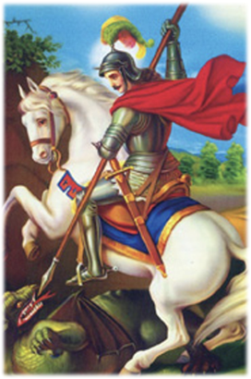
St. George
Once upon a time a city was attacked by a dragon. To make sure he doesn’t destroy the city, every day a pure girl has to be sacrificed. One day only the king’s daughter was left, and she said she doesn’t want to be treated in a different way than other ladies. At this point God tells his angel St. Michael to find a knight who kills the dragon. Sir George was chosen to kill the dragon and for that he receives a portion which protects him from the dragons breath. But when he hits the dragon with his sword, it brakes. Meanwhile he fights, the peasants decide to join him, even tough all swords are broken. Sir George asked for help and so St. Michael goes to god a receives a piece of the sun. At this point all swords are recomposing and she sun blinds the dragon and Sir George kills the dragon. For this brave action he receives half of the kingdom and the opportunity of marrying the princess

Slide 4
Common themes, topics and similarities
In both stories appear mythical creatures
The Hero/ Winner always gets a price
Always a good one and an evil one
In both legends there is a superstition

Slide 5
How are the stories told ?
The stories are told by a narrator
They are told in dialect and most appear in books
Moreover they are written in a neutral manner
Normally they are headed down orally

Slide 6
Similarities/ Differences between all the stories
Sir George is nearly the same in Italy and Spain
Dragon tries to eat the princess and a knight comes and safes her
Dragon dies in both stories
In Spain animals were sacrificed first, then the people
In Hungary women and men were sacrificed

