Slide 1
German Holidays

Slide 2
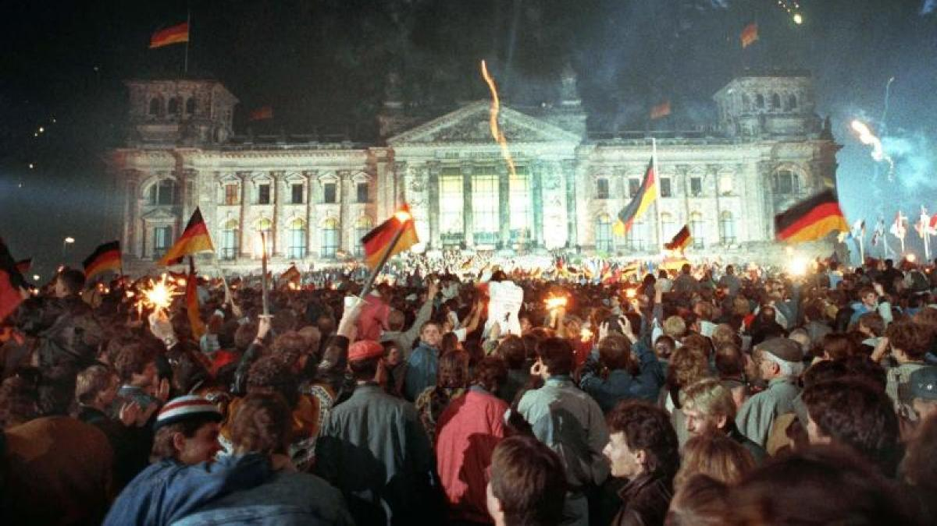
German Unity Day (3rd October) -> “Tag der Deutschen Einheit“
celebrated on 3 October
commemorates German reunification in 1990 when the Federal Republic of Germany (West Germany) and the German Democratic Republic (East Germany) were unified
is celebrated with a ceremonial act and a citizens' festival
image [1]

Slide 3
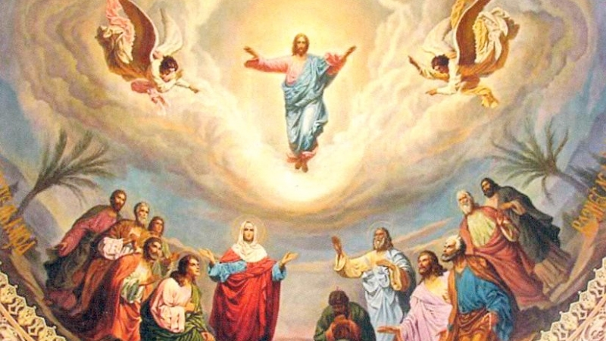
Feast of the Ascension -> “Christi Himmelfahrt“
celebrated 39 days after Easter
commemorates the Christian belief of the bodily Ascension of Jesus into heaven
is one of the ecumenical feasts of Christian churches, ranking with the feasts of the Passion, of Easter, and Pentecost.
image [2]

Slide 4
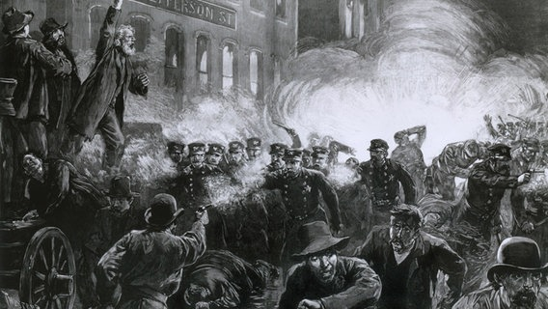
Labor Day (1st May) -> “Tag der Arbeit“
origin: 1st May 1886 massive strikes and demand for eight-hours workday
holiday lost its meaning of protesting for better working conditions
today: this day is primarily used as free time
image [3]

Slide 5
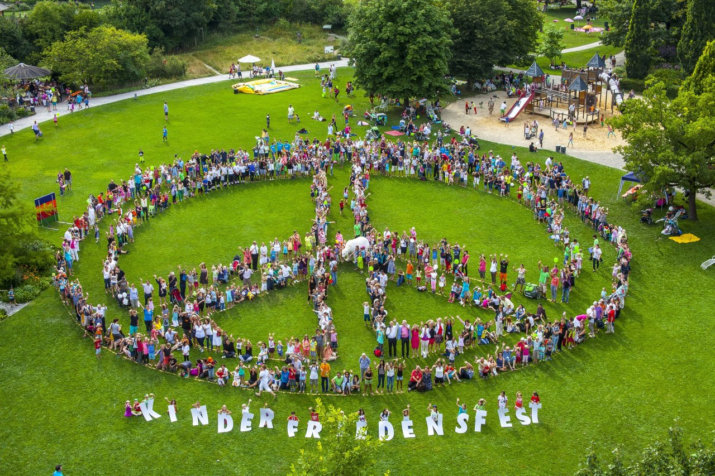
Augsburger Peace Festival (8th August) -> “Augsburger Friedensfest“
commemorates the parity of the city of Augsburg as well as the tradition of handling conflicts peacefully ever since the signing of the Augsburger Religious Peace agreement
only celebrated locally in the city of Augsburg
image [4]

Slide 6
Sources:
image [1]: https://www.augsburger-allgemeine.de/politik/Tag-der-Deutschen-Einheit-2021-Warum-ist-der-3-Oktober-ein-Feiertag-id55555651.html
image [2]: https://www.fsspx.at/de/news-events/news/christi-himmelfahrt-30022
image [3]: https://www.ndr.de/geschichte/chronologie/haymarket100_v-contentgross.jpg
image [4]: https://www.unesco.de/sites/default/files/styles/1280w/public/2018-12/007-BY-FRIEDENSFEST-Foto009_Kinderfriedensfest_ChristianMenkel.jpg

