Slide 1
cHristianity education

Slide 2
General informations
V-XV century (from the fall of the Western Roman Empire to the Age of Discovery)
Divided into three periods: Early, High and Late Middle Ages.
Population decline, counter urbanisation, invasions and movement of people.

Slide 3
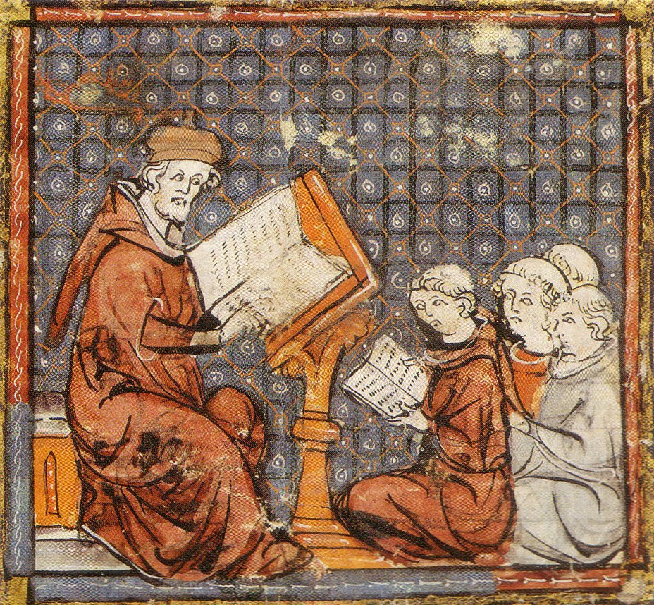
Let’s make the point…
At that time society was based on ancient Roman and Germanic culture but then, as soon as the Church became more powerful, it started leading the developement of the educational system. Since the Church was against the ancient culture and Germanic costumes, it decided to close down all pagan schools, by the year 529. Since then the teachers have been monks priests and bishops.
http://1.bp.blogspot.com/-FP_45j-3uK8/T0wfPUAu0JI/AAAAAAAAALY/CtBOrps1Ljc/s1600/Philo_mediev.jpg

Slide 4
Let’s compare…
Teachers were clericals
Education was something affordable just for the elite, and girls were not allowed to it
Young people were forced to obey and submit to their teachers, as they were cruely punished if they didn’t
During 1330 just the 5% of population could read and write
Education aimed to prepare for war and not for life
Teachers are laical people
Education is free and compulsory for everyone, thanks to the fundamental rights
There is so much more free thinking as teachers have the duty to not affect their pupils
Basically everyone can read and write nowadays
Also thanks to Europe we can focus on studying and we don’t need to be ready for wars, as we live in a peaceful society

Slide 5
LET’S DIVE INTO THE MIDDLE AGE…
If we lived in middle ages most of us wouldn’t be able to take part to school lessons, and we would be forcefully educated to only one way of thinking, so that our possibilities would be so limitated. A very important point to underline is that all the powerful people had been educated according to the same ideas. As a consequence no right laws could be maken and everything used to depend on Christianity influence and people.

Slide 6
Education is the most powerful weapon which you can use to change the world.
- Nelson Mandela
Calefati Diana
Chiatto Ilaria
Simone Martina
Tesse Alessandro
Kraus Simon
Barabas Hanna

