Slide 1
SECULARIZATION (education)

Slide 2
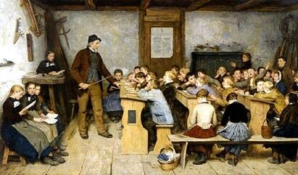
In general:
The secularization process started in 1648 with the Vestfalia peace. We can say it is the transition of the Church’s wealth and property to the State autority.

Slide 3
GERMANY
Before (18th century):
Education had already some modern
approaches; indeed there was a general
compulsory education, but you had to pay the
lessons.
So for many children it was impractical because
their parents could not afford that and the
schools were too far from their homes.

Slide 4
Today:
Now churches aren’t as important as they were
before.
Now everyone has to go to school for nine years
no matter how much money they have or where
they live.

Slide 5
ITALY
Before (18th century):
During this period started the process through
which the education passed from the Church to
the State.
But this transition was gradual indeed there was
still the influence of the Church.

Slide 6
Today:
Now schools are public and laic. So the Church
doesn’t have anymore the same importance as
before.
Nevertheless the illiteracy is still present, in
particular in the South.

Slide 7
SPAIN
Before (18th century):
The education was based on physical education
and in the study of classic authors and history.
There was also the admiration and respect for
Christianity and God.

Slide 8
Today:
Now it’s different. There are other subjects and
schools are private and public, unlike before
there are more public schools than private.
Now the scholastic education reaches 16 years.

Slide 9
HUNGARY
Before (18th century):
The schools were in the hands of the Church.
But in 1777, Maria Theresa (the queen), with a
law called “Order Ratio Educationis” placed all
the religious schools under State supervision
and the number of shools has increased.

Slide 10
Today:
Now, teaching in Hungary is quite complicated.
Anyway schools are public and seculum, but
there aren’t too many teachers and the children
must learn a lot of subjects so they are tired of
it.

Slide 11
Gerard Bosch
Confalone Mattia
Coppola Flavia
Pistillo Sara
Ehinger Jana
Vègh Anna

