Slide 1
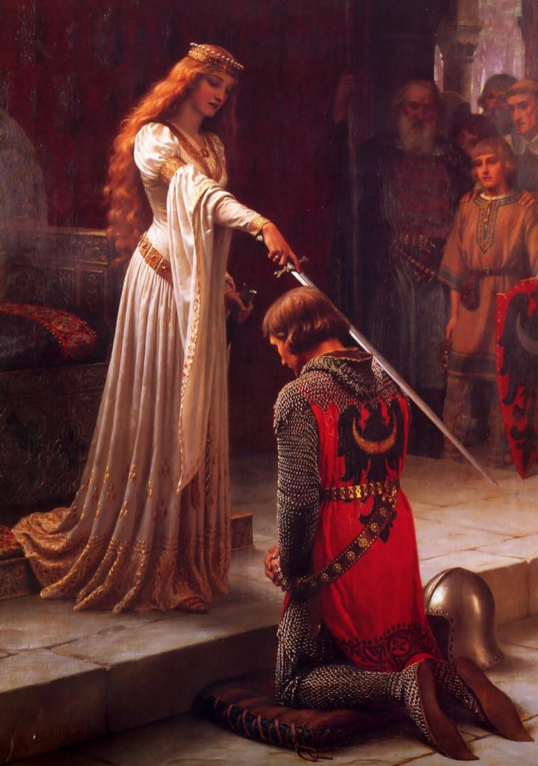
Christianity (normal life)

Slide 2
Daily life
It was difficult to have a normal life because people had to fight for their lives all the time.
The life for a teen living in a poor family was really different to the life of one living in a rich family

Slide 3
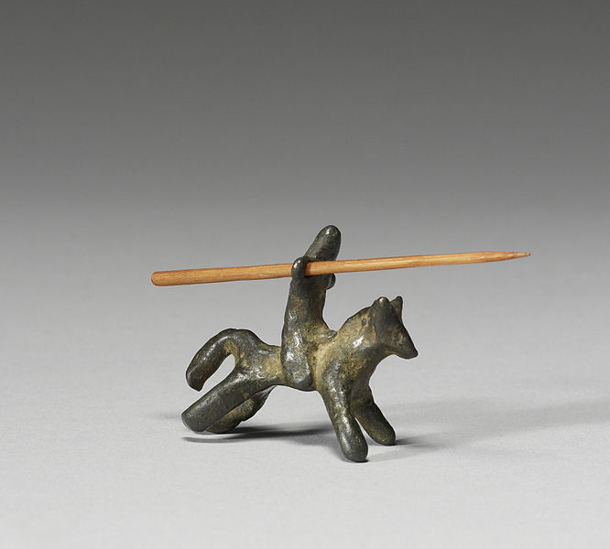
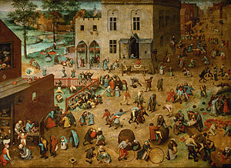
Free time activities
The amount of free time and type of leisure activities also depended on the rank of the family

Slide 4
Influence of the Christianity
Faith and the practice of religious ritual took a firm place in the everyday life
Praying such as saying grace was an integral part of the daily routine

Slide 5
Comparison with our life
Today everyone goes to school also the poor ones
Christianity isn’t as important today as it was in the Middle Age
There are much more leisure activities and games even for the poorer people than earlier
People now are a lot healthier and there are far less diseases than in the past

Slide 6
Credits:
-Chieppa Annarita
-Civita Armando
-Testini Vincenzo
-Claudia Roldan
-Kindl Christian
-Aina Maynou

