Slide 1
June 4 Day of National Unity
Source: https://hu.wikipedia.org/wiki/A_magyar_z%C3%A1szl%C3%B3_%C3%A9s_c%C3%ADmer_napja

Slide 2
What is National Unity Day in Hungary?
It is also known as the Memorial Day of the Treaty of Trianon
It is a holiday to commemorate a great ”national tragedy” that occured as a result of World War I
It has been an official holiday in Hungary since 2010
This day is a great opportunity for us Hungarian citizens to unite with Hungarian people who live outside the country

Slide 3
Treaty of Trianon
It was an agreement, but Hungarians tend to describe it as ”trauma” or ”tragedy”. It also meant the collapse of the Austro-Hungarian Empire.
It was signed on June 4, 1920, at the Trianon Palace at Versailles, France.
The treaty concluding World War I was signed by the representatives of Hungary on one side and the Allied Powers on the other.
Hungary was dismembered and it lost two-thirds of its pre-war territory and almost the same proportion of its population.
Millions of Hungarians found themselves living in foreign countries.

Slide 4
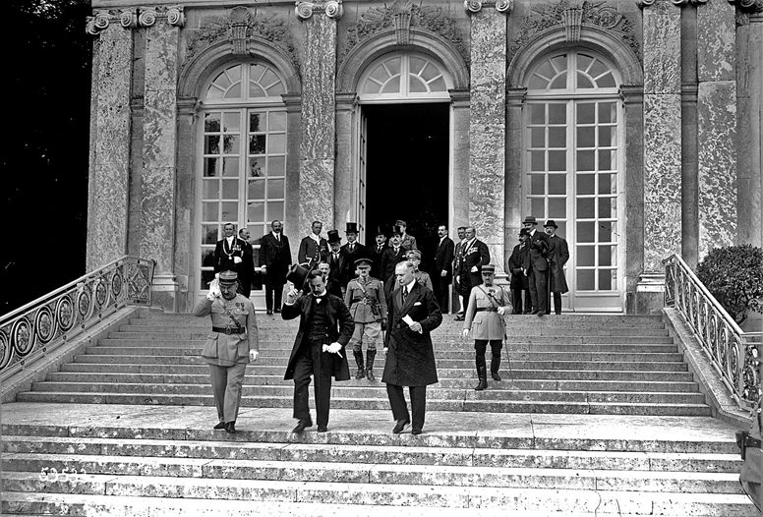
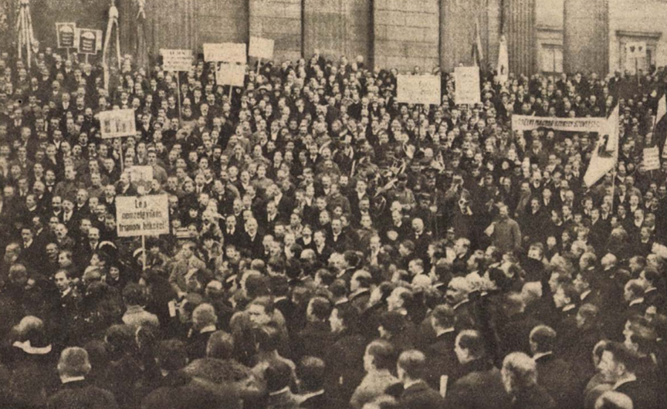
During WWII, Hungary managed to take back some of its lost territories. The Trianon frontiers were, however, reinstated in 1945.
”Trianon is everywhere, it is a part of our culture, our music, our history and our politics. It is very hard to understand Hungary without understanding it.” Dániel Bartha (CEID)
https://egypercestortenelem.blog.hu/2020/06/03/a_trianoni_bekeszerzodes_napja_kepekben

Slide 5
Disannexed Areas
Upland (Slovakia):km² 884 000 people- 30% of the local population
Transilvania (Romania): 102.813km² 1 662 000 people– 32% of the local poulation
Vojvodina (Serbia): km² 420 000 people – 28% of the local poulation
Transcarpathia (Ukrajna): km² 183 000 people– 30% of the local population
Croatia: 20.829km² 121 000 people – 3,5% of the local population
Mura region (Slovenia): 42 541km² 20 800 people – 1,6% of the local population

Slide 6
Burgenland (Austria): 4020km² 26 200 people– 9% of the local population
Source: https://doksi.hu/news.php?order=ShowArticle&id=466

Slide 7
Trianon Aftermath: Life beyond the borders
Millions of Hungarians were forced to live in the neighbouring countries. Their rights were limited and they had to face discrimination every day. They were deprived from citizenship, even from education in their mother tongue. The goverments of these countries made a lot of efforts to assimilate the Hungarian minorities into their societies.

Slide 8
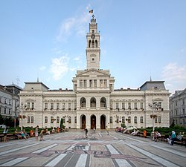
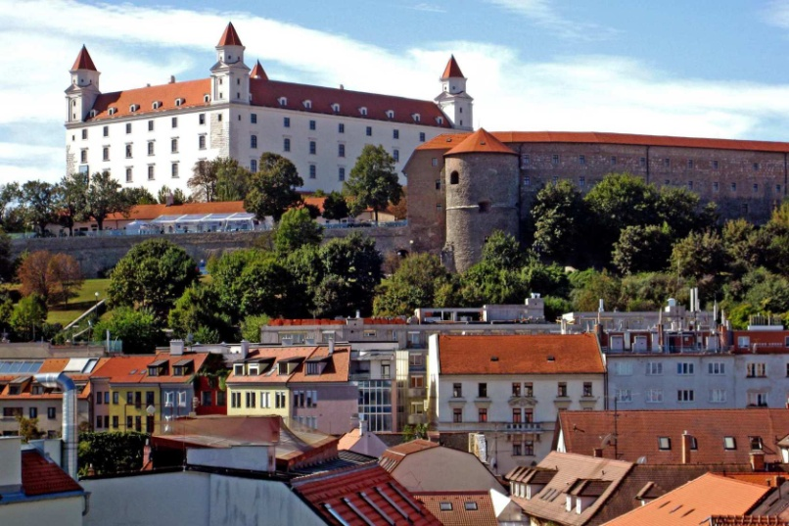
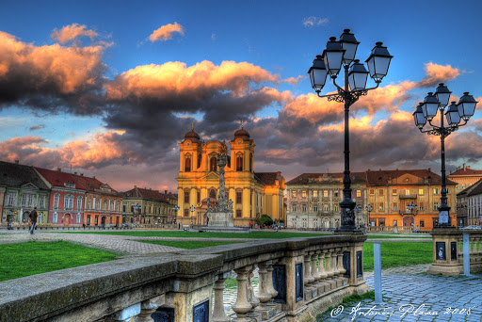
Famous cities disannexed from Hungary
Arad
Bratislava
Timisoara
Source: https://hu.wikipedia.org/wiki/F%C3%A1jl:Arad_Rathaus_3689.jpg
Source: https://www.latimes.com/travel/la-tr-bratislava-20120429-story.html
Source: http://www.magyarvagyok.hu/kultura/regiok/erdely/banat/3863-Temesvar.html

Slide 9
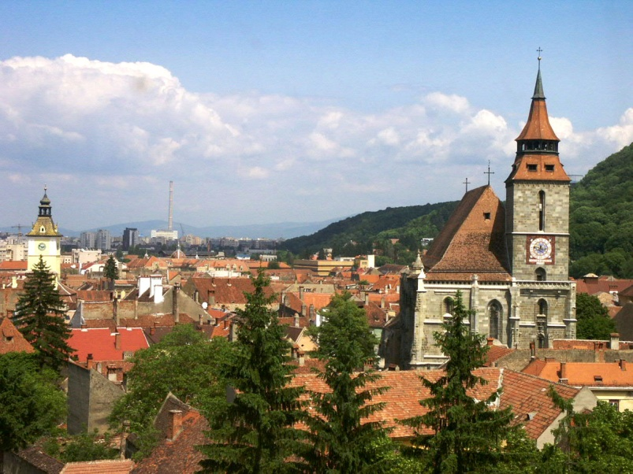
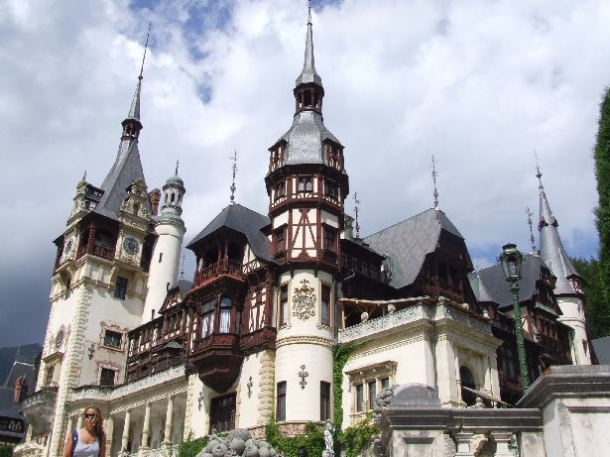
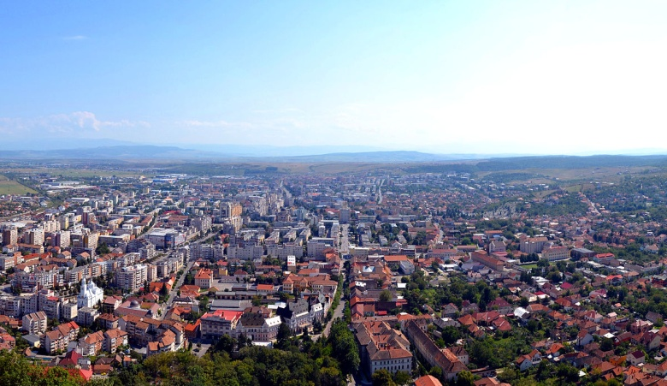
Brasov
Sighisoara
Source: https://hu.wikipedia.org/wiki/Brass%C3%B3#/media/F%C3%A1jl:Brassopanorama.jpg
Deva
Source: https://www.karpatinfo.net/latnivalok/segesvar-tortenelmi-kozpontja
Source: https://hu.wikipedia.org/wiki/D%C3%A9va#/media/F%C3%A1jl:RO_HD_Deva_Centru.jpg

Slide 10
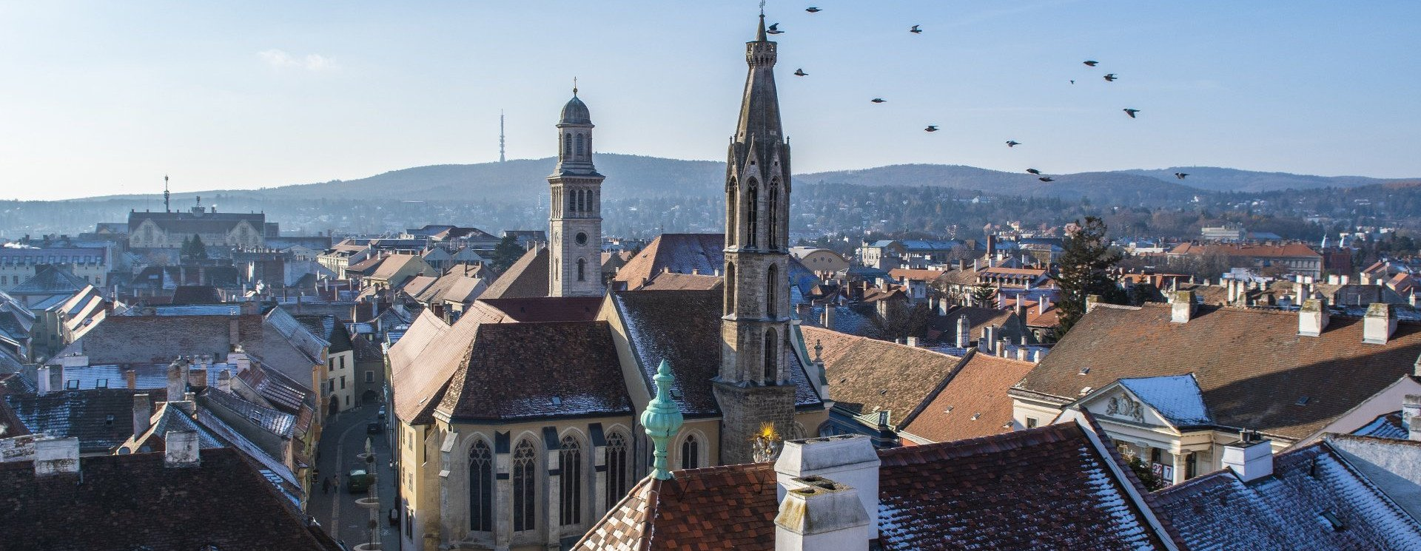
Sopron- The Town of Loyalty
Source: https://www.turistamagazin.hu/hir/sopron-tuztoronytol-a-banfalvi-kolostorig
In December 1921, a referendum was held to decide if Sopron should belong to Austria or Hungary. The residents of Sopron chose to remain with Hungary, earning it its respectable title ”The Town of Loyalty”.

Slide 11
Thank you for your attention!
Presentation by: Kristóf Baranyi Ábel Györe
Fruzsina Gaál Lili Lendvai

Slide 12
Sources:
https://www.hungarianpod101.com/blog/2020/05/25/celebrating-national-unity-day-in-hungary/?fbclid=IwAR0KCfqAfNsEv2ppsb8nBChxhVShcIymajABs_LHygTY4Y1cNSTc0zpz-y8
https://www.euronews.com/2020/06/04/trianon-trauma-why-is-the-peace-treaty-signed-100-years-ago-seen-as-a-national-tragedy
https://doksi.hu/news.php?order=ShowArticle&id=466
https://hungarytoday.hu/13041-2-89989/
https://www.linkedin.com/pulse/understanding-hungarys-day-national-unity-mikl%C3%B3s-korn%C3%A9l-l%C3%A1z%C3%A1r?fbclid=IwAR2vn4wDTjTNtl5EBsuy3OTjIzNK4gMQGfCoFRQwYVIxJqpaOMSkQb4vTr0

Slide 13
Pictures:
https://hu.wikipedia.org/wiki/A_magyar_z%C3%A1szl%C3%B3_%C3%A9s_c%C3%ADmer_napja
https://egypercestortenelem.blog.hu/2020/06/03/a_trianoni_bekeszerzodes_napja_kepekben
https://doksi.hu/news.php?order=ShowArticle&id=466
https://hu.wikipedia.org/wiki/F%C3%A1jl:Arad_Rathaus_3689.jpg
https://www.latimes.com/travel/la-tr-bratislava-20120429-story.html
http://www.magyarvagyok.hu/kultura/regiok/erdely/banat/3863-Temesvar.html
https://hu.wikipedia.org/wiki/Brass%C3%B3#/media/F%C3%A1jl:Brassopanorama.jpg
https://hu.wikipedia.org/wiki/D%C3%A9va#/media/F%C3%A1jl:RO_HD_Deva_Centru.jpg
https://www.karpatinfo.net/latnivalok/segesvar-tortenelmi-kozpontja
https://www.turistamagazin.hu/hir/sopron-tuztoronytol-a-banfalvi-kolostorig

