Slide 1
October 23rd: A National Holiday for Hungary
https://www.siofok.hu/media/thumbs/me/ge/ml/megemlekezes-oktober-23-an-3b460423-127848.jpg

Slide 2
In Hungary, October 23rd is a national holiday, which is celebrated with speeches, exhibitions and wreathing ceremonies at the tombs of the martyrs in remembrance of the 1956 revolution when the Hungarians attempted to break free from Soviet rule.

Slide 3
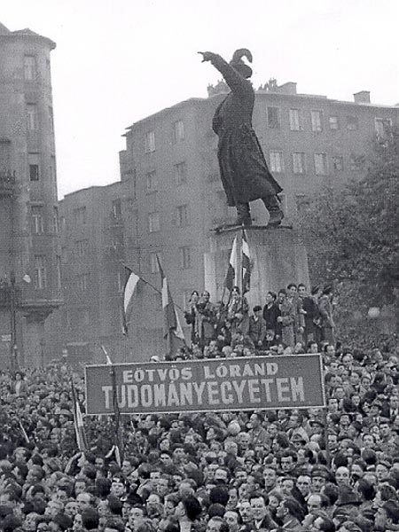
The uprising began as a student protest. On October 23, 1956 university students marched through central Budapest to the Hungarian Parliament and thousands of people joined them.
https://www.elte.hu/media/62/19/e5d6922a921fbf90d6bbacb167b16bab5bca552747ee2bd4c5c753116c31/elte3.jpg

Slide 4
When a student delegation wanted to enter the radio building to broadcast their demands listed in 16 points, they were fired upon by the State Security Police (called ÁVH in Hungarian). The revolt spread quickly throughout the country and militias were organised to fight against the ÁVH and Soviet troops.

Slide 5
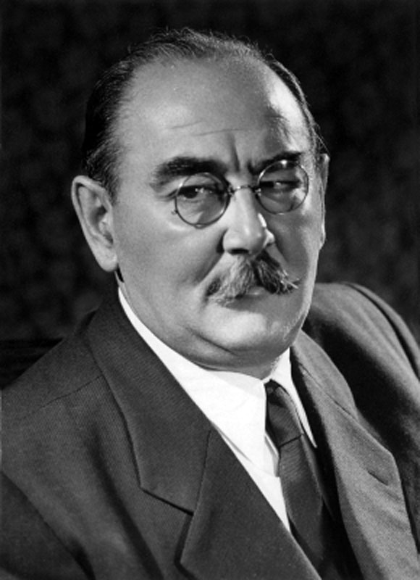
A revolutionary government was formed and Imre Nagy was asked to become prime minister.
http://www.nagyimreemlekhaz.hu/en/sending-e-card/odudecardshow/3/17.html

Slide 6
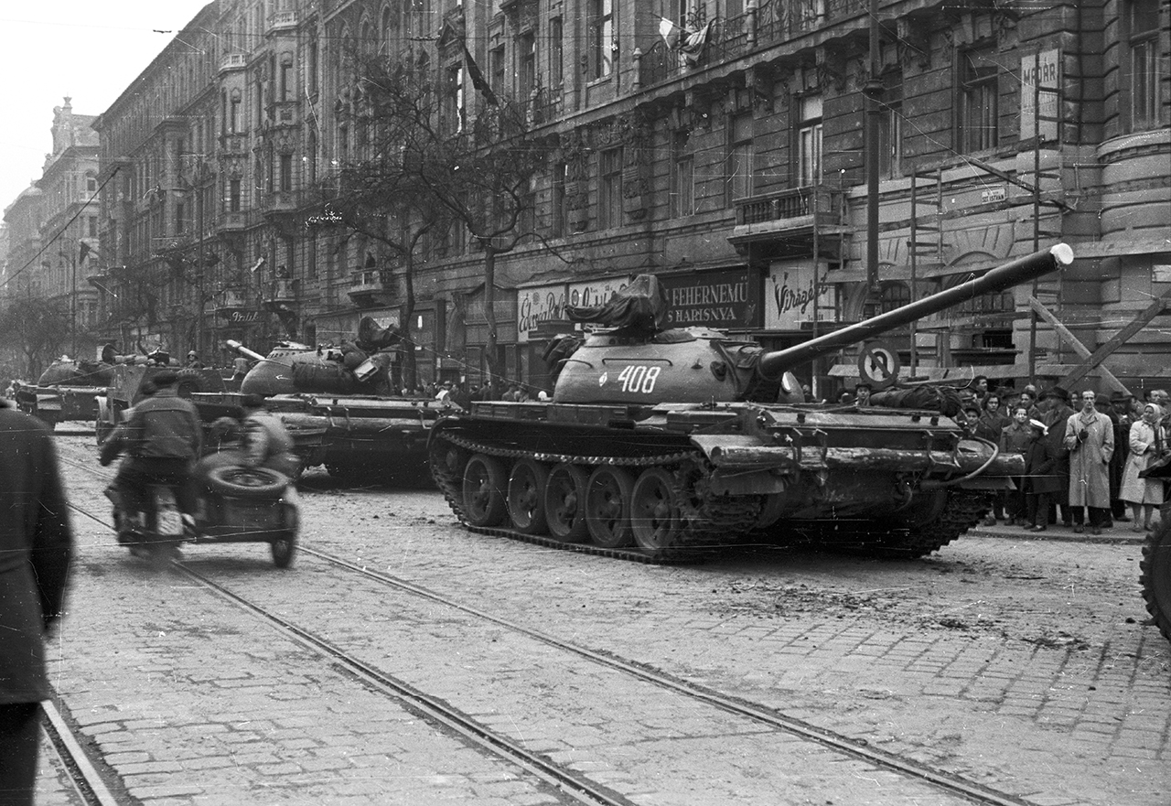
The revolution lasted only until November 10, 1956. On November 4 a large Soviet troop invaded the country and suppressed resistance.
https://taximagazin.hu/wp-content/uploads/2016/09/fortepan_40195-kicsi.jpg

Slide 7
About 200 000 Hungarians fled the country in fear of retaliation. Indeed, mass arrests and denunciations went on for months. The prime minister, Imre Nagy, was captured and deported to Romania. Two years later he and other leaders were tried for treason, executed and buried in an unmarked grave. In 1989, when Hungary finally became independent on the Soviet Union, these prominent figures were rehabilitated and reburied with full honours.

Slide 8
Legacy of the Revolution
The attempt for independence failed, but it was not in vain. The revolutionary spirit swept through all the countries which were forced to belong to the Communist Eastern Block, and it promoted the drive for historic change and democratic development in Europe. The events of 1956 in Hungary represent the struggle for liberty, independence, democracy, economic and cultural well-being.

Slide 9
”October 23, 1956, is a day that will live forever in the annals of free men and nations. It was a day of courage, conscience and triumph. No other day since history began has shown more clearly the eternal unquenchability of man's desire to be free, whatever the odds against success, whatever the sacrifice required.”
John F. Kennedy
(on the first anniversary of
the Hungarian Revolution)

Slide 10
Thank you for your attention!

Slide 11
Sources:
http://www.hunglish.org/articles/1956-revolution-of-hungary
https://en.wikipedia.org/wiki/Hungarian_Revolution_of_1956
https://en.wikipedia.org/wiki/Imre_Nagy
http://www.hungarianreview.com/article/legacy_of_the_revolution_-_the_Hungarian_experience

Slide 12
Pictures:
https://www.siofok.hu/media/thumbs/me/ge/ml/megemlekezes-oktober-23-an-3b460423-127848.jpg
https://www.elte.hu/media/62/19/e5d6922a921fbf90d6bbacb167b16bab5bca552747ee2bd4c5c753116c31/elte3.jpg
http://www.nagyimreemlekhaz.hu/en/sending-e-card/odudecardshow/3/17.html
https://taximagazin.hu/wp-content/uploads/2016/09/fortepan_40195-kicsi.jpg

Slide 13
Presentation by:
Soma Janzsó
Ábel Takács
Erik Horváth

