Slide 1
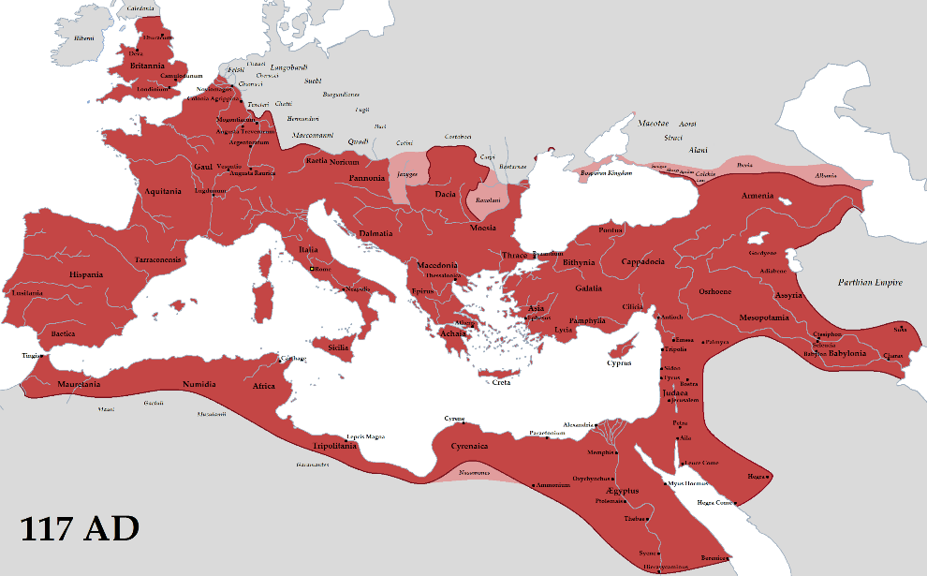
THE ROMAN EMPIRE
From the prespective of a teenager

Slide 2
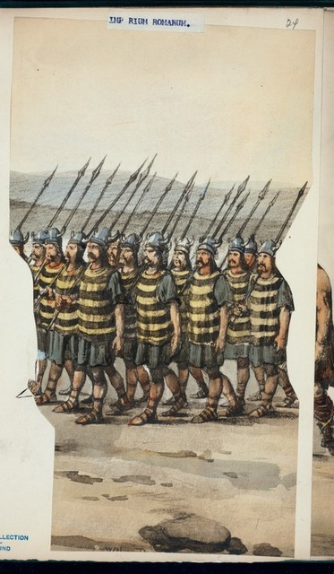
Teens from the Roman Empire:
Girls were not allowed to go to school and they were married at a very young age (12 years old).
From the age of 14 to 17, boys had to go to the military school for preapering themselves to the war
Just rich people had the possibility to go to school

Slide 3
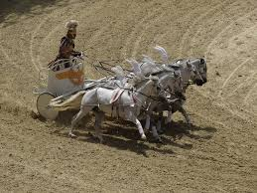
In their freetime they did outdoor activies
They did not meet people from the other part of the world, because they had no possibility to travel with train, plane or car, they had just their animals

Slide 4
Teens from today’s time:
Everyone has the right to attend a school, no matter if they are poor or rich
Poor people are supported by our state to pay for the school equipment
Everybody is allowed to do sports in school

Slide 5
Teens nowadays spend a lot of time on social medias
Today we have a lot of technology and exchange programs even in schools, so we can connect with poeple from all over the world and meet them in pearson
We are able to travel, because we have improved means of trasport, like plane, trains and cars

