Slide 1
Blended Learning scenarios in Foreign Language Lessons
An implementation to the Station Rotation Model

Slide 2
Blended Learning is an integrated learning approach that optimally exploits the possibilities available today, that means networking via the internet or intranet connection, with classical learning methods and media in a meaningful learning arrangement.

Slide 3
Characteristics
Learning
Communicate
Information
Knowledge management
Creativity
Differentiation

Slide 4
The aim of the mixed model is to optimize the learning process, in order to enable the achievement of the individual needs of students as well as their learning goals.

Slide 5
Didactic blended learning scenarios (according to Schulmeister):
Face to face meetings with electronic materials (www-Materialien)
Face to face meetings where Internet communication methods are in use, such as E-mails, forums, chats, etc.
Face to face courses alternate with virtual courses.

Slide 6
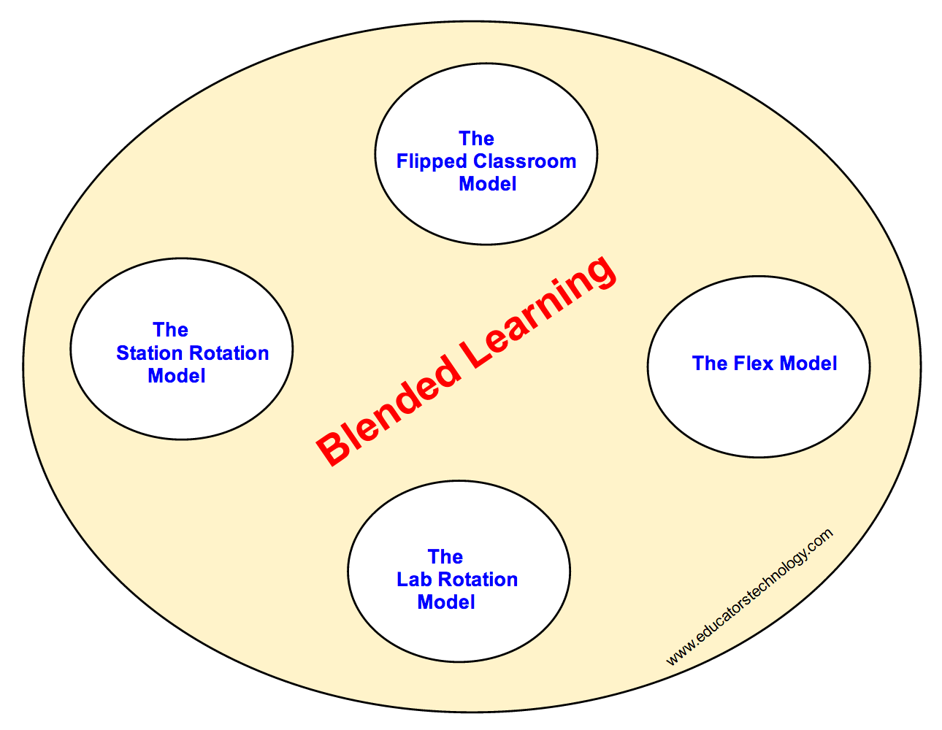
4 main blended learning models (Clayton-Christensen Institute)

Slide 7
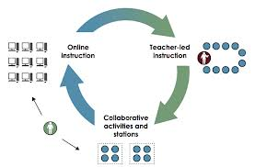
Station Rotation Model

Slide 8
Zeit: 15 Minuten pro Station
Aufgaben aus dem Buch
Schueler 5
Schueler 7
Schueler 6
Schueler 8
Schueler 9
Schueler 11
Schueler 12
Schueler 10
Arbeitsblatt
Blended learning/Station rotation model
Quizlet
Schueler 1
Schueler 3
Schueler 2
Schueler 4

Slide 9

Implementation in the class

Slide 10
Advantages of Blended Learning
The teaching scenarios presented here are integral parts of the learning process.
They combine virtual and face to face elements of the course.
Teaching and learning method at the same time.
Open, creative and collaborative process.
Promotes the autonomy of learning.

Slide 11
Conclusions of the case study
Students worked on the instructions they were given.
During the change of the stations there was a small inconvenience that did not last too long.
The time given for work per station was 10-15 minutes, which were utilized to the maximum.
Diversification of work excited students. When asked if they were tired during the course, they replied that not only they weren’t, but that "it was fun", and “we could do it again".
Although the students seemed familiar with the particular application, it takes even more familiarization with the use of technology at home.

