Slide 1
Christmas pies
Inese Rozenberga,Kristīne Reinholde, Grade 10
Dundagas vidusskola

Slide 2
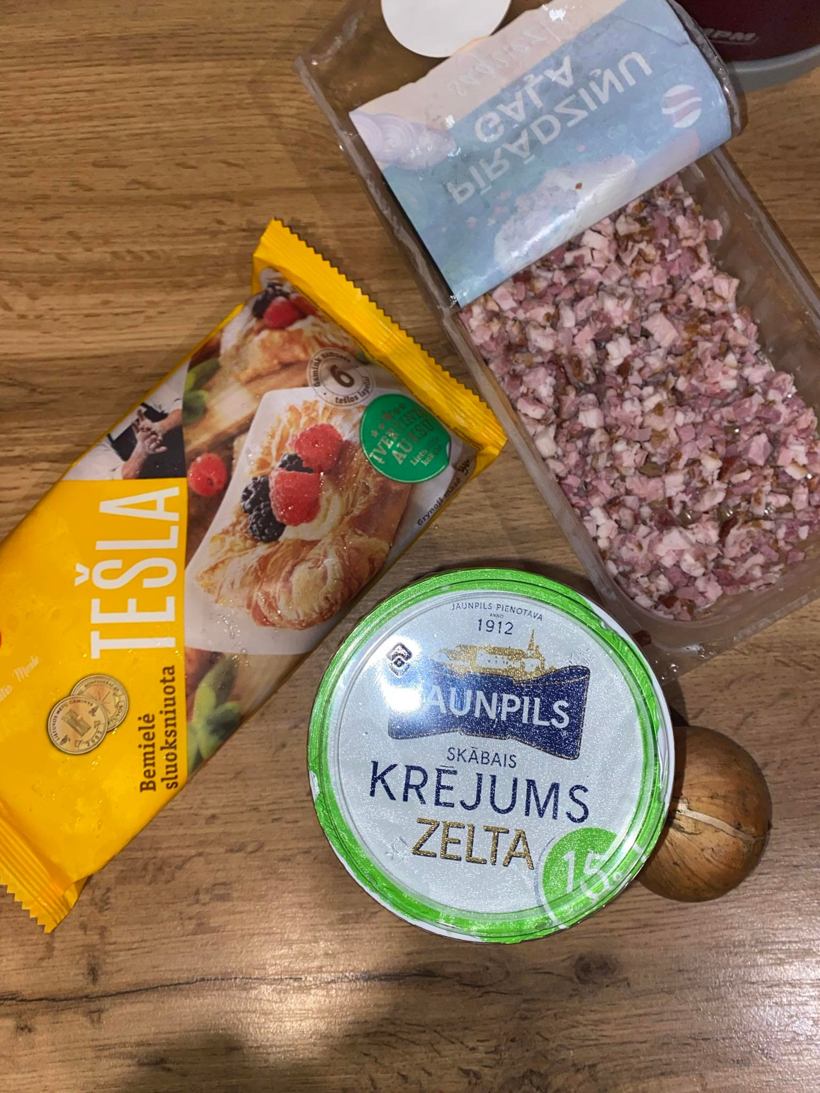
Ingredients
Puff pastry;
Onion;
One egg;
Sour cream;
Smoked meat;
Salt and pepper

Slide 3
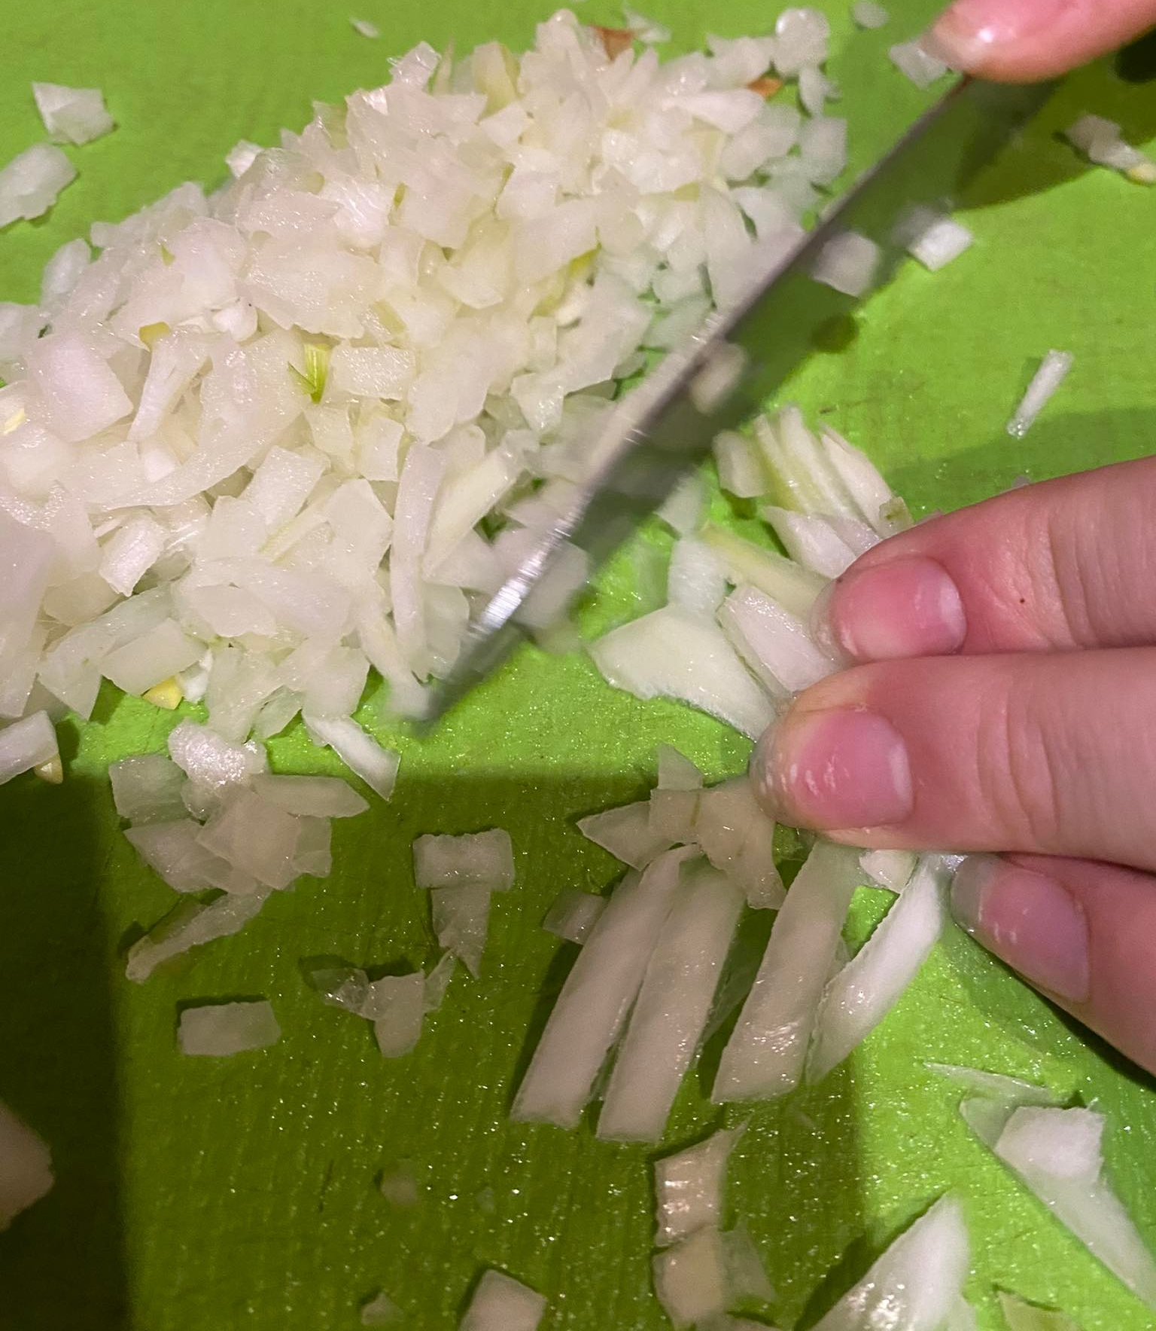
Step 1
Cut the onions into fine pieces

Slide 4
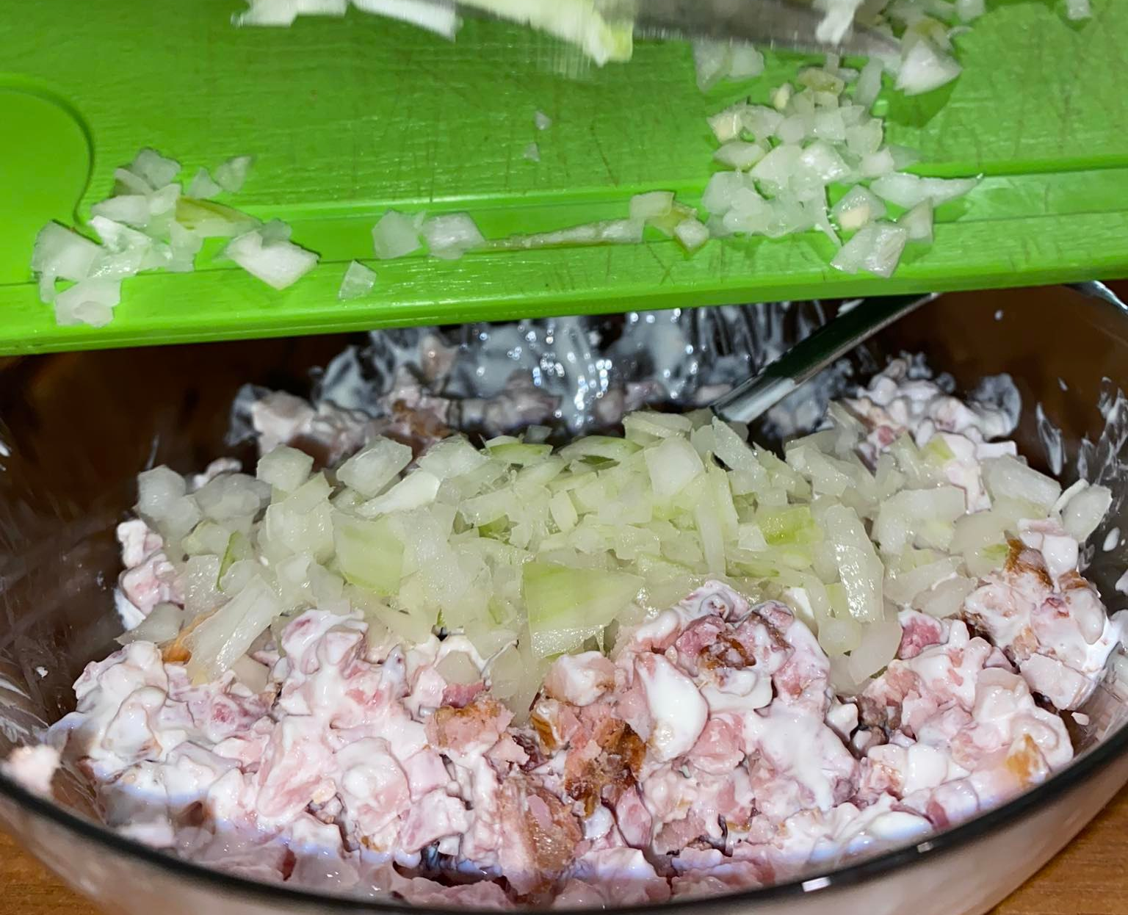
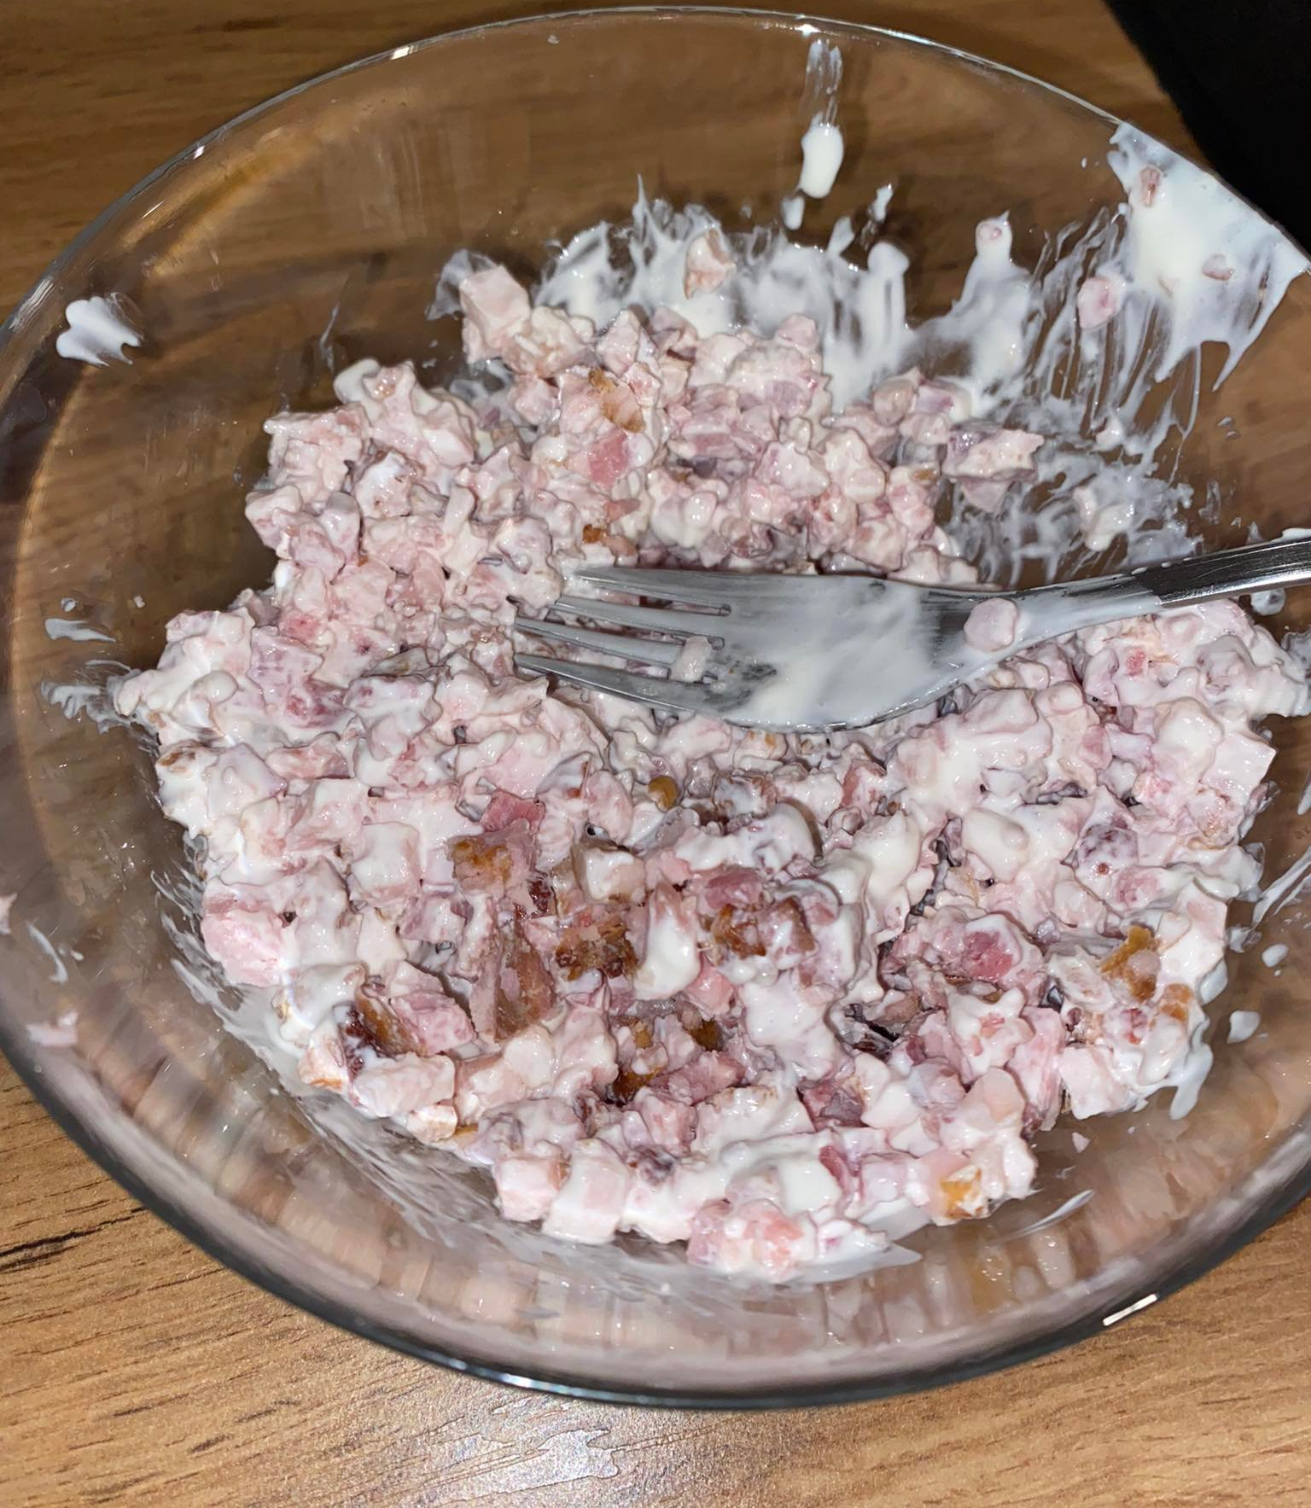
Step 2
Mix all together:
chopped onions,meat,sour cream and salt+pepper

Slide 5
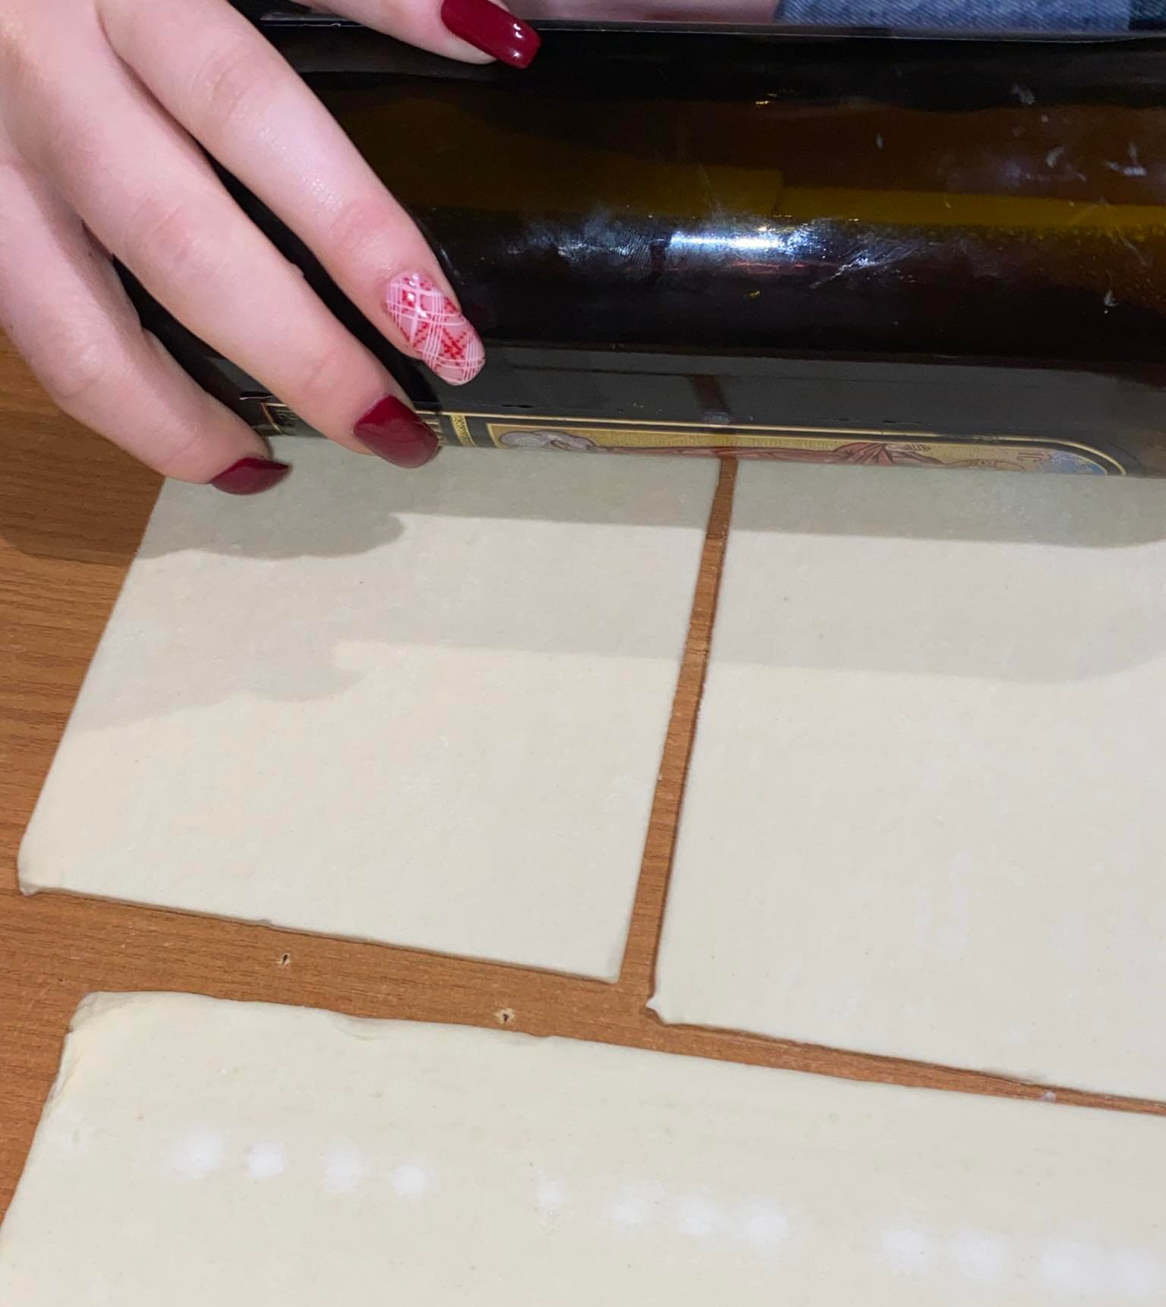
Step 3
Roll out the dough but not too thin

Slide 6
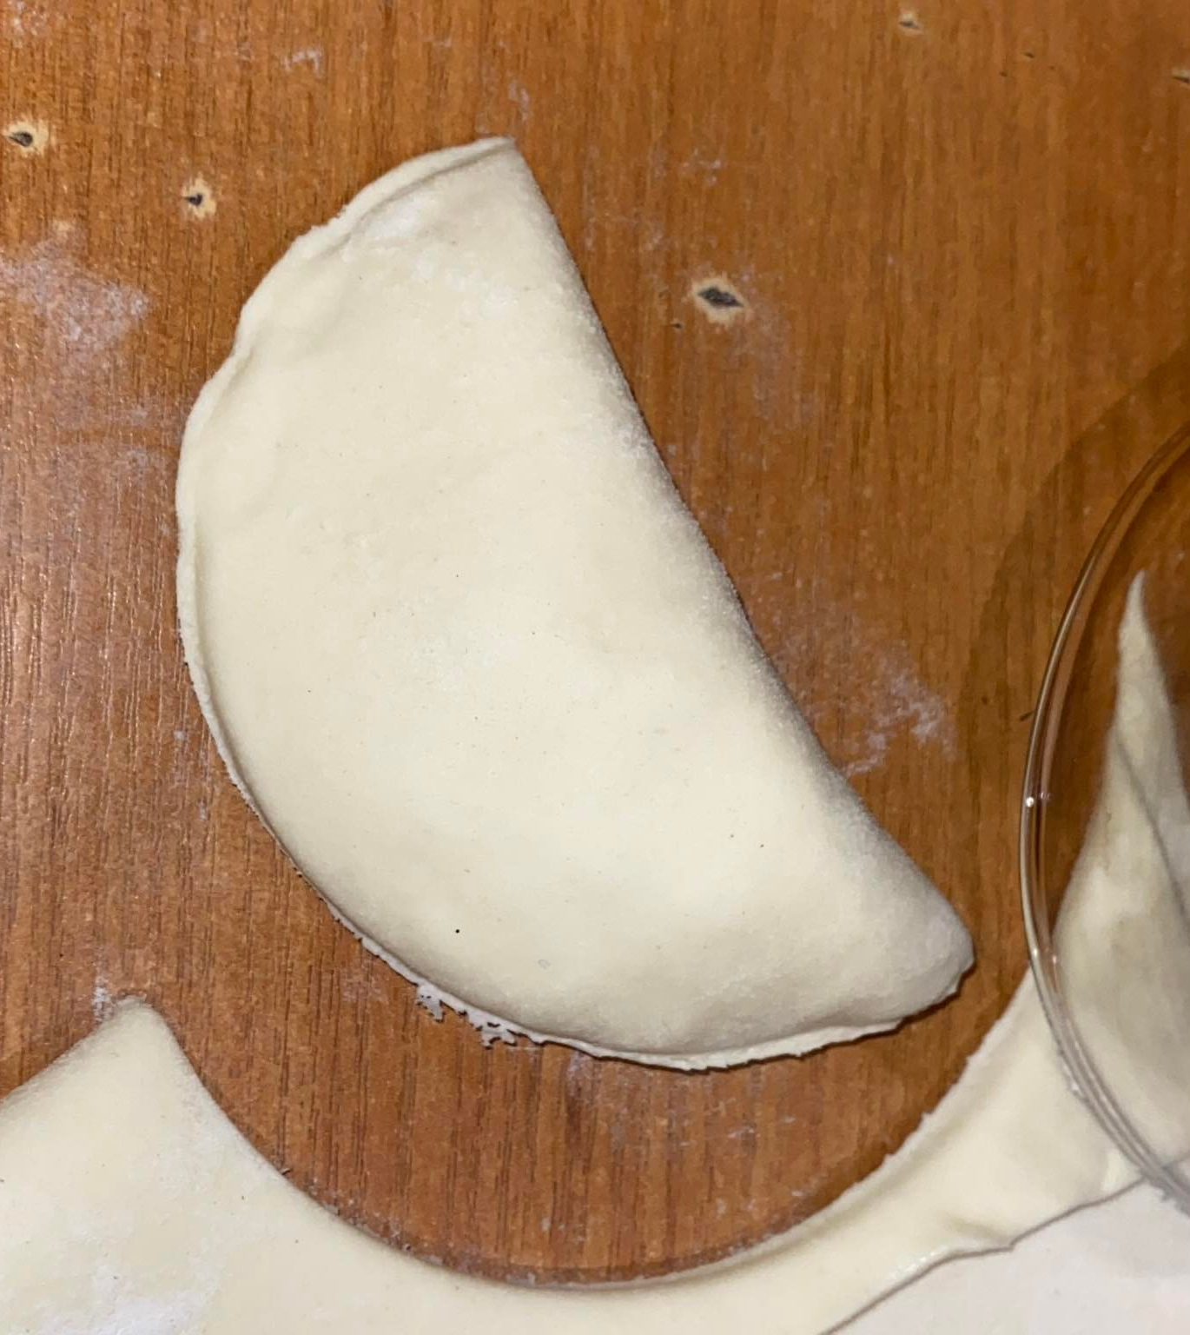
Step 4
place a bit of meat and onion in the rolled dough
then fold it and make the shape of a semicircle with the help of a glass

Slide 7
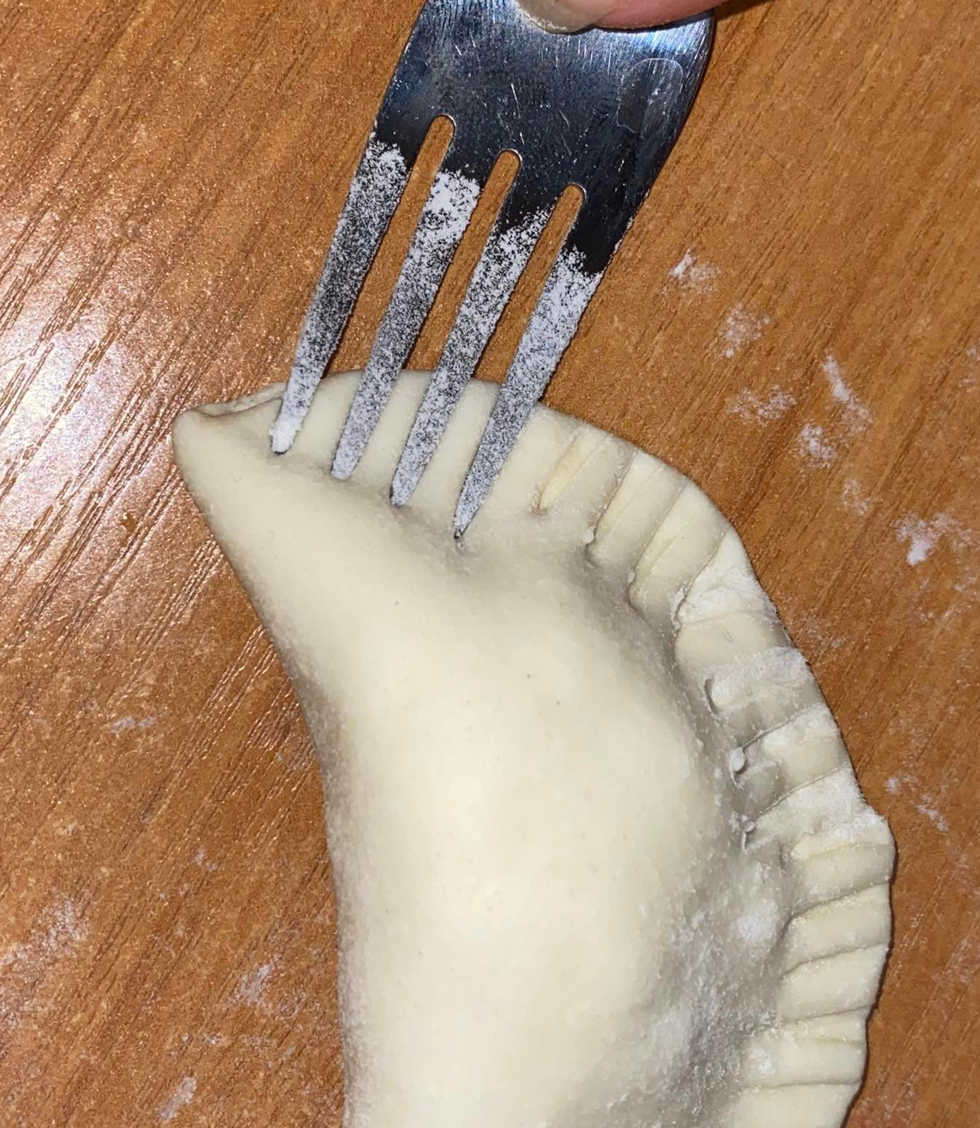
Step 5
Then press the edges with a fork

Slide 8
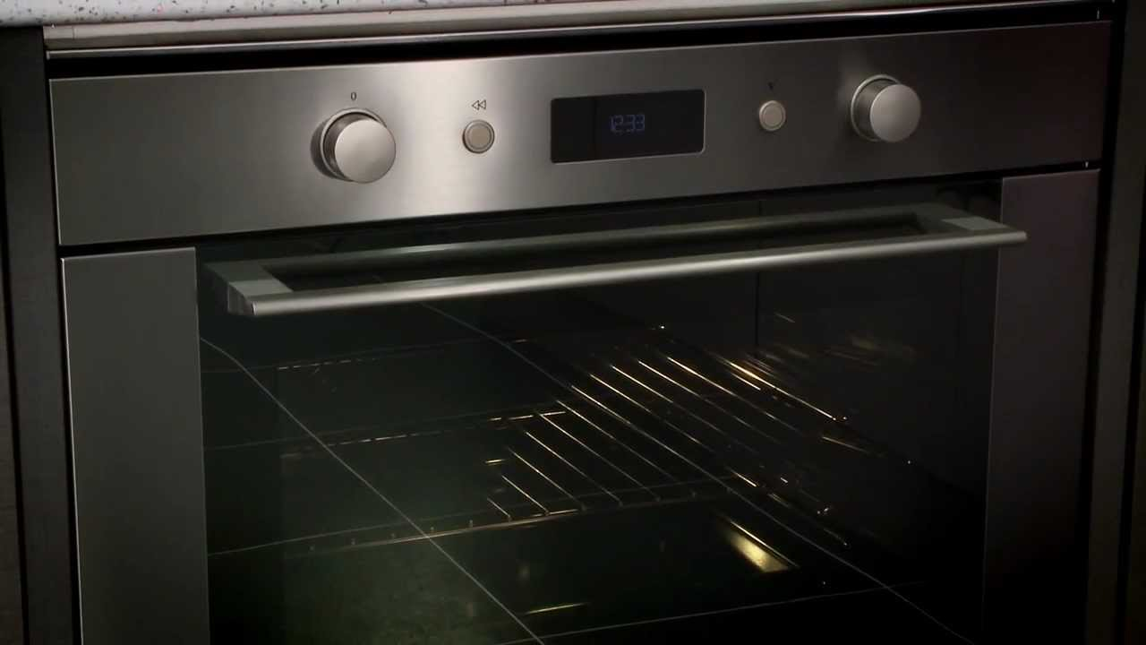
Step 6
heat the oven to 200 degrees Celsius

Slide 9
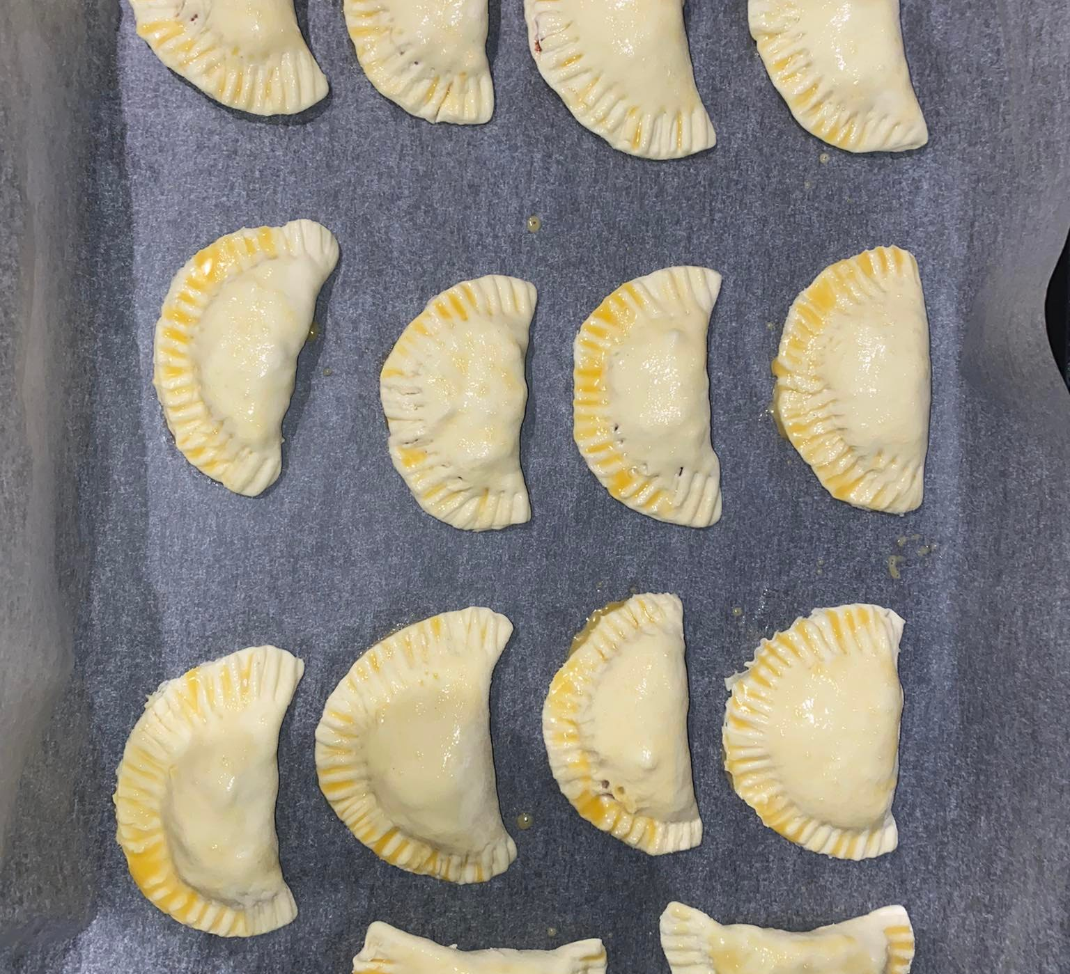
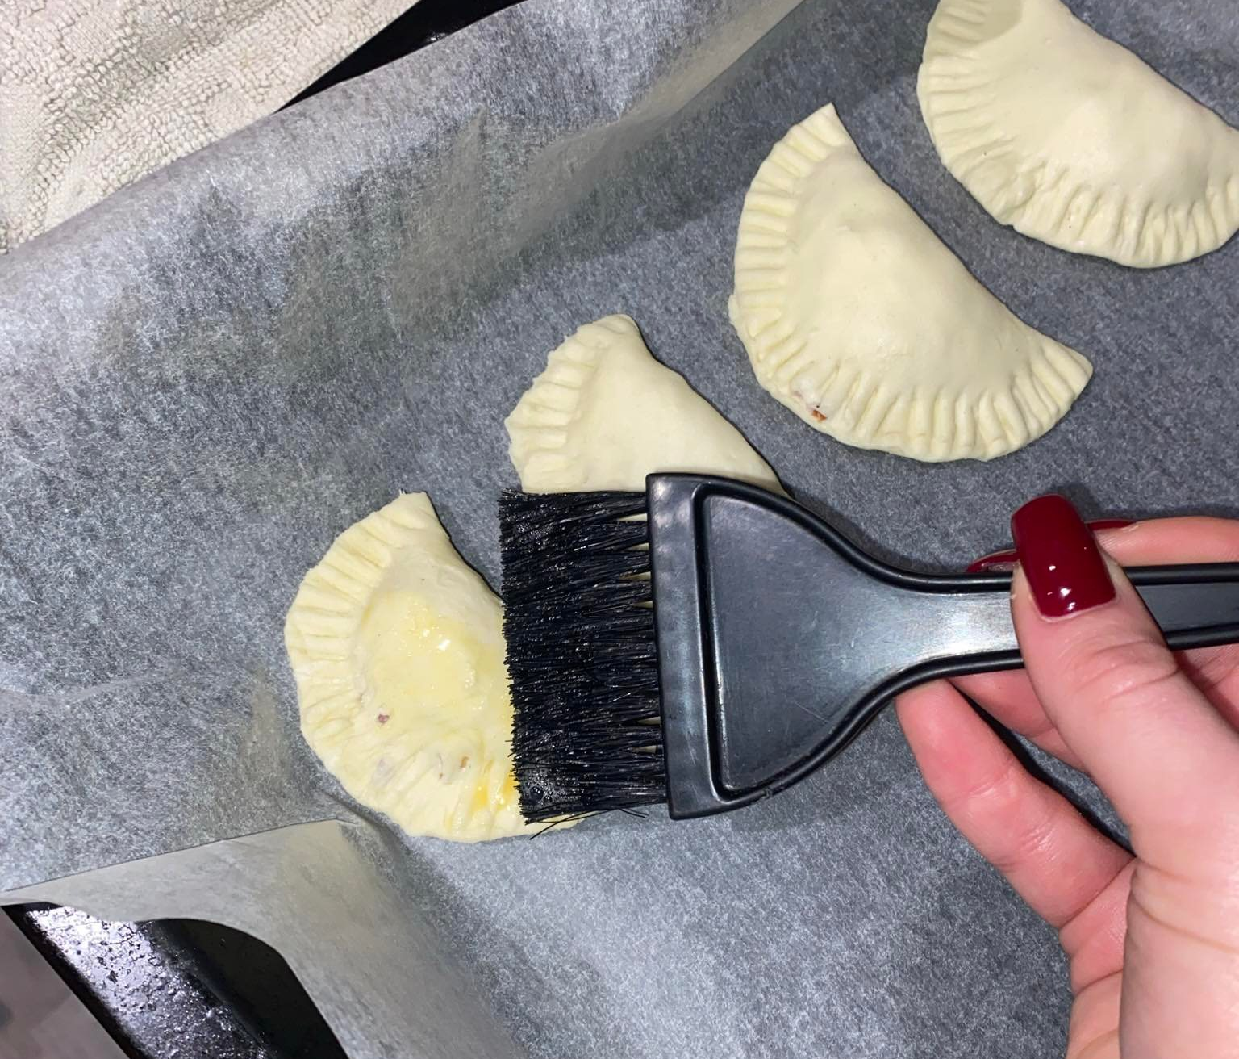
Step 7
place the pies on a baking sheet and smear with whipped egg, then put it in the oven

Slide 10
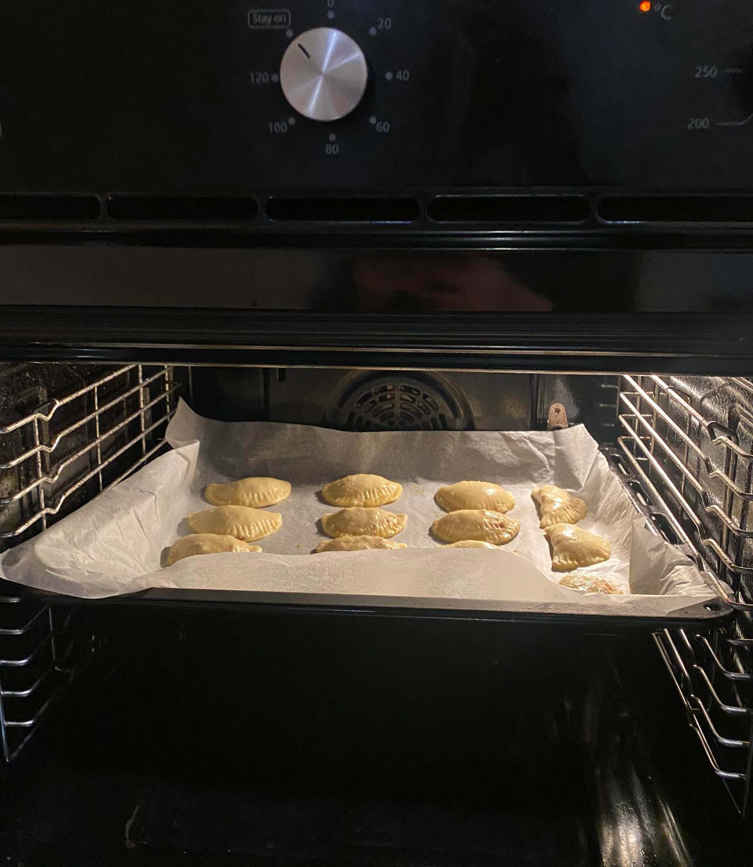
Step 8
Bake at 200 degrees Celsius for 15-20 minutes

Slide 11
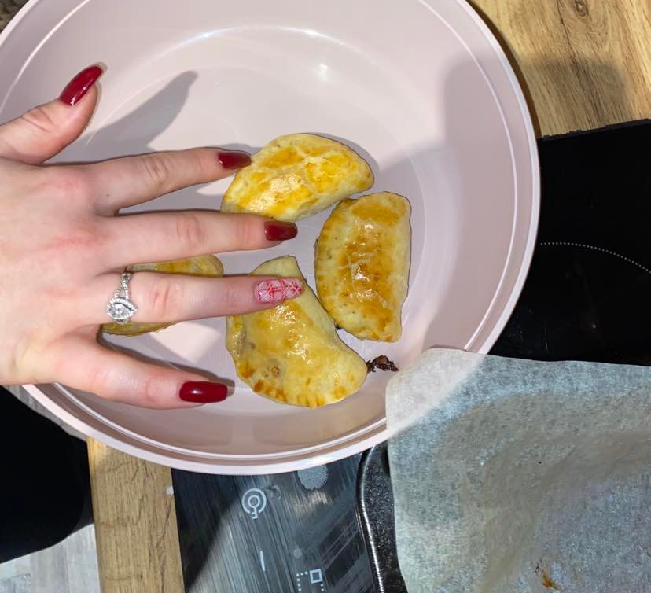
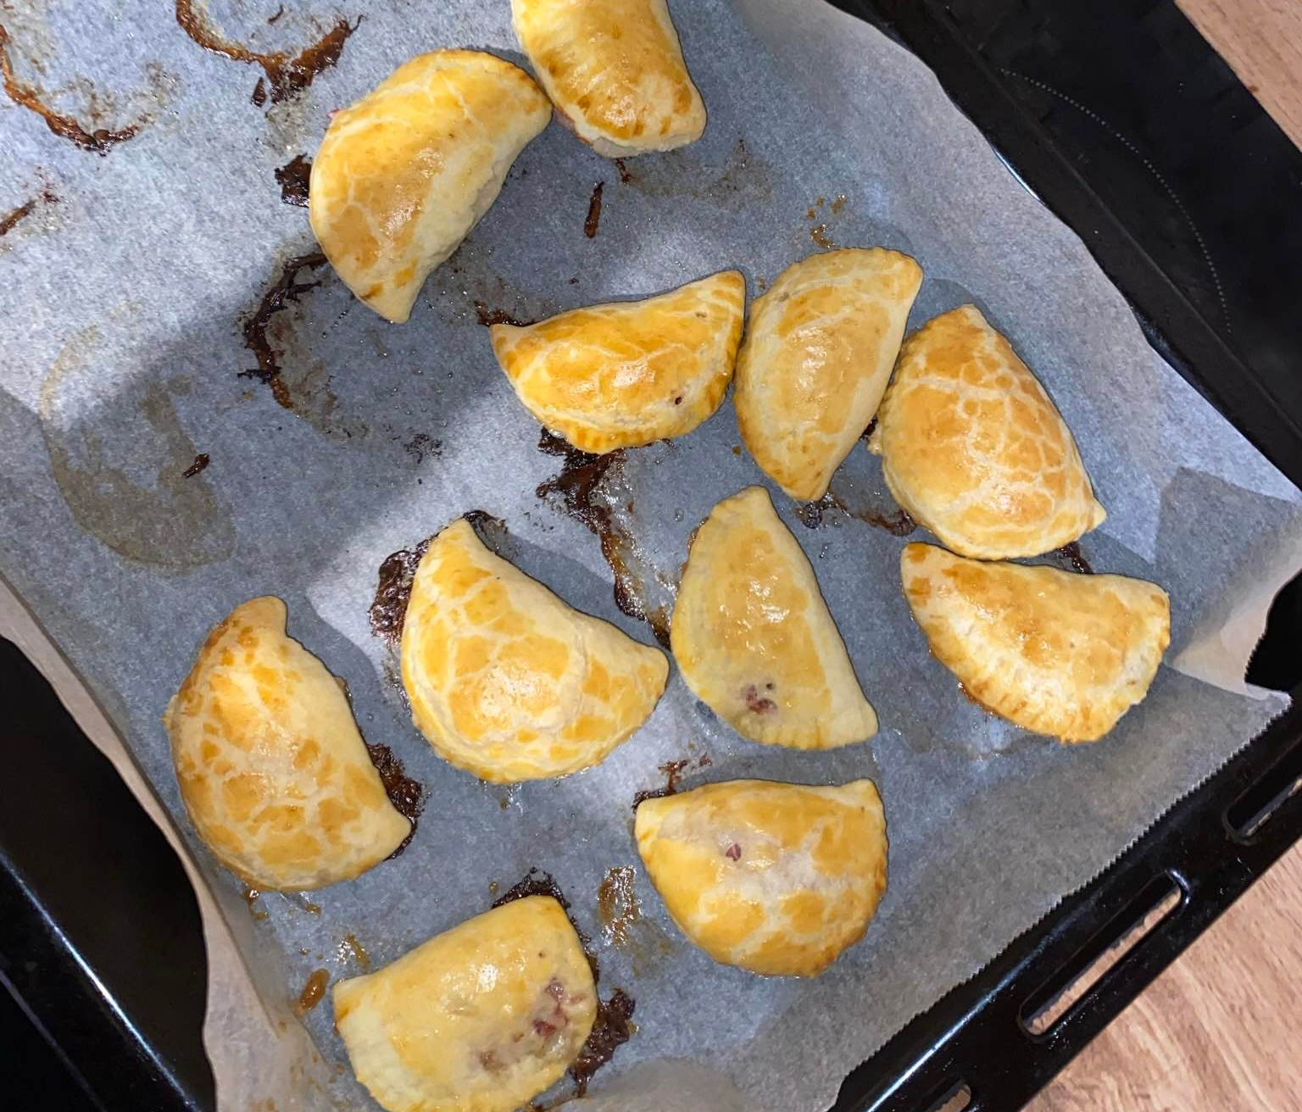
Step 9
Then take them out and they are ready to eat!

Slide 12
Bon appetit!

