Slide 1
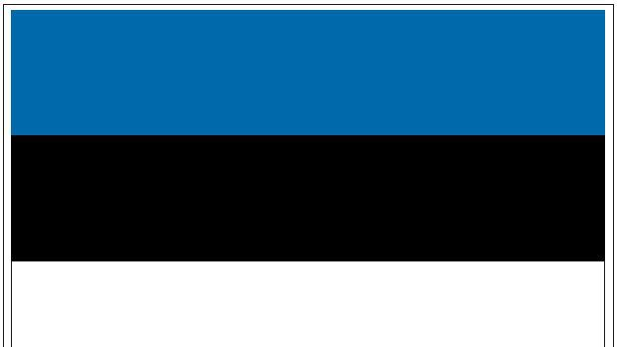
Estonia
Estonians

Slide 2
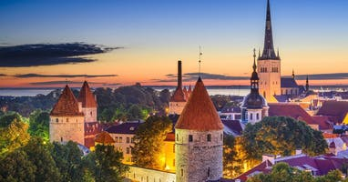
Facts
Capital City is Tallinn
Population is 1,3 mil
President Alar Karis

Slide 3
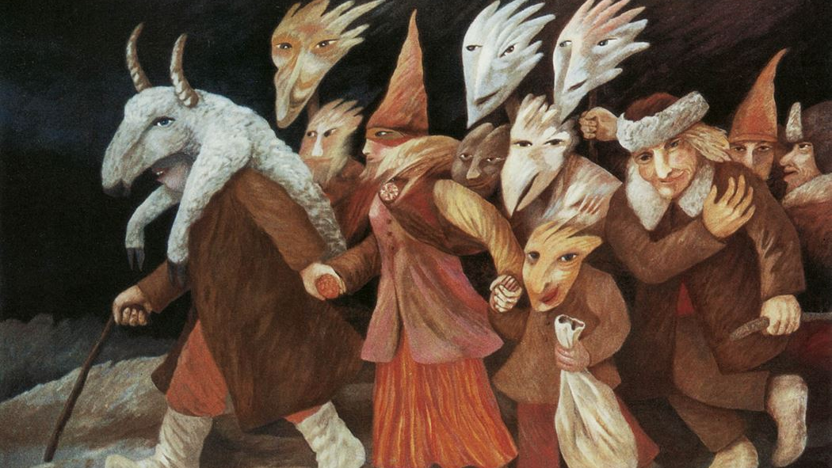
Mardipäev
10. November
Got it’s name after a death fairy
According to a legend, some type of work was forbidden
It symbolises the end of fieldworks and the beginning of winter and indoor work
Nowadays people dress as a Mart and go

Slide 4
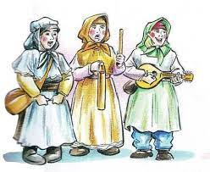
Kadripäev
25. November
Got it’s name after a Christian saint Katariina
People waited for herd luck

Slide 5
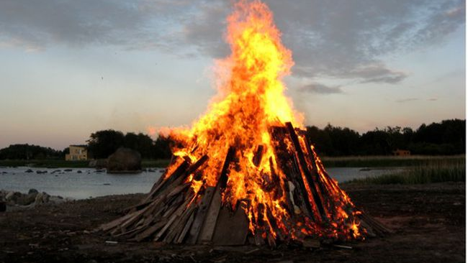
Jaanipäev (Midsummer day)
24. June
Got it’s name after John the Baptist, whos birthday is celebrated on that day
Bonfire
By some traditions people jump over the fire

Slide 6
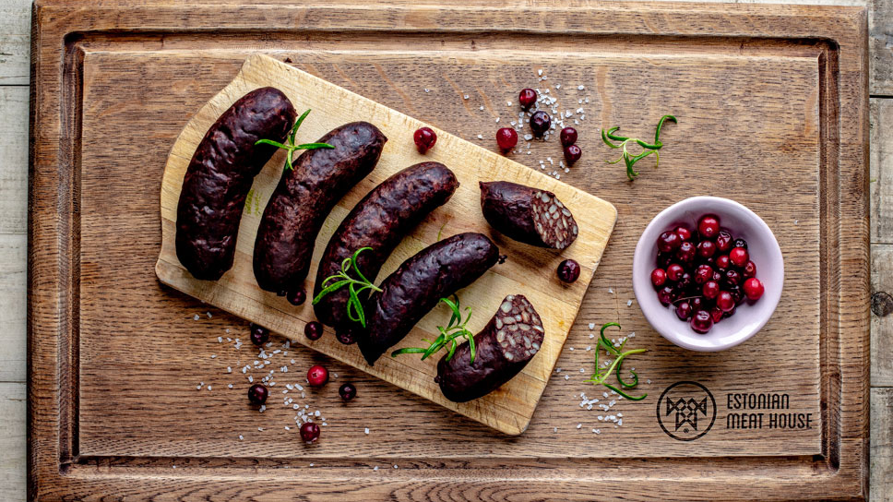
National symbols
Blue cornflower (1969)
Barn swallow (1962)
Grey limestone (1992)
Baltic herring (2007)
Blood sausage :P :D <3
Kama (mixture of roasted barley, rye, oat and pea flour)

