Slide 1
OUR LATVIA
Beate,
Inese,
Annija,
Kristine,
Krista,
Emils

Slide 2
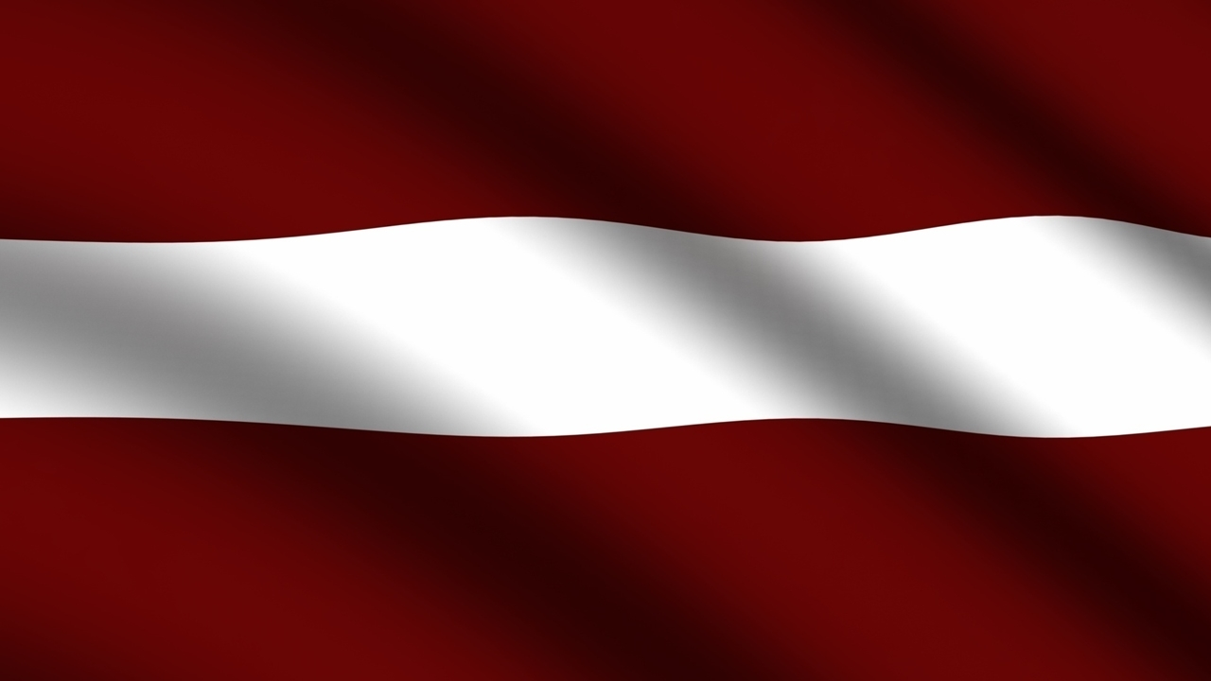
Our national flag

Slide 3
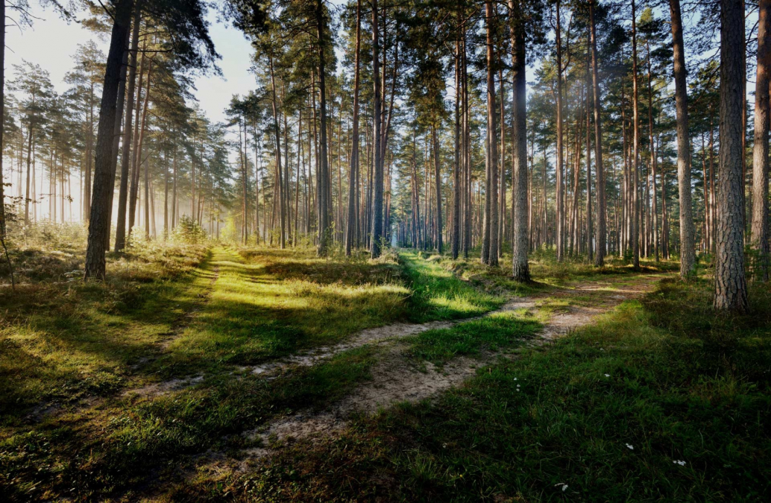
What is our country like?
There are many forests in Latvia (48%)

Slide 4
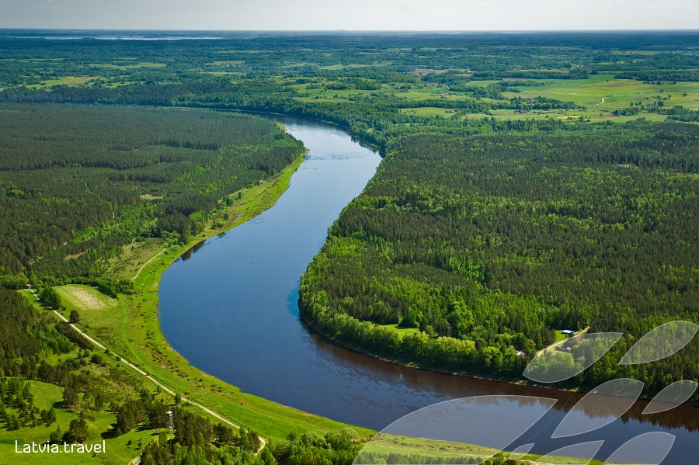
There are not many rivers in Latvia, but we are proud of the ones we have and they are very beautiful.

Slide 5
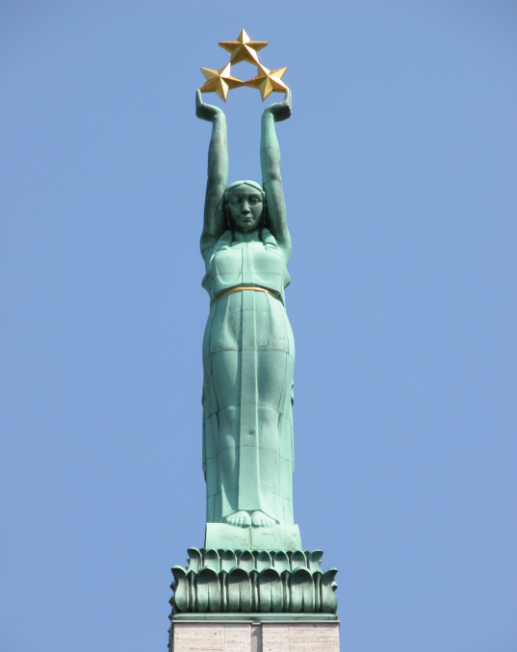
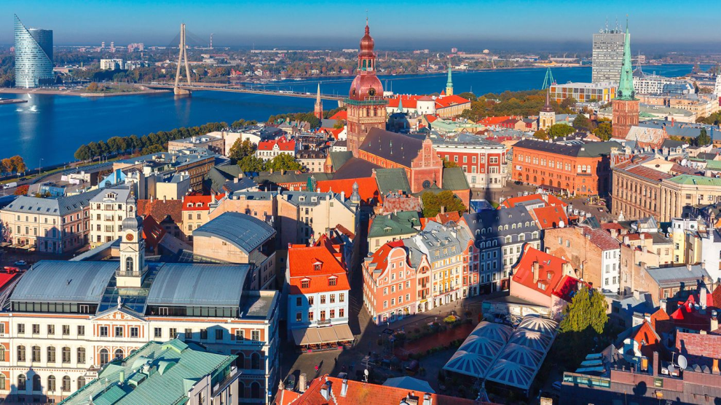
Capital city
Riga is the capital of Latvia.
The Monument of Freedom is the symbol of our country and the statue of a woman on top represents it.

Slide 6
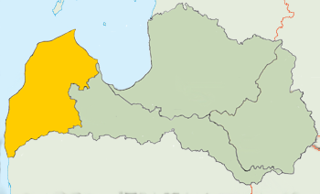
Our home town
Dundaga - in the north west of Latvia

Slide 7
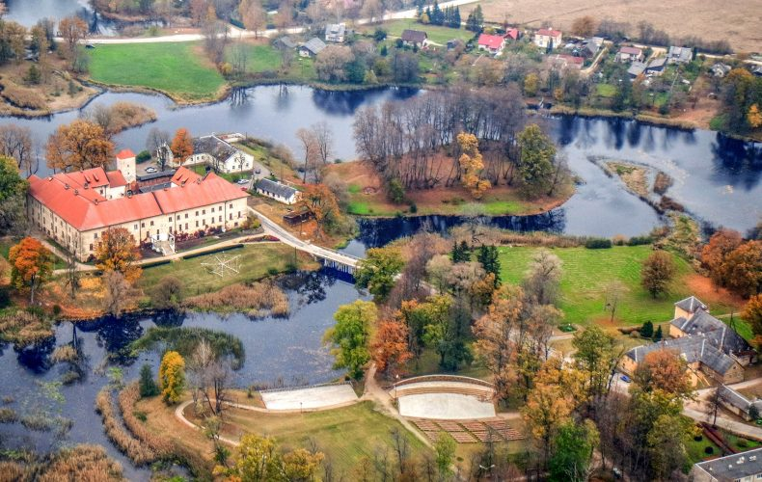
DUNDAGA

Slide 8
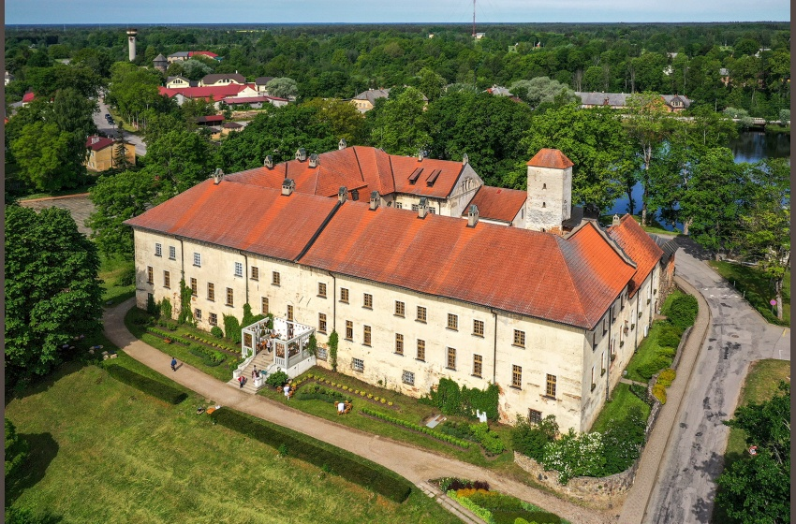
Dundaga
Dundaga is known for the castle and Green Maiden.

Slide 9
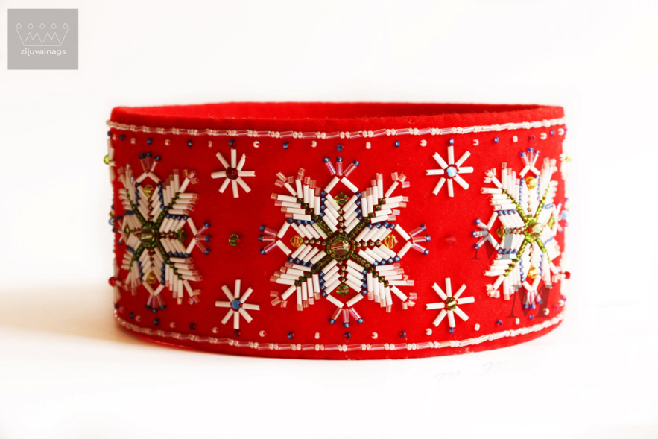
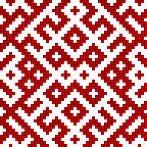
Our national ornaments

Slide 10
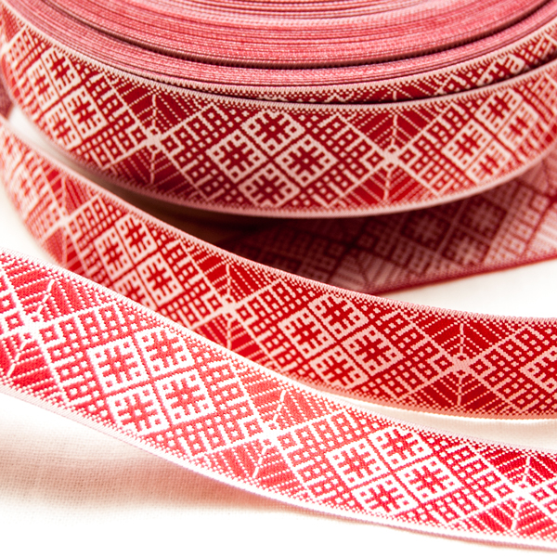
Lielvārde belt

Slide 11
LET’S MAKE OUR PROJECT BELT! Name _________ Birth data _____-______-______________
1 | 2 | 3 | 4 | 5 | 6 | 7 | 8 | 9 | 9 | 8 | 7 | 6 | 5 | 4 | 3 | 2 | 1
2 | 4 | 6 | 8 | 0 | 2 | 4 | 6 | 8 | 8 | 6 | 4 | 2 | 0 | 8 | 6 | 4 | 2
3 | 6 | 9 | 2 | 5 | 8 | 1 | 4 | 7 | 7 | 4 | 1 | 8 | 5 | 2 | 9 | 6 | 3
4 | 8 | 2 | 6 | 0 | 4 | 8 | 2 | 6 | 6 | 2 | 8 | 4 | 0 | 6 | 2 | 8 | 4
5 | 0 | 5 | 0 | 5 | 0 | 5 | 0 | 5 | 5 | 0 | 5 | 0 | 5 | 0 | 5 | 0 | 5
6 | 2 | 8 | 4 | 0 | 6 | 2 | 8 | 4 | 4 | 8 | 2 | 6 | 0 | 4 | 8 | 2 | 6
7 | 4 | 1 | 8 | 5 | 2 | 9 | 6 | 3 | 3 | 6 | 9 | 2 | 5 | 8 | 1 | 4 | 7
8 | 6 | 4 | 2 | 0 | 8 | 6 | 4 | 2 | 2 | 4 | 6 | 8 | 0 | 2 | 4 | 6 | 8
9 | 8 | 7 | 6 | 5 | 4 | 3 | 2 | 1 | 1 | 2 | 3 | 4 | 5 | 6 | 7 | 8 | 9
9 | 8 | 7 | 6 | 5 | 4 | 3 | 2 | 1 | 1 | 2 | 3 | 4 | 5 | 6 | 7 | 8 | 9
8 | 6 | 4 | 2 | 0 | 8 | 6 | 4 | 2 | 2 | 4 | 6 | 8 | 0 | 2 | 4 | 6 | 8
7 | 4 | 1 | 8 | 5 | 2 | 9 | 6 | 3 | 3 | 6 | 9 | 2 | 5 | 8 | 1 | 4 | 7
6 | 2 | 8 | 4 | 0 | 6 | 2 | 8 | 4 | 4 | 8 | 2 | 6 | 0 | 4 | 8 | 2 | 6
5 | 0 | 5 | 0 | 5 | 0 | 5 | 0 | 5 | 5 | 0 | 5 | 0 | 5 | 0 | 5 | 0 | 5
4 | 8 | 2 | 6 | 0 | 4 | 8 | 2 | 6 | 6 | 2 | 8 | 4 | 0 | 6 | 2 | 8 | 4
3 | 6 | 9 | 2 | 5 | 8 | 1 | 4 | 7 | 7 | 4 | 1 | 8 | 5 | 2 | 9 | 6 | 3
2 | 4 | 6 | 8 | 0 | 2 | 4 | 6 | 8 | 8 | 6 | 4 | 2 | 0 | 8 | 6 | 4 | 2
1 | 2 | 3 | 4 | 5 | 6 | 7 | 8 | 9 | 9 | 8 | 7 | 6 | 5 | 4 | 3 | 2 | 1

Slide 12
THANK YOU FOR LISTENING

