Slide 1



Slide 2
“May the words of our mouths
and the thoughts of our minds become reactions to our souls!”

Slide 3


Slide 4


Slide 5
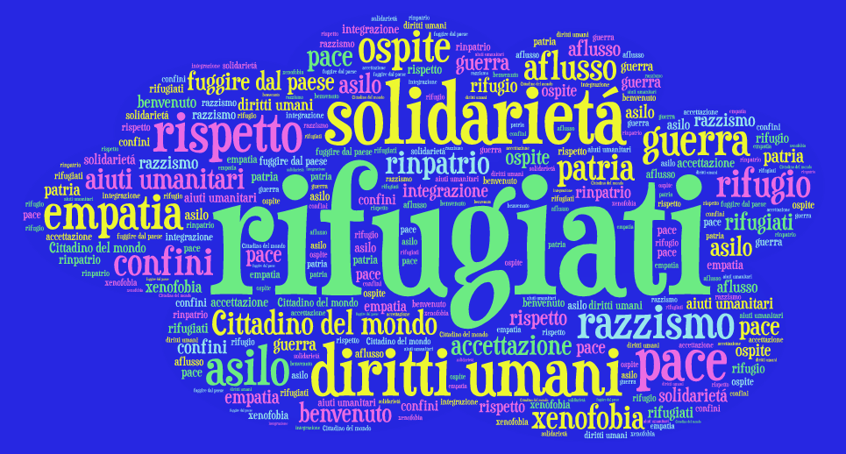

Slide 6


Slide 7


Slide 8


Slide 9
Thank you for watching it!
Matteo Tonietto (Italy)
Babis Volitakis (Greece)
Refugee class in Austria (Afghanistan)
Magdalena Beyer (Austria)
Antonis Kalaitzakis (Greece)
Philipp Westhoff (Germany)
Machteld Hammink (Holland)

