Slide 1
Erasmus+ Programme
Work by: Bruna Garcia
Joana Teófilo
Luana Azevedo
Nádia Mesquita
Teacher: João Teodósio

Slide 2
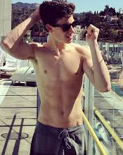
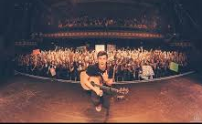
Why did we chose him?
He is a great singer
He has portuguese filiation
And for obvious reasons

Slide 3
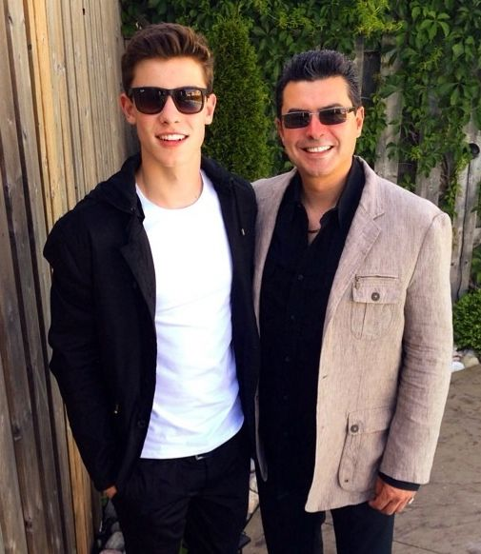
Technnical file
Shawn Peter Raúl Mendes
8 /august/1998 (17 years)
Canadian
English mother and portuguese father

Slide 4
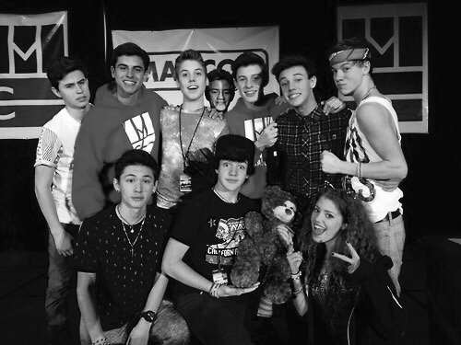
Early carrer
He was found in the app “Vine”
January 2014 - Andrew Gertler found him
Tour MagCon (before he sign the contract)
June 2014 – Life of The Party
Openings in “Live on Tour” of Austin Mahone (july- september 2014)

Slide 5
Albums
July 2014 – The Shawn Mendes Extended Plays
Recorder: Island Records
5th position in the Billboard chart of the USA and Canada
April 2015 – Handwritten
Recorder: Island Records
1st position in Canada

Slide 6
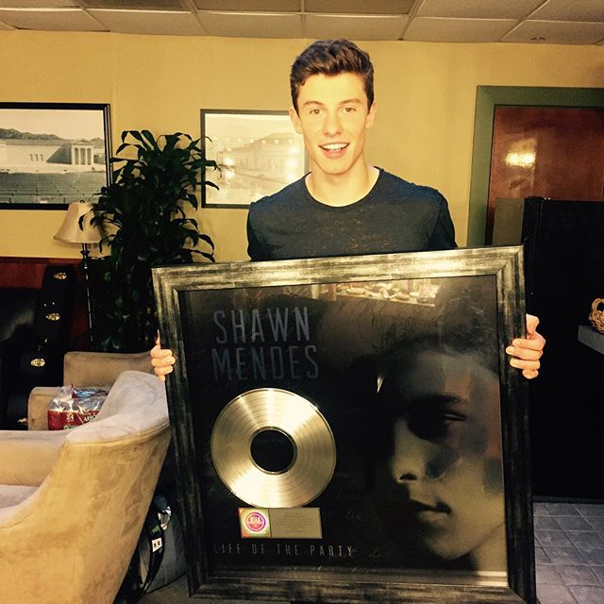
Singles/ Musics with the most success
Life of The Party
Something Big
Stitches
I Know What You Did Last Summer
6 platinum
2 double platinum
2 gold

Slide 7
Awards
Teen Choice Awards: -Choice Webstar Music
Teen Video Awards: -Best Newcommer In Video (Something Big)
MTV Europe Music Awards: -Best New Artist
-Best New Act
Teen World Awards: -Best New Artist
-Best Crush Artist
-Best Canadian Artist
Teen Music Awards: -Best New Artist
Canadian Music Awards: -Best New Artist
-Best Pop Artist
-Best Pop Album (Handwritter)
-Best Pop Song (Stitches)

Slide 8
The End

