Slide 1
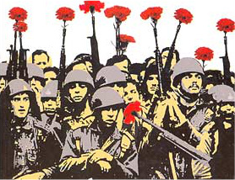
25th april 1974 Liberty day
“People united will never be defeated”
Work done by:
Juliana Cunha nº18 10ºCT2
Patrícia Lucas nº21 10ºLH

Slide 2
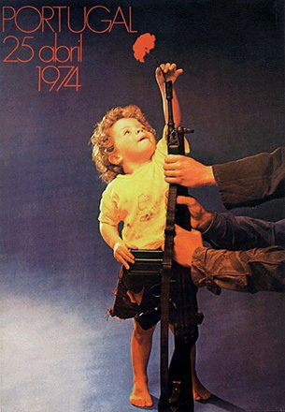
introduction
This work, done in english class, and this theme national portuguese days. We choose the day 25th april 1974, the freedom day in our country.

Slide 3
history
The April 25 Revolution, refers to a period in Portugal's history as a result of a social movement, occurred April 25, 1974, which overthrew the dictatorial regime of theEstado Novo, in force since 1933 and began a process that would end with the establishment of a democratic regime and the entry into force of the new Constitution on 25 April 1976, with a strong socialist orientation in its origin.
This action was led by a military movement, the Armed Forces Movement, which was composed mostly by captains who had participated in the Colonial War. This movement emerged around 1973, based initially on corporatist claims as the fight for the prestige of the armed forces, eventually reaching the political regime in force.

Slide 4
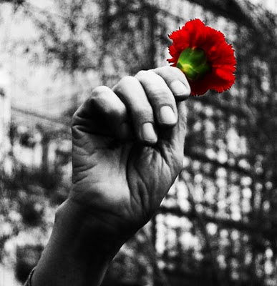
Life before 25th april 1974
Existence of censorship
There were political prisoners
There was the PIDE (policia politica)
People had no right to say what they thought freely government
There were no free elections
There was no democracy (there was a dictatorship)
Child labor
The right to health and education were not guaranteed to citizens
There was no right of assembly
The way of life of the population was controlled

Slide 5
causes of revolution
Lack of freedom
Poor working conditions
Discontent of the military
Worsening of poor living conditions
International isolation of the country

Slide 6
Revolution consequences in the country
Release of political prisoners
The African colonies became independent
Creation of the 1st Democratic Constitution
Return of opponents to Portugal
Training of the Junta of National Salvation

Slide 7
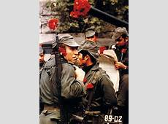
Why carnation?
It is said that they used carnations
because a lady in the street saw a soldier
with a gun and put a carnation
on the tip of the gun.

Slide 8
celebrations of this day
Each year, 25th april is celebrated with a national holiday. In primary schools, students are encouraged to do various activities related to this day. Sometimes they also do marches in recognition of the military in various parts of the country.

Slide 9
Our view
In our view, the celebrations of this day are important to glorify all the people who fought so that today there is freedom. However, these celebrations should be taken more seriously across our country, because it was through this revolution that today we can live the way we live.

Slide 10
end

