Slide 1
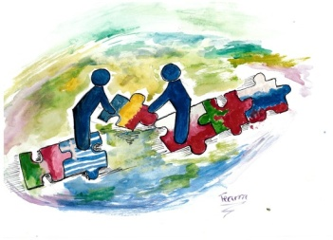
My favorite sport is…
… Karate ☺

Slide 2
Karate Kyokushin is…
…a style of stand-up, full contact karete, founded in 1964 by Korean-Japanese Masutatsu Ovama. Kyokushin is Japanese for "the ultimate truth." Kyokushin is rooted in a philosophy of self-improvement, discipline and hard training. Its full contact style has had international appeal (practitioners have over the last 40+ years numbered more than 12 million).

Slide 3
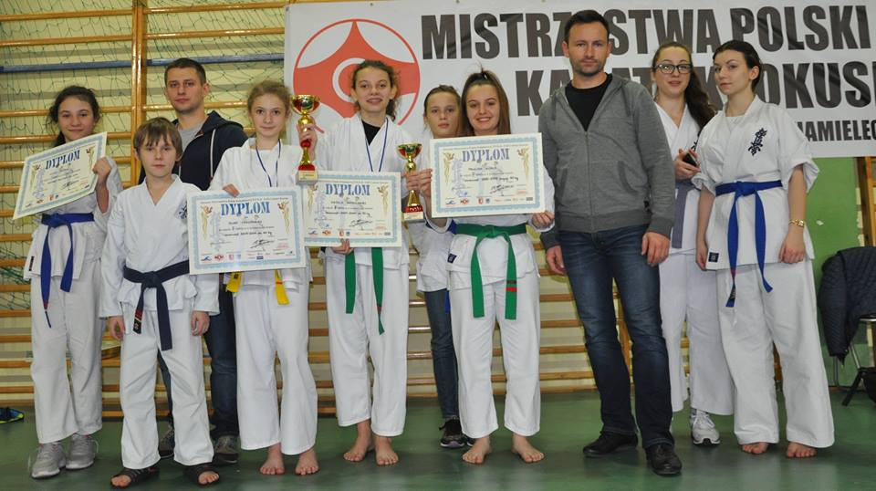
I have started my karate lesson 3 years ago. Now I have yellow belt (6.1 kyu). My club is involved in many sports competitons. I was 2 times in Mielec:

Slide 4
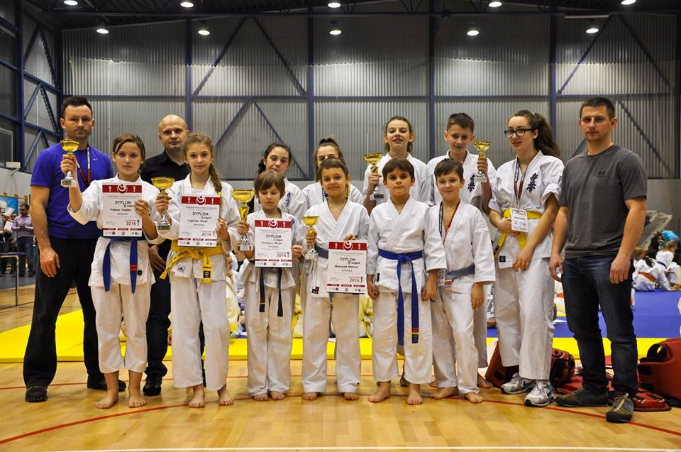
And one time in Starachowice:

Slide 5
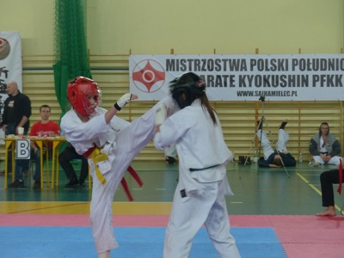
I love this sport beacause i can do amazing stuff, like: kicking,punching or jumping.
(Yes, I am this girl on left)

Slide 6
Last summer I was on karate camp in Wisełka, too ☺ I spent there 10 days. Everyday we woke up on 6 o’clock and we were running in the forest. I love it.

Slide 7
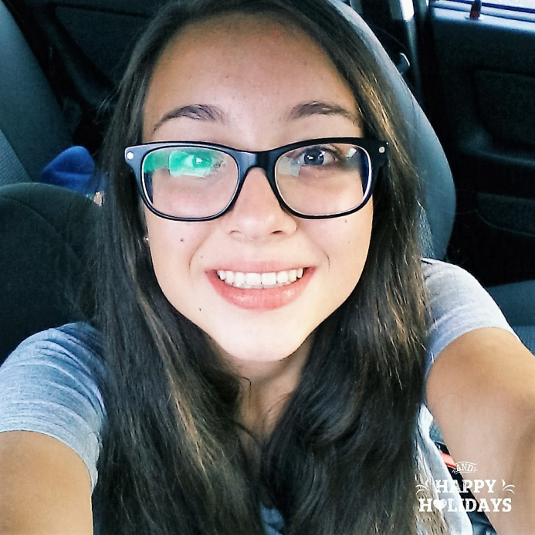
Thanks for Watching ☺
By: Julia Krzywicka

