Slide 1
ABOUT DULCE FÉLIX
MADE BY:
Ana Silva nr. 2
Beatriz Martina nr. 4
Maria Gonçalves nr. 17

Slide 2
BIO INFO
FULL NAME: Ana Dulce Félix
BIRTHDAY: 23rd October 1982
SPORTS ARRANGEMENTS: 1000 METRES
MARATHON
CROSS COUNTRY RUNNING

Slide 3
CAREER
WHERE IT ALL BEGAN:
Only being 12 years old in a local club
IN 1999:
She was transferred to Vizela – where she had to work besides doing sports
That, eventually, became harmfull for her results.

Slide 4
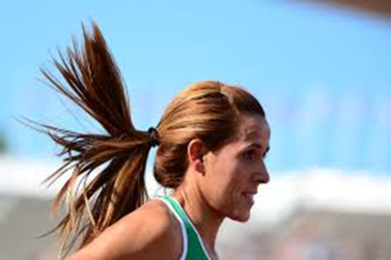
CAREER
IN 2007:
She went to “Sporting de Braga”
She decided to only dedicate herself to sport due to bad results.
IN 2013:
She was transferred to “Maratona Clube de Portugal” where she still remains.

Slide 5
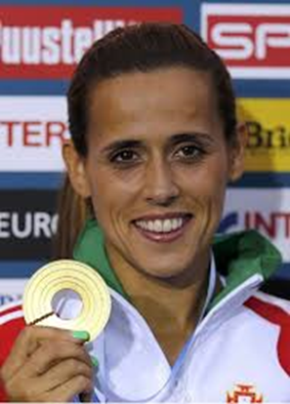
SPORTS PARTICIPATION & MEDALS
2012 OLYMPIC GAMES – 21st place
2009 WORLD CHAMPIONSHIP – 13th place
2011 WORLD CHAMPIONSHIP – 8th place
2010 EUROPE CHAMPIONSHIP – 8th place
2012 EUROPE CHAMPIONSHIP – GOLD MEDAL
2008 WORLD CROSS COUNTRY CHAMPIONSHIP – 72nd place

Slide 6
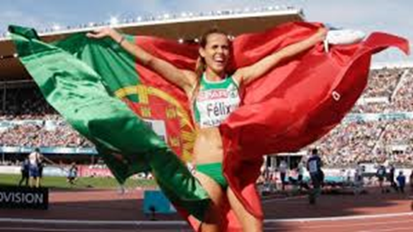
SPORTS PARTICIPATION & MEDALS
2009 WORLD CROSS COUNTRY CHAMPIONSHIP — 15th place
2008 EUROPE CROSS COUNTRY CHAMPIONSHIP – 17th place
2009 EUROPE CROSS COUNTRY CHAMPIONSHIP – 6th place
2010 EUROPE CROSS COUNTRY CHAMPIONSHIP – Bronze Medal
2011 and 2012 EUROPE CROSS COUNTRY CHAMPIONSHIPS – Silver Medal

