Slide 1
Adaptive Learning Environments
Alexandra Gasparinatou
Computer Science Education
2nd Experimental High School of Athens

Slide 2
Adaptive Learning Environments

Slide 3
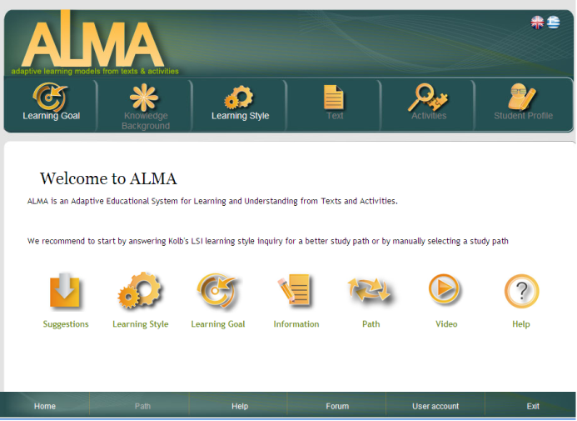
Adaptive Learning Environments

Slide 4
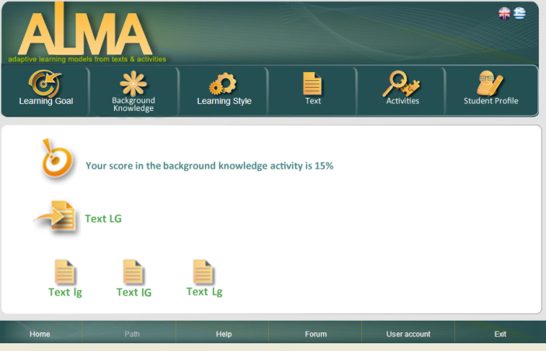
Adaptive Learning Environments

Slide 5
ALMA (Adaptive Learning Models from texts and Activities) http://hermes.di.uoa.gr:8088/alma3
ALMA supports students’ text comprehension via texts and activities. It supports learning via:
texts with various local and global cohesion for students with low, median, and high background-knowledge;
ALMA motivates high knowledge students to read the minimally cohesive text and low knowledge students to read the maximally cohesive text. Thus, ALMA offers individualized support via the technique of adaptive presentation.

Slide 6
ALMA (Adaptive Learning Models from texts and Activities) http://hermes.di.uoa.gr:8088/alma3
(2)activities which correspond to different levels of comprehension and activate the student to apply different reading strategies while the proposed learning sequence of activities is adapted to students’ learning style;
ALMA takes into account readers’ learning preferences in order to propose them to start from activities that match their learning preferences and continue with less “learning preferences matched” activities in order to develop new capabilities .

Slide 7
ALMA (Adaptive Learning Models from texts and Activities) http://hermes.di.uoa.gr:8088/alma3
(3) feedback during the performing of activities in order to inform, guide, and support students to discover their mistakes and to make any corrections; and
(4) individual support and guidance according to students’ special characteristics.

Slide 8
ALMA (Adaptive Learning Models from texts and Activities) - Activities
ALMA supports and assesses students’ comprehension through a series of activities such as:
text recall,
summaries,
text-based,
bridging inference,
elaborative inference,
problem solving,
case studies,
active experimentation,
and sorting tasks.

Slide 9
ALMA (Adaptive Learning Models from texts and Activities) – Active experimentation
Active experimentation activities motivate students to undertake an active role and, through experimentation, to construct their own internal representations for the concept they are studying.
(e.g., Students are given the diagram of a home network and they are asked if the network operates properly. Next, they are asked to design the same network by themselves via a software tool (e.g., Network Notepad) and check via the software if their original answer was correct).

Slide 10
ALMA (Adaptive Learning Models from texts and Activities) – Active experimentation
In order students of secondary education to understand the Bubble sort algorithm we developed a visualization that implements it.
This visualization developed in the context of Active Experimentation of the learning goal “Introduction to the Principles of Computer Science”.
Available on:
http://hermes.di.uoa.gr:8088/alma3/Bubl_Vis/index_en.html

Slide 11
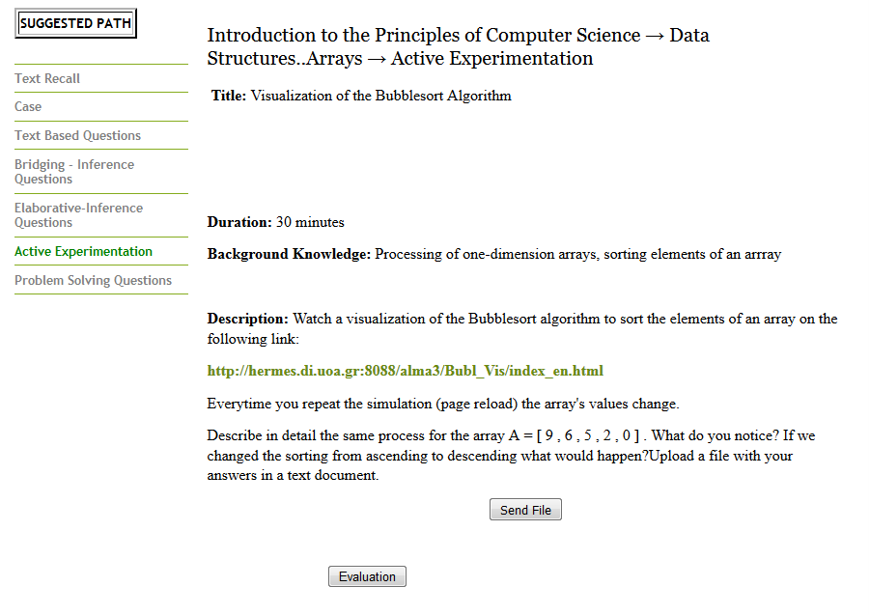
ALMA (Adaptive Learning Models from texts and Activities) – Active experimentation
In order students of secondary education to understand the Bubble sort algorithm we developed a visualization that implements it.
This visualization developed in the context of Active Experimentation of the learning goal “Introduction to the Principles of Computer Science”.
Available on:
http://hermes.di.uoa.gr:8088/alma3/Bubl_Vis/index_en.html

Slide 12
The Bubble Sort Algorithm: Active experimentation activity
Let it be that we have read an array Α[5] with 5 elements. The array is the following:
A
7
3
4
9
0
For the visualization we assume that we have 5 spheres which represent the 5 elements of the array.
The biggest the value of the array is, the biggest the radius of the sphere will be. Our goal is to sort these spheres from the smallest one to the biggest one (ascending order).

Slide 13
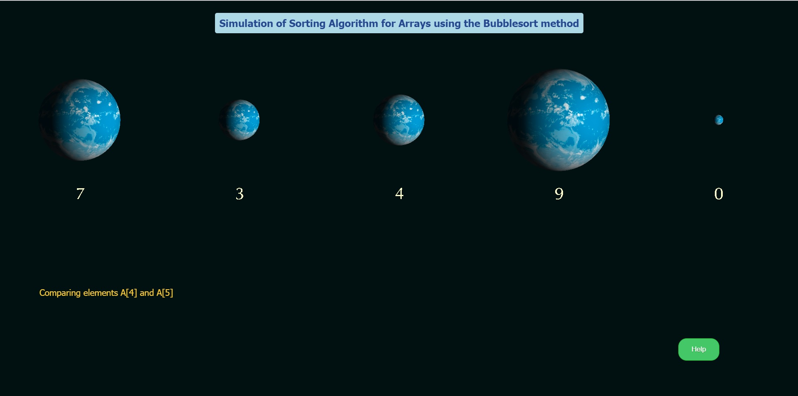
The Bubble Sort Algorithm: Active experimentation activity
The initial condition of the spheres will be like this:
Notice that we have started comparing the elements A[4] and A[5].

Slide 14
The Bubble Sort Algorithm: Active experimentation activity
Let’s take a minute to understand the Bubble sort algorithm. The code to express the algorithm is the following:
For i from 2 to n For j from n to i with step -1 If A[j-1] > A[j] then Swap A[j-1] with A[j] End_if End_repeat End_repeat
What we actually do is comparing 2 neighbor elements, for example A[2] with A[1], A[5] with A[4], etc. If the left element of the two has a smaller value than the right element we will exchange them. If we do this one time for all the elements of the array, it will still be unsorted, but the element with the smallest value will go on the most left position of the array (A[1]). But this is the position it should be on the sorted array. So we can repeat the same process for every other element except for that one (from A[2] to A[5]). If we repeat the same process until we only have to compare the last two elements (including that last compare) the array will be sorted.

Slide 15
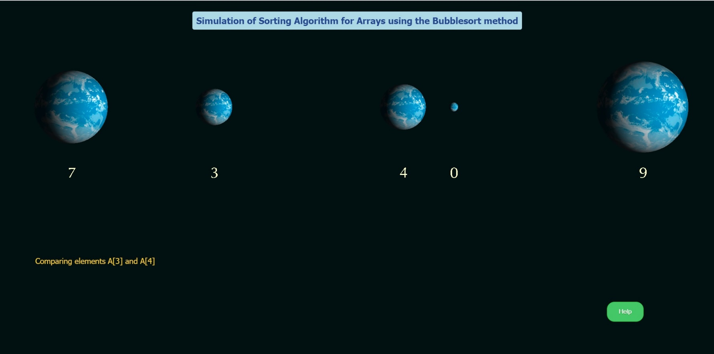
The Bubble Sort Algorithm: Active experimentation activity
Let’s get back to the visualization. We can see that the algorithm compares and exchanges the neighbor spheres.

Slide 16
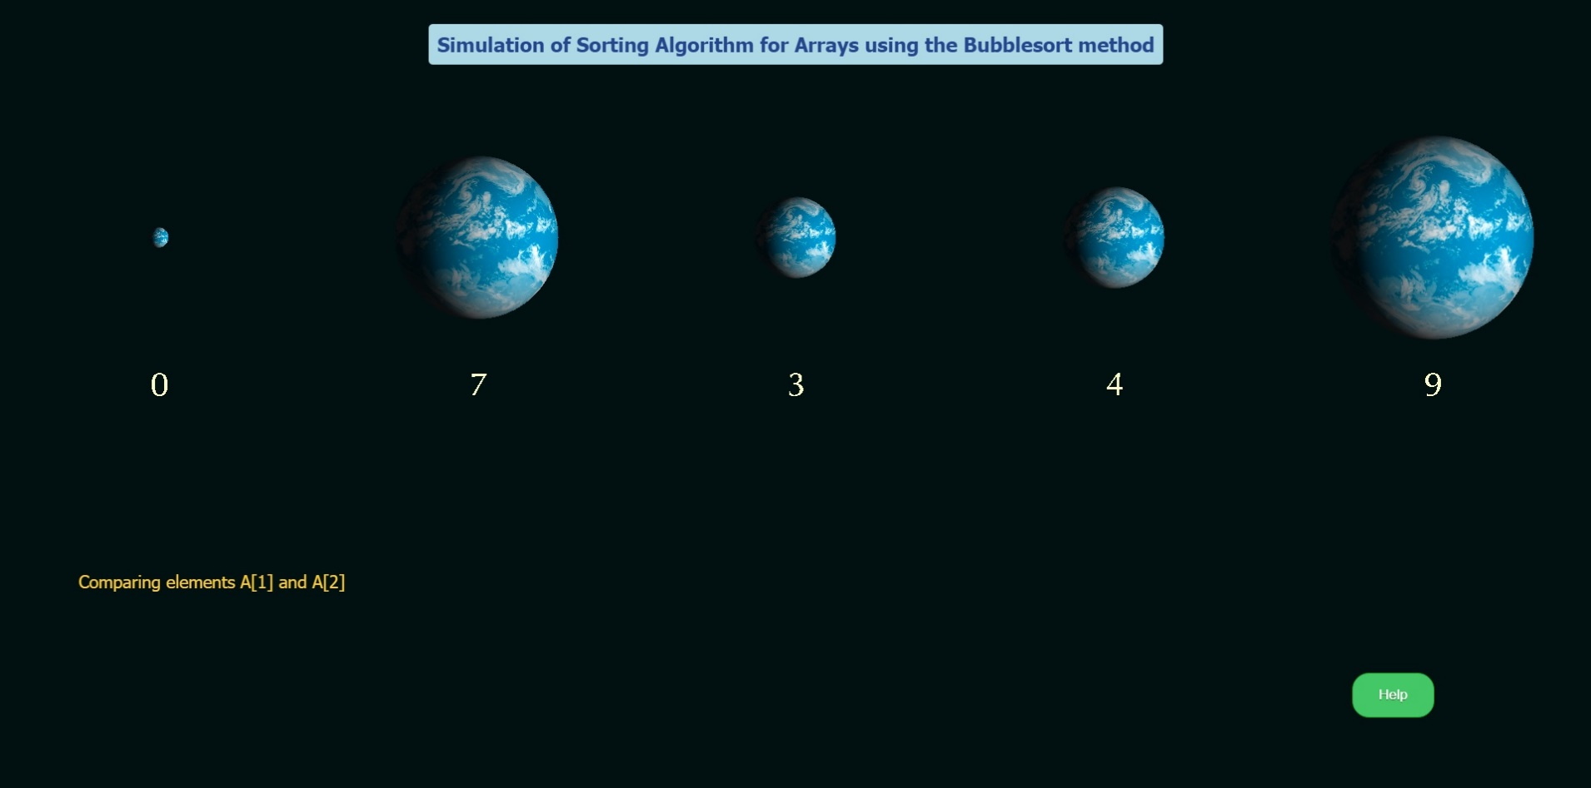
The Bubble Sort Algorithm: Active experimentation activity
After doing the compares for all the spheres one time we will have the following condition:
Notice that the smallest sphere (or the element with the smallest value of our array) is where it should be, on the first position of the array. Now we will do the same process for the 2nd to the 5th sphere.

Slide 17
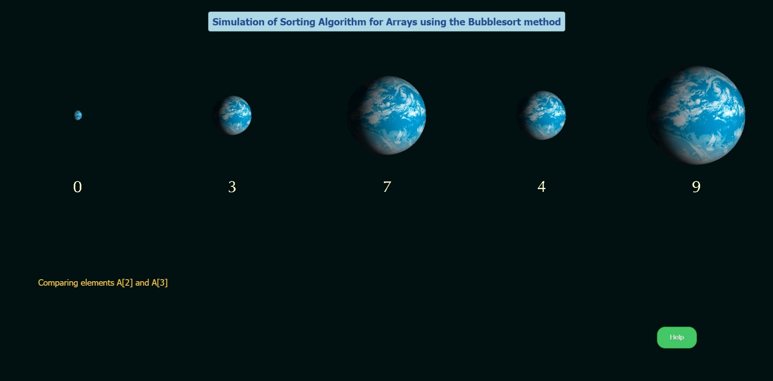
The Bubble Sort Algorithm: Active experimentation activity
On the next repeat we will compare the spheres left. So the last comparison will be like below: We can see that now we will not compare sphere 1 with sphere 2 because sphere 1 is already in the position where it should be. In addition sphere 2 has taken it’s place on the array.

Slide 18
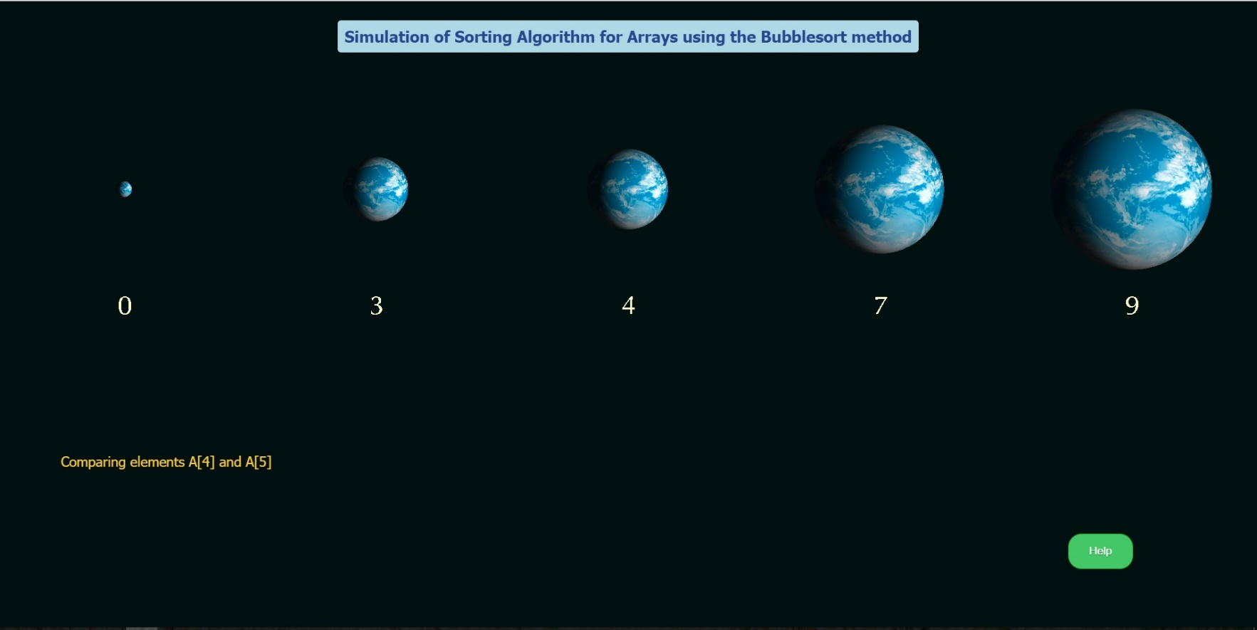
The Bubble Sort Algorithm: Active experimentation activity
If we repeat the same process for every element the array will be sorted, and we can see that the spheres are sorted from the smallest one to the biggest one. The last comparison we did was for the last two spheres and as we can’t compare any more spheres the spheres are sorted.

Slide 19
The Bubble Sort Algorithm: Active experimentation activity
The Bubble sort algorithm is the simplest sort algorithm but it is the one with the most complexity. That means that it requires many calculations and it is very slow. Let’s see the complexity of the algorithm:
For i from 2 to n For j from n to i with step -1 If A[j-1] > A[j] then Swap A[j-1] with A[j] End_if End_repeat End_repeat
The execute time (complexity) depends on the number of times we execute the commands inside the two loops.
If the array has N elements the number of total comparisons is:
(N-1)+(N-2)+…1=N*(N-1)/2

Slide 20
The Bubble Sort Algorithm: Active experimentation activity
The Bubble sort algorithm is the simplest sort algorithm but it is the one with the most complexity. That means that it requires many calculations and it is very slow. Let’s see the complexity of the algorithm:
For i from 2 to n For j from n to i with step -1 If A[j-1] > A[j] then Swap A[j-1] with A[j] End_if End_repeat End_repeat
The execute time (complexity) depends on the number of times we execute the commands inside the two loops.
If the array has N elements the number of total comparisons is:
(N-1)+(N-2)+…1=N*(N-1)/2

Slide 21
The Bubble Sort Algorithm: Active experimentation activity
In a pilot study a group of 10 students of third class of high school of 2nd experimental school of Athens interacted with the ALMA environment and conducted the above activity successfully.
According to these students, the visualization enhanced their in-depth comprehension of Bubble Sort Algorithm.
Among our future plans is to repeat the study in a larger sample aiming to generalize the results.

Slide 22
The advantages of the web graphics
The above application for the visualization of the bubble sort algorithm was developed using web graphics.
This visualization was developed with the programming language WebGL which is a language that was created in the last few years (first edition at 2011) and gives us the opportunity to use complex shapes and animations, that we wouldn’t be able to use if we were using JavaScript or any other web based language.
Through WebGL we can develop an application that is visually better and the animations of the shapes are more conspicuous so that the student could understand them in a better way.

Slide 23
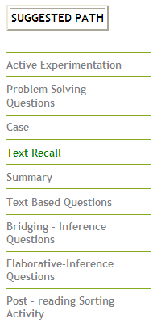
. Adaptive Techniques Provided via ALMA
Adaptive Navigation
Learning sequence for student with converging learning style

Slide 24
. Adaptive Techniques Provided via ALMA
Adaptive presentation

Slide 25
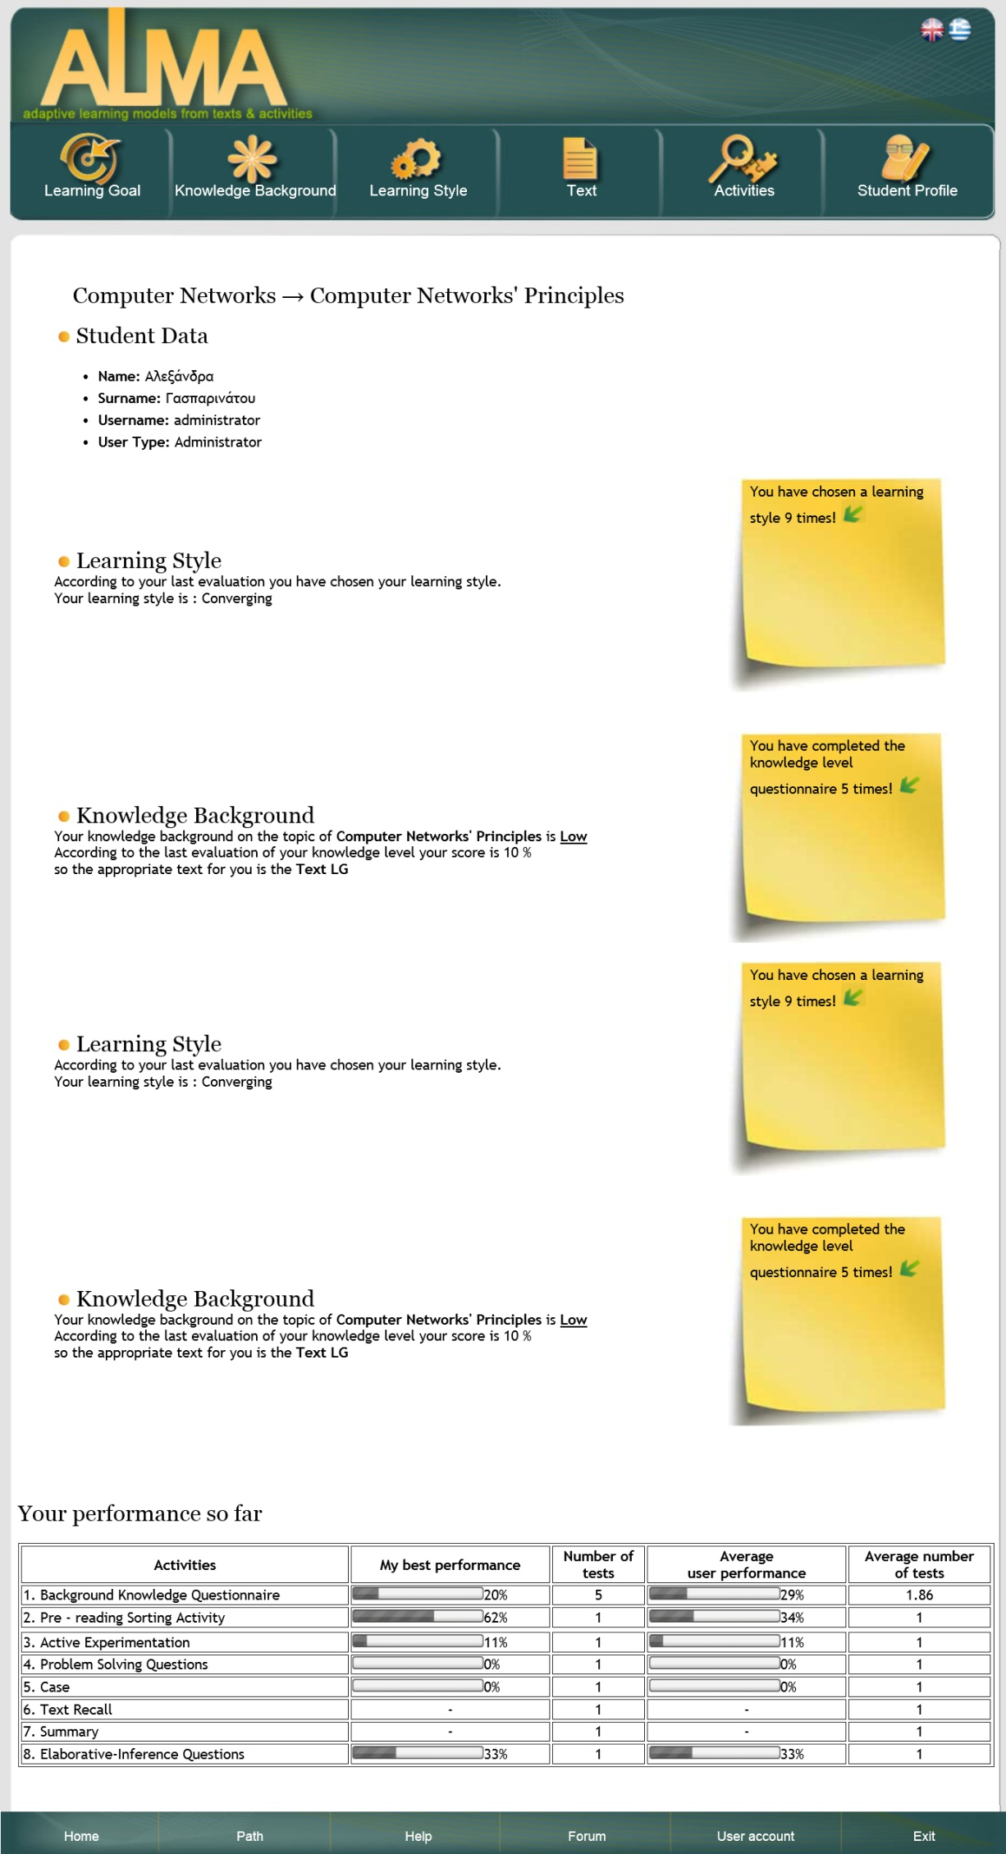
. The Learner Model

Slide 26
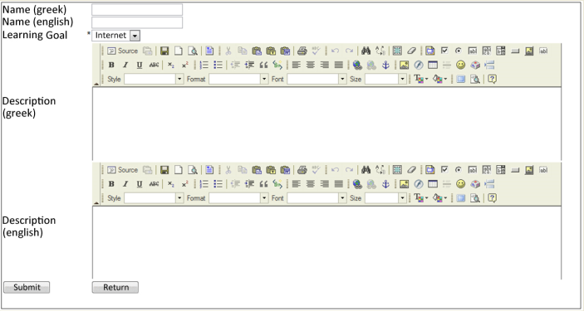
. AUTHORING TOOL

Slide 27
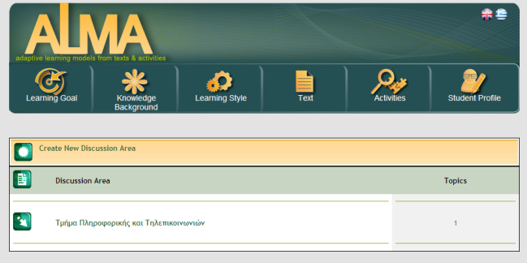
. FORUM

Slide 28
References
Dirksen, Jos (2013). “Learning Three.js: The JavaScript 3D Library for WebGL”. Packt Publishing. ISBN 9781782166283
Gasparinatou, A and Grigoriadou, M. Supporting Student Learning in Computer Science Education via the Adaptive Learning Environment ALMA. Systems 2015, 3(4), 237-263; doi:10.3390/systems3040237
Gasparinatou, A., & Grigoriadou, M. (2011). ALMA: An Adaptive Learning Models environment from texts and Activities that improves students' science comprehension. Procedia-Social and Behavioral Sciences Journal, Vol. 15, p.2742-2747.
Gianni, Daniele; D'Ambrogio, Andrea; Tolk, Andreas, eds. (04-12-2014). “Modeling and Simulation-Based Systems Engineering Handbook”. CRC Press. ISBN 9781466571457

Slide 29
Thank you!

