Slide 1
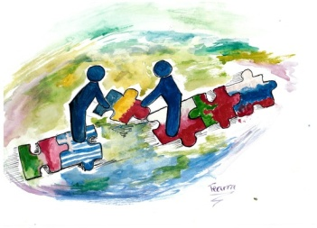
The most popular sport – Mix ☺
Part II
The older students
(classes I-III of Junior Secondary School)

Slide 2
Horse ridding
by Karolina Konefał IIIb

Slide 3
Basketball
by Adam Wójcik IIIb

Slide 4
Football (by Patrycja Dzierba Ia)

Slide 5
Football (by Stanisław Nowosad Ia)

Slide 6
Handball
by Zuzanna Posturzynska Ia

Slide 7
Football (by Kamil Gierczak Ia)

Slide 8
Most popular sports
by Kacper Jaszczuk IIb

Slide 9
Tennis (by Kinga Trojanowska IIb)

Slide 10
Thank you for your attention ☺

