Slide 1
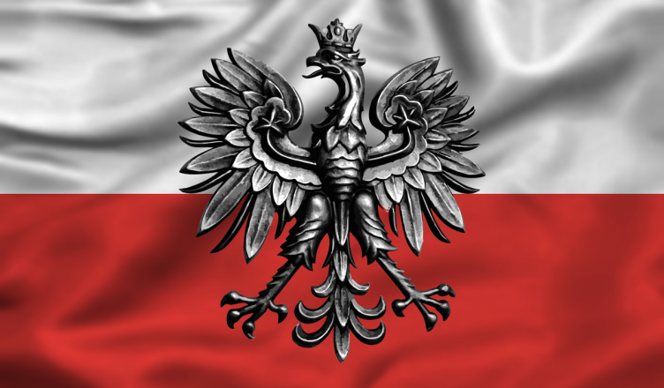
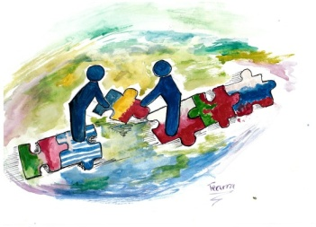
m
11 November Independence Day

Slide 2
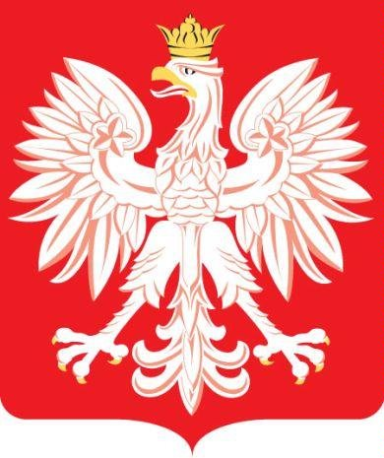
11 November 1918 is one of important dates in the history of Poland - Holiday of regaining independence.
For 123 years the country didn't exist on the map, however a nation and his culture lived.

Slide 3
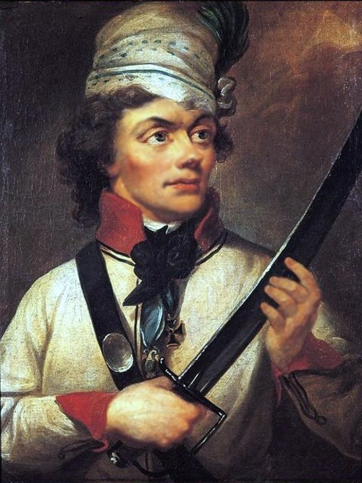
In 1772 Russia, Prussia and Austria acceded to 1 disassembly of Poland.
In 1794 an uprising against invaders broke out under Tadeusza Kościuszki.

Slide 4
In October 1795 Russia, Austria and Prussia signed an agreement on the power of which recognised too non-existent Congress Kingdom of Poland established in 1815 at the Congress of Vienna.
A heroism didn't help the Coming into existence collapsed after all 1865
The year is finishing the period of the peace in Europe, for Poles became both a chance and a tragedy.

Slide 5
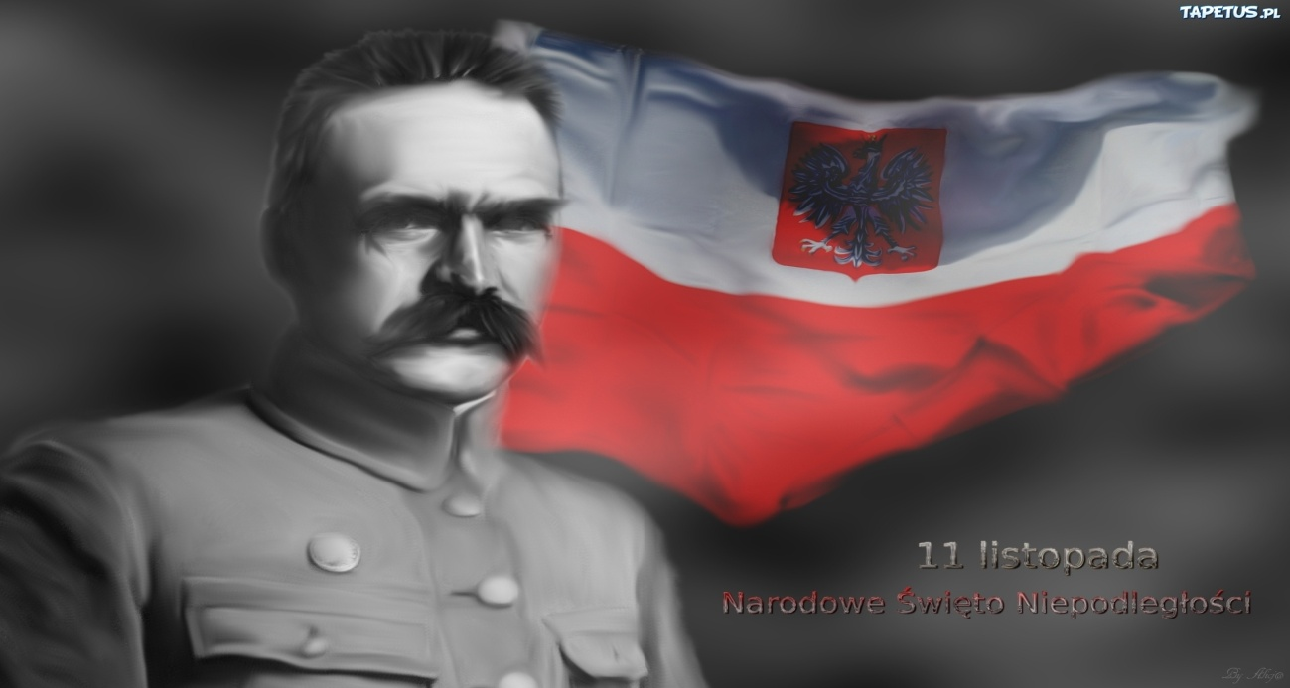
Józef Piłsudzki was a hero of events of 1 world war - commander of the first brigade.
11 November 1918 the Regional Council handed over Piłsudzkiemu military power.

Slide 6
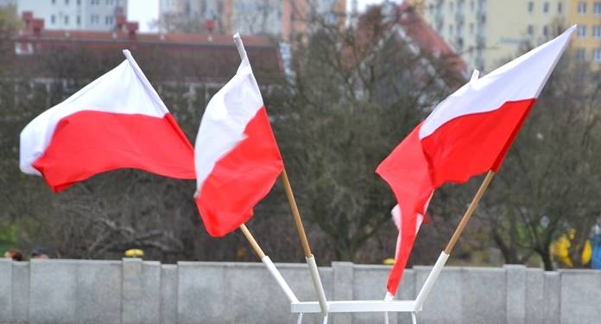
And in the end Poland gained with an effort came, with blood of generations.
Of the ones which believed that not yet she had died.
Grandsons of insurgents from 1863r. gained free Poland!!!

