Slide 1
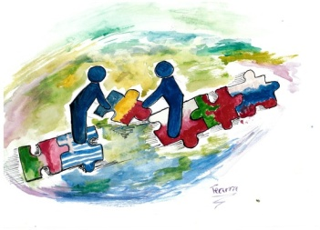
The most popular sport – Mix ☺
Part I
The younger students (classes IV-VI)

Slide 2
Karate
By Jakub Kowalski (IV a)

Slide 3
Football
By Oliwier Bielecki (IV a)

Slide 4
Volleyball
My favourite sportsperson is Karol Kłos. He is a very good volleyball player. He can jump very high, block and serve. His team won the 2014 World Championship. He became the Best Middle Blocker in the 2014 FIVB World Championship.
by Mikołaj Krzywicki

Slide 5
Ski jumping (by Ela Buczacka Va)

Slide 6
Volleyball
by Maja Soczyńska Va

Slide 7
Swimming

Slide 8
Volleyball (by Natalia Szczupak Vb)

Slide 9
Football (by Adrian Soczyński VIa)

Slide 10
Football (by Jakub Kucharski VIa)

Slide 11
Handball
Julia Jaszczuk VIa

Slide 13
Swimming
by P. Repczyńska
& J. Kułaga VIa

Slide 14
Handball
by Ewa Wójcik

Slide 15
Thank you to your attention ☺

