Slide 1
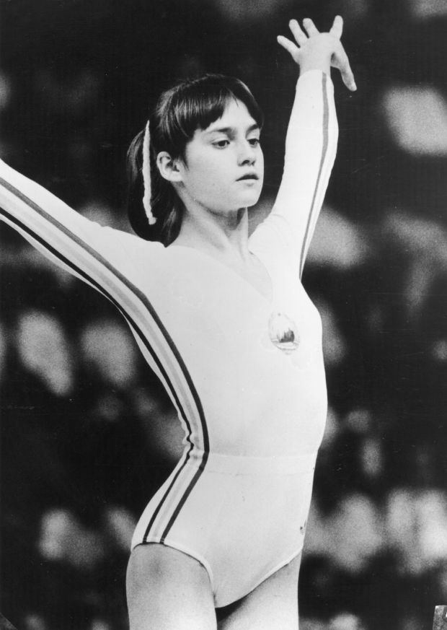
NADIA COMANECI
Students: Ana Budai, Andreea Budai, Daria Dumitru
Technical writing: Matei Schipor

Slide 2
Contents:
Early life
Gymnastics career
Montreal Olympics
Recent activities

Slide 3
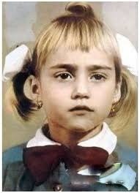
Early life
Nadia Elena Comaneci was born in Onesti, Romania, the daughter of Gheorghe and Stefania-Alexandrina Comaneci. Her mother was inspired to call her Nadia by a Russian film she watched while pregnant, whose heroine was called Nadya, the diminutive version of the Russian name Nadezhda, which means “hope”. Comaneci has a brother named Adrian who is four years younger than she.

Slide 4
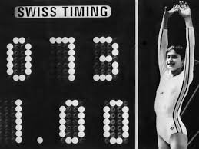
Early life
Nadia Elena Comaneci is a former Romanian gymnast, winner of three gold medals at the 1976 Summer Olympics in Montreal and the first gymnast to be awarded a perfect score of 10 in an Olympic gymnastics event.
She also won two gold medals at the 1980 Summer Olympics in Moscow. She is one of the best-known gymnasts in the world. In 2000, Comaneci was named as one of the Athletes of the Century by the Laureus World Sports Academy.

Slide 5
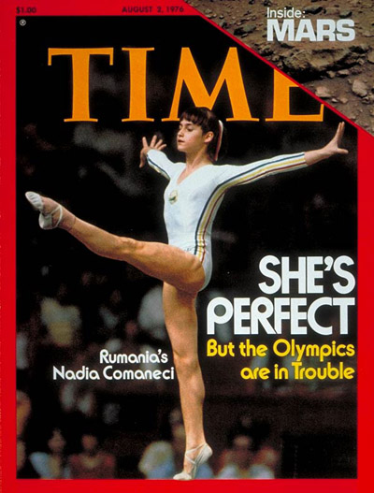
Gymnastics career
Comaneci began gymnastics in kindergarten with a local team called Flacara with coaches Duncan and Munteanu. She placed 13th in her first Romanian National Championships in 1969, at the age of 8. A year later, in 1970, she began competing as a member of her hometown team. Comaneci’s first major international success came at the age of 13. She continued to enjoy success that year, winning the all-around at the Champions All.
In March 1976 Comaneci competed in the inaugural edition of the American Cup at Madison Square Garden in New York City. She received rare scores of 10, which signified a perfect routine without any deductions. Comaneci also received 10s in other meets in 1976 including the Chunichi Cup in Japan, where she posted perfect marks on the vault and uneven bars.

Slide 6
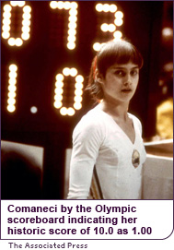
Montreal Olympics
At the age of 14, Nadia became one of the stars of the 1976 Summer Olympics in Montreal. During the team compulsory portion of the competition on July 18, her routine on the uneven bars was awarded a perfect ten. It was the first time in modern Olympic gymnastics history that the score had ever been awarded. Nadia’s perfect marks were thus displayed a 1.00 instead. The crowd was at first confused, but soon understood and gave her a rousing ovation.
Nadia Comaneci was the first Romanian gymnast to win the Olympic all-around title.

Slide 7
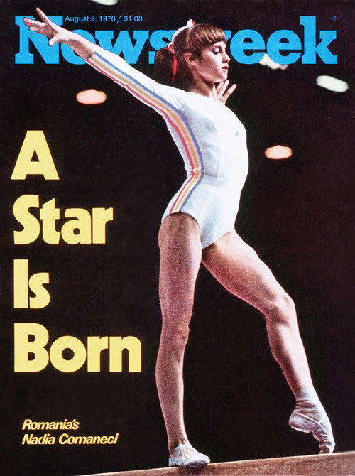
Montreal Olympics
She also holds the record for being the youngest Olympic gymnastics all-around champion ever.
Nadia Comaneci was the 1976 BBC Sports Personality of the year in the overseas athletes category and Associated Press’s 1976 “Female Athlete of the year”

Slide 8
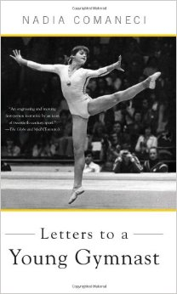
Recent activities
In December 2003, Comaneci’s book “Letters to a Young Gymnast” was published, a combination of a mentoring book and a memoir. The book answered questions that she received in letters from fans. She has also been the subject of several unofficial biographies , television documentaries, and a made-for-television film, Nadia, that was broadcast in the United States shortly before the 1984 Summer Olympics in Los Angeles.
Comaneci is active in many charities and international organizations. In 1999 she was the first athlete to speak at the United Nations to launch the Year 2000 International Year of Volunteers.

Slide 9
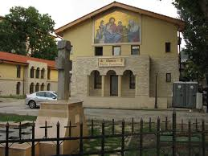
Recent activities
She is currently on the International Board of Directors for the Special Olympics and is vice-president of the B0ard of Directors of the Muscular Dystrophy Association. She has also personally funded the construction and operation of the Nadia Comaneci Children’s Clinic, a clinic in Bucharest that provides low-cost and free medicine and social support to Romanian poor children, in a partnership with Romanian Orthodox Church. Romanian government appointed her as an honorary consul general of Romania to the United States to deal with bilateral relations between the two nations.

Slide 10
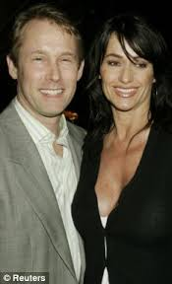
Recent activities
In the world of gymnastics Comaneci is the honorary president of the Romanian Gymnastics Federation, the honorary president of Romanian Olympic Committee, sports ambassador of Romania, and a member of the International Gymnastics Federation Foundation.
She and her husband own the Bart Conner Gymnastics Academy, the Perfect 10 Production Company and several sports equipment shops. They are also the editors of International Gymnast magazine.
Additionally, Comaneci and Conner have provided television commentary for many gymnastics meetings, most recently the 2005 World Championships in Melbourne and the 2008 Olympic Games in Beijing. One of her perfect 10 Montreal uneven bars routine was featured in a commercial for Adidas that ran during the 2004 Summer Olympics in Athens.

Slide 11
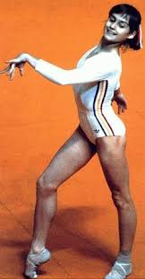
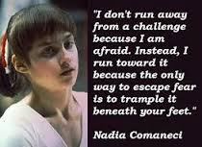
The Perfect 10…

