Slide 1
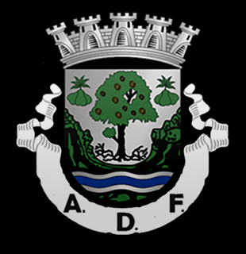
ADF Futsal
Assignment done by:
Jéssica Almeida
11º CT3

Slide 2
Team history
Founded on April 23, 1955; AD Fundão was born from the fusion of Sporting, Benfica of Fundão and Hockey Club Fundão. However, futsal modality was only introduced in this association in 1997.

Slide 3
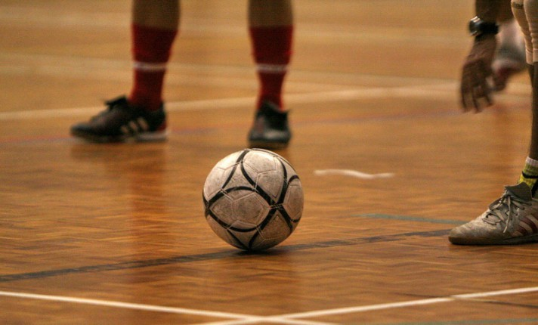
What is futsal?
Futsal is a sport played in teams of five players in a covered field. It demands a big physical effort since there are no periods of time where a player isn’t running. This sport also demands a great capacity of focus because it is practiced in a small area where one little mistake can be crucial to the entire game.

Slide 4
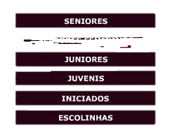
Nowadays, ADF is the most important team representing Beira Interior in the national futsal championship.
This is the result of the hard work and effort of all the directors, team players and other entities associated.
Inside ADF five levels were
settled to the present day.

Slide 5
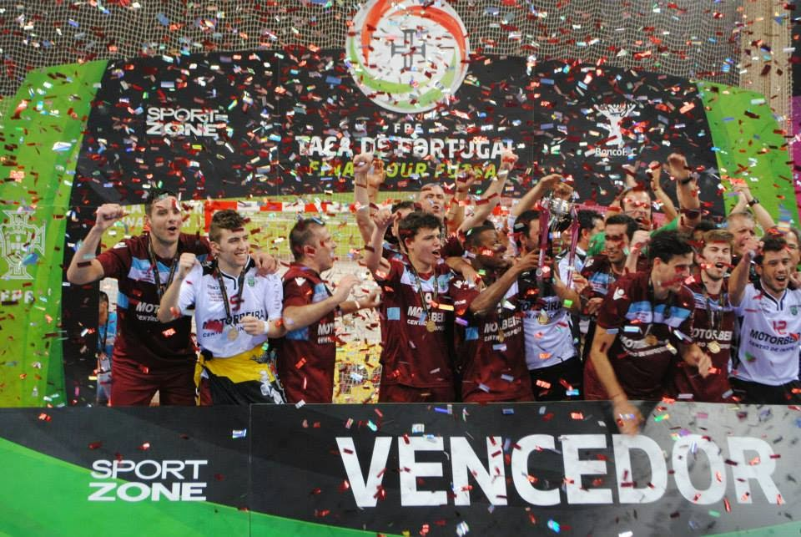
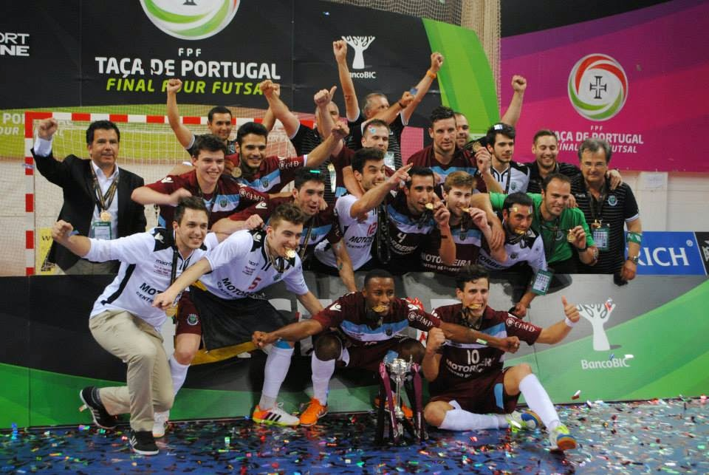
The Rising of ADF
The futsal team has been evolving and winning plenty of supporters and favoritism through the years. In 2013/2014 the team won the Portugal cup. A big accomplishment for ADF and a motive for everyone in Fundão to be extremely proud.

Slide 6
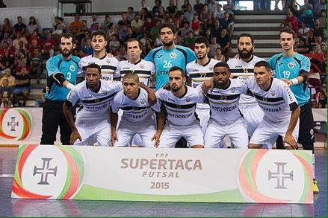
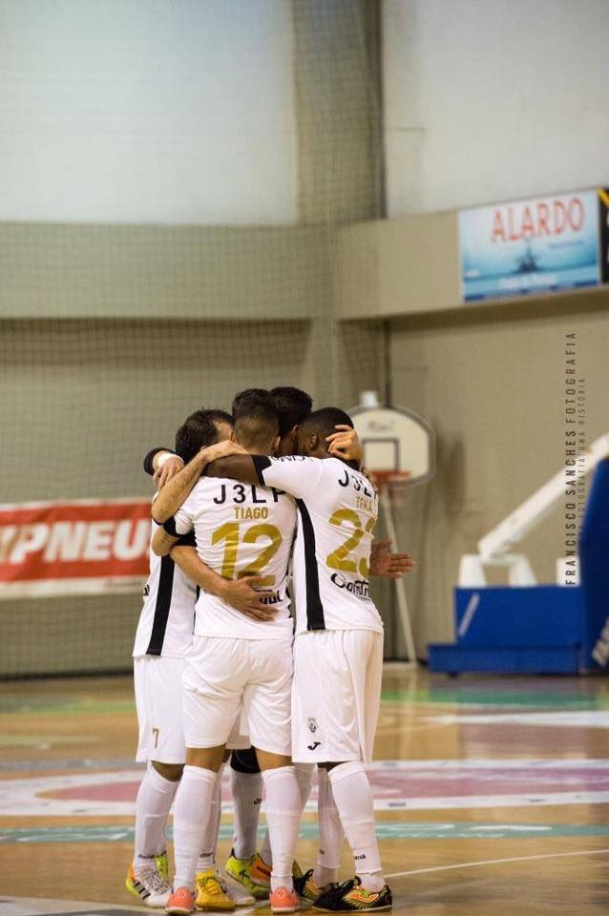
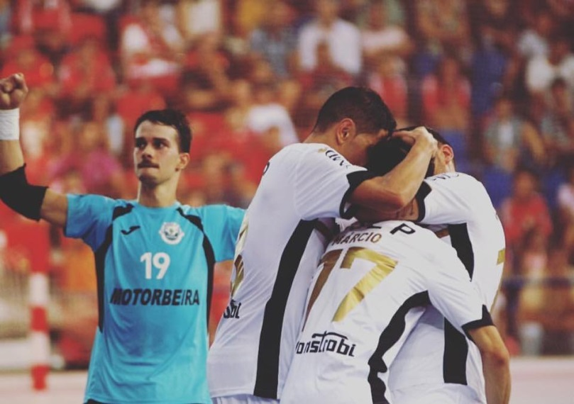
Pictures of the team

Slide 7
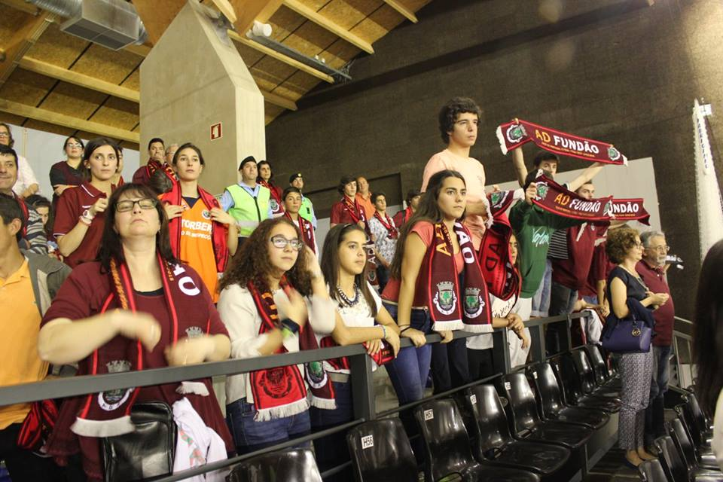
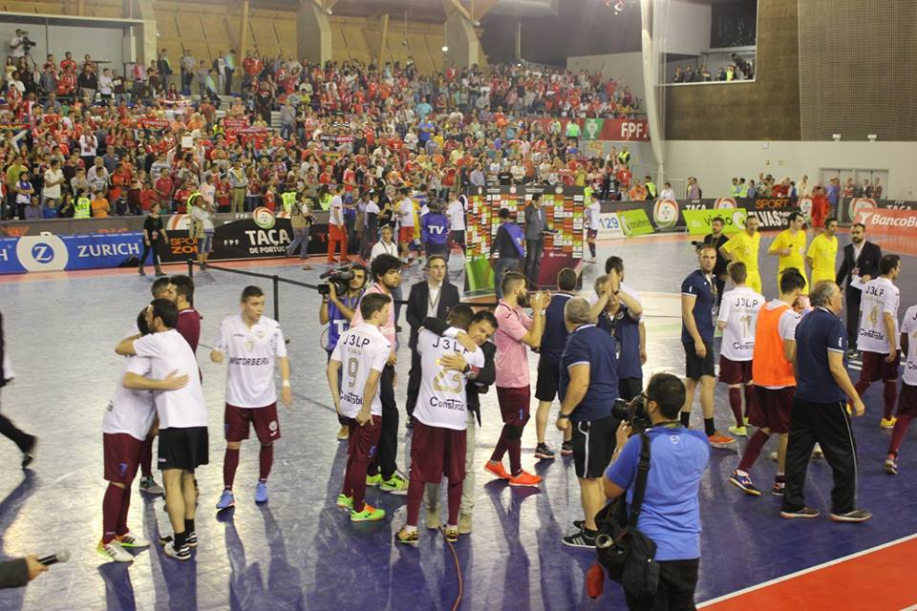
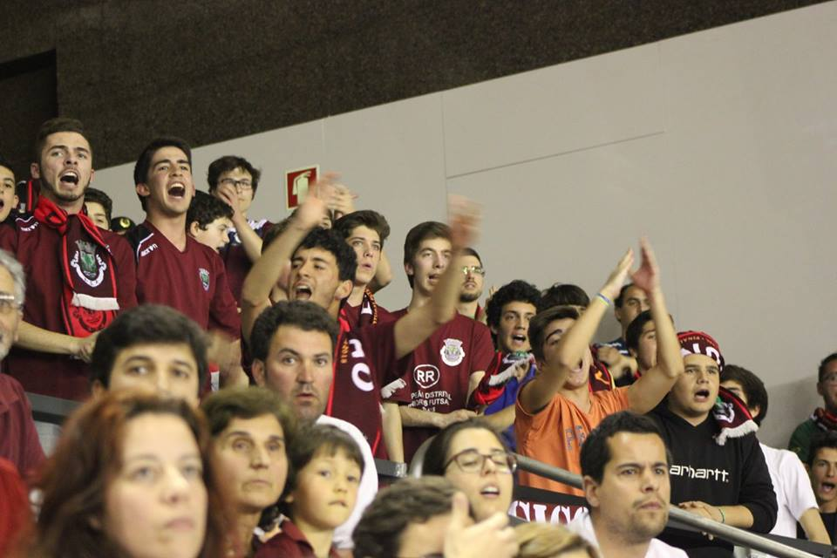
ADF fans that offer their support and motivation to the futsal team.

Slide 8
Video about the victory of the Portugal Cup

Slide 9
