Slide 1
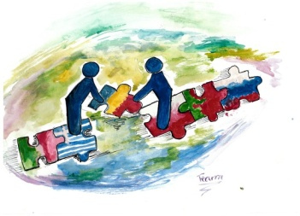
11-th of November-Polish Independence Day
Polish National Day

Slide 2
Background
In 1795, after III-rd partition of Poland,Polish country have lost the Independence. The partitions were conducted by the Russian Empire(1772,1793,1795), the Kingdom of Prussia(1772,1793,1795) and Habsburg Austria(1772,1795).

Slide 3
Years of annexation (1795-1918)
Polish people after annexation were going back onto old Polish territories. The biggest migrations were on east border side of old Poland. People were really terrified,they were trying to take the Independence back,most times without a result. In 1807 after 3 French wins after Prussia,Austria and Russia on a part of annexation grounds raised Warsaw Princedom (1807-1830)

Slide 4
Warsaw Princedom and Polish Kingdom (1807-
After a creating of a Warsaw Princedom Polish community was really happy. They thought that old Poland finally gets the Independence back. It wasn’t so long. After the lost battle of Napoleon Warsaw Princedom has been devoted for Russian administration. After the Congress of Vienna name has changed to Polish Kingdom.
In November 1830 in Polish Kingdom blowed uprising,which it was really quickly stopped by Russian army.

Slide 5
After Polish Kingdom (1831-1904)
After dethronization of Polish Kingdom there were 3 attempts to uprise.
Any single one wasn’t a success,and Polish people had to wait until 1905,when rised a halfly-Independed Polish Kingdom.

Slide 6
Getting an Independence back (1905-1918)
The system was the same like in 1830,Poland had to wait for the I World War end in 1918,when finally,after 123 years of annexation,Poland got back an Independence. Nowadays on 11 November Polish has National Polish Indepence Day.

Slide 7
Years between world wars (1918-1939)
II Republic of Poland was really upset,the economy raised up,but one day has destroyed a II Republic. At 1-st of September 1939 the II World War begins.

Slide 8
Communism after II World War (1939-1989)
Poland was theoretically one of the winners of II World War,Poland was dependent on the USSR. First free presidential elections were in 1989,after the fall of USRR.

Slide 9
The End
In my opinion Polish Independence Day is the most important national day because of hard work,that mine predecessors did to make our present country Independent. I am happy that I live in Independent country,and I don’t have to worry about Poland’s future. My civic duty is celebrating this day,because i have to thank my precessors for making my country free.

Slide 10
Thank you for your attention
Made by Bartosz Łobodziński (Poland)

